Slide 1
When the target is wrong
ICAISE 2026 · CC5090
Authors: Sanvi Desai, Sushant Donadi, Gayatri Goli, Soham Gupta, Aswath Madhan, Jackson Szekeres, Srikanth Samy, Ishaan Gupta
Notes:
Open with the research question. The official paper title is: When the Target Is Wrong: Reframing Plant Radiation Dosimetry as Cross-Study Exposure Triage. Credit every author listed on the slide.
[Sources]
- /private/tmp/research-projects-icaise-read/papers/raddose-triage/main.pdf
[/Sources]

Slide 2
Audit the target before fitting the model
Original target
Predict absorbed radiation dose from gene expression.
Identifiability problem
A dose-response model needs a well-sampled dose axis. Here 87% of samples sit at exactly 0 or 100 Gy.
Reframed question
For a sample from a study never seen in training, was the plant irradiated?
Scientific discipline
Retain the failed exact-dose regression as the negative result that motivates the more defensible exposure-triage endpoint.
Notes:
Frame the problem before introducing models. State the specific research question and the criterion that makes the answer defensible.
[Sources]
- /private/tmp/research-projects-icaise-read/papers/raddose-triage/main.pdf
[/Sources]

Slide 3
Validate across studies, not samples
DATA
158 Arabidopsis RNA-seq samples × 4,002 genes from six NASA OSDR studies: 58 controls and 100 exposed samples.
VALIDATION
Leave one complete study out. Gene selection, scaling, and fitting all occur inside each training fold; threshold fixed at 0.5.
MODELS
Literature panel, logistic, RBF-SVM, ExtraTrees, and a 50/100-gene stability ensemble; dose regression repeated secondarily.
Notes:
Walk left to right: data, validation boundary, then models or analysis. Emphasize the unit that is held out.
[Sources]
- /private/tmp/research-projects-icaise-read/papers/raddose-triage/main.pdf
[/Sources]

Slide 4
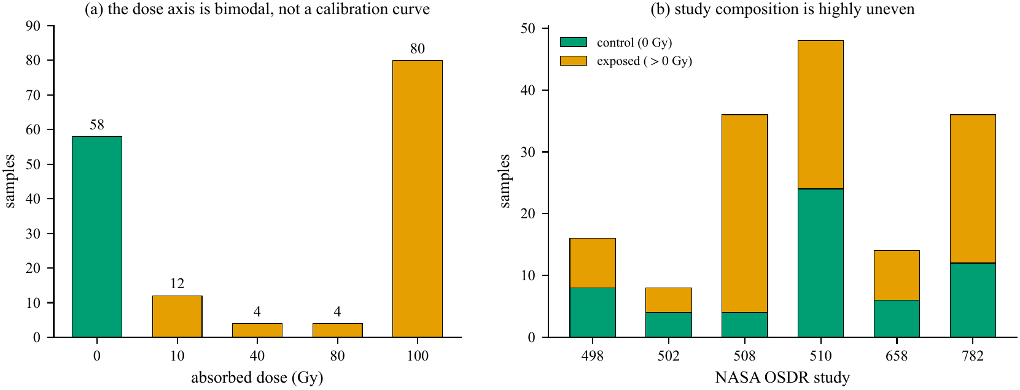
The dose axis is bimodal
The design determines the target
Of 158 samples, 138 are at 0 or 100 Gy. Only 20 occupy intermediate doses, and study composition is highly uneven.
The collection supports exposed-versus-control triage far better than exact-dose estimation.
Notes:
Use the figure to explain why the study design matters. Describe the visual pattern first, then interpret it.
[Sources]
- /private/tmp/research-projects-icaise-read/papers/raddose-triage/main.pdf
- /private/tmp/research-projects-icaise-read/papers/raddose-triage/figures/fig1_design_audit.pdf
[/Sources]

Slide 5
The reframed classifier transfers across studies
Main result
The stability ensemble reaches 84.2% pooled accuracy under leave-one-study-out validation. Exact-dose regression returns 33.6 Gy MAE—the negative result the design predicts.
82.4%
0.883
33.6 Gy
pooled balanced accuracy
pooled ROC-AUC
exact-dose regression MAE
Notes:
Pause on the three headline values. Explain the strongest supported claim and avoid turning descriptive differences into stronger causal or statistical claims.
[Sources]
- /private/tmp/research-projects-icaise-read/papers/raddose-triage/main.pdf
[/Sources]

Slide 6
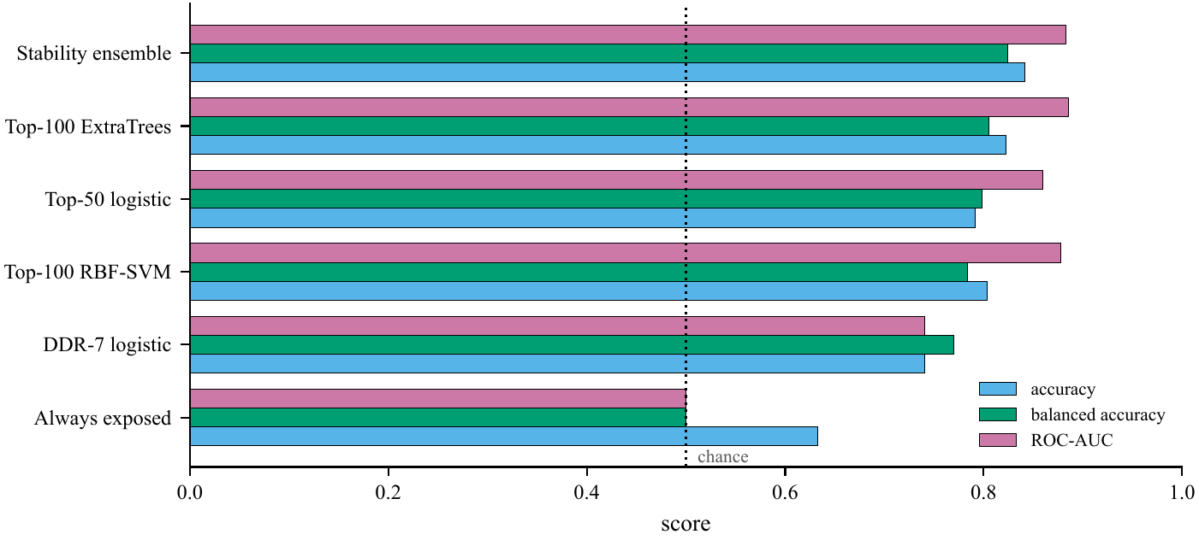
Balanced metrics change the ranking
Why accuracy is not enough
Because 63.3% of samples are exposed, the always-exposed rule reaches 63.3% accuracy but only 0.50 balanced accuracy and zero specificity.
The ensemble leads at the fixed threshold, while pooled AUC is similar to top-100 ExtraTrees.
Notes:
Use the second figure to connect the numeric result to the paper's central methodological lesson.
[Sources]
- /private/tmp/research-projects-icaise-read/papers/raddose-triage/main.pdf
- /private/tmp/research-projects-icaise-read/papers/raddose-triage/figures/fig2_model_ladder.pdf
[/Sources]

Slide 7
Conclusion: change the target to match the data
What we did
We audited six plant RNA-seq studies, showed exact dose was weakly identified, and reframed the task as exposed-versus-control triage.
FOUND · Triage reached 0.883 ROC-AUC
Exact-dose regression remained poor at 33.6 Gy MAE
WHY IT MATTERS · A defensible target changes the conclusion
Hold out whole studies—not samples
Confirm on a genuinely untouched study
Notes:
State the conclusion in three steps: what we did, what we found, and why the result matters. End with the next experiment or validation step that would strengthen the evidence.
[Sources]
- /private/tmp/research-projects-icaise-read/papers/raddose-triage/main.pdf
[/Sources]

Slide 8
The right target changed
the scientific conclusion
CC5090 · Questions
Did: audited the design and reframed the target
Found: 0.883 AUC triage; 33.6 Gy dose MAE
Matters: match the endpoint to identifiable data
Notes:
Return to the opening question. Summarize what was done, the main finding, and its importance in three short sentences, then invite questions.
[Sources]
- /private/tmp/research-projects-icaise-read/papers/raddose-triage/main.pdf
[/Sources]

