Slide 1
Fraudulent Claim Detection
Submitted by:
Keshav Gupta
Deepika Hegde

Slide 2
Contents
Problem Statement
Data Analysis with respect to business objective
Data Cleaning
Univariate Analysis
Bivariate Analysis
Model Selection
Logistic Regression
Random Forest
Conclusion

Slide 3
Problem Statement
Global Insure wants to build a model to classify insurance claims as either fraudulent or legitimate based on historical claim details and customer profiles. By using features like claim amount, customer profiles and claim types, the company aims to predict which claims are likely to be fraudulent before they are approved.
Goal
Global Insure aims to enhance its ability to detect fraudulent insurance claims by leveraging historical claim data.
The company seeks to identify patterns and key indicators that differentiate fraudulent claims from genuine ones.
By developing a predictive model, it intends to assess the likelihood of fraud in incoming claims, enabling proactive fraud detection and reducing financial losses

Slide 4
Data Analysis With Respect To Business Objective
Fraudulent claim detection provided us with data which contained information having 1000 rows and 40 columns related to customer past credit history.

Slide 5
Data Analysis With Respect To Business Objective
Key Analysis
Risk Assessment: Access the risk of fraud based on claim characteristics and claim type.
Trend analysis for future prediction: Identify trends in claim over time(example would be which type of claim are more likely to default i.e. vehicle/property/injury).

Slide 6
Data Cleaning
Replaced the character with missing values for columns
- ‘property_damage’,‘police_report_available’,‘collision_type’,’authorities.
Dropped the column which are not adding any value for analysis -C_39,
Dropped the columns with less predictive power
-’policy_number’,’insured_hobbies’,’auto_make’,’auto_year’,’incident_location’
Changed the column format (changed to date-time-format)-’policy_bind_date’,’incident_date’

Slide 7
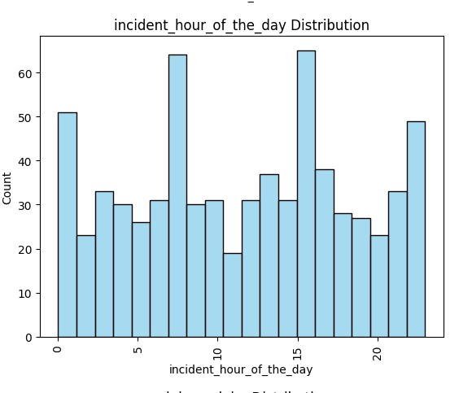
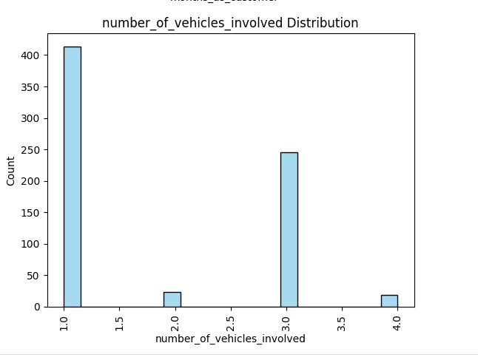
Univariate Analysis

Slide 8
Bivariate Analysis
Bivariate analysis is an essential part of data analysis which help in identifying the relationship between columns and in decision making process. Type of analysis depend on nature of variables and goal of analysis.
Analysis was performed between numerical features, Categorical Variables vs target variable.
Target Variable- 'Fraud_detected'
Numeric features - 'Age', 'Bodily_injuries', 'Captial_gain', 'Capital_loss', 'Incidnet_date', 'Incident_hour_of_the_day', 'Injury_claim', 'Insured_zip', 'Month_as_customer', 'Number_of_vehicles_involved', 'Policy_annual_premium', 'Property_claim', 'Total_claim_amount'
Categorical features-’insured_occupation’, ‘insured_relationship’.’incident_type’.’incident_severity’.’authorities_contacted’,’incident_state’.

Slide 9
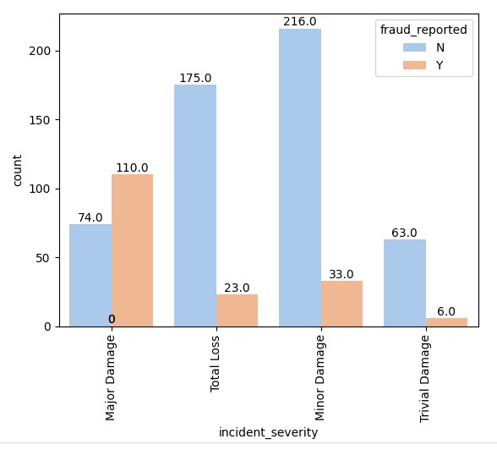
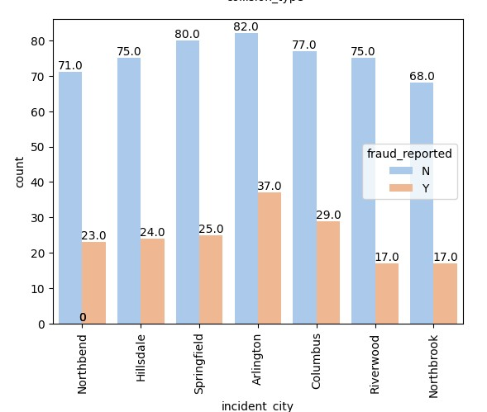
Bivariate Analysis

Slide 10
Model Selection
Logistic Regression
Random Forest

Slide 11
Logistic Regression

Slide 12
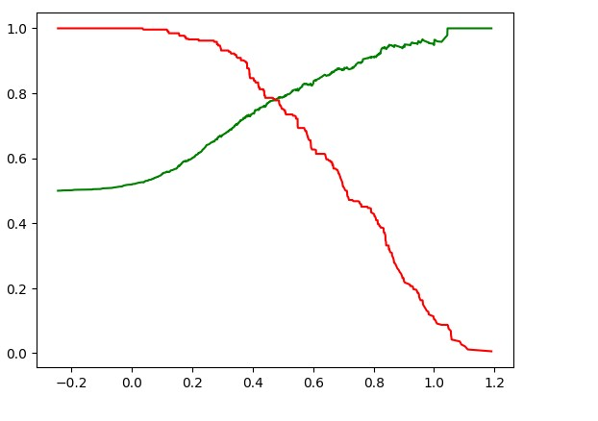
Precision-Recall plot

Slide 13
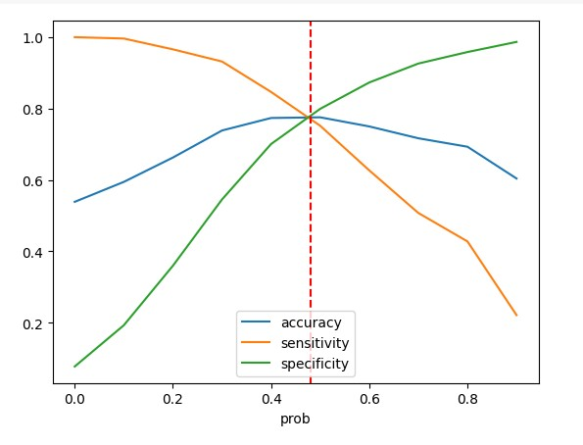
Sensitivity Vs Specificity Vs Accuracy Plot

Slide 14
Model Performance
Metric | Training Data | Validation Data
Precision | 83% | 57%
Sensitivity | 63% | 68%
Specificity | 87% | 83%
Recall | 63% | 68%
F1 Score | 71% | 62%

Slide 15
Random Forest

Slide 16
Model Performance
Metric | Training Data | Validation Data
Precision | 82% | 61%
Sensitivity | 77% | 44%
Specificity | 83% | 91%
Recall | 77% | 44%
F1 Score | 80% | 51%

Slide 17
Tuned Hyperparameters Random forest
max_depth - 6
max_leaf_node - 7
min_samples_split – 4
n_estimators -60

Slide 18
Conclusion
Both the models are overfitting but Logistic regression is performing better compared to Random forest.
In context of business implications models is likely to catch most fraudulent claims but high false positives would make process inefficient.

Slide 19
Recommendations
Further analysis should be performed to refine the model and improve its performance.
The model can be deployed to predict the likelihood of fraud for incoming claims.

