Slide 1


QUANTUM-SECURE BANKING NETWORK USING BB84 QUANTUM KEY DISTRIBUTION
Design and Simulation of a Hybrid Quantum-Classical Framework for Secure Inter-Bank Transactions
SRM INSTITUTE OF SCIENCE AND TECHNOLOGY
SCHOOL OF COMPUTING
DEPARTMENT OF COMPUTING TECHNOLOGIES
Rudraksh Tewari
RA2311003010535
Shaleen Soni
RA2311003010589
Rachit Agarwal
RA2311003010598

Slide 2
Problem Statement
Problem
Modern banking systems exchange highly sensitive information such as transaction details, account information, authentication data, and inter-bank settlement messages over network infrastructure.
Conventional cryptographic systems provide strong security against current classical attackers, but the emergence of cryptographically relevant quantum computers threatens widely used public-key techniques such as RSA and ECC. Financial-sector research has therefore begun investigating QKD and hybrid quantum-safe architectures for protecting sensitive financial communication.
Background
Quantum Key Distribution (QKD) provides a mechanism for establishing shared secret keys using quantum states. In BB84, measurement of quantum states in incompatible bases can introduce detectable discrepancies when an eavesdropper attempts to intercept the transmission.
However, practical QKD deployment faces challenges including channel noise, optical losses, limited key-generation rates, implementation vulnerabilities, and integration with conventional network infrastructure.

Slide 3
Problem Statement
Need for the Study
There is a need for a secure communication framework that demonstrates how QKD can be integrated with conventional cryptographic systems for financial communication.
The proposed system addresses this need by:
Establishing shared keys between simulated banking endpoints using BB84 QKD
Detecting potential eavesdropping using Quantum Bit Error Rate (QBER)
Simulating quantum-channel noise and intercept-and-resend attacks
Using the accepted quantum-derived key with AES-256-GCM for transaction encryption and integrity protection
Evaluating the effect of noise and attacks on key generation and communication security
Recent financial-sector research shows that QKD is being investigated both as a simulated financial-data security mechanism and in real operational financial infrastructure, supporting the relevance of this application area.

Slide 4
Objectives
Objective 1
To design and simulate a BB84-based Quantum Key Distribution mechanism between two banking endpoints.
The system will generate quantum bits, select measurement bases, perform quantum measurements, reconcile bases, generate a sifted key, and estimate QBER.
Objective 2
To develop a security analysis module for detecting eavesdropping and channel noise.
The system will simulate intercept-and-resend attacks and configurable channel noise and evaluate their effect on QBER, sifted-key quality, and key acceptance.
Objective 3
To integrate the quantum-derived key with classical symmetric encryption for secure banking transactions.
An accepted QKD key will be processed and used with AES-256-GCM to provide confidentiality and integrity for simulated inter-bank transactions.

Slide 5
Literature Review
Existing Systems / Recent Research
1. Brazaola-Vicario et al. (2024)
Quantum key distribution: a survey on current vulnerability trends and potential implementation risks
Reviewed practical QKD vulnerabilities and highlighted implementation-level risks, including side-channel attacks and weaknesses associated with optical components and protocol implementation.
2. Nikula, Lintulampi & Halunen (2024)
Security Analysis for BB84 Key Distillation
Studied classical post-processing in BB84 and showed that key distillation, information leakage, and parameter selection strongly affect the security of the final key. Their case study considered intercept-and-resend attacks.
3. Stathis et al. (2024)
Experimental feasibility analysis of quantum/classical coexistence over fibre and free space links
Demonstrated practical BB84-oriented QKD evaluation under fibre and free-space conditions, emphasizing the influence of noise, losses, and coexistence with classical communication.

Slide 6
4. Dervisevic et al. (2025)
Quantum Key Distribution Networks – Key Management: A Survey
Highlighted that QKD networks must efficiently generate, manage, distribute, and consume limited key resources when integrated with critical infrastructures.
5. Wawage et al. (2025)
Quantum Key Distribution for Secure Financial Data Exchange
Specifically investigated QKD for financial data exchange, including inter-bank transfers, trading, digital payments and hybrid models. The study also discusses practical issues including distance, cost, infrastructure compatibility, and scalability.
6. Selimović et al. (2026)
Deployment of Entanglement-Based QKD in Financial Infrastructure
Demonstrated QKD in operational financial infrastructure over a 22 km fibre connection between two data centres, generating secure keys continuously for four months and using the keys to establish a VPN tunnel. The work demonstrates practical feasibility but uses entanglement-based BBM92 rather than BB84.

Slide 7
Key Findings
Recent studies confirm increasing interest in practical QKD deployment and network integration.
QBER and key post-processing are important for assessing the quality and security of generated keys.
Practical QKD performance is influenced by noise, channel loss, implementation imperfections and network infrastructure.
Financial applications are moving from theoretical discussion toward simulation, hybrid architectures and real infrastructure deployment.
Research / Implementation Gap
Recent work focuses significantly on physical QKD systems, network key management, or large-scale deployment.
There is room for a compact, application-level platform that visually connects BB84 key establishment, eavesdropping detection, QBER analysis, key validation and encrypted financial transactions.
The proposed project addresses this implementation gap through a simulation-based inter-bank banking environment.

Slide 8
Methodology
1. Hybrid Quantum-Classical Cryptography
The proposed system follows a hybrid cryptographic architecture, where quantum cryptography is used for secure key distribution, while classical cryptography is used for actual data encryption.
The basic principle is:
BB84 QKD -> Shared Secret Key -> AES-256-GCM -> Encrypted Transaction
This is important because BB84 is a Quantum Key Distribution protocol, not a conventional message-encryption algorithm.
In the proposed banking network, two simulated banks establish a common secret key through BB84. Once the key is accepted, the key is processed and used by AES-256-GCM to encrypt a banking transaction.
Thus, the system combines:
Quantum cryptography: secure key establishment
Classical cryptography: transaction encryption and integrity
Security analysis: detection of eavesdropping and channel disturbances

Slide 9
System Architecture
Three-tier simulation platform (all components run locally)
React + Vite frontend
FastAPI backend (Python 3.12)
SQLite
Dashboard
QKD Laboratory
Security Simulator
Transaction Transfer
Experimental Analysis
History & Security Logs
Recharts · Tailwind CSS
app/qkd
QKD sessions
Transactions
Security events
Experiment results
No key material ever stored
BB84 · NumPy & Qiskit Aer · Eve & noise · QBER · Cascade · Toeplitz PA
REST /api
app/crypto
HKDF-SHA256 · AES-256-GCM · nonces · replay check
app/services
Transfer workflow · security events · experiments
app/api
Pydantic-validated REST endpoints
Experiments (backend/experiments) drive the same engine headlessly and regenerate every figure from a seed.
Notes:
The QKD engine has no web or database imports, so it is unit-tested directly and reused by the experiment scripts. The database stores parameters, metrics, ciphertext, nonce, tag and a public key id only.

Slide 10
Key-Exchange Pipeline
One fresh BB84 session per transfer, from qubits to an authenticated message
1 Alice prepares
2 Quantum channel
3 Bob measures
4 Sifting
Random bits, random Z/X bases: |0⟩ |1⟩ |+⟩ |−⟩
Optional Eve (intercept-resend) then noise
Random basis; Born-rule outcome
Compare bases only; ≈ 50% kept
5 QBER test
6 Cascade
7 Privacy amp.
8 HKDF → AES-GCM
Disclose 25%; abort if QBER > 11%
Fix errors; count leaked parities; 64-bit hash check
Toeplitz hash removes Eve's information
Per-direction keys; encrypt + authenticate
Abort paths: QBER above threshold → transfer BLOCKED before any encryption; hash mismatch after Cascade or < 256 bits after privacy amplification → no key. Tampered or replayed messages → REJECTED by Bank B.
Notes:
Each step exists in the code as its own tested module: states/backends, channel, bb84 sifting, estimation, reconciliation, privacy_amplification, then crypto/kdf and crypto/aead.

Slide 11
Tools & Technologies
Programming & Frameworks
Python 3.12 — quantum simulation and backend
NumPy — Born-rule measurement model (fast, used for large experiments)
Qiskit 2.6 / Qiskit Aer — gate-level circuit simulation (stabilizer method)
FastAPI + Pydantic — REST API; React 18 + Vite + Tailwind CSS — web interface
Cryptography & Key Processing
BB84 QKD with Cascade reconciliation and hash verification
Toeplitz universal hashing — privacy amplification
HKDF-SHA256 — key derivation only (not privacy amplification)
AES-256-GCM — confidentiality + integrity (Python cryptography / OpenSSL)
Database
SQLite via SQLAlchemy — sessions, transactions, security events, experiments (PostgreSQL-ready)
Visualization & Testing
Recharts (web) and Matplotlib (report figures); pytest (446 tests) and Vitest (32 tests)
Notes:
Changes since the proposal: privacy amplification uses Toeplitz hashing and HKDF only derives keys; SQLite replaced PostgreSQL for portability (PostgreSQL remains supported via the database URL).

Slide 12
Implementation
Design decisions that make the simulation scientifically defensible
Two honest simulation modes
Exact channel models
NumPy samples Born-rule probabilities from state vectors; Qiskit Aer runs X/H/measure circuits. Every result is labelled.
Intercept-resend (QBER p/4), depolarizing (p/2), bit-phase flip (q) — each with closed-form theory.
Honest key budget
Unique nonces
Clopper–Pearson bound; every disclosed parity counted; m = n(1 − h(e)) − leak − 2·log₂(1/ε).
4-byte sender field + 64-bit counter; per-direction keys; fresh key per transfer; never wraps.
Tamper & replay defence
No secrets stored
Routing metadata bound as AES-GCM associated data; replayed nonces rejected.
Only public key id, nonce, tag and ciphertext; a test scans the raw database file for keys.
Notes:
These decisions are documented in docs/quantum-assumptions.md and docs/cryptography.md.

Slide 13
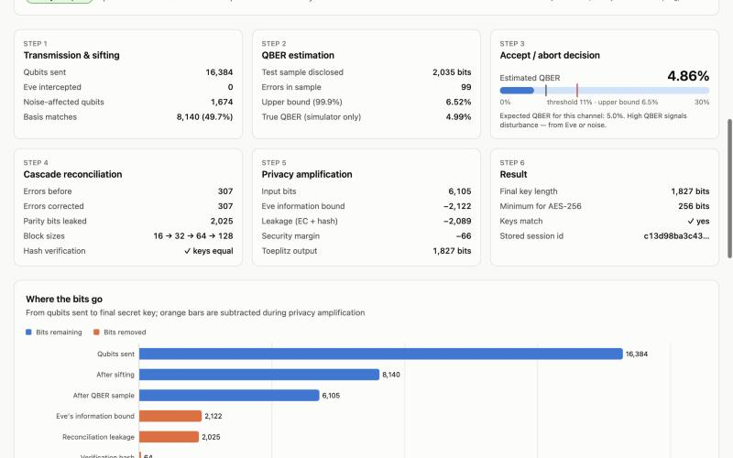
Application Demo
QKD Laboratory — 16,384 qubits, 10% depolarizing noise: QBER 4.86% → accepted; Cascade fixed 307 errors; 1,827-bit final key; Alice's and Bob's keys match.
Notes:
Live demo: run the lab with defaults, then Eve = 100% (aborts at about 25% QBER), then noise = 10%.

Slide 14
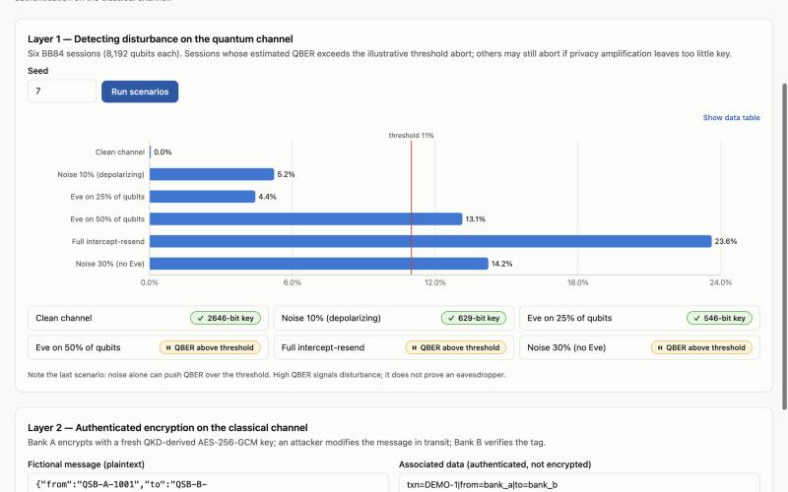
Application Demo
Security Simulator, layer 1 — full intercept-resend (23.6%) aborts; noise alone (30%) also crosses the 11% threshold, so QBER signals disturbance, not proof of Eve.
Notes:
Six fixed-seed scenarios with 8,192 qubits each; badges show key length or abort reason.

Slide 15
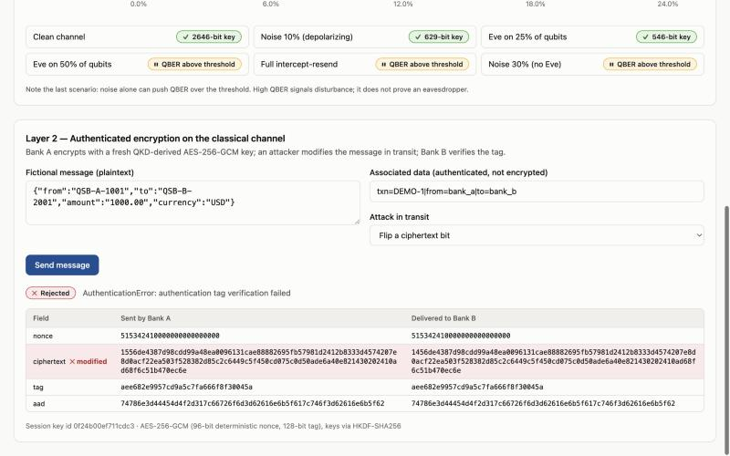
Application Demo
Security Simulator, layer 2 — one ciphertext bit flipped in transit: Bank B's AES-GCM tag check fails and the message is rejected with no plaintext released.
Notes:
Also demonstrate tag, nonce, associated-data, wrong-key and replay attacks — all are rejected.

Slide 16
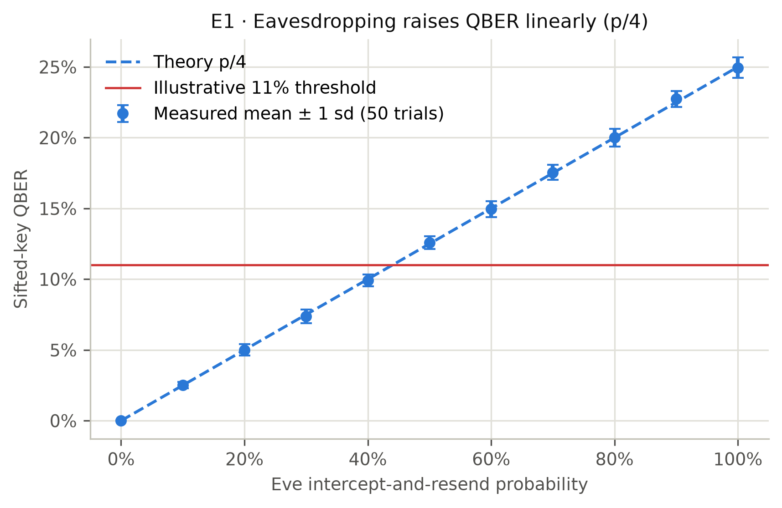
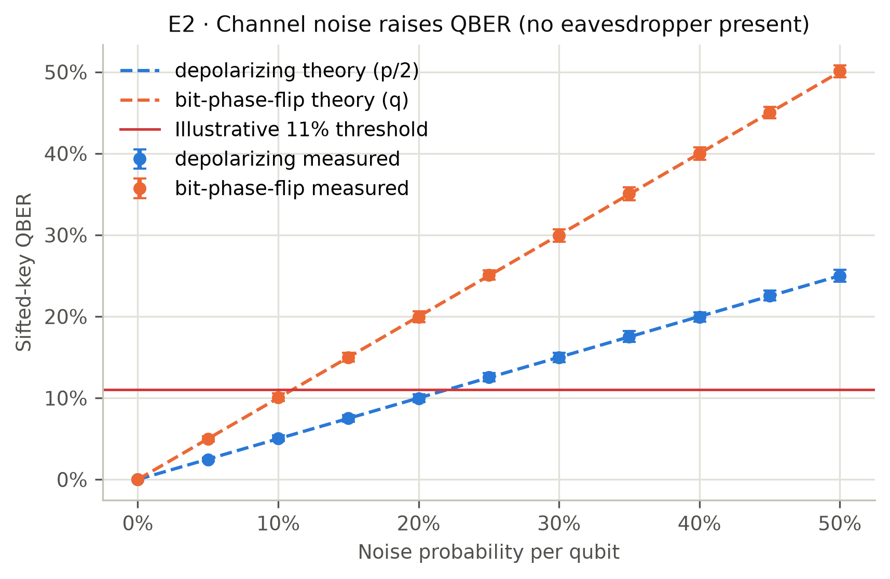
Results
QBER under eavesdropping and channel noise (8,192 qubits, 50 trials per point)
• Full intercept-and-resend: 24.94% ± 0.73% QBER (theory 25%); Eve learns 50.1% of sifted bits.
• Noise alone crosses 11%: depolarizing 25% → 12.55%, bit-phase flip 15% → 15.00%, with no eavesdropper.
• All 50 measured points lie within 3 standard errors of closed-form theory (max |z| = 2.98).
Notes:
p/4 derivation: Eve picks the wrong basis half the time; then Bob's result is random, so half of those are errors.

Slide 17
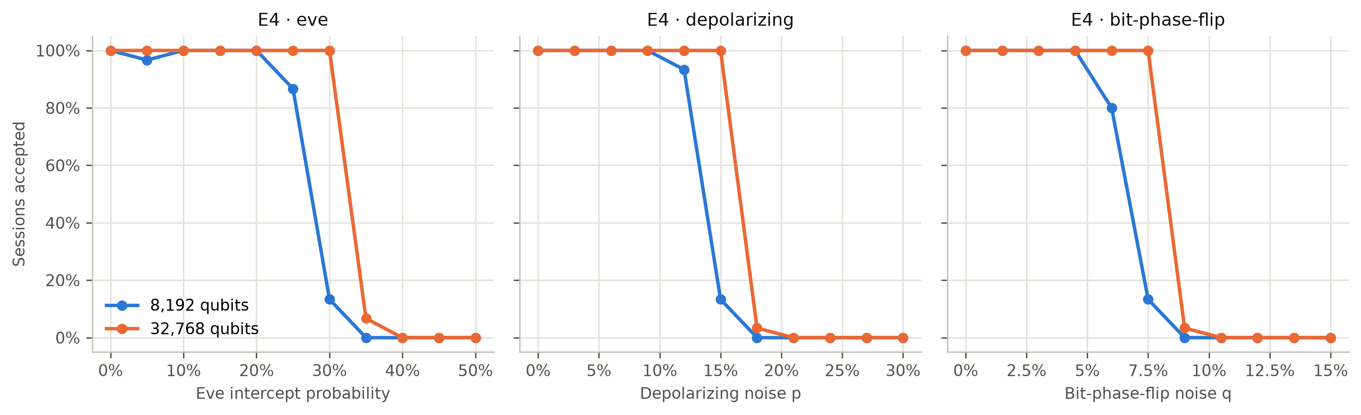
Results
Key acceptance under attack and noise (full pipeline, 30 sessions per point)
Channel | QBER | Accepted (8,192 qubits) | Accepted (32,768 qubits)
Eve on 25% of qubits | ≈ 6.3% | 87% | 100%
Eve on 30% of qubits | ≈ 7.4% | 13% | 100%
Depolarizing noise 15% | ≈ 7.5% | 13% | 100%
Any channel with QBER ≳ 10.5% | — | 0% | 0%
Notes:
1,053 of 1,980 sessions were accepted and every accepted session gave identical keys at both banks. One session aborted with reconciliation_failed: Cascade left an even pair of errors; the hash check caught it.

Slide 18
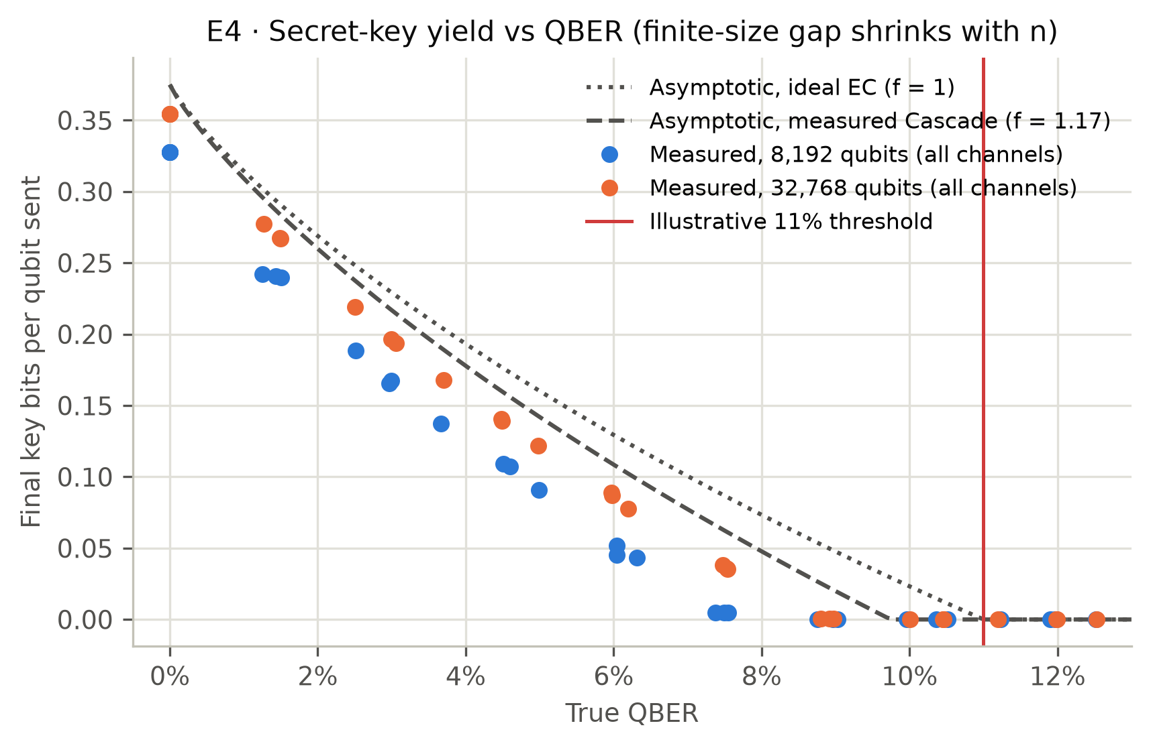
Results
Main finding: privacy amplification, not the 11% threshold, is the binding constraint
• Keys stop surviving at ≈ 6–7% QBER (8,192 qubits) and ≈ 7.5–9% (32,768 qubits).
• Cascade leaks 1.13–1.22× the Shannon limit, so the asymptotic key rate hits zero at ≈ 9.8%.
• Finite-sample bounds cost more: clean-channel yield 0.328 → 0.354 bits/qubit as n grows (max 0.375).
• A 45% threshold still gives 0 key bits under full attack (tested).
Notes:
Dashed curve: asymptotic rate with measured Cascade efficiency; dotted: ideal error correction. Measured points approach the dashed curve as block length grows.

Slide 19
Results
Validation against theory and key-processing accuracy
Check | Points | max |z| | |z| > 3
E1 Eve vs QBER | 11 | 2.98 | 0
E2 Depolarizing vs QBER | 11 | 1.35 | 0
E2 Bit-phase flip vs QBER | 11 | 1.43 | 0
E3 Sifted length vs n/2 | 9 | 1.12 | 0
E7 Qiskit Aer vs theory | 4 | 1.01 | 0
E7 Qiskit vs NumPy | 4 | 0.69 | 0
+0.03 pp
99.97%
QBER estimate bias (1,000 runs)
Upper-bound coverage (2,979 / 2,980)
≈ 1.17×
100%
Cascade leakage vs Shannon limit
Accepted sessions with identical keys (1,053)
• Sifting keeps half the qubits: ratio 0.498–0.501 for n = 256 … 65,536; spread matches √(0.25/n).
• NumPy model and Qiskit Aer circuits differ by ≤ 0.15 percentage points — statistically indistinguishable.
• Every result regenerates from root seed 2024 with one command (≈ 90 s): no hand-entered data.
Notes:
z = (measured mean − theory) / (sd/√trials). Under correct modelling |z| > 3 occurs in about 0.3% of points.

Slide 20
Security & Performance
Attacks simulated
Performance (Apple silicon laptop)
Attack | Outcome
Full intercept-and-resend | ✕ Blocked (QBER > 11%)
Flip ciphertext bit | ✕ Rejected (tag)
Flip authentication-tag bit | ✕ Rejected (tag)
Flip nonce bit | ✕ Rejected (tag)
Alter routing metadata (AAD) | ✕ Rejected (tag)
Receiver uses wrong key | ✕ Rejected (tag)
Replay delivered message | ✕ Rejected (replay)
Operation | Median
BB84, NumPy model | 19 M qubits/s
BB84, Qiskit Aer circuits | ≈ 9.4 K qubits/s
Key exchange, 8,192 qubits | 4.2 ms
Key exchange, 32,768 qubits | 14.6 ms
HKDF session keys | 24.6 µs
AES-256-GCM encrypt / decrypt | 1.6 / 0.9 µs
End-to-end transfer + SQLite | 3.1 ms
• Every single-bit flip of ciphertext, tag, nonce or associated data is rejected (exhaustive test).
• Cascade dominates key-exchange time (≈ 60%); classical cryptography cost is negligible.
• Circuit simulation is ≈ 2,000× slower than the NumPy model, which is why large experiments use NumPy.
Notes:
Timings are from one machine (recorded in docs/results/RESULTS.md); experiment tables are machine-independent.

Slide 21
Testing & Validation
446
32
20 / 20
0
backend tests (pytest)
frontend tests (Vitest)
deliberate bugs caught
keys found in database scan
Specification tests: matching bases agree; sifting ≈ ½; full intercept-resend → ≈ 25% QBER; more noise → higher QBER; high-QBER sessions abort; accepted keys match; AES-GCM recovers plaintext and rejects tampering; nonces unique under each key.
Published test vectors: RFC 5869 (HKDF) and McGrew–Viega AES-256-GCM vectors reproduce exactly.
Statistical tests: fixed seeds and 5σ binomial tolerances derived from theory, not from observed results.
Mutation testing: each component was deliberately broken. One bug (Cascade without back-tracking) was initially missed → we added a Cascade-invariant test that now catches it.
Notes:
Commands: dev.py test (backend), dev.py test-ui (frontend + build). Details in docs/testing.md.

Slide 22
Work Completed
Phase | Deliverable | Status
1 Setup | Monorepo, pinned dependencies, one-command setup on Windows & macOS | ✓ Done
2 BB84 engine | Qubit preparation, measurement, sifting; NumPy & Qiskit backends | ✓ Done
3 Eve & noise | Intercept-and-resend, depolarizing and bit-phase-flip channels | ✓ Done
4 Key processing | QBER sampling, abort rule, Cascade, Toeplitz privacy amplification | ✓ Done
5 AES-256-GCM | HKDF keys, unique nonces, tamper and replay rejection | ✓ Done
6 Banking & DB | Bank A ↔ Bank B transfers, SQLite history, security event log | ✓ Done
7 Web application | Six React pages with live charts | ✓ Done
8 Evaluation | Seeded experiments, figures, report, demo guide | ✓ Done
Notes:
All eight planned phases are complete; each ended with tests passing on macOS, with Windows setup verified.

Slide 23
Outcomes Achieved
Research Output
Working simulation-based quantum-secure banking platform (web app + REST API)
BB84 key establishment between Bank A and Bank B, fresh key per transfer
Eavesdropping detection via QBER: full intercept-resend → 24.94% (theory 25%)
Quantified noise / attack → QBER → key-acceptance relationship from ≈ 5,200 sessions
Transactions protected with AES-256-GCM; all tampering and replays rejected
Security-event and transaction logging; no key material ever persisted
SDG Mapping
Primary: SDG 9 – Industry, Innovation and Infrastructure — secure, resilient digital infrastructure
Secondary: SDG 16 – Peace, Justice and Strong Institutions — trustworthy financial communication
Notes:
Each outcome links to evidence in docs/results/RESULTS.md and the demo.

Slide 24
Limitations
Physics & attack model
Security analysis & engineering
• Ideal single-photon source; no loss or detector imperfections
• Only intercept-and-resend Eve (no collective or side-channel attacks)
• I.i.d. noise; pseudo-random (not quantum) random numbers
• Classical computer simulation — no quantum hardware
• Key length is Shor–Preskill-style, asymptotic-inspired — not a composable finite-key proof
• Classical-channel authentication assumed, not implemented
• 11% threshold is illustrative, not universal
• Keys in Python memory; no API auth or TLS; fictional banking only
Notes:
We do not claim production-grade security. Full list in docs/limitations.md.

Slide 25
Conclusion
Summary of Work
Built a Quantum-Secure Banking Network simulation: BB84 key establishment, QBER-based eavesdropping detection, Cascade reconciliation, Toeplitz privacy amplification and AES-256-GCM transaction protection.
Results match quantum theory (50/50 points within 3σ); NumPy and Qiskit Aer agree.
Key finding: privacy amplification — not the 11% threshold — decides whether a usable key exists (keys stop at ≈ 6–9% QBER depending on block size).
QKD and classical cryptography complement each other: quantum for key establishment, AES-GCM for data.
Future Scope
Decoy-state BB84 with loss and detector models; BBM92 / E91 protocols
Composable finite-key analysis; LDPC reconciliation to reduce leakage
Post-quantum hybrid (ML-KEM + QKD); authenticated classical channel
Multi-bank trusted-node network and key-pool management; photonic testbed validation
Notes:
Close with the main finding and the honesty statement: educational simulation, not production security.

Slide 26
References
[1] A. Brazaola-Vicario, A. Ruiz, O. Lage, E. Jacob, and J. Astorga, “Quantum key distribution: a survey on current vulnerability trends and potential implementation risks,” Optics Continuum, vol. 3, no. 8, pp. 1438–1460, 2024. doi: 10.1364/OPTCON.530352.
[2] S. Nikula, A. Lintulampi, and K. Halunen, “Security Analysis for BB84 Key Distillation,” in Proceedings of the 21st International Conference on Security and Cryptography (SECRYPT), 2024, vol. 1, pp. 407–415. doi: 10.5220/0012717500003767
[3] A. Stathis, A. Ntanos, P. Toumasis, N. K. Lyras, G. Giannoulis, and H. Avramopoulos, “Experimental feasibility analysis of quantum/classical coexistence over fibre and free space links,” IET Quantum Communication, vol. 5, no. 4, pp. 575–585, 2024.
[4] E. Dervisevic et al., “Quantum Key Distribution Networks – Key Management: A Survey,” ACM Computing Surveys, vol. 57, no. 10, Article 257, 2025.
[5] P. Wawage et al., “Quantum Key Distribution for Secure Financial Data Exchange,” in 2025 15th International Conference on Mathematics, Actuarial Science, Computer Science and Statistics (MACS), 2025.
[6] M. Selimović et al., “Deployment of Entanglement-Based QKD in Financial
Infrastructure,” arXiv preprint arXiv:2607.11252, 2026.

Slide 27
References
[7] C. H. Bennett and G. Brassard, “Quantum cryptography: Public key distribution and coin tossing,” Proc. IEEE Int. Conf. Computers, Systems and Signal Processing, Bangalore, pp. 175–179, 1984.
[8] P. W. Shor and J. Preskill, “Simple proof of security of the BB84 quantum key distribution protocol,” Phys. Rev. Lett., vol. 85, p. 441, 2000.
[9] G. Brassard and L. Salvail, “Secret-key reconciliation by public discussion,” EUROCRYPT ’93, LNCS 765, pp. 410–423, 1994.
[10] C. H. Bennett, G. Brassard, C. Crépeau and U. M. Maurer, “Generalized privacy amplification,” IEEE Trans. Inf. Theory, vol. 41, no. 6, pp. 1915–1923, 1995.
[11] H. Krawczyk, “LFSR-based hashing and authentication,” CRYPTO ’94, LNCS 839, pp. 129–139, 1994.
[12] C. J. Clopper and E. S. Pearson, “The use of confidence or fiducial limits illustrated in the case of the binomial,” Biometrika, vol. 26, no. 4, pp. 404–413, 1934.
[13] M. Dworkin, “Recommendation for Block Cipher Modes of Operation: GCM and GMAC,” NIST SP 800-38D, 2007.
[14] H. Krawczyk and P. Eronen, “HMAC-based Extract-and-Expand Key Derivation Function (HKDF),” RFC 5869, 2010.
[15] M. Tomamichel, C. C. W. Lim, N. Gisin and R. Renner, “Tight finite-key analysis for quantum cryptography,” Nature Communications, vol. 3, p. 634, 2012.
[16] A. Javadi-Abhari et al., “Quantum computing with Qiskit,” arXiv:2405.08810, 2024.

