Slide 1
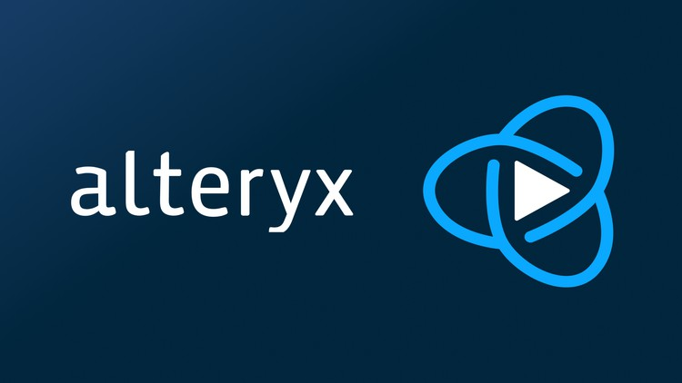
Data Analytic Process Automation Virtual Internship
Submitted By:
Kumar Gupta
CSIT 7-b
2000290110083

Slide 2
About The Organization
Alteryx Academy is an online learning platform designed to provide comprehensive training and education on Alteryx, a leading data analytics and data blending software.
It offers a range of courses, learning paths, and resources tailored to users of varying expertise levels, from beginners to advanced users, enabling them to harness the full potential of the Alteryx platform.
Integration with the Alteryx Community Forum, enabling users to connect, share knowledge, seek advice, and engage with other learners and experts.

Slide 3
What is data analytics?
Data analytics involves examining raw data to uncover patterns, trends, correlations, and insights that can inform decision-making or solve problems within various domains such as business, healthcare, finance, and more.
It encompasses a range of techniques and methodologies, including data cleaning, transformation, and modeling, to make data more structured, understandable, and useful for analysis.
Its significance lies in its ability to transform vast and complex datasets into actionable intelligence, fueling innovation, driving efficiencies, and aiding in the formulation of data-driven strategies
By employing statistical, mathematical, and computational tools, data analytics assists in making informed decisions, forecasting future trends, optimizing processes, and mitigating risks based on data-driven evidence.

Slide 4
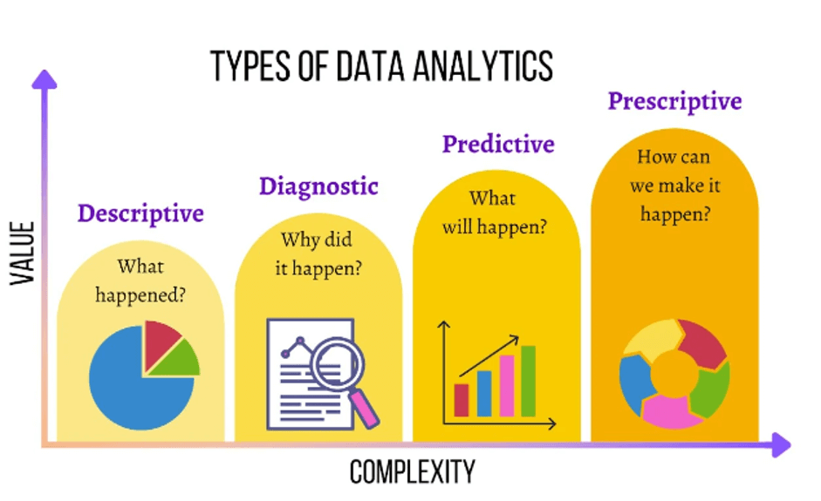
Types of Data Analytics

Slide 5
Key Learnings
During the course of the internship we had to complete two certification exams:
Alteryx Foundational Micro-credentials Certification which gave basic knowledge of data analytics concepts and key Designer functionality. It made us aware to identify data types and data formats; the basic elements of Alteryx Designer; and associate commonly used tools with their functionality.
Alteryx Designer Core Certification provided knowledge of the “core” toolset in Designer and your ability to apply your knowledge and use the tools to solve real-world problems. The core toolset includes the tools that are used most often in Alteryx Designer and are fundamental to data preparation and analysis.

Slide 6
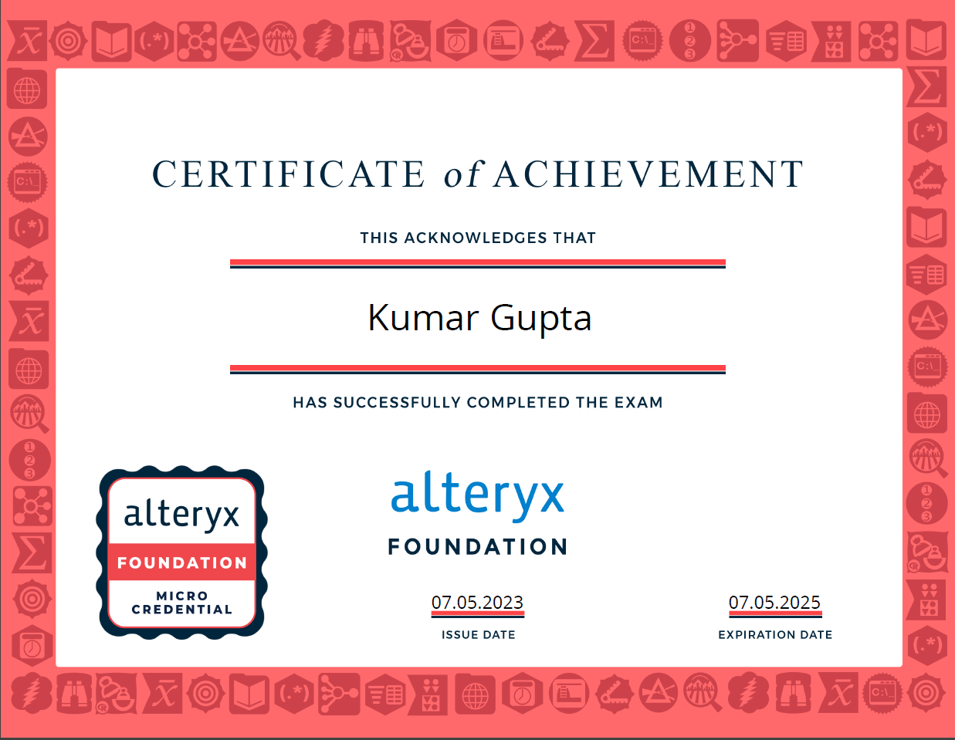

Slide 7
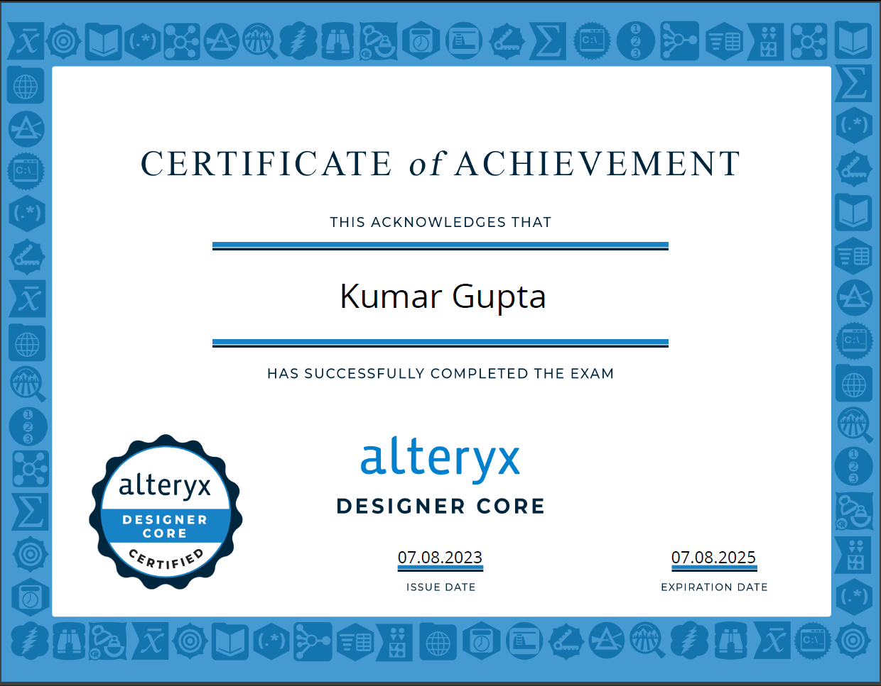

Slide 8
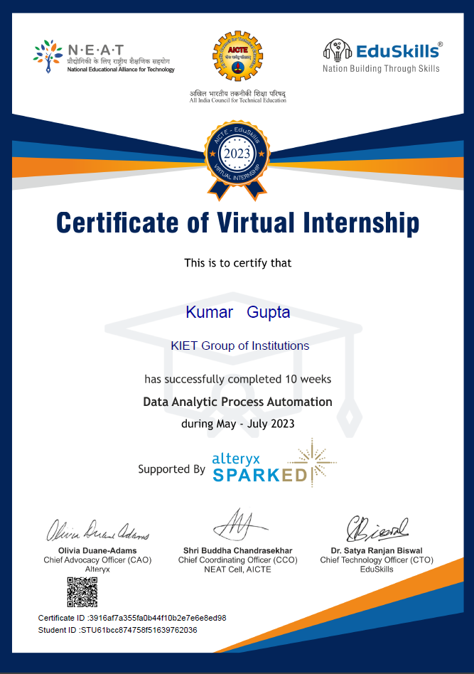

Slide 9
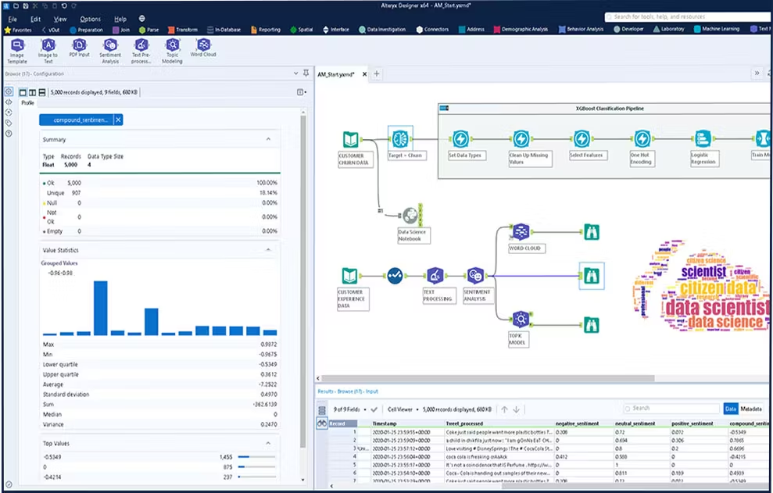
Platform used
Alteryx Designer Core

Slide 10
Thank You

