Slide 1

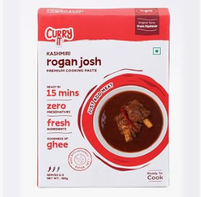
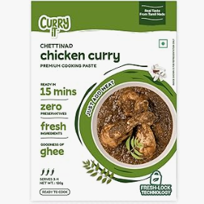


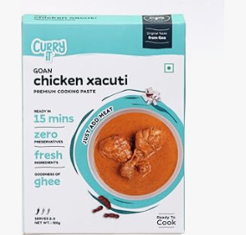
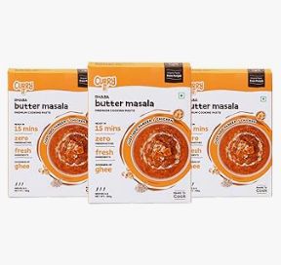
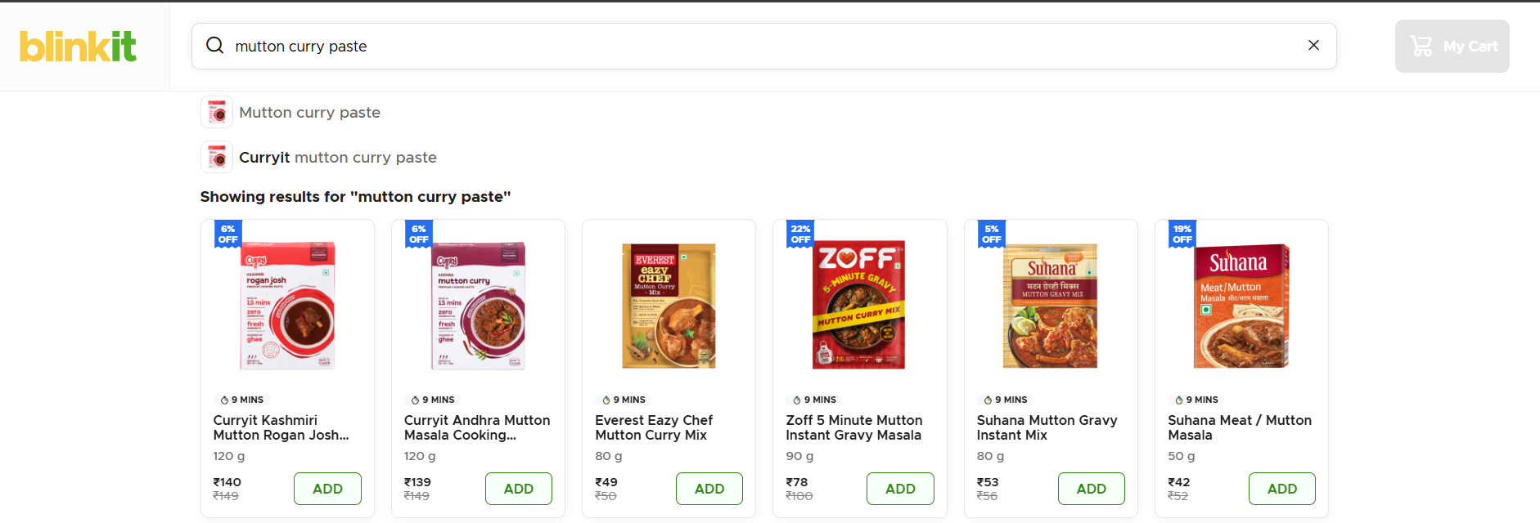
MEDIA LANDSCAPE · MEDIA OVERVIEW
CURRYiT MEDIA
LANDSCAPE 2026
From ‘What Should I Eat?’ to ‘I’ll Buy CURRYiT’
CONSUMER INTENT
MEDIA SURFACE
CURRYiT
Research evidence · Blinkit — search: mutton curry paste
CURRYiT packs as captured in the Amazon research screenshots
Built only from: CurryIT Reserch.docx · CURRYiT_Media_Overview.xlsx · CURRYiT 2026 Surface Blueprint

Slide 2











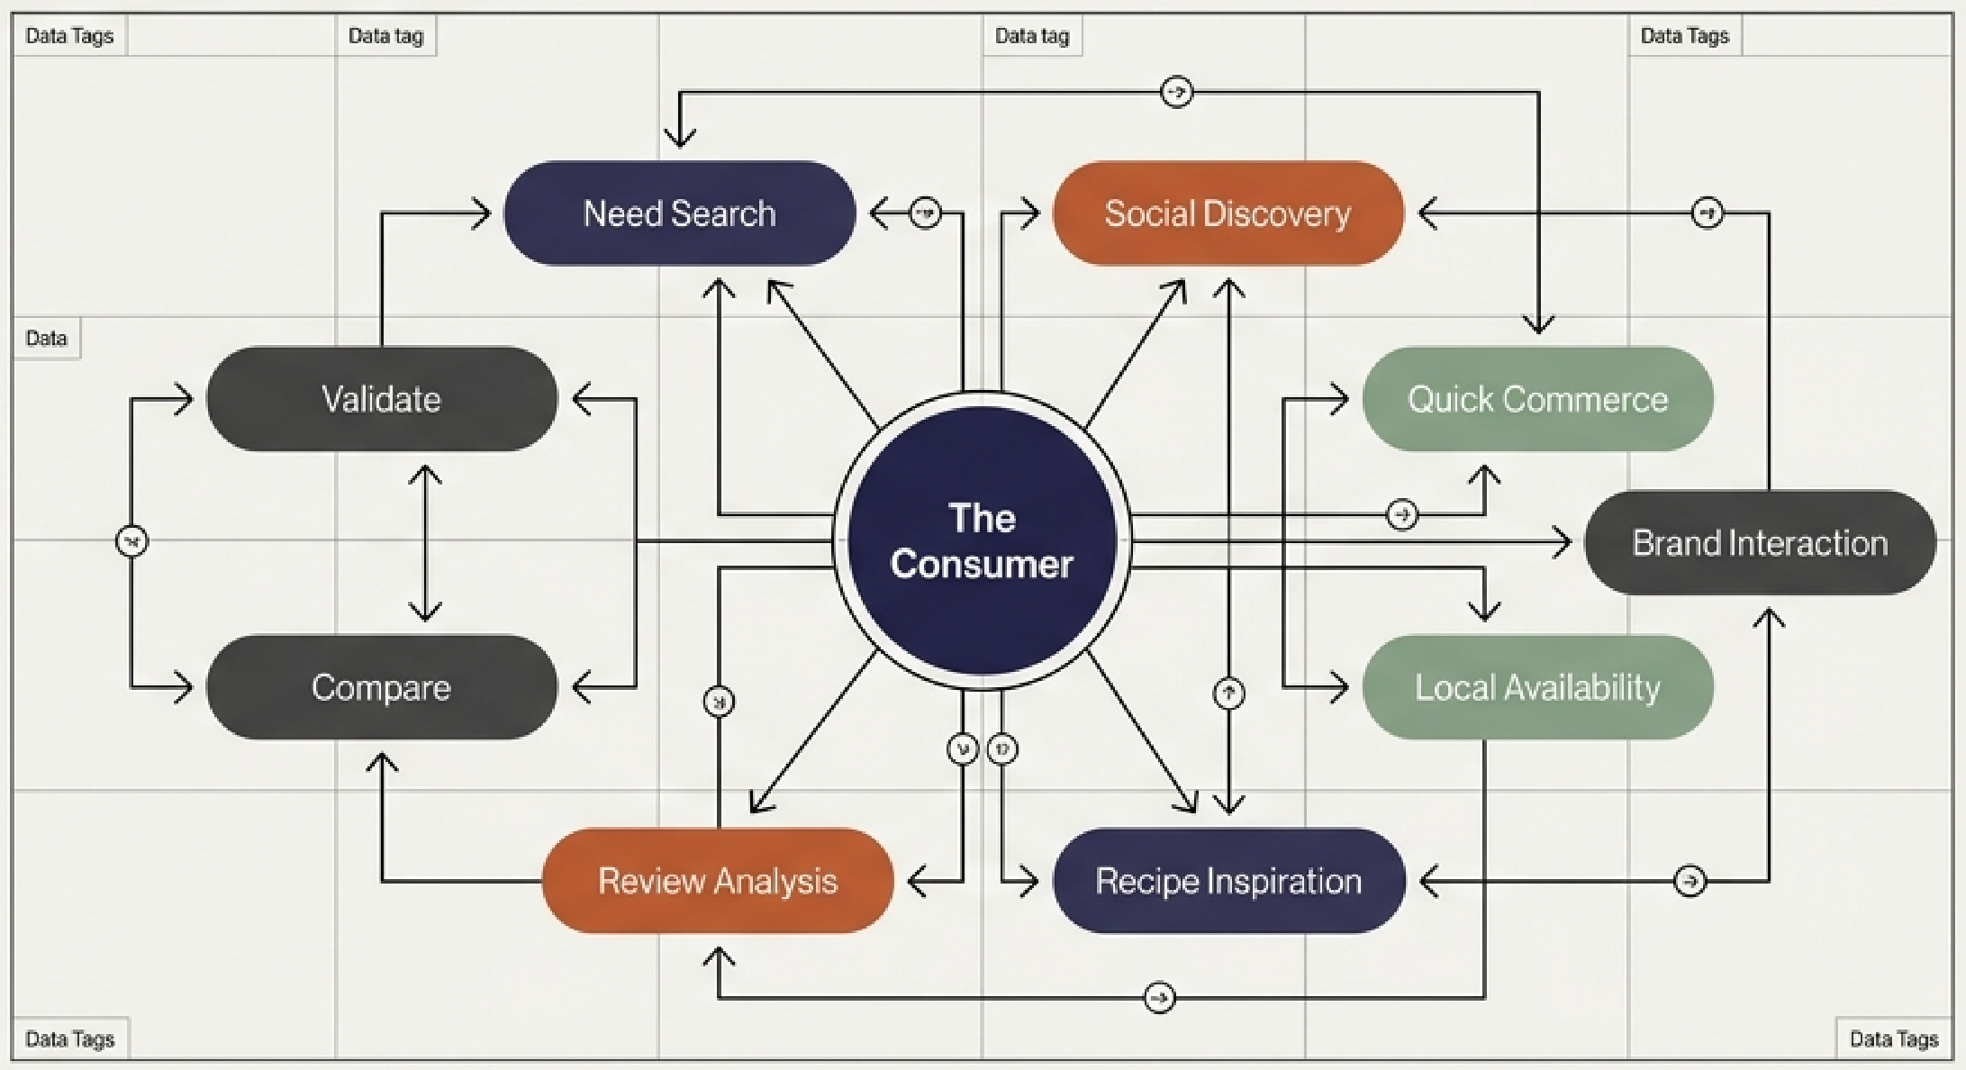
THE CONSUMER MEDIA ECOSYSTEM
WHERE THE CONSUMER MOVES
DISCOVER & DECIDE
1
2
3
4
5
6
SOCIAL DISCOVERY
PROBLEM / NEED SEARCH
RECIPE / DISH SEARCH
AI / ANSWER ENGINES
TRUST / COMMUNITY
MARKETPLACE COMPARISON
Instagram · YouTube Shorts · Facebook
Google Search
YouTube · Google · recipe publishers
Google AI Mode · Gemini · ChatGPT
Reddit · Quora · reviews
Amazon
BUY, RETURN & RECOMMEND
7
8
9
10
11
QUICK COMMERCE
D2C CONVERSION
OFFLINE DISCOVERY
CRM / REPEAT
ADVOCACY
Blinkit · Zepto · Swiggy Instamart
CURRYiT website (curryit.in)
Retail · modern trade · sampling
WhatsApp · email · retargeting
Reviews · referrals · UGC
CORE PRINCIPLE
CURRYiT should be present wherever the consumer moves from ‘What should I eat?’ to ‘I’ll buy CURRYiT’ — and then bring them back again.
Intent-driven ecosystem map — CURRYiT 2026 Surface Blueprint
2 / 12

Slide 3
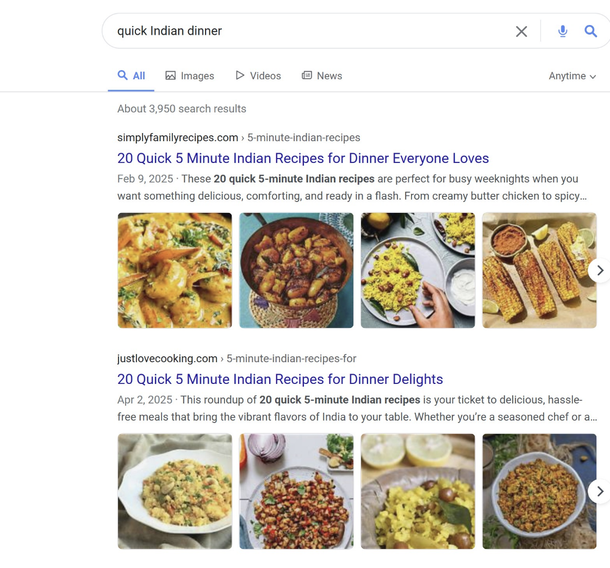
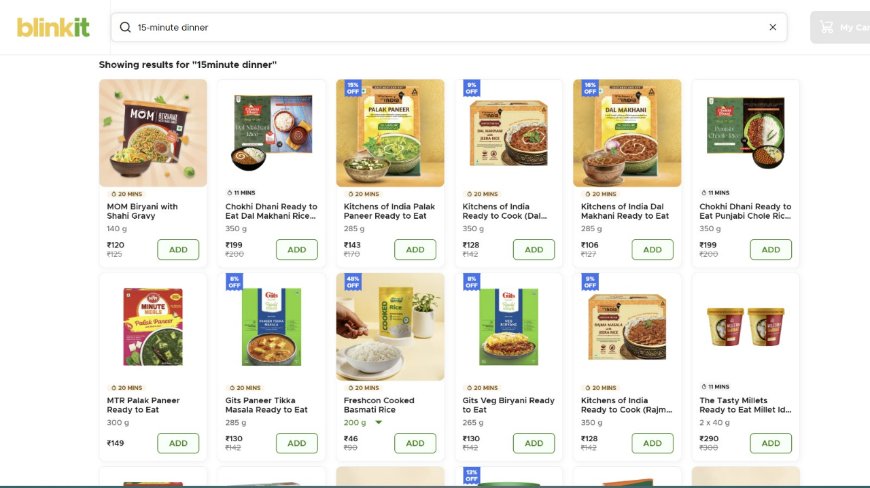
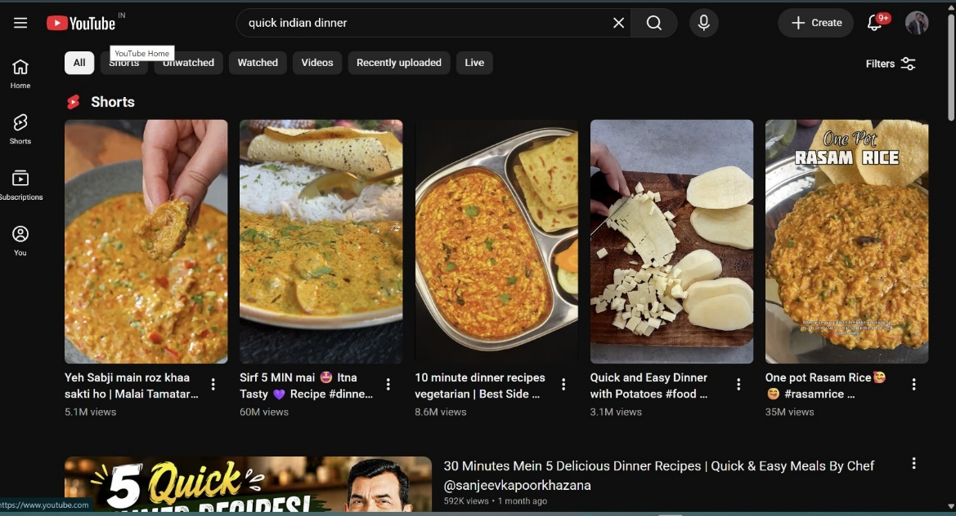

MEDIA MOMENTS 1 + 2 · GOOGLE / AI SEARCH · YOUTUBE
1. SEARCH: SOLVE MY DINNER → SHOW ME HOW
A · PROBLEM / NEED SEARCH — “SOLVE MY DINNER”
B · RECIPE / DISH SEARCH — “SHOW ME HOW”
Google — search: quick Indian dinner
Blinkit — search: 15-minute dinner
YouTube — search: quick indian dinner
CREATIVE PRINCIPLE
FINISHED DISH FIRST
↓
HOW CURRYiT MAKES IT EASY
CURRYiT NOT VISIBLE
CURRYiT NOT VISIBLE — ready-to-eat packs lead
CURRYiT NOT VISIBLE — creators own the results
WHAT IS THE CONSUMER DOING AND WHERE?
WHO IS WINNING THE SURFACE TODAY?
WHAT IS CURRYiT'S LEVER HERE?
WHAT IS THE CONSUMER DOING AND WHERE?
WHO IS WINNING THE SURFACE TODAY?
WHAT IS CURRYiT'S LEVER HERE?
Tired after work; searching for a dinner solution, not a brand.
Google Search · Google AI search · search-led discovery
Captured: “quick Indian dinner” (Google), “15-minute dinner” (Blinkit).
Recipe publishers. Captured Google results: simplyfamilyrecipes.com, justlovecooking.com.
Media Overview names Swasthi’s Recipes & Hebbar’s Kitchen as established quick-dinner publishers.
Problem-led SEO + Search Ads while organic builds.
Ranking action:
Dedicated “quick dinner” intent pages
Link content to relevant SKUs
FAQs / structured, GEO-ready content
Internal linking → topical authority
Knows the dish; wants an easier way to make it.
YouTube · Google · recipe publishers · searchable Shorts
Dish intents from brief: Butter Chicken, Paneer Butter Masala, Chettinad Chicken, Biryani, Rogan Josh.
Recipe creators. Captured Shorts show 3.1M–60M views; Chef Sanjeev Kapoor Khazana long-form ranks below.
Media Overview: Hebbar’s Kitchen quick-dinner video ~3M views vs far smaller reach for CURRYiT’s product-led video.
Recipe SEO · YouTube SEO · Shorts · creator collabs · dish landing pages · 3-step demos.
Ranking action:
One search-optimised asset per high-intent dish (title, description, chapters, link to SKU).
Sources: CurryIT Reserch.docx (screenshots) · CURRYiT_Media_Overview.xlsx · CURRYiT 2026 Surface Blueprint
3 / 12

Slide 4
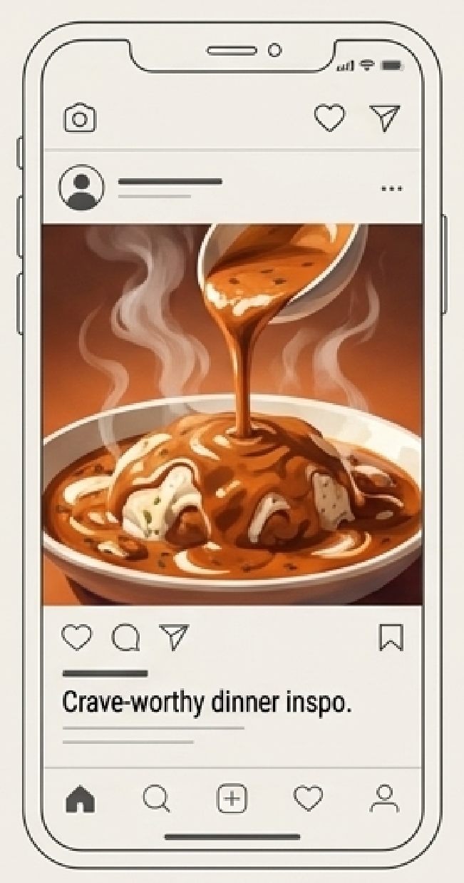
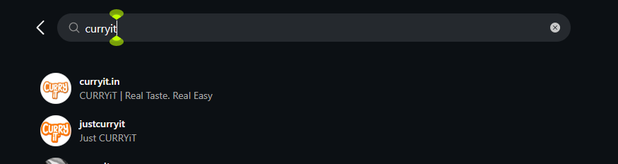
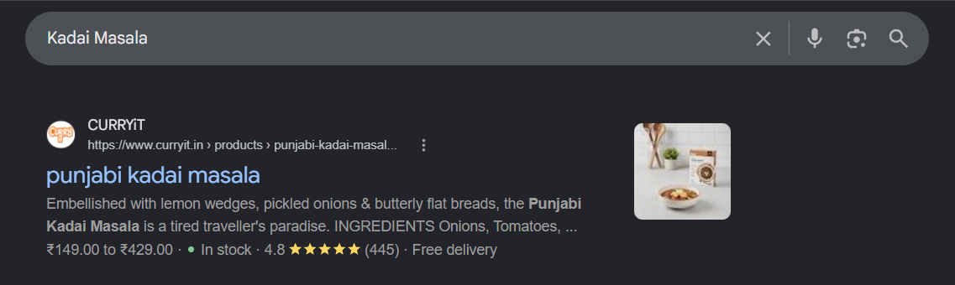
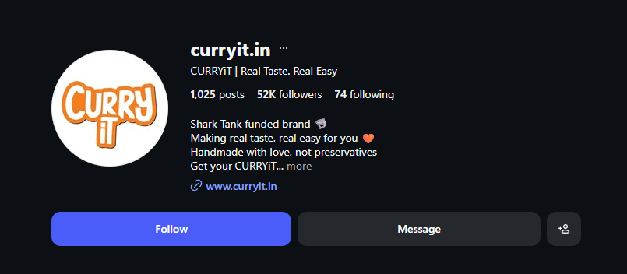



MEDIA MOMENTS 3 + 4 · SOCIAL · AI / ANSWER ENGINES
2. DISCOVERY: MAKE ME HUNGRY → ANSWER MY QUESTION
SOCIAL DISCOVERY — “MAKE ME HUNGRY”
AI / ANSWER ENGINE — “ANSWER MY QUESTION”
Instagram — search: curryit
Google — search: Kadai Masala
Structured product data already surfaces: price range, in stock, 4.8★ (445), free delivery.
curryit.in: 52K followers, 1,025 posts. A second account (justcurryit, 9 followers) also appears.
UNDERSTAND
TRUST
REFERENCE
Illustrative — Surface Blueprint
Make CURRYiT easy for answer engines to understand, trust and reference.
WHAT IS THE CONSUMER DOING AND WHERE?
WHO IS WINNING THE SURFACE TODAY?
WHAT IS CURRYiT'S LEVER HERE?
WHAT IS THE CONSUMER DOING AND WHERE?
WHO IS WINNING THE SURFACE TODAY?
WHAT IS CURRYiT'S LEVER HERE?
Casually scrolling after work, not searching: “That looks good. I could make that tonight.”
Instagram Reels · Facebook · YouTube Shorts · food/lifestyle creators
Food & lifestyle creators, UGC and short-form cooking content.
Benchmark (Media Overview): Cookd built a 1M+ home-cook community on YouTube/Instagram before its product business.
Creator seeding · UGC · Reels/Shorts · Meta amplification of organic winners · retargeting.
Hooks:
“POV: You reach home at 8:30 PM” · “What I cooked after work” · “Dinner in 15 minutes” · “3 steps from packet to plate”
Asks full questions, e.g. “What can I cook with paneer in 20 minutes?”, “Which curry paste is preservative-free?”
Google AI Mode / AI Overviews · Gemini · ChatGPT
No single winner. Trusted, structured, well-supported sources are best placed.
Google reports AI Mode queries are 2–3× longer than traditional searches (Media Overview).
GEO / AEO: FAQs, ingredient & recipe pages, serving + prep info, process & shelf-life explanation, structured data, credible external mentions.
Improves eligibility; does not guarantee AI inclusion.
Sources: CurryIT Reserch.docx (screenshots) · CURRYiT_Media_Overview.xlsx · CURRYiT 2026 Surface Blueprint
4 / 12

Slide 5
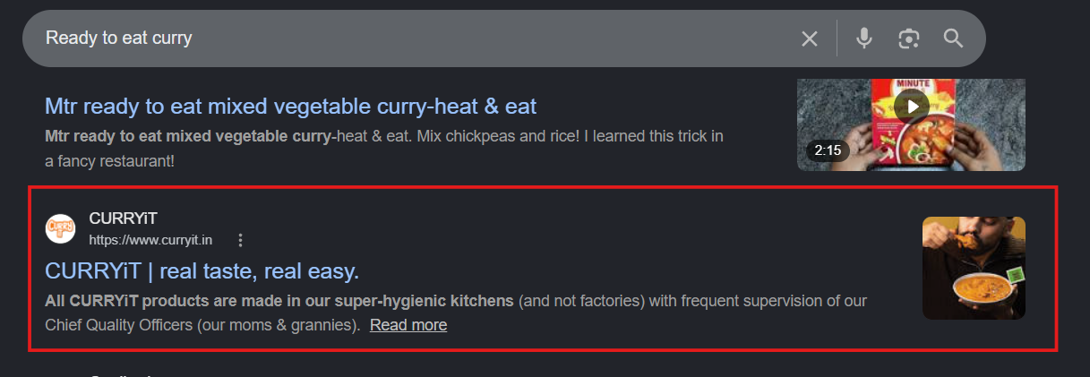



MEDIA MOMENT 5 · REDDIT · QUORA · GOOGLE · REVIEWS
3. TRUST: PROVE IT TO ME
Google — search: Ready to eat curry
WHAT IS THE CONSUMER DOING AND WHERE?
“Is CURRYiT actually good?”
“Do curry pastes taste packaged?”
“How can CURRYiT last so long without preservatives?”
“Is it worth the money?”
Reddit · Quora · Google · reviews · social comments · communities
WHO IS WINNING THE SURFACE TODAY?
Real consumer experiences and credible peer conversations — not advertisers. Surface Blueprint: trusted community discussions and transparent manufacturing proof win over marketing claims.
PARTIALLY VISIBLE — CURRYiT at 8th position (research)
CURRYiT’s own trust message is what surfaces: “super-hygienic kitchens (and not factories)… Chief Quality Officers (our moms & grannies)”.
WHAT IS CURRYiT'S LEVER HERE?
WHERE THE TRUST CONVERSATION HAPPENS
Community listening · earned advocacy · genuine reviews · transparent factual answers · FAQ development · ingredient/process education · reputation monitoring.
Visibility action:
Monitor relevant questions → identify recurring objections → improve FAQs → publish factual shelf-life/process answers → encourage genuine reviews → earn credible third-party mentions.
Reddit
Quora
Google
Reviews
Social comments
Communities
Reddit evidence (Media Overview): users recommend MTR, ITC, Haldiram’s, Cookd and CURRYiT depending on the use case; CURRYiT already gets organic mentions for biryani, chhole, Kosha Mangsho and butter masala.
Do NOT manipulate Reddit or Quora — treat them as listening posts, not ad channels.
Sources: CurryIT Reserch.docx (screenshots) · CURRYiT_Media_Overview.xlsx · CURRYiT 2026 Surface Blueprint
5 / 12

Slide 6
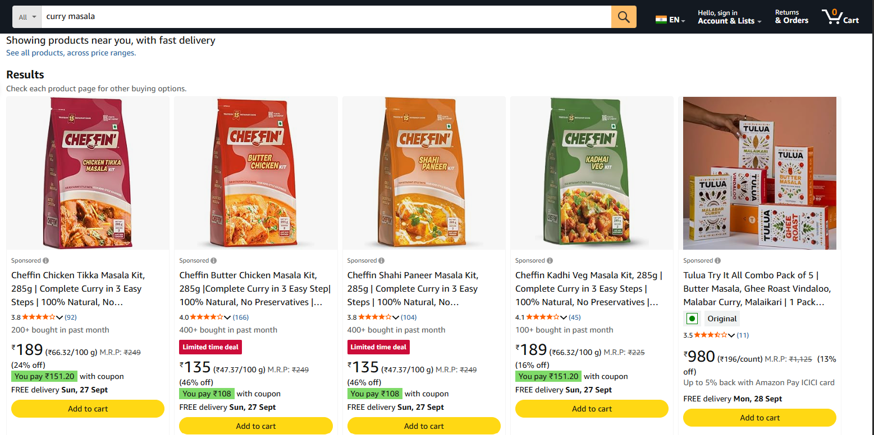
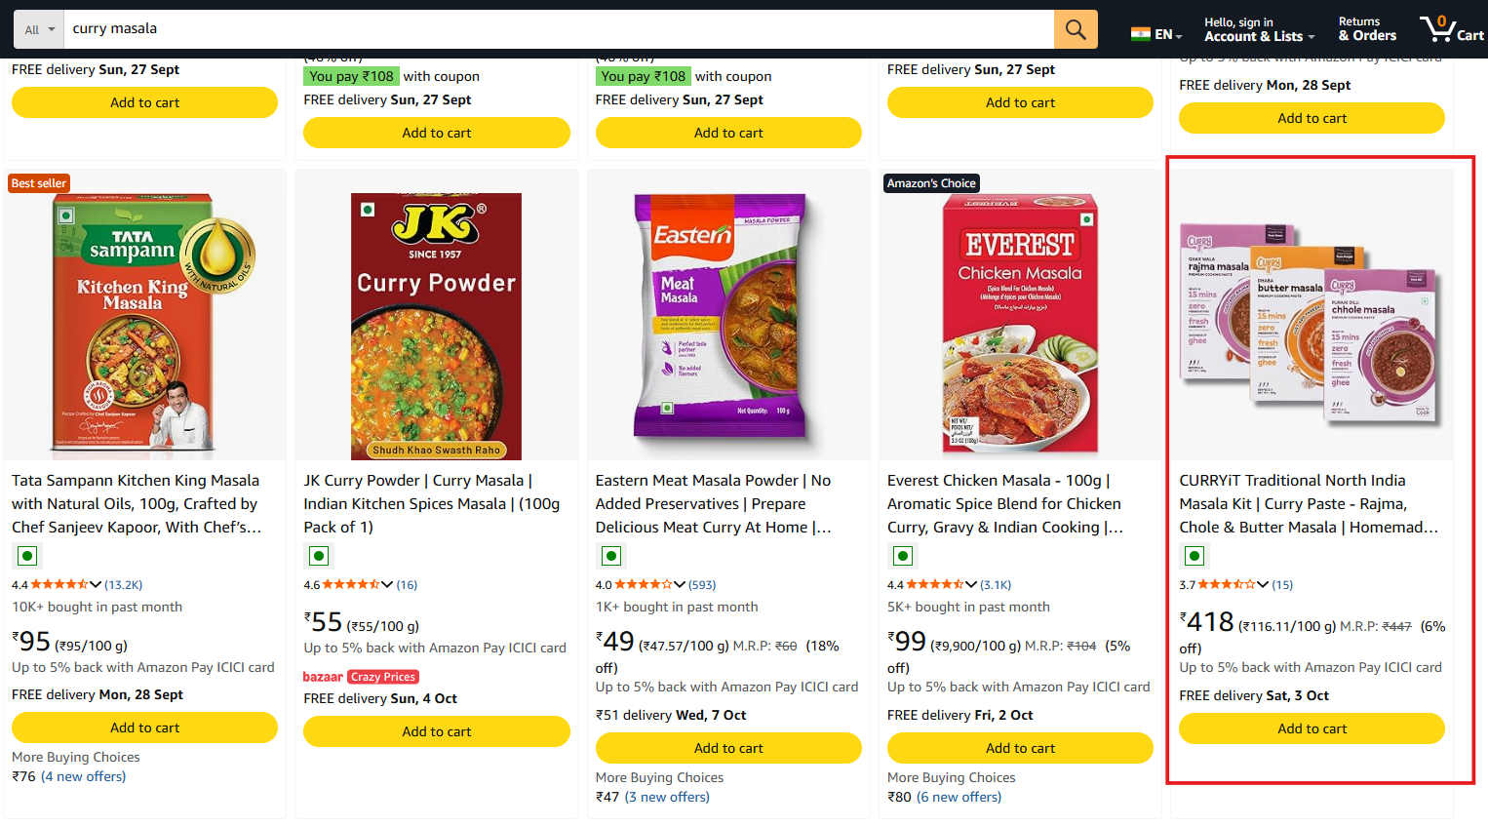
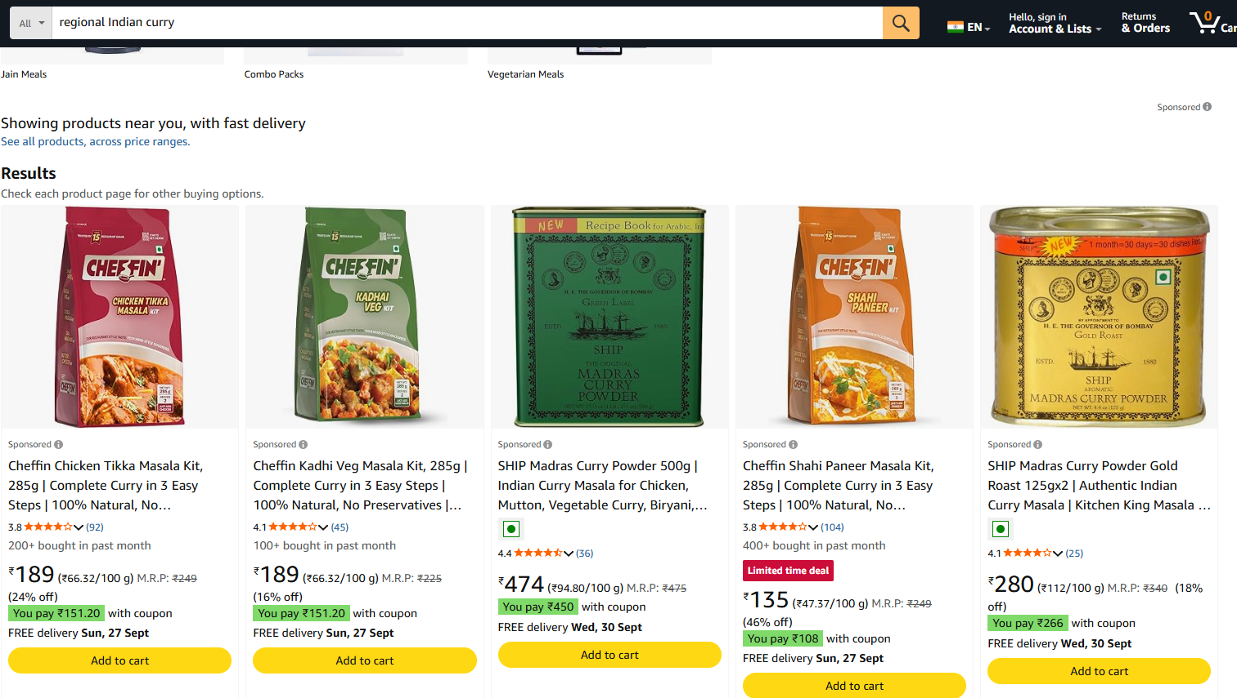
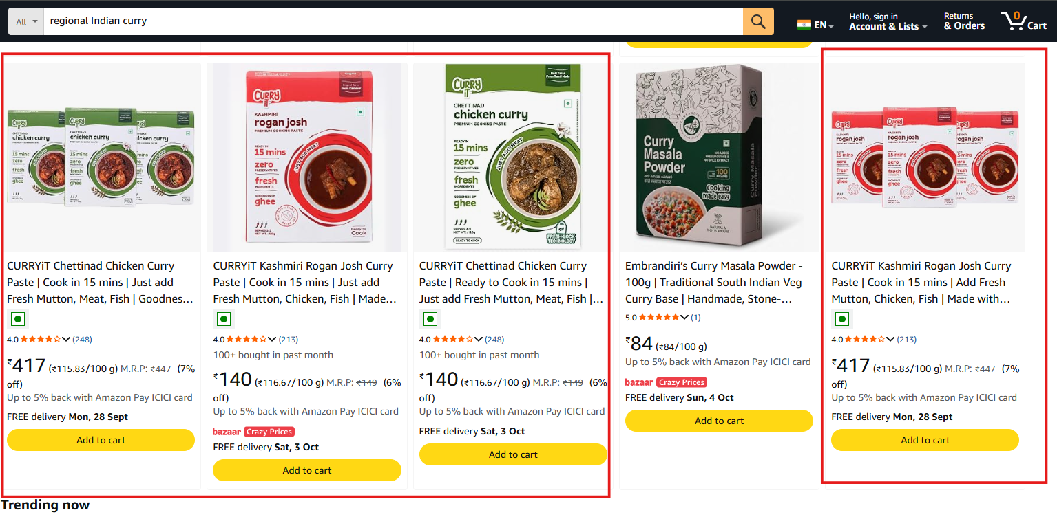
MEDIA MOMENT 6 · AMAZON = MEDIA + COMMERCE
4. MARKETPLACE: LET ME COMPARE
Amazon is both a search/ad surface and the checkout.
Amazon — search: curry masala
Amazon — search: curry masala
WHAT IS THE CONSUMER DOING AND WHERE?
Compares curry paste, ready-to-cook curry, butter masala, biryani paste, wet masala.
Judges price, ratings, reviews, serving size, prep time, ingredients, images, offers, brand credibility.
Captured: “curry masala”, “regional Indian curry”.
WHO IS WINNING THE SURFACE TODAY?
No universal winner. Sponsored slots lead: Cheffin (plus Tulua on “curry masala”; SHIP on “regional Indian curry”).
CURRYiT appears organically right after: Chettinad 4.0★ (248), Rogan Josh 4.0★ (213).
SPONSORED FIRST: Cheffin ×4, Tulua
CURRYiT ORGANIC right after sponsored
Amazon — search: regional Indian curry
Amazon — search: regional Indian curry
WHAT IS CURRYiT'S LEVER HERE?
Amazon SEO · Sponsored Products/Brands on hero SKUs · A+ Content · first image stating 15 mins / what to add / serves · ratings · coupons · regional flavour.
Ranking action:
Title/bullets/search terms → hero-SKU ads → lift CTR & conversion → legitimate reviews → test high-intent sponsored keywords.
SPONSORED FIRST: Cheffin, SHIP
CURRYiT ORGANIC: Chettinad + Rogan Josh
Sources: CurryIT Reserch.docx (screenshots) · CURRYiT_Media_Overview.xlsx · CURRYiT 2026 Surface Blueprint
6 / 12

Slide 7
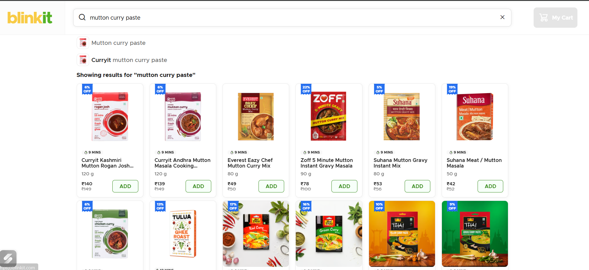
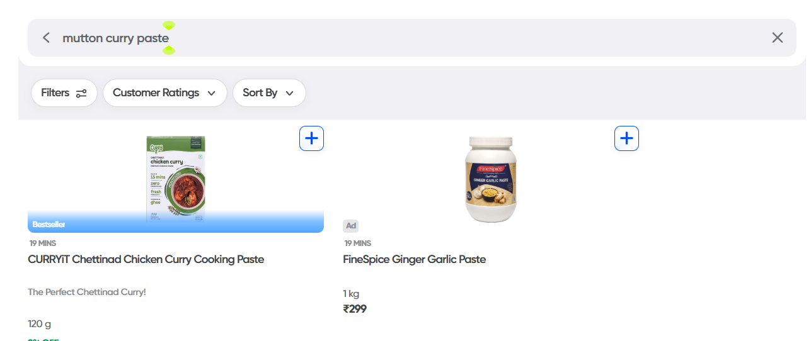
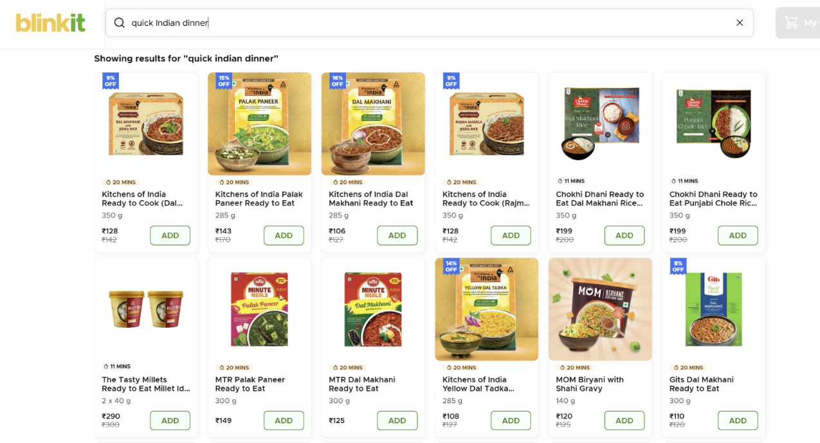
MEDIA MOMENT 7 · BLINKIT + ZEPTO + SWIGGY INSTAMART = ONE SURFACE
5. QUICK COMMERCE: LET ME BUY IT NOW
Blinkit — search: mutton curry paste
Swiggy Instamart — search: mutton curry paste
Blinkit — search: quick Indian dinner
VISIBLE — CURRYiT 1st, “Bestseller”
NOT VISIBLE
WHAT THE SHOPPER COMPARES
Search position
Sponsored position
Ratings
Reviews
Price
Discounts
Availability
Pack imagery
Prep claims
Hero SKUs
VISIBLE — CURRYiT first two results + “Curryit mutton curry paste” autosuggest
WHAT IS THE CONSUMER DOING AND WHERE?
WHO IS WINNING THE SURFACE TODAY?
WHAT IS CURRYiT'S LEVER HERE?
Dinner needs solving now. Captured: “mutton curry paste” on Blinkit and Swiggy Instamart.
Blinkit · Zepto · Swiggy Instamart
No Zepto screenshot in the research set.
No single winner declared. For this query CURRYiT leads organically; an Ad (FineSpice) sits beside it on Instamart.
Price tier as captured: CURRYiT ₹139–140 vs Everest ₹49, Suhana ₹42–53, Zoff ₹78. Media Overview: CURRYiT & Cheffin share the ₹130–150 wet-paste tier.
Retail media · sponsored search · category placement · hero SKU · pack thumbnails · ratings · promotions · stock · city-level assortment · 5–9 PM dinner-time visibility.
If not ranking:
Catalogue relevance → category mapping → in-stock → ratings → first image → sponsored search on broad dinner terms.
Sources: CurryIT Reserch.docx (screenshots) · CURRYiT_Media_Overview.xlsx · CURRYiT 2026 Surface Blueprint
7 / 12

Slide 8
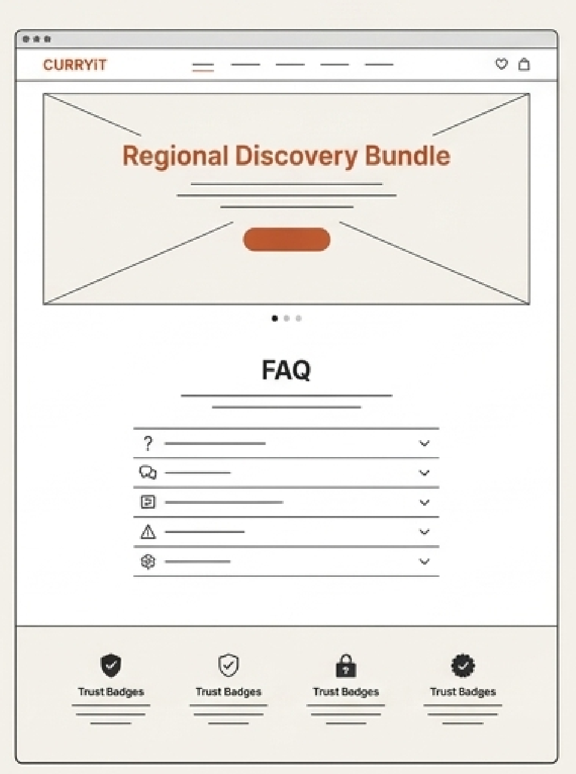
MEDIA MOMENTS 8 + 9 · CURRYiT.IN · RETAIL & SAMPLING
6. CONVINCE ME FULLY → LET ME EXPERIENCE IT
D2C — CURRYiT.IN · “CONVINCE ME FULLY”
OFFLINE — RETAIL & SAMPLING · “LET ME EXPERIENCE IT”
WHAT IS THE CONSUMER DOING AND WHERE?
WHAT IS THE CONSUMER DOING AND WHERE?
What exactly am I buying?
What do I need to add?
How does it work? Will it taste good?
Is the no-preservative claim believable?
Which flavour should I buy?
Supermarket · modern trade · sampling · live demo · retail display · food exhibition.
WHO IS WINNING THE SURFACE TODAY?
Availability-led benchmarks (Media Overview): MTR wins through presence wherever consumers shop; Cookd reports 2,000+ stores in Tamil Nadu.
WHO OWNS THE SURFACE?
CURRYiT. Strongest assets (Media Overview): sourcing explanation, process, 20+ checks, shelf-life explanation, bookable kitchen visits.
Illustrative D2C concept — Surface Blueprint
Shelf / sampling concept using real CURRYiT packs from research screenshots
WHAT IS CURRYiT'S LEVER HERE?
WHAT IS CURRYiT'S LEVER HERE?
CRO · product selector · what-you-add · serving size & cost per serving · bundles · ingredient/process proof · FAQs · reviews · email/WhatsApp capture · retargeting.
Distribution · sampling · 3-step demos · end caps · shelf visibility · POS · QR recipe demos · regional displays.
IF ORGANIC VISIBILITY IS WEAK
IF TRAFFIC EXISTS, CONVERSION IS WEAK
KEY BARRIER
Search-intent landing pages → recipe/category authority → internal linking
Product-page clarity → trust proof → prep & serving info → finished-food imagery
“Will it actually taste good?”
One good sample can resolve the taste objection faster than multiple digital ads.
Sources: CurryIT Reserch.docx (screenshots) · CURRYiT_Media_Overview.xlsx · CURRYiT 2026 Surface Blueprint
8 / 12

Slide 9
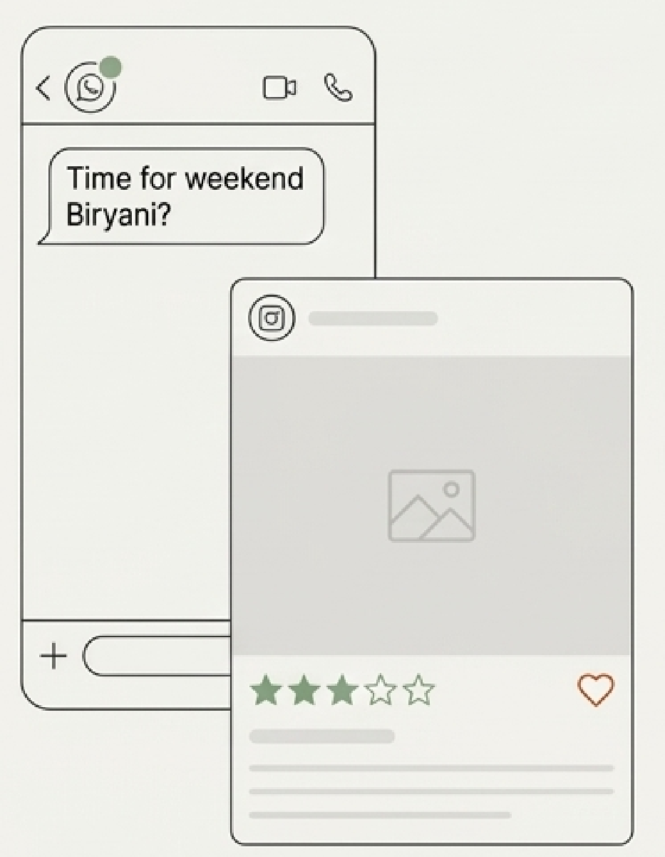


MEDIA MOMENT 10 · WHATSAPP · EMAIL · CRM · RETARGETING
7. BRING ME BACK → MAKE ME RECOMMEND IT
1. PURCHASE
“You tried Butter Masala — try Chettinad next.”
“What are we cooking this weekend?”
6. REFERRAL
2. WHATSAPP
“Explore another region of India.”
Illustrative — Surface Blueprint
WHAT IS THE CONSUMER DOING AND WHERE?
WHO IS WINNING THE SURFACE TODAY?
WHAT IS CURRYiT'S LEVER HERE?
5. REVIEW
3. RECIPE
Has already bought. May forget to reorder, want another flavour, need a dinner idea, replenish, buy a bundle or recommend.
WhatsApp · email · Meta retargeting · website · CRM
No verifiable single RTC brand winner. Advantage comes from first-party data, personalisation and easy reorder journeys.
Meta/RAI 2026 retail study: 72% product discovery reported on WhatsApp (Media Overview).
WhatsApp CRM · email · reorder & replenishment reminders · cross-sell · personalised recipes · cart recovery · bundles · new-flavour launches · review & referral asks.
No conventional ranking — visibility = staying in the repeat loop.
4. REORDER
PURCHASE → REPEAT → HABIT → ADVOCACY
Sources: CurryIT Reserch.docx (screenshots) · CURRYiT_Media_Overview.xlsx · CURRYiT 2026 Surface Blueprint
9 / 12

Slide 10
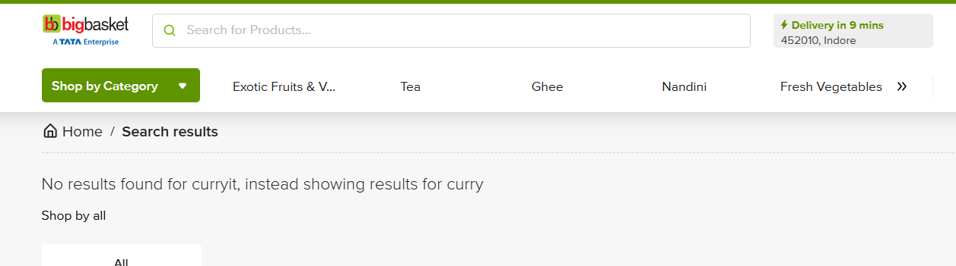
VISIBLE 4
PARTIAL 3
GAP 3
EVIDENCE · ACTUAL RESEARCH SCREENSHOTS
8. WHERE CURRYiT IS VISIBLE — AND WHERE IT IS NOT
VISIBLE
VISIBLE
VISIBLE
VISIBLE
PARTIALLY VISIBLE
Google — search: Kadai Masala
Blinkit — search: mutton curry paste
Swiggy Instamart — search: mutton curry paste
Instagram — search: curryit
Google — search: Ready to eat curry
CURRYiT product page ranks (7th in research) with 4.8★ (445) rich result.
CURRYiT holds the first two organic tiles.
CURRYiT Chettinad first, tagged Bestseller.
Two accounts: curryit.in (52K) and justcurryit (9 followers).
CURRYiT at 8th position, below MTR content.
PARTIALLY VISIBLE
PARTIALLY VISIBLE
NOT VISIBLE / GAP
NOT VISIBLE / GAP
NOT VISIBLE / GAP
Amazon — search: curry masala
Amazon — search: regional Indian curry
Blinkit — search: 15-minute dinner
Google — search: quick Indian dinner
BigBasket — search: curryit
Organic only after Cheffin/Tulua sponsored row.
Chettinad + Rogan Josh organic after sponsored ads.
Not visible; ready-to-eat brands fill results.
Not visible; also absent in captured Amazon, Blinkit & YouTube results.
“No results found for curryit” — not listed.
Source: CurryIT Reserch.docx — platform labels follow the visible screenshot UI; positions only where stated in the research.
10 / 12

Slide 11
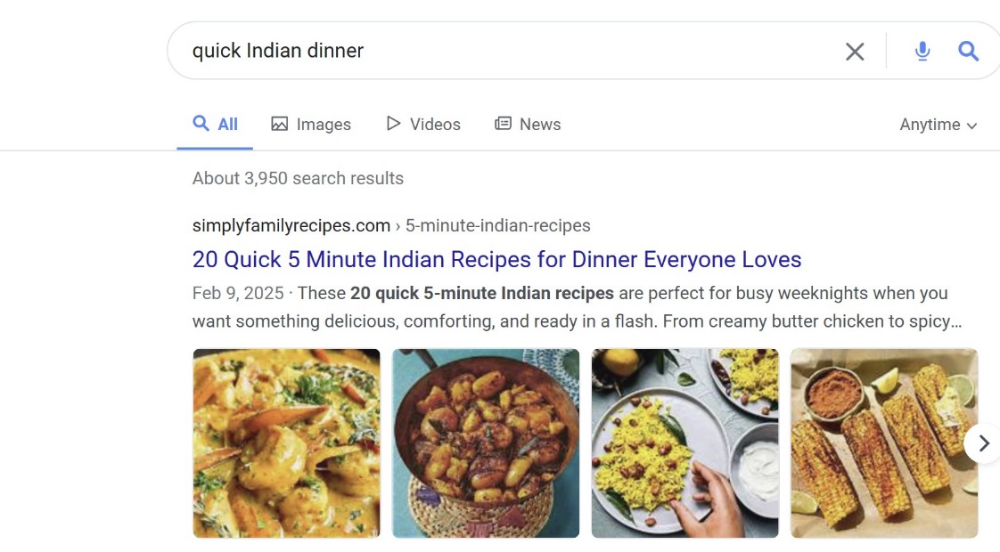
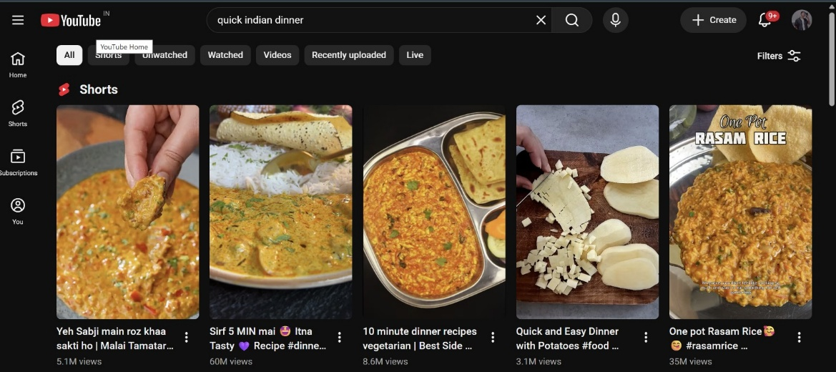
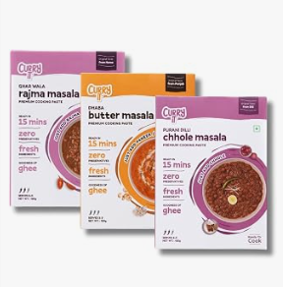
SYNTHESIS
9. WHAT THE MARKET IS TELLING CURRYiT
1
2
3
4
5
CURRYiT cannot optimise only for branded searches.
Recipe content is both discovery AND commerce infrastructure.
CURRYiT already has evidence of organic visibility in some high-intent searches.
Search visibility is surface-specific.
The opportunity is to connect the journey.
It needs to capture the problem before consumers know the brand.
Creators turn dish searches into demand.
The opportunity is to systematically expand that visibility.
Google, Amazon, Quick Commerce, YouTube and Instagram require different optimisation mechanisms.
DISCOVERY → SEARCH → EDUCATION → TRUST → COMPARISON → PURCHASE → REPEAT
Google — search: quick Indian dinner
YouTube — search: quick indian dinner
Blinkit — search: mutton curry paste
CURRYiT packs (Amazon screenshot)
THE MEDIA JOURNEY CURRYiT NEEDS TO CONNECT
SOCIAL DISCOVERY
SEARCH / AI
RECIPE EDUCATION
TRUST
MARKETPLACE COMPARISON
QUICK-COMMERCE PURCHASE
D2C CONVERSION
CRM / REPEAT
ADVOCACY
Sources: CurryIT Reserch.docx (screenshots) · CURRYiT_Media_Overview.xlsx · CURRYiT 2026 Surface Blueprint
11 / 12

Slide 12


STRATEGIC PRIORITIES
10. WHAT CURRYiT SHOULD DO NEXT
1. OWN NON-BRANDED SEARCH INTENT
Build content around dinner problems and dish searches.
2. BUILD RECIPE-TO-COMMERCE CONTENT
Connect YouTube, Shorts, creators and SEO with CURRYiT products.
3. CLOSE SEARCH VISIBILITY GAPS
Prioritise queries where CURRYiT is absent or low-ranking.
4. STRENGTHEN HIGH-INTENT COMMERCE SURFACES
Amazon + Quick Commerce: hero SKUs + retail media + search optimisation + ratings + availability.
5. TURN FIRST PURCHASE INTO A HABIT
WhatsApp + CRM + recipes + reorder + cross-sell + advocacy.
MAKE ME
HUNGRY
HELP ME
SOLVE DINNER
SHOW ME
HOW
PROVE I CAN
TRUST YOU
LET ME
COMPARE
LET ME
BUY NOW
CONVINCE
ME FULLY
BRING ME
BACK
MAKE ME
RECOMMEND
YOU
CURRYiT should be present wherever the consumer moves from ‘What should I eat?’ to ‘I’ll buy CURRYiT’ — and then bring them back again.
Sources: CurryIT Reserch.docx (screenshots) · CURRYiT_Media_Overview.xlsx · CURRYiT 2026 Surface Blueprint
12 / 12

