Slide 1
Process sequence

Slide 2
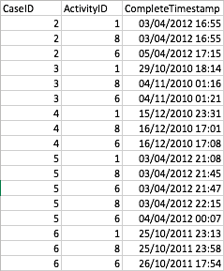
Data
CaseID: ID of a case
ActivityID: ID of activity (this can be switched to name of activity by using Disco)
CompleteTimestamp: Time when activity ended

Slide 3
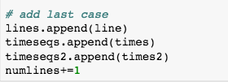



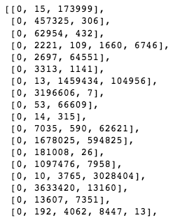
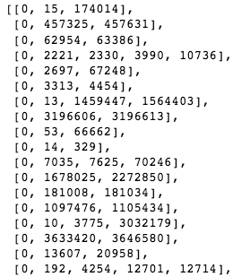
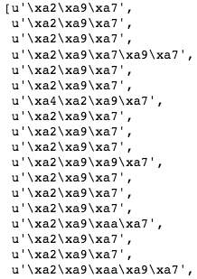
Preprocessing
Result:
timeseqs
timeseqs2
lines
timeseqs: duration of each activity in a case
Timeseqs2: cumulative duration of each activity in a case.
lines: activities
Numlines: number of cases
divisor: mean of timeseqs
divisor2: mean of timeseqs2.

Slide 4
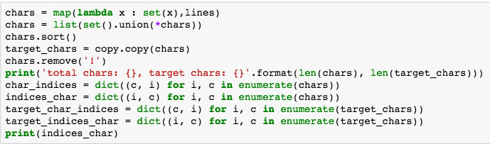
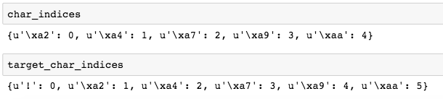
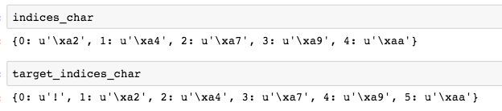
Preprocessing
Result:
chars: list of unique activities
char_indices: mapping list char-indices
target_char_indices: mapping list char-indices including symbol for EOS (end of sentence)
indices_chars: similar
target_indices_chars: similar

Slide 5
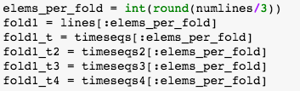
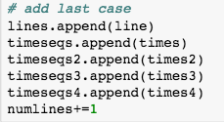



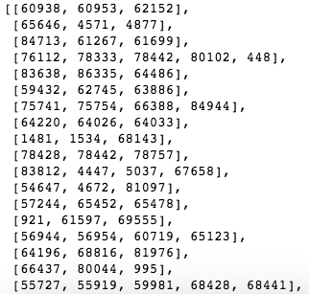
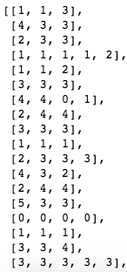
Preprocessing
Divided into 3 folds
1+2 for training
3 for testing
Result:
lines: activities
timeseqs: duration of each activity in a case
timeseqs2: cumulative duration of each activity in a case.
timeseqs3: time since midnight
timeseqs4: weekday
lines
timeseqs
timeseqs2
timeseqs3
timeseqs4

Slide 6
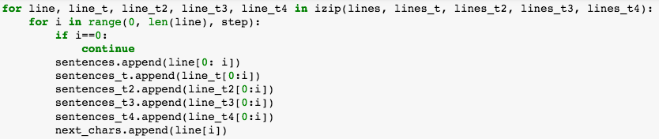
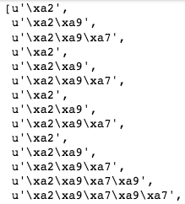
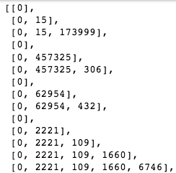
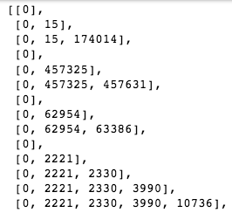
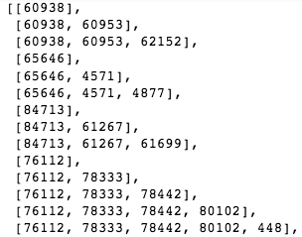
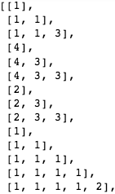

Preprocessing
sentences
sentences_t
sentences_t2
sentences_t3
sentences_t4
These variables have same length and used as INPUT later

Slide 7
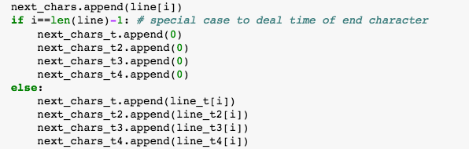





Preprocessing
next_chars
next_chars_t
next_chars_t2
next_chars_t3
next_chars_t4
These variables have same length and used as OUTPUT later

Slide 8


Vectorization
Create array with zeros:
- X: INPUT
- y: OUTPUT
maxlen: len of longest case
num_features: number of unique activities (to specify the existence of activity) + 4 variables + 1 (number of activities in a case)
len(target_chars): number of unique activities + 1 (eos)
maxlen
num_features
len(target_chars)

Slide 9
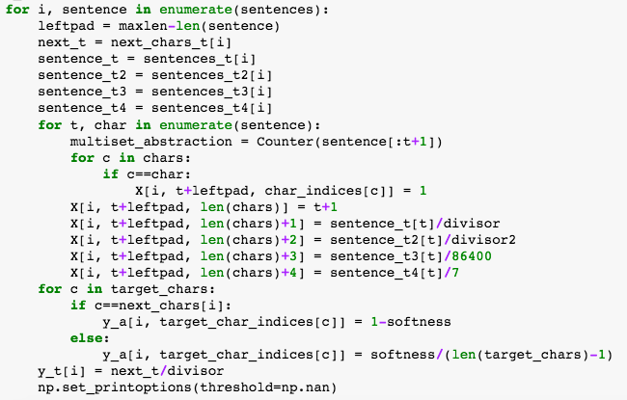

Vectorization
Q: Why we have only 5 features but X.shape[2] =10???
A: The previous features denote the activities happened
t enumerate within a case → t: 1 → 9
maxlen
num_features
maxlen: len of longest case
num_features: number of unique activities + 4 variables + 1 (order of activity in a case)

Slide 10
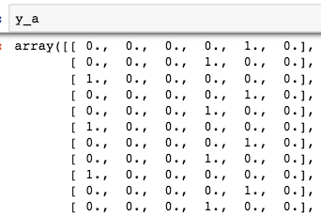
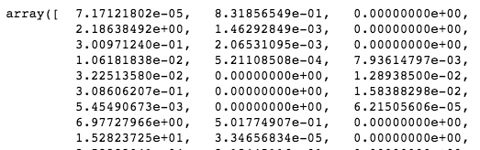
Vectorization
next_char
target_char_indices
y_a (One-hot encode)
next_char_t/divisor
y_t

Slide 11




Training

Slide 12
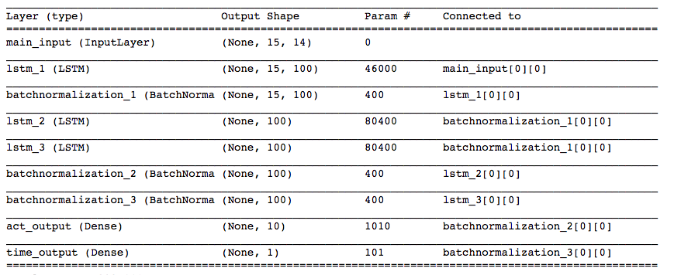
Training

Slide 13



Experiment

Slide 14
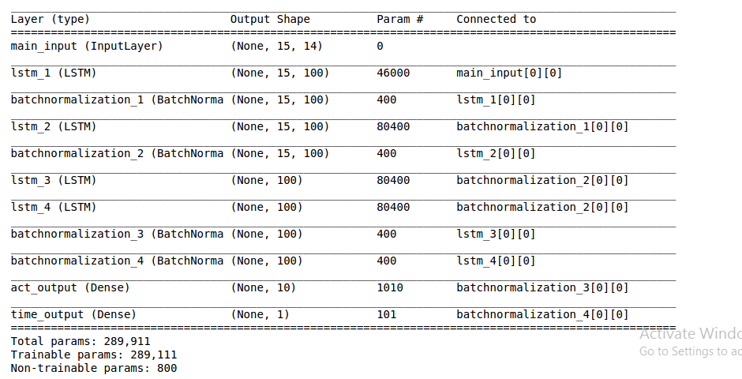




Experiment_1
Use 2 shared layers LSTM

Slide 15
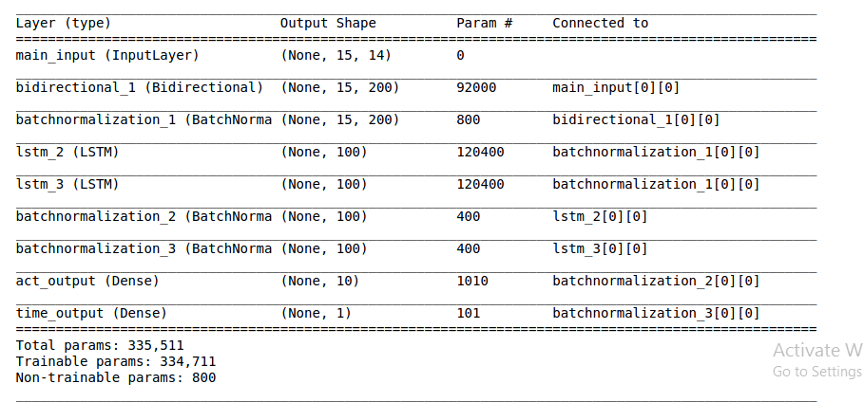



Experiment_2
Use Bidirectional LSTM

Slide 16
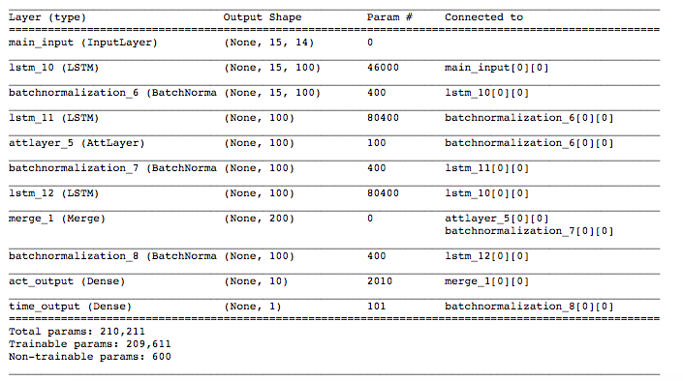



Experiment_2
Use Attention for act: class, usage

Slide 17
Evaluation
Raw test data
Crop by suffix
Input X
One-hot encode
Encoded input X
Encoded prediction Y
Predict model
Ground truth Y
Predicted Y
Inverse transform label
(inverse-encode/normalize)
Ground truth activity
Ground truth time
Predicted activity
Predicted time
Evaluation
Evaluation

Slide 18

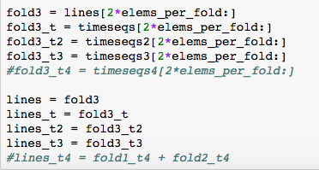
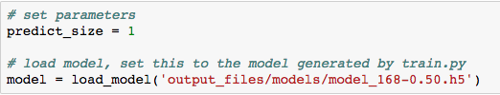

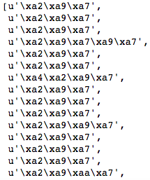
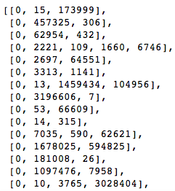

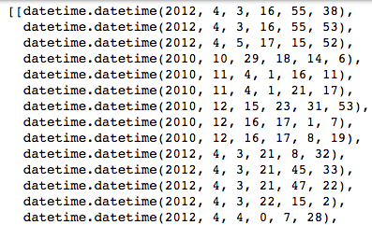


evaluate_next_activity_and_time
Fold 3 for testing
lines
timeseqs2
timeseqs3
timeseqs
Note:
Shape of timeseqs2 is different
Timeseq3 is the time of activity
lines
lines_t
lines_t2
lines_t3

Slide 19
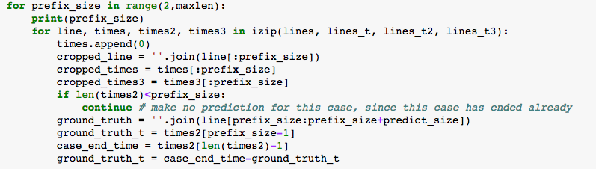




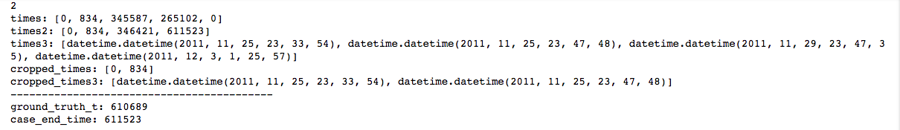
evaluate_suffix_and_remaining_time
To deal with short case when suffix>len(case)
ground_truth: next activity after suffix activities
ground_truth_t: 610689 = 611523 – 834: remaining time after suffix activities

Slide 20
Evaluation metrics
For activity: (refer to this package: https://pypi.python.org/pypi/Distance/)
distance.nlevenshtein:
damerau_levenshtein_distance:
distance.jaccard
For time:
Mean absolute error:
Median absolute error:

Slide 21
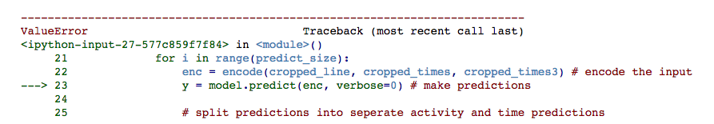
Questions:
- If maxlen of test data > train data?

