Slide 1
Asymptotic Notations
Algorithms perform f(n) basic operations to accomplish task
  Identify that function
  Identify size of problem (n)
  Count number of operations in terms of n

Slide 2
Execution time
Time computer takes to execute f(n) operations is cf(n)
where c
  depends on speed of computer and
  varies from computer to computer

Slide 3
Development of Notation
Not concerned with small values of n
Concerned with VERY LARGE values of n
Asymptotic – refers to study of function f as n approaches infinity
Example: f(n) = n²+4n + 20
n² is the dominant term and the term 4n + 20 becomes insignificant as n grows larger

Slide 4
Development of Notation
Drop insignificant terms and constants
Say function is of O(n²) called Big-O of n²
Common Big-O functions in algorithm analysis
  g(n) = 1 (growth is constant)
  g(n) = log ₂ n (growth is logarithmic)
  g(n) = n (growth is linear)
  g(n) = n log ₂ n (growth is faster than linear)
  g(n) = n² (growth is quadratic)
  g(n) = 2^{n} (growth is exponential)

Slide 5
n | log2n | nlog2n | n^2 | 2^n
1 | 0 | 0 | 1 | 2
2 | 1 | 2 | 4 | 4
4 | 2 | 8 | 16 | 16
8 | 3 | 24 | 64 | 256
16 | 4 | 64 | 256 | 65536
32 | 5 | 160 | 1024 | 4294967296

Slide 6
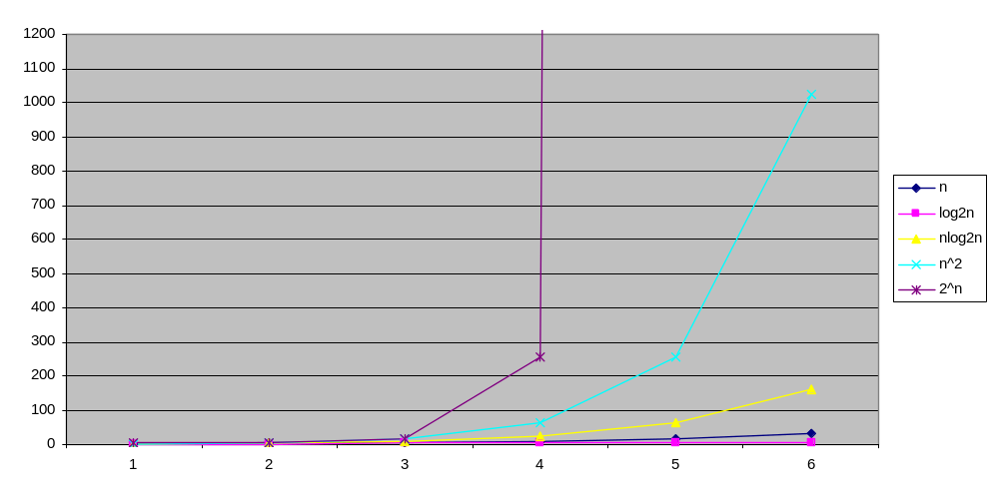
Common Growth Functions
(How f(n) grows as n grows)

Slide 7
List search
unsuccessful successful
Sequential search (n+1)/2 = O(n) n = O(n)
Binary search 2(n+1)log₂(n+1)-3 = O(log₂n) 2*log₂(n+1) = O(log₂n)
Lower bound of comparison based searches are O(log₂n). If we want to do better, then we must come up with an algorithm that does not do comparisons

