Slide 1
Introduction to Algorithms Sorting in Linear Time
CSE 680
Prof. Roger Crawfis

Slide 2
Comparison Sorting Review
Insertion sort:
Pro’s:
Easy to code
Fast on small inputs (less than ~50 elements)
Fast on nearly-sorted inputs
Con’s:
O(n²) worst case
O(n²) average case
O(n²) reverse-sorted case

Slide 3
Comparison Sorting Review
Merge sort:
Divide-and-conquer:
Split array in half
Recursively sort sub-arrays
Linear-time merge step
Pro’s:
O(n lg n) worst case - asymptotically optimal for comparison sorts
Con’s:
Doesn’t sort in place

Slide 4
Comparison Sorting Review
Heap sort:
Uses the very useful heap data structure
Complete binary tree
Heap property: parent key > children’s keys
Pro’s:
O(n lg n) worst case - asymptotically optimal for comparison sorts
Sorts in place
Con’s:
Fair amount of shuffling memory around

Slide 5
Comparison Sorting Review
Quick sort:
Divide-and-conquer:
Partition array into two sub-arrays, recursively sort
All of first sub-array < all of second sub-array
Pro’s:
O(n lg n) average case
Sorts in place
Fast in practice (why?)
Con’s:
O(n²) worst case
Naïve implementation: worst case on sorted input
Good partitioning makes this very unlikely.

Slide 6
Non-Comparison Based Sorting
Many times we have restrictions on our keys
Deck of cards: Ace->King and four suites
Social Security Numbers
Employee ID’s
We will examine three algorithms which under certain conditions can run in O(n) time.
Counting sort
Radix sort
Bucket sort

Slide 7
Counting Sort
Depends on assumption about the numbers being sorted
Assume numbers are in the range 1.. k
The algorithm:
Input: A[1..n], where A[j] ∈ {1, 2, 3, …, k}
Output: B[1..n], sorted (not sorted in place)
Also: Array C[1..k] for auxiliary storage

Slide 8
Counting Sort
1 CountingSort(A, B, k)
2 for i=1 to k
3 C[i]= 0;
4 for j=1 to n
5 C[A[j]] += 1;
6 for i=2 to k
7 C[i] = C[i] + C[i-1];
8 for j=n downto 1
9 B[C[A[j]]] = A[j];
10 C[A[j]] -= 1;
This is called a histogram.

Slide 9
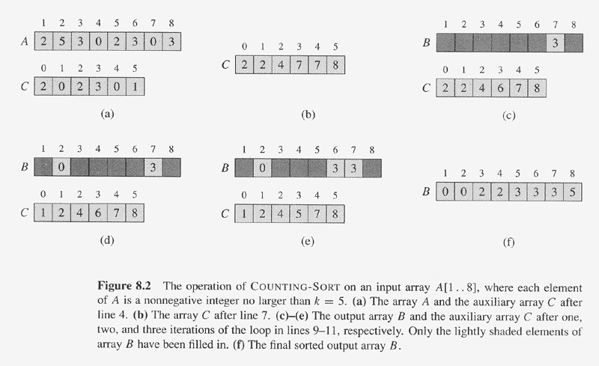
Counting Sort Example

Slide 10
Counting Sort
1 CountingSort(A, B, k)
2 for i=1 to k
3 C[i]= 0;
4 for j=1 to n
5 C[A[j]] += 1;
6 for i=2 to k
7 C[i] = C[i] + C[i-1];
8 for j=n downto 1
9 B[C[A[j]]] = A[j];
10 C[A[j]] -= 1;
Takes time O(k)
Takes time O(n)
What is the running time?

Slide 11
Counting Sort
Total time: O(n + k)
Works well if k = O(n) or k = O(1)
This sorting is stable.
A sorting algorithm is stable when numbers with the same values appear in the output array in the same order as they do in the input array.

Slide 12
Counting Sort
Why don’t we always use counting sort?
Depends on range k of elements.
Could we use counting sort to sort 32 bit integers? Why or why not?

Slide 13
Counting Sort Review
Assumption: input taken from small set of numbers of size k
Basic idea:
Count number of elements less than you for each element.
This gives the position of that number – similar to selection sort.
Pro’s:
Fast
Asymptotically fast - O(n+k)
Simple to code
Con’s:
Doesn’t sort in place.
Elements must be integers.
Requires O(n+k) extra storage.
countable

Slide 14
Radix Sort
How did IBM get rich originally?
Answer: punched card readers for census tabulation in early 1900’s.
In particular, a card sorter that could sort cards into different bins
Each column can be punched in 12 places
Decimal digits use 10 places
Problem: only one column can be sorted on at a time

Slide 15
Radix Sort
Intuitively, you might sort on the most significant digit, then the second msd, etc.
Problem: lots of intermediate piles of cards (read: scratch arrays) to keep track of
Key idea: sort the least significant digit first
RadixSort(A, d)
for i=1 to d
StableSort(A) on digit i

Slide 16
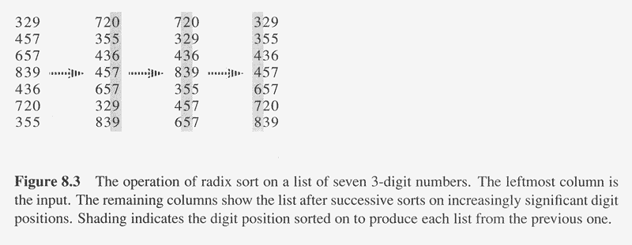
Radix Sort Example

Slide 17
Radix Sort Correctness
Sketch of an inductive proof of correctness (induction on the number of passes):
Assume lower-order digits {j: j<i }are sorted
Show that sorting next digit i leaves array correctly sorted
If two digits at position i are different, ordering numbers by that digit is correct (lower-order digits irrelevant)
If they are the same, numbers are already sorted on the lower-order digits. Since we use a stable sort, the numbers stay in the right order

Slide 18
Radix Sort
What sort is used to sort on digits?
Counting sort is obvious choice:
Sort n numbers on digits that range from 1..k
Time: O(n + k)
Each pass over n numbers with d digits takes time O(n+k), so total time O(dn+dk)
When d is constant and k=O(n), takes O(n) time

Slide 19
Radix Sort
Problem: sort 1 million 64-bit numbers
Treat as four-digit radix 2¹⁶ numbers
Can sort in just four passes with radix sort!
Performs well compared to typical O(n lg n) comparison sort
Approx lg(1,000,000) ≅ 20 comparisons per number being sorted

Slide 20
Radix Sort Review
Assumption: input has d digits ranging from 0 to k
Basic idea:
Sort elements by digit starting with least significant
Use a stable sort (like counting sort) for each stage
Pro’s:
Fast
Asymptotically fast (i.e., O(n) when d is constant and k=O(n))
Simple to code
A good choice
Con’s:
Doesn’t sort in place
Not a good choice for floating point numbers or arbitrary strings.

Slide 21
Bucket Sort
Assumption: input elements distributed uniformly over some known range, e.g., [0,1), so all elements in A are greater than or equal to 0 but less than 1 . (Appendix C.2 has definition of uniform distribution)
Bucket-Sort(A)
1. n = length[A]
2. for i = 1 to n
do insert A[i] into list B[floor of nA[i]]
4. for i = 0 to n-1
do sort list i with Insertion-Sort
6. Concatenate lists B[0], B[1],…,B[n-1]

Slide 22
Bucket Sort
Bucket-Sort(A, x, y)
1. divide interval [x, y) into n equal-sized subintervals (buckets)
2. distribute the n input keys into the buckets
3. sort the numbers in each bucket (e.g., with insertion sort)
4. scan the (sorted) buckets in order and produce output array
Running time of bucket sort: O(n) expected time
Step 1: O(1) for each interval = O(n) time total.
Step 2: O(n) time.
Step 3: The expected number of elements in each bucket is O(1)
(see book for formal argument, section 8.4), so total is O(n)
Step 4: O(n) time to scan the n buckets containing a total of n input
elements

Slide 23
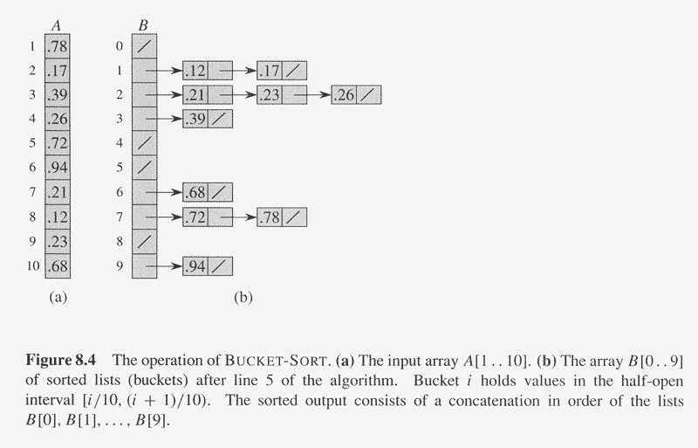
Bucket Sort Example

Slide 24
Bucket Sort Review
Assumption: input is uniformly distributed across a range
Basic idea:
Partition the range into a fixed number of buckets.
Toss each element into its appropriate bucket.
Sort each bucket.
Pro’s:
Fast
Asymptotically fast (i.e., O(n) when distribution is uniform)
Simple to code
Good for a rough sort.
Con’s:
Doesn’t sort in place

Slide 25
Summary of Linear Sorting
Non-Comparison Based Sorts
Running Time
worst-case average-case best-case in place
Counting Sort O(n + k) O(n + k) O(n + k) no
Radix Sort O(d(n + k')) O(d(n + k')) O(d(n + k')) no
Bucket Sort O(n) no
Counting sort assumes input elements are in range [0,1,2,..,k] and uses array indexing to count the number of occurrences of each value.
Radix sort assumes each integer consists of d digits, and each digit is in range [1,2,..,k'].
Bucket sort requires advance knowledge of input distribution (sorts n numbers uniformly distributed in range in O(n) time).

