Slide 1
The Insertion Sort
Mr. Dave Clausen
La Cañada High School

Slide 2
Insertion Sort Description
The insertion sort uses a vector's partial ordering. On the kth pass, the kth item should be inserted into its place among the first k items in the vector.
After the kth pass (k starting at 1), the first k items of the vector should be in sorted order.
This is like the way that people pick up playing cards and order them in their hands. When holding the first (k - 1) cards in order, a person will pick up the kth card and compare it with cards already held until its sorted spot is found.

Slide 3
Insertion Sort Algorithm
  For each k from 1 to n - 1 (k is the index of vector element to insert)
  Set item_to_insert to v[k]
  Set j to k - 1
  (j starts at k - 1 and is decremented until insertion position is found)
  While (insertion position not found) and (not beginning of vector)
  If item_to_insert < v[j]
  Move v[j] to index position j + 1
  Decrement j by 1
  Else
  The insertion position has been found
  item_to_insert should be positioned at index j + 1

Slide 4
C + + Code For Insertion Sort
  void Insertion_Sort(apvector<int> &v)
  {
  int item_to_insert, j; // On the kth pass, insert item k into its correct
  bool still_looking; // position among the first k entries in vector.
  for (int k = 1; k < v.length(); ++k)
  { // Walk backwards through list, looking for slot to insert v[k]
  item_to_insert = v[k];
  j = k - 1;
  still_looking = true;
  while ((j >= 0) && still_looking )
  if (item_to_insert < v[j])
  {
  v[j + 1] = v[j];
  --j;
  }
  else
  still_looking = false; // Upon leaving loop, j + 1 is the index
  v[j + 1] = item_to_insert; // where item_to_insert belongs
  }
}

Slide 5
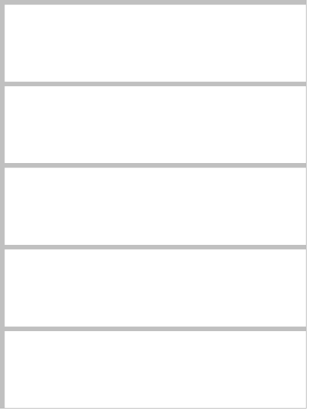
Insertion Sort Example
The Unsorted Vector:
For each pass, the index j begins at the (k - 1)st item and moves that item to position j + 1 until we find the insertion point for what was originally the kth item.
We start with k = 1
and set j = k-1 or 0 (zero)

Slide 6
The First Pass
K = 2
80
Insert 40,
compare & move
80
Insert 40
40
40
80
80
32
32
32
84
84
84
61
61
61
item_to_insert
40

Slide 7
The Second Pass
K = 3
40
40
Compare & move
40
Insert 32
32
80
Insert 32,
compare & move
80
40
40
32
80
80
80
84
84
84
84
61
61
61
61
item_to_insert
32

Slide 8
The Third Pass
K = 4
32
40
80
Insert 84?
compare & stop
84
61
item_to_insert
84

Slide 9
The Fourth Pass
K = 5
32
32
32
32
40
40
40
Compare
& stop
Insert 61
40
80
80
Compare & move
80
61
84
Insert 61,
compare & move
84
80
80
61
84
84
84
item_to_insert
61

Slide 10

What “Moving” Means
item_to_insert
40
Place the second element into the variable item_to_insert.

Slide 11
What “Moving” Means
item_to_insert
40
Replace the second element with the value of the first element.

Slide 12
What “Moving” Means
item_to_insert
40
Replace the first element (in this example) with the variable item_to_insert.

Slide 13
C + + Examples of
The Insertion Sort
On the Net:
http://compsci.exeter.edu/Winter99/CS320/Resources/sortDemo.html
http://www.aist.go.jp/ETL/~suzaki/AlgorithmAnimation/index.html

Slide 14
Big - O Notation
Big - O notation is used to describe the efficiency of a search or sort. The actual time necessary to complete the sort varies according to the speed of your system. Big - O notation is an approximate mathematical formula to determine how many operations are necessary to perform the search or sort. The Big - O notation for the Insertion Sort is O(n²), because it takes approximately n² passes to sort the “n” elements.

