Slide 1
Problem: Sorting
  arranging elements of set into order
Algorithm design technique:
  Divide and Conquer
Solution:
  Insertion Sort
  Quicksort
  Mergesort
  Heapsort
  Shellsort
  Radix Sorting
Optimality:
  Lower bounds for Sorting by
  Comparison of Keys

Slide 2
Application of Sorting
For searching on unsorted data by comparing keys, optimal solutions require θ(n) comparisons.
For searching on sorted data by comparing keys, optimal solutions require θ(log n) comparisons.
Sorting data for users
More…

Slide 3
Insertion Sort
Strategy:
  Insertion of an element in proper order:
  Begin with a sequence E of n elements in arbitrary order
  Initially assume the sorted segment contains first element
  Let x be the next element to be inserted in sorted segment, pull x “out of the way”, leaving a vacancy
  repeatedly compare x to the element just to the left of the vacancy, and as long as x is smaller, move that element into the vacancy,
  else put x in the vacancy,
  repeat the next element that has not yet examined.

Slide 4
Insertion Sort: Algorithm
Input
  E, an array of elements, and n >=0, the number of elements. The range of indexes is 0, …, n-1
Output
  E, with elements in nondecreasing order of their keys
void insertionSort(Element[] E, int n)
  int xindex;
  for (xindex = 1; xindex < n; xindex++)
    Element current = E[xindex];
    key x = current.key
    int xLoc = shiftVacRec(E, xindex, x);
    E[xLoc] = current;
  return;

Slide 5
Insertion Sort: Specification for subroutine
Specification
  int shiftVacRec(Element[] E, int vacant, Key x)
  Precondition
    Vacant is nonnegative
  Postconditions
    1. Elements in E at indexes less than xLoc are in their original positions and have keys less than or equal to x
    2. Elements in E at positions xLoc+1, …, vacant are greater than x and were shifted up by one position from their positions when shiftVacRec was invoked.

Slide 6
Insertion Sort: Algorithm shiftVacRec
int shiftVacRec(Element[] E, int vacant, Key x)
  int xLoc;
  if (vacant == 0)
    xLoc = vacant;
  else if (E[vacant-1].key <= x)
    xLoc = vacant;
  else
    E[vacant] = E[vacant-1];
    xLoc = shiftVacRec(E, vacant-1, x);
  return xLoc

Slide 7
Insertion Sort: Analysis
Worst-Case Complexity
  W(n) = ∑{i=1 to n-1}[i] = n(n-1)/2 ∈ θ(n²)
Average Behavior
  average number of comparisons in shiftVacRec
  1/(i+1) ∑{i=1 to j} (j) + i/(i+1) = i/2+1-1/(i+1)
  A(n) = ∑{i=1 to n-1} [1/2+1-1/(i+1)] ≈ (n^2)/4

Slide 8
Insertion Sort: Optimality
Theorem 4.1
  Any algorithm that sorts by comparison of keys and removes at most one inversion after each comparison must do at least n(n-1)/2 comparisons in the worst case and at least n(n-1)/4 comparisons on the average (for n elements)
Proof…
Insertion Sort is optimal for algorithms that works “locally” by interchanging only adjacent elements.
But, it is not the best sorting algorithm.

Slide 9
Algorithm Design Technique:
Divide and Conquer
  It is often easier to solve several small instances of a problem than one large one.
    divide the problem into smaller instances of the same problem
    solve (conquer) the smaller instances recursively
    combine the solutions to obtain the solution for original input
Solve(I)
  n = size(I)
  if (n <= smallsize)
    solution = directlySolve(I);
  else
    divide I into I1, …, Ik.
    for each i in {1, …, k}
      Si = solve(Ii);
    solution = combine(S1, …, Sk);
  return solution;

Slide 10
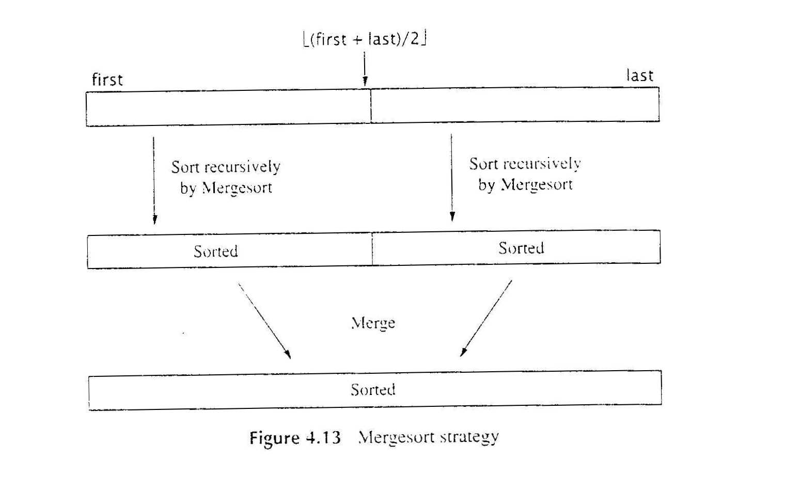
Using Divide and Conquer: Mergesort
Mergesort Strategy

Slide 11
Algorithm: Mergesort
  Input: Array E and indexs first, and Last, such that the elements E[i] are defined for first <= i <= last.
  Output: E[first], …, E[last] is sorted rearrangement of the same elements
void mergeSort(Element[] E, int first, int last)
  if (first < last)
    int mid = (first+last)/2;
    mergeSort(E, first, mid);
    mergeSort(E, mid+1, last);
    merge(E, first, mid, last);
  return;
W(n) = W(n/2)+W(n/2) + Wmerge(n) ∈ θ(n log n)
  Wmerge(n) = n-1
  W(1) = 0

Slide 12
Merging Sorted Sequences
Problem:
  Given two sequences A and B sorted in nondecreasing order, merge them to create one sorted sequence C
Strategy:
  determine the first item in C: It is the minimum between the first items of A and B. Suppose it is the first items of A. Then, rest of C consisting of merging rest of A with B.

Slide 13
Algorithm: Merge
Merge(A, B, C)
  if (A is empty)
    rest of C = rest of B
  else if (B is empty)
    rest of C = rest of A
  else if (first of A <= first of B)
    first of C = first of A
    merge (rest of A, B, rest of C)
  else
    first of C = first of B
    merge (A, rest of B, rest of C)
  return
W(n) = n – 1

Slide 14
Heap and Heapsort
A Heap data structure is a binary tree with special properties:
  Heap Structure
  Partial order tree property
Definition: Heap Structure
  A binary tree T is a heap structure if and only if it satisfies the following conditions: (h = height of the tree)
    1. T is complete at least through depth h-1
    2. All leaves are at depth h or h –1
    3. All paths to leaf of depth h are to the left of all parts to a leaf of depth h-1
  Such a tree is also called a left-complete binary tree.
Definition: Partial order tree property
  A tree T is a (maximizing) partial order tree if and only if the key at any node is greater than or equal to the keys at each of its children (if it has any)

Slide 15
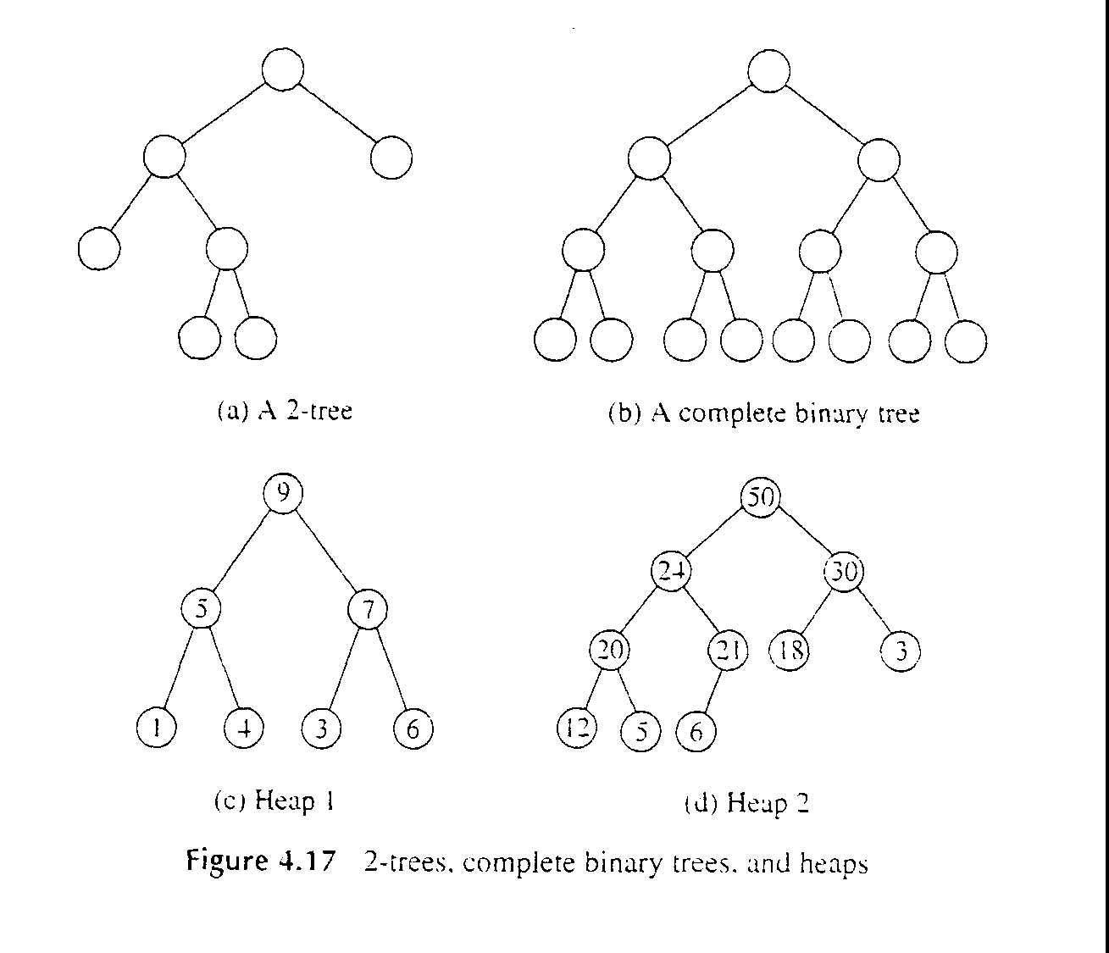
e.g. Heaps (or not)

Slide 16
Heapsort Strategy
If the elements to be sorted are arranged in a heap,
then we can build a sorted sequence in reverse order by repeatedly removing the element from the root,
rearranging the remaining elements to reestablish the partial order tree property, and so on.
How does it work?

Slide 17
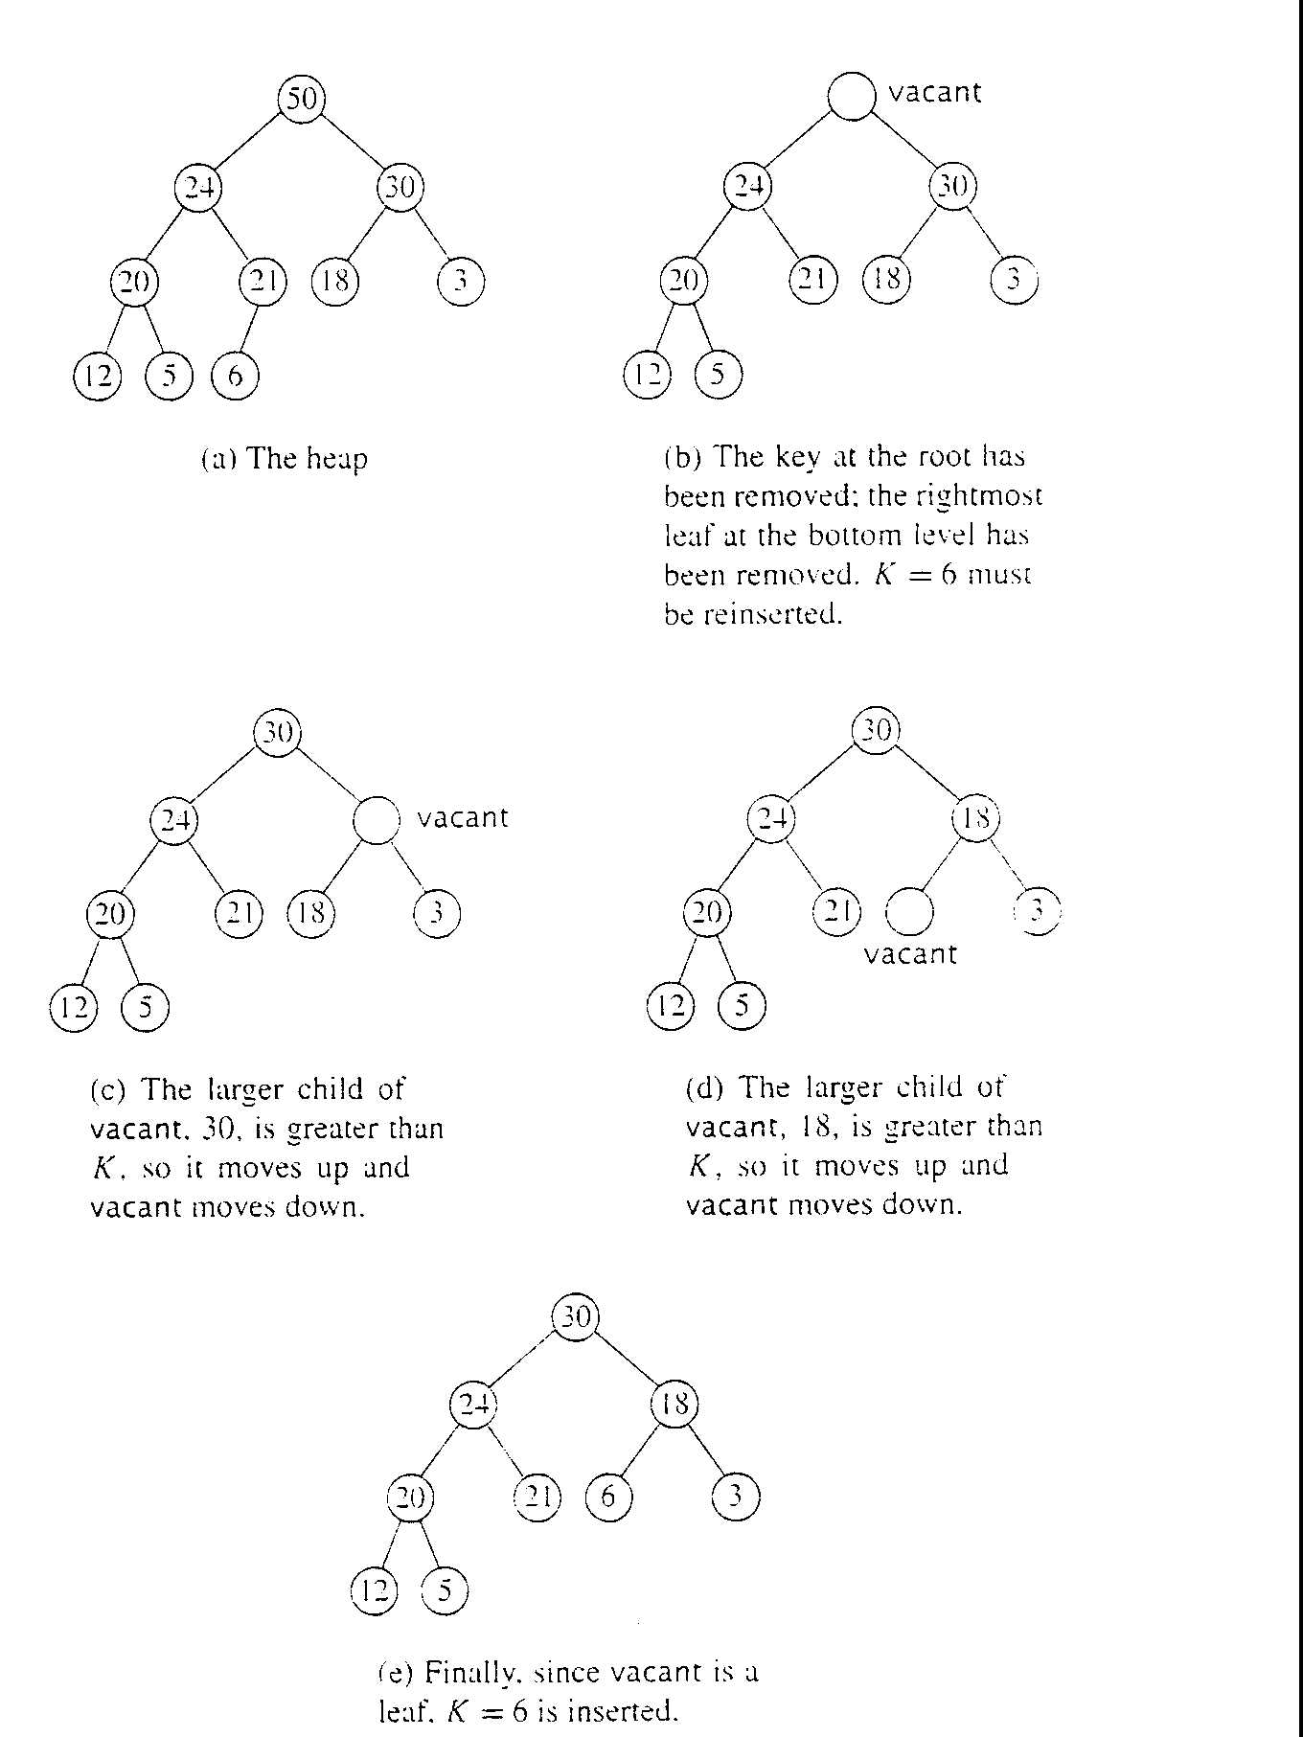
Heapsort in action

Slide 18
Heapsort Outlines
heapSort(E, n) // Outline
  construct H from E, the set of n elements to be sorted
  for (i = n; i >= 1; i--)
    curMax = getMax(H)
    deleteMax(H);
    E[i] = curMax;
deteleMax(H) // Outline
  copy the rightmost element of the lowest level of H into K
  delete the rightmost element on the lowest level of H
  fixHeap(H, K);

Slide 19
Fixheap Outline
fixHeap(H, K) // Outline
  if (H is a leaf)
    insert K in root(H);
  else
    set largerSubHeap to leftSubtree(H) or rightSubtree(H), whichever has larger key at is root. This involves one key comparison.
    if (K.key >= root(largerSubHeap.key)
      insert K in root(H);
    else
      insert root(largerSubHeap) in root(H);
      fixHeap(largerSubHeap, K);
  return;
FixHeap requires 2h comparisons of keys in the worst case on a heap with height h. W(n) ≈ 2 lg(n)

Slide 20
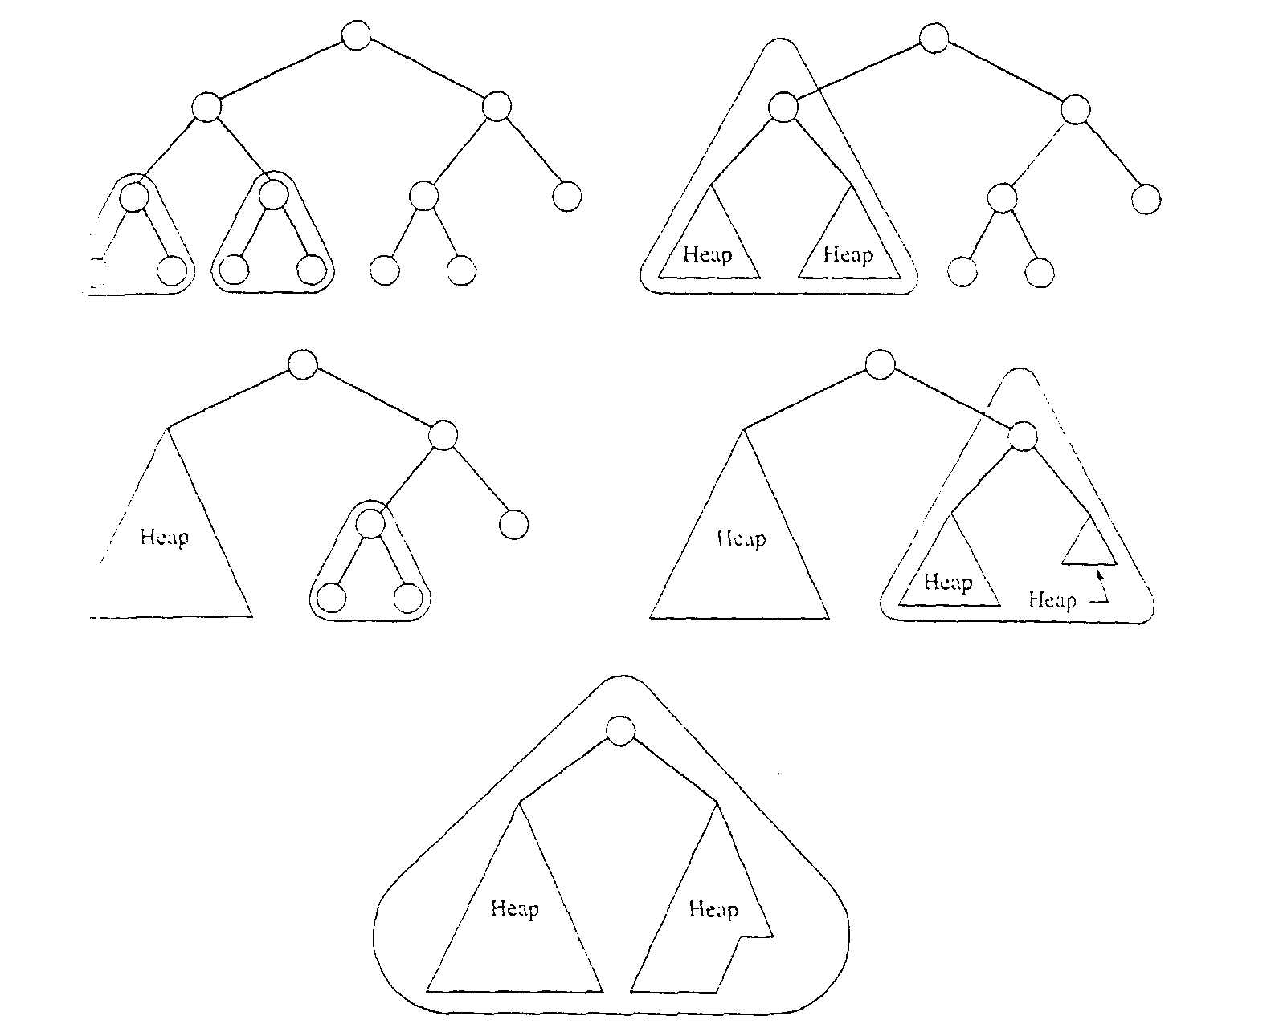
Heap construction Strategy
(divide and conquer)
base case is a tree consisting of one node

Slide 21
Construct Heap Outline
  Input: A heap structure H that does not necessarily have the partial order tree property
  Output: H with the same nodes rearranged to satisfy the partial order tree property
void constructHeap(H) // Outline
  if (H is not a leaf)
    constructHeap (left subtree of H);
    constructHeap (right subtree of H);
    Element K = root(H);
    fixHeap(H, K);
  return;
W(n) = W(n-r-1) + W(r) + 2 lg(n) for n > 1
W(n) ∈ θ(n); heap is constructed in linear time.

Slide 22
Heapsort Analysis
The number of comparisons done by fixHeap on heap with k nodes is at most 2 lg(k)
  so the total for all deletions is at most
  2 Σ [k=1 to n-1]( lg(k) ) ∈ θ(2n lg(n))
Theorem: The number of comparisons of keys done by Heapsort in the worst case is 2n lg(n) + O(n).
Heapsort does θ(n lg(n)) comparisons on average as well. (How do we know this?)

Slide 23
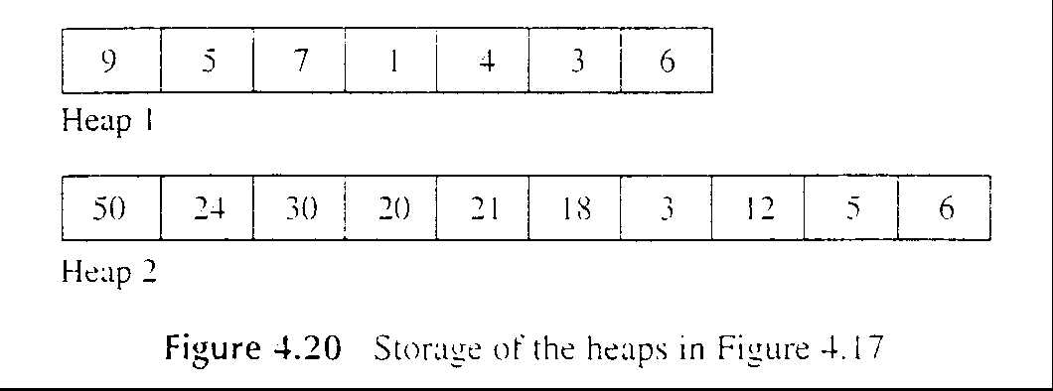
Implementation issue: storing a tree in an array
Array E with range from 1, …, n
Suppose the index i of a node is given, then
  left child has index 2i
  right child has index 2i + 1
  parent has index floor( i/2 )
e.g.

Slide 24
Accelerated Heapsort
Speed up Heapsort by about a factor of two.
Normal fixHeap costs 2h comparisons in the worst case. Can we do better?
…
The solution is a surprising application of divide and conquer!
  filter the vacant position halfway down the tree, h/2
  test whether K is bigger than the parent of vacant
  yes: bubble the vacant back up to where K should be
  no: repeat filter the vacant position another halfway down recursively!

Slide 25
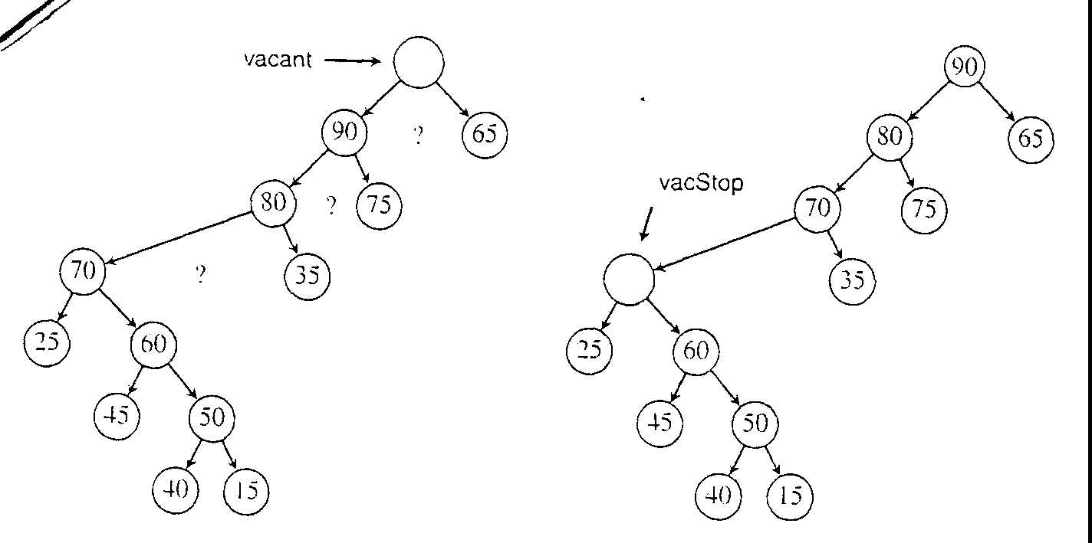
Accelerated Heapsort Strategy in Action
K = 55
nodes not
all shown

Slide 26
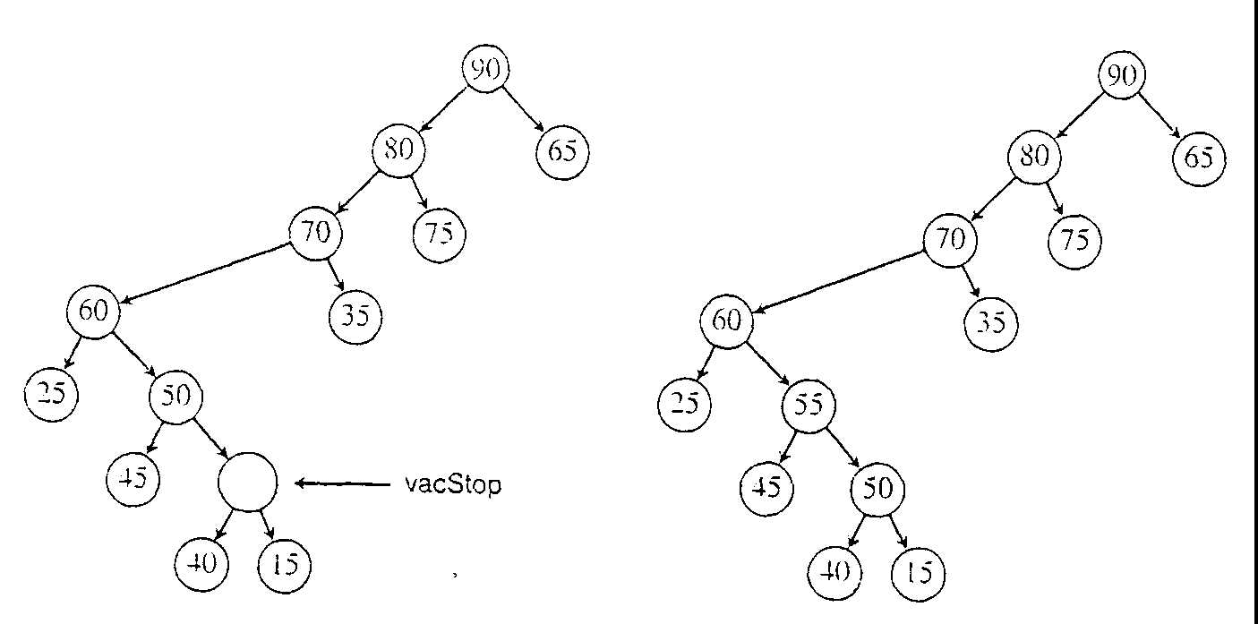
Action continues
K = 55

Slide 27
Accelerated Heapsort Algorithm
void fixHeapFast(Element[] E, int n, Element K, int vacant, int h)
  if (h <= 1)
    Process heap of height 0 or 1
  else
    int hStop = h/2
    int vacStop = promoste (E, hStop, vacant, h);
    // vacStop is new vacnt location, at height hStop
    int vacParent = vacStop / 2;
    if (E[vacParent].key <= K.key)
      E[vacStop] = E[vacParent];
      bubbleUpHeap (E, vacant, K, vacParent);
    else
      fixHeapFast (E, n, K, vacStop, hStop);

Slide 28
Algorithm: promote
int promote (Element[] E, int hStop, int vacant, int h)
  int vacStop;
  if (h <= hStop)
    vacStop = vacant;
  else if (E[2*vacant].key <= E[2*vacant+1].key)
    E[vacant] = E[2*vacant+1];
    vacStop = promote (E, hStop, 2*vacant+1, h-1)
  else
    E[vacant] = E[2*vacant];
    vacStop = promote (E, hStop, 2*vacant, h-1);
  return vacStop;

Slide 29
Algorithm: bubbleUpHeap
void bubbleUpHeap (Element[] E, int root, Element K, int vacant)
  if (vacant == root)
    E[vacant] = K;
  else
    int parent = vacant / 2;
    if (K.key <= E[parent].key)
      E[vacant] = K;
    else
      E[vacant] = E[parent];
      bubbleUpHeap (E, root, K, parent);

Slide 30
Analysis: fixHeapFast
Essentially, there is one comparison each time vacant changes a level due to the action of either bubbleUpHeap or Promote. The total is h.
Assume bubbleUpHeap is never call, so fixHeapFast reaches its base case. Then, it requires lg(h) checks along the way to see whether it needs to reverse direction.
Therefore, altogether fixHeapFast uses h+lg(h) comparisons in the worst case.

Slide 31
Accelerated Heapsort Analysis
The number of comparisons done by fixHeapFast on heap with k nodes is at most lg(k)
  so the total for all deletions is at most
  Σ [k=1 to n-1]( lg(k) ) ∈ θ(n lg(n))
Theorem: The number of comparisons of keys done by Accelerated Heapsort in the worst case is n lg(n) + O(n).

Slide 32
Comparison of Four Sorting Algorithms
Algorithm Worst case Average Space Usage
Insertion n^2/2 θ(n^2) in place
Quicksort n^2/2 θ(n log n) log n
Mergesort n lg n θ(n log n) n
Heapsort 2n lg n θ(n log n) in place
Ac.Heaps. n lg n θ(n log n) in place
Accelerated Heapsort currently is the method of choice.

Slide 33
Lower Bounds for
Sorting by Comparison of Keys
The Best possible!
  Lower Bound for Worst Case
  Lower Bound for Average Behavior
Use decision tree for analyzing the class of sorting algorithms (by comparison of keys)
  Assuming the keys in the array to be sorted are distinct.
  Each internal node associates with one comparison for keys x_{i} and x_{j}; labeled i :j
  Each leaf nodes associates with one permutation (total n! permutations for problem size n)
  The action of Sort on a particular input corresponds to following one path in its decision tree from the root to a leaf.

Slide 34
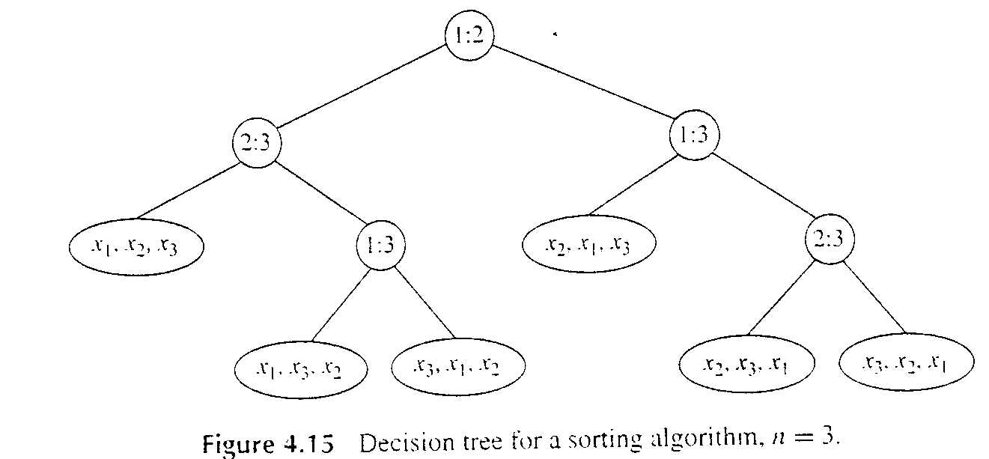
Decision tree for sorting algorithms
n = 3
<
>

Slide 35
Lower Bound for Worst Case
Lemma:
  Let L be the number of leaves in a binary tree and let h be its height.
  Then L <= 2^{h}, and h >= Ceiling[ lg L ]
  For a given n, L = n!, the decision tree for any algorithm that sorts by comparison of keys has height as least Ceiling [ lg n! ].
Theorem:
  Any algorithm to sort n items by comparisons of keys must do at least Ceiling [ lg n! ],
  or approximately Ceiling [ n lg n – 1.443 n ],
  key comparisons in the worst case.

Slide 36
Lower Bound for Average Behavior
Theorem:
  The average number of comparisons done by an algorithm to sort n items by comparison of keys is at least lg n!
  or approximately n lg n – 1.443 n
The only difference from the worst-case lower bound is that there is no rounding up to an integer
  the average needs not be an integer,
  but the worst case must be.

Slide 37
Improvement beyond lower bound?!
Know more → Do better
Up to now,
  only one assumption was make about the keys: They are elements of linearly ordered set.
  The basic operation of the algorithms is a comparison of two keys.
If we know more (or make more assumptions) about the keys,
  we can consider algorithms that perform other operations on them.
    // Recall algorithms for searching from unordered data vs.
    searching from ordered data

Slide 38
Using properties of the keys
  support the keys are names
  support the keys are all five-digit decimal integers
  support the keys are integer between 1 and m.
For sorting each of these examples, the keys are
  distributed into different piles as a result of examining individual letters or digits in a key or comparing keys to predetermined values
  sort each pile individually
  combine all sorted piles
Algorithms that sort by such methods are not in the class of algorithms previously considered because
  to use them we must know something about either the structure or the range of the keys.

Slide 39
Radix Sort
Strategy: It is startling that
  if the keys are distributed into piles (also called buckets) first according to their least significant digits (or bits, letters, or fields),
    and the piles are combined in order
    and the relative order of two keys placed in the same pile is not changed
  then the problem of sorting the piles has been completely eliminated!

Slide 40
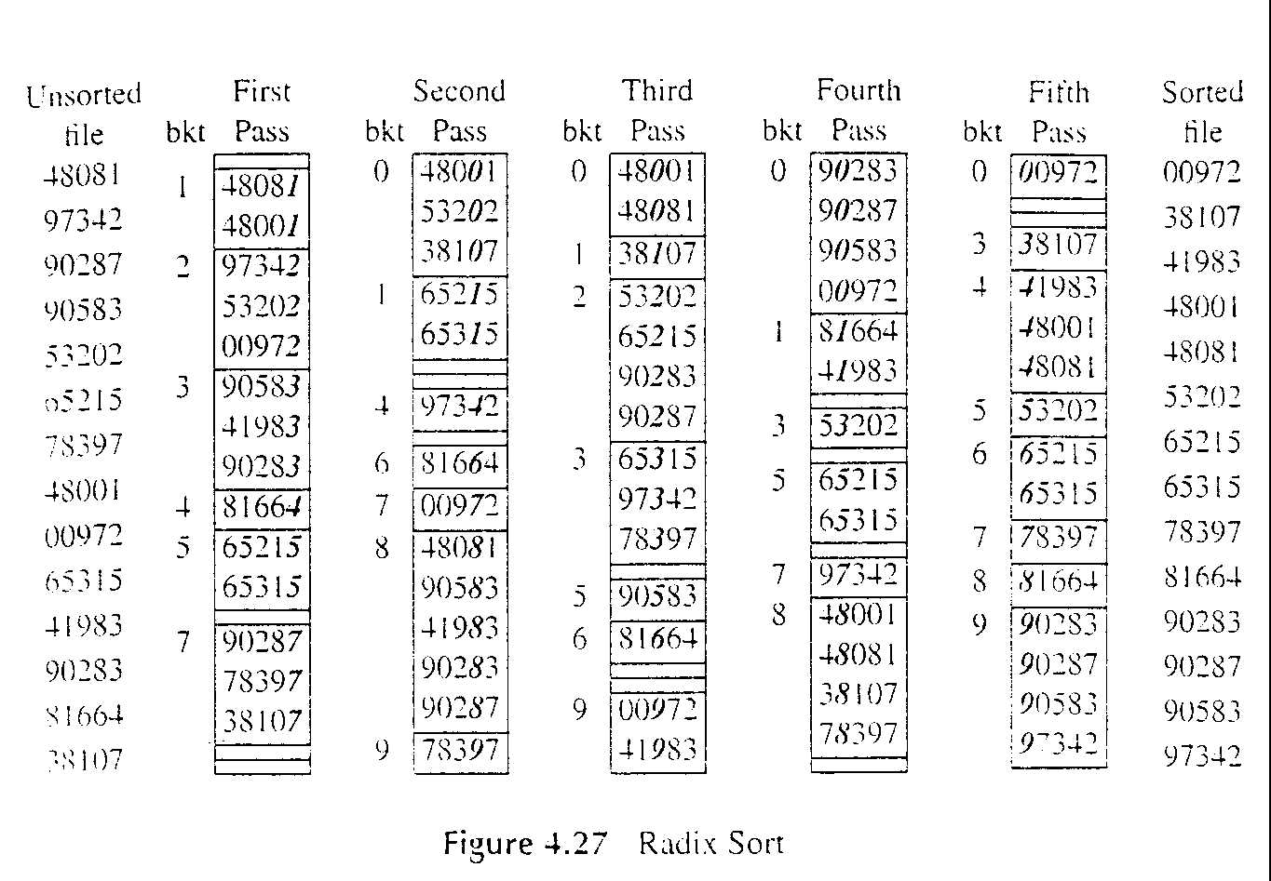
Radix Sort e.g
Start from least significant digit

Slide 41
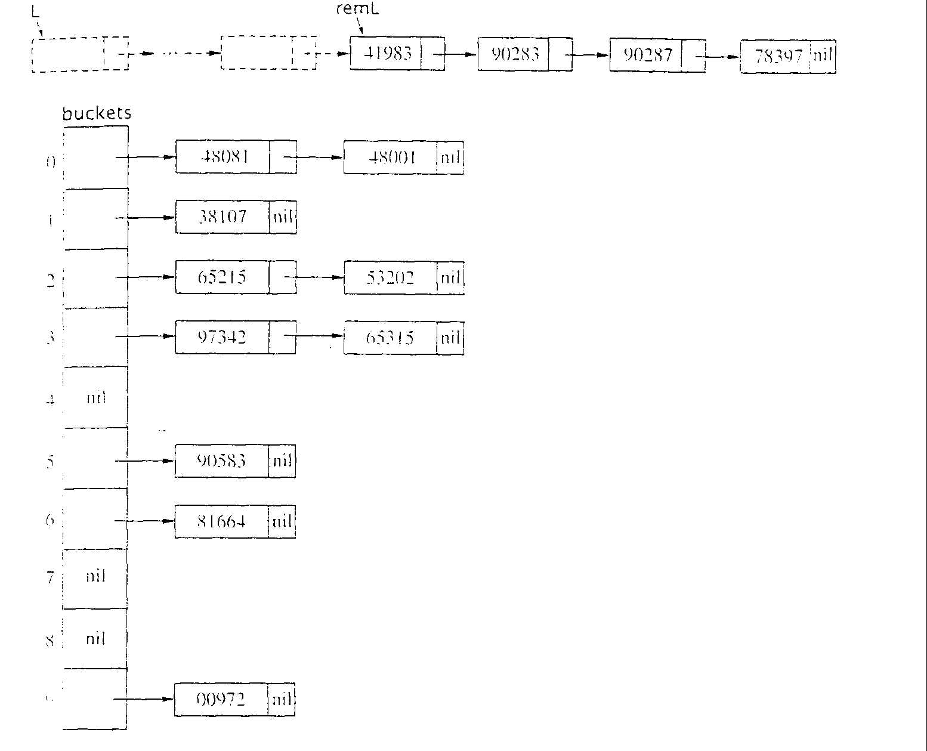
Radix Sort e.g. Data Structure, array of lists
>
radix = 10
numFields = 5
field = 4
field = 0

Slide 42
Radix Sort: Algorithm
List radixSort (List L, int radix, int numFields)
  List[] buckets = new List[radix];
  int field; // filed number within the key
  List newL;
  newL = L;
  For (filed = 0; field < numFields; field++)
    Initialize buckets array to empty lists.
    distribute (newL, buckets, radix, field);
    newL = combine (buckets, radix);
  return newL;

Slide 43
Radix Sort: distribute
void distribute (List L, List[] buckets, int radix, int field)
  //distribute keys into buckets
  List remL;
  remL = L;
  while (remL != nil)
    Element K = first (remL);
    int b = maskShift (field, radix, K.key);
      // maskShif(f, r, key) selects field f (counting from the right) of key,
      // based on radix r. the result, b, is the range 0 … radix –1,
      // and is the bucket number for K
    buckets[b] = cons(K, buckets[b]); // construct list
    remL = rest (remL);
  return

Slide 44
Radix Sort: Combine
List combine (List[] buckets, int radix)
  // Combine linked lists in all buckets into one list L
  int b; // bucket number
  List L, remBucket;
  L = nil;
  for (b = radix-1; b>=0; b--)
    remBucket = buckets[b];
    while (remBucket != nil)
      key K = first (remBucket);
      L = cons (K, L);
      remBucket = rest (remBucket);
  return L;

Slide 45
Radix Sort: Analysis
  distribute does θ(n) steps
  combine does θ(n) steps
if number of field is constant,
  then the total number of steps done by radix sort is linear in n.
radix sort use θ(n) extra space for link fields, provided the radix is bounded by n.

Slide 46
Exercise
Do it or loss it!

