Slide 1
Introduction to Algorithm design and analysis
Example: sorting problem.
Input: a sequence of n number <a₁, a₂, …,a_{n}>
Output: a permutation (reordering) <a₁', a₂', …,a_{n}'>
such that a₁'≤ a₂' ≤ … ≤ a_{n} '.
Different sorting algorithms:
Insertion sort and Mergesort.

Slide 2
Efficiency comparison of two algorithms
Suppose n=10⁶ numbers:
  Insertion sort: c₁n²
  Merge sort: c₂n (lg n)
  Best programmer (c₁=2), machine language, one billion/second computer A.
  Bad programmer (c₂=50), high-language, ten million/second computer B.
  2 (10⁶)² instructions/10⁹ instructions per second = 2000 seconds.
  50 (10⁶ lg 10⁶) instructions/10⁷ instructions per second ≈ 100 seconds.
  Thus, merge sort on B is 20 times faster than insertion sort on A!
  If sorting ten million numbers, 2.3 days VS. 20 minutes.
Conclusions:
  Algorithms for solving the same problem can differ dramatically in their efficiency.
  much more significant than the differences due to hardware and software.

Slide 3
Algorithm Design and Analysis
Design an algorithm
  Prove the algorithm is correct.
    Loop invariant.
    Recursive function.
    Formal (mathematical) proof.
Analyze the algorithm
  Time
    Worse case, best case, average case.
    For some algorithms, worst case occurs often, average case is often roughly as bad as the worst case. So generally, worse case running time.
  Space
Sequential and parallel algorithms
  Random-Access-Model (RAM)
  Parallel multi-processor access model: PRAM

Slide 4
Insertion Sort Algorithm (cont.)
INSERTION-SORT(A)
for j = 2 to length[A]
do key ← A[j]
//insert A[j] to sorted sequence A[1..j-1]
i ← j-1
while i >0 and A[i]>key
do A[i+1] ← A[i] //move A[i] one position right
i ← i-1
A[i+1] ← key

Slide 5
Correctness of Insertion Sort Algorithm
Loop invariant
  At the start of each iteration of the for loop, the subarray A[1..j-1] contains original A[1..j-1] but in sorted order.
Proof:
  Initialization : j=2, A[1..j-1]=A[1..1]=A[1], sorted.
  Maintenance: each iteration maintains loop invariant.
  Termination: j=n+1, so A[1..j-1]=A[1..n] in sorted order.

Slide 6
Analysis of Insertion Sort
INSERTION-SORT(A) cost times
for j = 2 to length[A] c₁ n
do key ← A[j] c₂ n-1
//insert A[j] to sorted sequence A[1..j-1] 0 n-1
i ← j-1 c₄ n-1
while i >0 and A[i]>key c₅ ∑_{j=2}^{n} t_{j}
do A[i+1] ← A[i] c₆ ∑_{j=2}^{n}(t_{j} –1)
i ← i-1 c₇ ∑_{j=2}^{n}(t_{j} –1)
A[i+1] ← key c₈ n –1
(t_{j} is the number of times the while loop test in line 5 is executed for that value of j)
The total time cost T(n) = sum of cost × times in each line
=c₁n + c₂(n-1) + c₄(n-1) + c₅∑_{j=2}^{n} t_{j}+ c₆∑_{j=2}^{n} (t_{j}-1)+ c₇∑_{j=2}^{n} (t_{j}-1)+ c₈(n-1)

Slide 7
Analysis of Insertion Sort (cont.)
Best case cost: already ordered numbers
  t_{j}=1, and line 6 and 7 will be executed 0 times
  T(n) = c₁n + c₂(n-1) + c₄(n-1) + c₅(n-1) + c₈(n-1)
  =(c₁ + c₂ + c₄ + c₅ + c₈)n – (c₂ + c₄ + c₅ + c₈) = cn + c‘
Worst case cost: reverse ordered numbers
  t_{j}=j,
  so ∑_{j=2}^{n} t_{j} = ∑_{j=2}^{n} j =n(n+1)/2-1, and ∑_{j=2}^{n}(t_{j} –1) = ∑_{j=2}^{n}(j –1) = n(n-1)/2, and
  T(n) = c₁n + c₂(n-1) + c₄(n-1) + c₅(n(n+1)/2 -1) + + c₆(n(n-1)/2 -1) + c₇(n(n-1)/2)+ c₈(n-1) =((c₅ + c₆ + c₇)/2)n₂ +(c₁ + c₂ + c₄ +c₅/2-c₆/2-c₇/2+c₈)n-(c₂ + c₄ + c₅ + c₈) =an²+bn+c
Average case cost: random numbers
  in average, t_{j} = j/2. T(n) will still be in the order of n², same as the worst case.

Slide 8
Merge Sort—divide-and-conquer
Divide: divide the n-element sequence into two subproblems of n/2 elements each.
Conquer: sort the two subsequences recursively using merge sort. If the length of a sequence is 1, do nothing since it is already in order.
Combine: merge the two sorted subsequences to produce the sorted answer.

Slide 9
Merge Sort –merge function
Merge is the key operation in merge sort.
Suppose the (sub)sequence(s) are stored in the array A. moreover, A[p..q] and A[q+1..r] are two sorted subsequences.
MERGE(A,p,q,r) will merge the two subsequences into sorted sequence A[p..r]
  MERGE(A,p,q,r) takes Θ(r-p+1).

Slide 10
MERGE-SORT(A,p,r)
if p < r
then q ← ⎣(p+r)/2⎦
MERGE-SORT(A,p,q)
MERGE-SORT(A,q+1,r)
MERGE(A,p,q,r)
Call to MERGE-SORT(A,1,n) (suppose n=length(A))

Slide 11
Analysis of Divide-and-Conquer
Described by recursive equation
Suppose T(n) is the running time on a problem of size n.
T(n) = Θ(1) if n≤n_{c}
aT(n/b)+D(n)+C(n) if n> n_{c}
Where a: number of subproblems
n/b: size of each subproblem
D(n): cost of divide operation
C(n): cost of combination operation

Slide 12
Analysis of MERGE-SORT
Divide: D(n) = Θ(1)
Conquer: a=2,b=2, so 2T(n/2)
Combine: C(n) = Θ(n)
T(n) = Θ(1) if n=1
2T(n/2)+ Θ(n) if n>1
T(n) = c if n=1
2T(n/2)+ cn if n>1

Slide 13
Compute T(n) by Recursive Tree
The recursive equation can be solved by recursive tree.
T(n) = 2T(n/2)+ cn, (See its Recursive Tree).
lg n+1 levels, cn at each level, thus
Total cost for merge sort is
  T(n) =cnlg n +cn = Θ(nlg n).
  Question: best, worst, average?
In contrast, insertion sort is
  T(n) = Θ(n²).

Slide 14
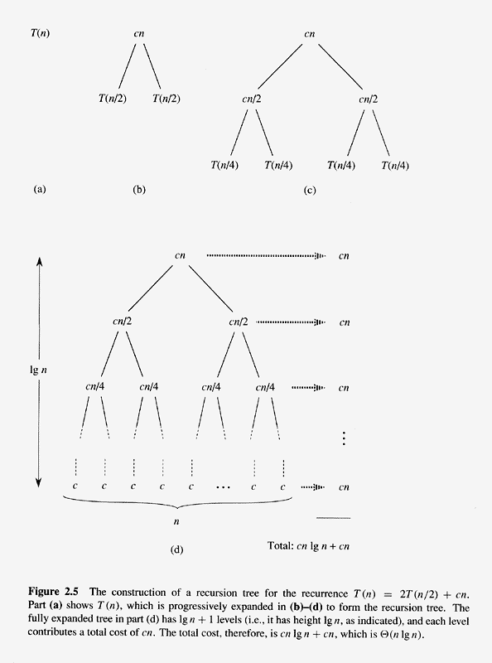
Recursion tree of T(n)=2T(n/2)+cn

Slide 15
Order of growth
Lower order item(s) are ignored, just keep the highest order item.
The constant coefficient(s) are ignored.
The rate of growth, or the order of growth, possesses the highest significance.
Use Θ(n²) to represent the worst case running time for insertion sort.
Typical order of growth: Θ(1), Θ(lg n), Θ(√n),Θ(n), Θ(nlg n), Θ(n²), Θ(n³), Θ(2^{n}), Θ(n!)
Asymptotic notations: Θ, O, Ω, o, ω.

Slide 16
There exist positive constants c
such that there is a positive constant n₀
such that …
There exist positive constants c₁ and c₂
such that there is a positive constant n₀
such that …
cg(n)
c₂g(n)
f(n)
f(n)
c₁g(n)
n
n
n₀
n₀
f(n) = Θ( g(n))
f(n) = O( g(n))
There exist positive constants c
such that there is a positive constant n₀
such that …
f(n)
cg(n)
n
n₀
f(n) = Ω( g(n))

Slide 17
Prove f(n)=an²+bn+c=Θ(n²)
a, b, c are constants and a>0.
Find c₁, and c₂ (and n₀) such that
  c₁n² ≤ f(n) ≤c₂n² for all n≥ n_{0.}
It turns out: c₁ =a/4, c₂ =7a/4 and
  n₀ = 2⋅max(|b|/a, sqrt(|c|/a))
Here we also can see that lower terms and constant coefficient can be ignored.
How about f(n)=an³+bn²+cn+d?

Slide 18
o-notation
For a given function g(n),
  o(g(n))={f(n): for any positive constant c,there exists a positive n₀ such that 0≤ f(n) ≤ cg(n) for all n≥ n₀}
  Write f(n) ∈ o( g(n)), or simply f(n) = o( g(n)).
2g(n)
g(n)
1/2g(n)
f(n)
n₀
n₀
n₀
n
f(n) = o( g(n))

Slide 19
Notes on o-notation
O-notation may or may not be asymptotically tight for upper bound.
  2n² = O(n²) is tight, but 2n = O(n²) is not tight.
o-notition is used to denote an upper bound that is not tight.
  2n = o(n²), but 2n² ≠ o(n²).
Difference: for some positive constant c in O-notation, but all positive constants c in o-notation.
In o-notation, f(n) becomes insignificant relative to g(n) as n approaches infinitely: i.e.,
  lim = 0.
f(n)
n→∝
g(n)

Slide 20
ω-notation
For a given function g(n),
  ω(g(n))={f(n): for any positive constant c, there exists a positive n₀ such that 0 ≤ cg(n) ≤ f(n) for all n≥ n₀}
  Write f(n) ∈ ω( g(n)), or simply f(n) = ω( g(n)).
ω-notation, similar to o-notation, denotes lower bound that is not asymptotically tight.
  n²/2 = ω(n), but n²/2 ≠ ω(n²)
f(n) = ω( g(n)) if and only if g(n)=o(f(n)).
lim = ∝
f(n)
n→∝
g(n)

Slide 21
Techniques for Algorithm Design and Analysis
Data structure: the way to store and organize data.
  Disjoint sets
  Balanced search trees (red-black tree, AVL tree, 2-3 tree).
Design techniques:
  divide-and-conquer, dynamic programming, prune-and-search, laze evaluation, linear programming, …
Analysis techniques:
  Analysis: recurrence, decision tree, adversary argument, amortized analysis,…

Slide 22
NP-complete problem
Hard problem:
  Most problems discussed are efficient (poly time)
  An interesting set of hard problems: NP-complete.
Why interesting:
  Not known whether efficient algorithms exist for them.
  If exist for one, then exist for all.
  A small change may cause big change.
Why important:
  Arise surprisingly often in real world.
  Not waste time on trying to find an efficient algorithm to get best solution, instead find approximate or near-optimal solution.
Example: traveling-salesman problem.

