Slide 1
Sorting in
Linear Time
Lower bound for comparison-based sorting
Counting sort
Radix sort
Bucket sort

Slide 2
Sorting So Far
Insertion sort:
  Easy to code
  Fast on small inputs (less than ~50 elements)
  Fast on nearly-sorted inputs
  O(n²) worst case
  O(n²) average (equally-likely inputs) case
  O(n²) reverse-sorted case

Slide 3
Sorting So Far
Merge sort:
  Divide-and-conquer:
    Split array in half
    Recursively sort subarrays
    Linear-time merge step
  O(n lg n) worst case
  Doesn’t sort in place

Slide 4
Sorting So Far
Heap sort:
  Uses the very useful heap data structure
    Complete binary tree
    Heap property: parent key > children’s keys
  O(n lg n) worst case
  Sorts in place
  Fair amount of shuffling memory around

Slide 5
Sorting So Far
Quick sort:
  Divide-and-conquer:
    Partition array into two subarrays, recursively sort
    All of first subarray < all of second subarray
    No merge step needed!
  O(n lg n) average case
  Fast in practice
  O(n²) worst case
    Naïve implementation: worst case on sorted input
    Address this with randomized quicksort

Slide 6
How Fast Can We Sort?
First, an observation: all of the sorting algorithms so far are comparison sorts
  The only operation used to gain ordering information about a sequence is the pairwise comparison of two elements
  Comparisons sorts must do at least n comparisons (why?)
  What do you think is the best comparison sort running time?

Slide 7
Decision Trees
Abstraction of any comparison sort.
Represents comparisons made by
  a specific sorting algorithm
  on inputs of a given size.
Abstracts away everything else: control and data movement.
  We’re counting only comparisons.
Each node is a pair of elements being compared
Each edge is the result of the comparison (< or >=)
Leaf nodes are the sorted array

Slide 8

Insertion Sort 4 Elements as a Decision Tree
Compare A[1] and A[2]

Slide 9
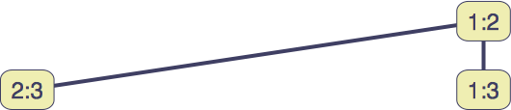
Insertion Sort 4 Elements as a Decision Tree
Compare A[1] and A[2]
<
>=
Compare A[2] and A[3]

Slide 10
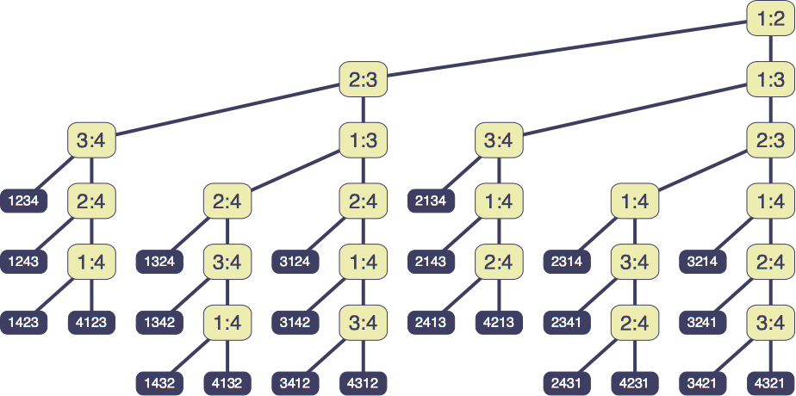
Insertion Sort 4 Elements as a Decision Tree
Compare A[1] and A[2]
Compare A[2] and A[3]

Slide 11
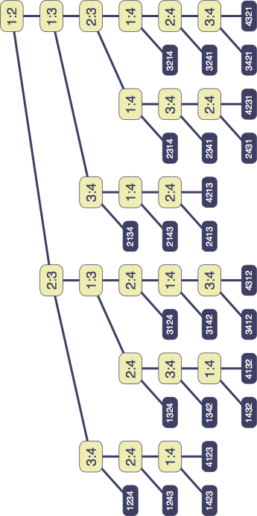
The Number of Leaves in a Decision Tree for Sorting
Lemma: A Decision Tree for Sorting must have at least n! leaves.

Slide 12
Lower Bound For
Comparison Sorting
Thm: Any decision tree that sorts n elements has
height Ω(n lg n)
  If we know this, then we know that comparison sorts are always Ω(n lg n)
Consider a decision tree on n elements
  We must have at least n! leaves
  The max # of leaves of a tree of height h is 2^{h}

Slide 13
Lower Bound For
Comparison Sorting
So we have…
n! ≤ 2^{h}
Taking logarithms:
lg (n!) ≤ h
Stirling’s approximation tells us:
Thus:

Slide 14
Lower Bound For
Comparison Sorting
So we have
Thus the minimum height of a decision tree is Ω(n lg n)

Slide 15
Lower Bound For
Comparison Sorts
Thus the time to comparison sort n elements is Ω(n lg n)
Corollary: Heapsort and Mergesort are asymptotically optimal comparison sorts
But the name of this lecture is “Sorting in linear time”!
  How can we do better than Ω(n lg n)?

Slide 16
Counting Sort – Sort small numbers
Why it’s not a comparison sort:
  Assumption: input - integers in the range 0..k
  No comparisons made!
Basic idea:
  determine for each input element x its rank: the number of elements less than x.
  once we know the rank r of x, we can place it in position r+1

Slide 17
Counting Sort
The Algorithm
Counting-Sort(A)
  Initialize two arrays B and C of size n and set all entries to 0
Count the number of occurrences of every A[i]
  for i = 1..n
  do C[A[i]] ← C[A[i]] + 1
Count the number of occurrences of elements <= A[i]
  for i = 2..n
  do C[i] ← C[i] + C[i – 1]
Move every element to its final position
  for i = n..1
  do B[C[A[i]] ← A[i]
  C[A[i]] ← C[A[i]] – 1

Slide 18
Counting Sort Example
1 2 3 4 5 6 7 8
A =
2
5
3
0
2
3
0
3
0 1 2 3 4 5
C =
2
0
2
3
0
1
0 1 2 3 4 5
C =
2
2
4
7
7
8
1 2 3 4 5 6 7 8
B =
3
0 1 2 3 4 5
7
C =
2
2
4
6
7
8

Slide 19
Counting Sort Example
1 2 3 4 5 6 7 8
A =
2
5
3
0
2
3
0
3
0 1 2 3 4 5
C =
2
2
4
6
7
8
1 2 3 4 5 6 7 8
B =
0
3
0 1 2 3 4 5
C =
2
1
2
4
6
7
8

Slide 20
Counting Sort Example
1 2 3 4 5 6 7 8
A =
2
5
3
0
2
3
0
3
0 1 2 3 4 5
C =
2
2
4
6
7
8
1 2 3 4 5 6 7 8
B =
0
3
3
0 1 2 3 4 5
C =
1
2
4
6
5
7
8

Slide 21
Counting Sort
1 CountingSort(A, B, k)
2 for i=1 to k
3 C[i]= 0;
4 for j=1 to n
5 C[A[j]] += 1;
6 for i=2 to k
7 C[i] = C[i] + C[i-1];
8 for j=n downto 1
9 B[C[A[j]]] = A[j];
10 C[A[j]] -= 1;
Takes time O(k)
Takes time O(n)
What will be the running time?

Slide 22
Counting Sort
Total time: O(n + k)
  Usually, k = O(n)
  Thus counting sort runs in O(n) time
But sorting is Ω(n lg n)!
  No contradiction--this is not a comparison sort (in fact, there are no comparisons at all!)
  Notice that this algorithm is stable
    If numbers have the same value, they keep their original order

Slide 23

Stable Sorting Algorithms
A sorting algorithms is stable if for any two indices i and j with i < j and a_{i} = a_{j}, element a_{i} precedes element a_{j} in the output sequence.
Input
2₁
7₁
4₁
4₂
2₂
5₁
2₃
6₁
Output
2₁
2₂
2₃
4₁
4₂
5₁
6₁
7₁
Observation: Counting Sort is stable.

Slide 24
Counting Sort
Linear Sort! Cool! Why don’t we always use counting sort?
Because it depends on range k of elements
Could we use counting sort to sort 32 bit integers? Why or why not?
Answer: no, k too large (2³² = 4,294,967,296)

Slide 25
Radix Sort
Why it’s not a comparison sort:
  Assumption: input has d digits each ranging from 0 to k
  Example: Sort a bunch of 4-digit numbers, where each digit is 0-9
Basic idea:
  Sort elements by digit starting with least significant
  Use a stable sort (like counting sort) for each stage

Slide 26
Radix Sort
The Algorithm
Radix Sort takes parameters: the array and the number of digits in each array element
Radix-Sort(A, d)
1 for i = 1..d
2 do sort the numbers in arrays A by their i-th digit from the right, using a stable sorting algorithm

Slide 27
Radix Sort Example
329
457
657
839
436
720
355
720
355
436
457
657
329
839
720
329
436
839
355
457
657
329
355
436
457
657
720
839

Slide 28
Radix Sort
Correctness and Running Time
What is the running time of radix sort?
  Each pass over the d digits takes time O(n+k), so total time O(dn+dk)
        When d is constant and k=O(n), takes O(n) time
Stable, Fast
Doesn’t sort in place (because counting sort is used)

Slide 29
Bucket Sort
Assumption: input - n real numbers from [0, 1)
Basic idea:
  Create n linked lists (buckets) to divide interval [0,1) into subintervals of size 1/n
  Add each input element to appropriate bucket and sort buckets with insertion sort
Uniform input distribution → O(1) bucket size
  Therefore the expected total time is O(n)

Slide 30
Bucket Sort
Bucket-Sort(A)
n ← length(A)
for i ← 0 to n
do insert A[i] into list B[floor(n*A[i])]
for i ← 0 to n –1
do Insertion-Sort(B[i])
Concatenate lists B[0], B[1], … B[n –1] in order
Distribute elements over buckets
Sort each bucket

Slide 31
Bucket Sort Example
.78
.17
.39
.26
.72
.94
.21
.12
.23
.68
0
.12
1
.12
.17
.17
2
.21
.23
.26
.21
3
.39
.23
4
.26
5
.39
6
.68
.68
7
.72
.78
.72
8
.78
9
.94
.94

Slide 32
Bucket Sort – Running Time
All lines except line 5 (Insertion-Sort) take O(n) in the worst case.
In the worst case, O(n) numbers will end up in the same bucket, so in the worst case, it will take O(n²) time.
Lemma: Given that the input sequence is drawn uniformly at random from [0,1), the expected size of a bucket is O(1).
So, in the average case, only a constant number of elements will fall in each bucket, so it will take O(n)
Use a different indexing scheme (hashing) to distribute the numbers uniformly.

Slide 33
Summary
Every comparison-based sorting algorithm has to take
Ω(n lg n) time.
Merge Sort, Heap Sort, and Quick Sort are comparison-based and take O(n lg n) time. Hence, they are optimal.
Other sorting algorithms can be faster by exploiting assumptions made about the input
Counting Sort and Radix Sort take linear time for integers in a bounded range.
Bucket Sort takes linear average-case time for uniformly distributed real numbers.

