Slide 1
MapReduce Algorithm Design
Adapted from Jimmy Lin’s slides

Slide 2
MapReduce: Recap
Programmers must specify:
  map (k, v) → <k’, v’>*
  reduce (k’, v’) → <k’, v’>*
  All values with the same key are reduced together
Optionally, also:
  partition (k’, number of partitions) → partition for k’
  Often a simple hash of the key, e.g., hash(k’) mod n
  Divides up key space for parallel reduce operations
  combine (k’, v’) → <k’, v’>*
  Mini-reducers that run in memory after the map phase
  Used as an optimization to reduce network traffic
The execution framework handles everything else…

Slide 3
“Everything Else”
The execution framework handles everything else…
  Scheduling: assigns workers to map and reduce tasks
  “Data distribution”: moves processes to data
  Synchronization: gathers, sorts, and shuffles intermediate data
  Errors and faults: detects worker failures and restarts
Limited control over data and execution flow
  All algorithms must expressed in m, r, c, p
You don’t know:
  Where mappers and reducers run
  When a mapper or reducer begins or finishes
  Which input a particular mapper is processing
  Which intermediate key a particular reducer is processing

Slide 4
k₁
v₁
k₂
v₂
k₃
v₃
k₄
v₄
k₅
v₅
k₆
v₆
map
map
map
map
a
1
b
2
c
3
c
6
a
5
c
2
b
7
c
8
combine
combine
combine
combine
a
1
b
2
c
9
a
5
c
2
b
7
c
8
partition
partition
partition
partition
Shuffle and Sort: aggregate values by keys
a
1
5
b
2
7
c
2
9
8
reduce
reduce
reduce
r₁
s₁
r₂
s₂
r₃
s₃

Slide 5
Tools for Synchronization
Cleverly-constructed data structures
  Bring partial results together
Sort order of intermediate keys
  Control order in which reducers process keys
Partitioner
  Control which reducer processes which keys
Preserving state in mappers and reducers
  Capture dependencies across multiple keys and values

Slide 6
Preserving State
Mapper object
Reducer object
one object per task
state
state
configure
API initialization hook
configure
map
one call per input
key-value pair
reduce
one call per
intermediate key
close
API cleanup hook
close

Slide 7
Scalable Hadoop Algorithms: Themes
Avoid object creation
  Inherently costly operation
  Garbage collection
Avoid buffering
  Limited heap size
  Works for small datasets, but won’t scale!

Slide 8
Importance of Local Aggregation
Ideal scaling characteristics:
  Twice the data, twice the running time
  Twice the resources, half the running time
Why can’t we achieve this?
  Synchronization requires communication
  Communication kills performance
Thus… avoid communication!
  Reduce intermediate data via local aggregation
  Combiners can help

Slide 9
Shuffle and Sort
Mapper
intermediate files
(on disk)
merged spills
(on disk)
Combiner
Reducer
circular buffer
(in memory)
Combiner
other reducers
spills (on disk)
other mappers

Slide 10
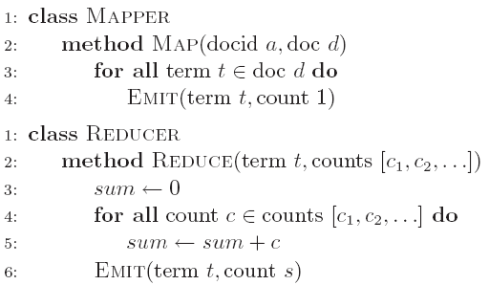
Word Count: Baseline
What’s the impact of combiners?

Slide 11
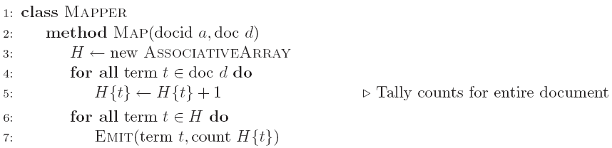
Word Count: Version 1
Are combiners still needed?

Slide 12
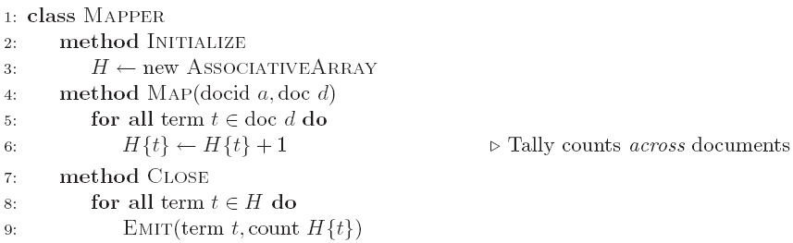
Word Count: Version 2
Key: preserve state across
input key-value pairs!
Are combiners still needed?

Slide 13
Design Pattern for Local Aggregation
“In-mapper combining”
  Fold the functionality of the combiner into the mapper by preserving state across multiple map calls
Advantages
  Speed
  Why is this faster than actual combiners?
Disadvantages
  Explicit memory management required
  Potential for order-dependent bugs

Slide 14
Combiner Design
Combiners and reducers share same method signature
  Sometimes, reducers can serve as combiners
  Often, not…
Remember: combiner are optional optimizations
  Should not affect algorithm correctness
  May be run 0, 1, or multiple times
Example: find average of all integers associated with the same key

Slide 15
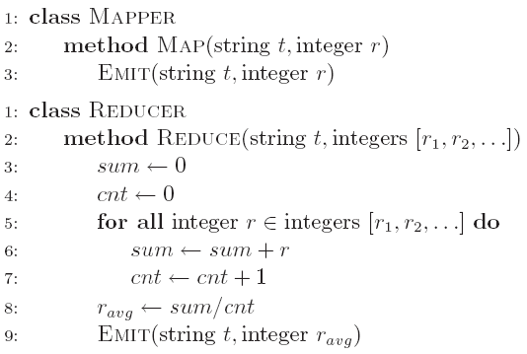
Computing the Mean: Version 1
Why can’t we use reducer as combiner?

Slide 16
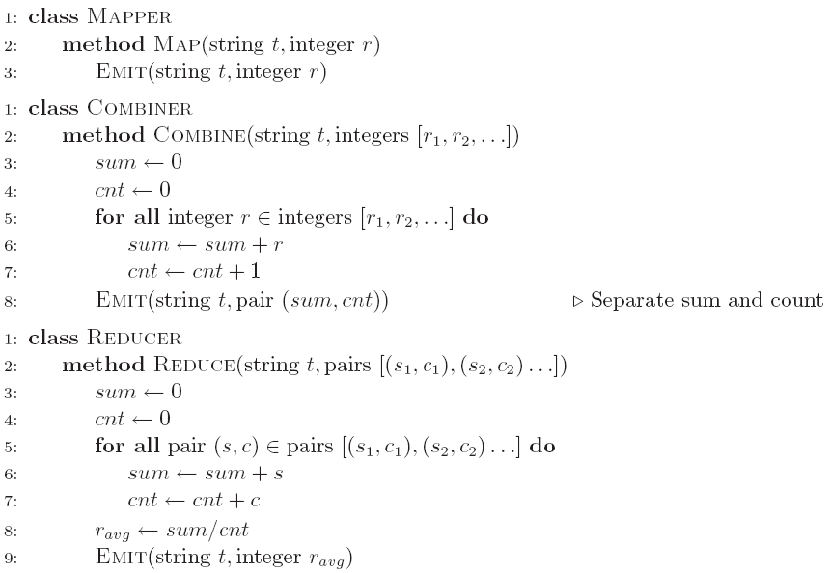
Computing the Mean: Version 2
Why doesn’t this work?

Slide 17
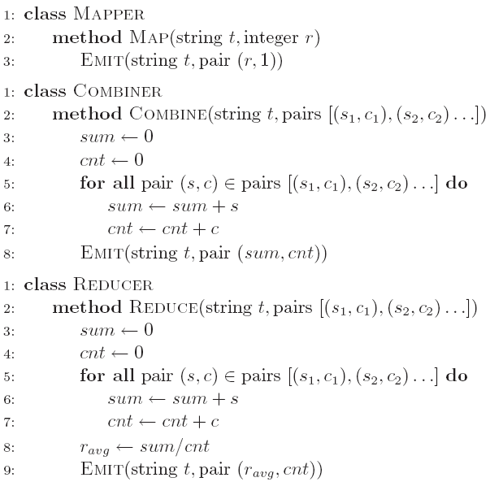
Computing the Mean: Version 3
Fixed?

Slide 18
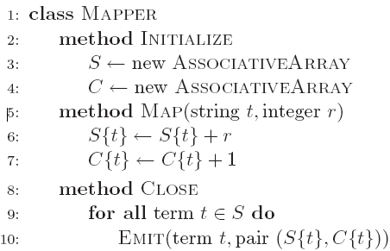
Computing the Mean: Version 4
Are combiners still needed?

Slide 19
Algorithm Design: Running Example
Term co-occurrence matrix for a text collection
  M = N x N matrix (N = vocabulary size)
  M_{ij}: number of times i and j co-occur in some context
  (for concreteness, let’s say context = sentence)
Why?
  Distributional profiles as a way of measuring semantic distance
  Semantic distance useful for many language processing tasks

Slide 20
MapReduce: Large Counting Problems
Term co-occurrence matrix for a text collection
= specific instance of a large counting problem
  A large event space (number of terms)
  A large number of observations (the collection itself)
  Goal: keep track of interesting statistics about the events
Basic approach
  Mappers generate partial counts
  Reducers aggregate partial counts
How do we aggregate partial counts efficiently?

Slide 21
First Try: “Pairs”
Each mapper takes a sentence:
  Generate all co-occurring term pairs
  For all pairs, emit (a, b) → count
Reducers sum up counts associated with these pairs
Use combiners!

Slide 22
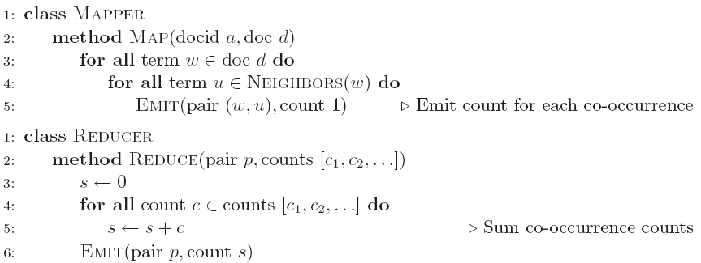
Pairs: Pseudo-Code

Slide 23
“Pairs” Analysis
Advantages
  Easy to implement, easy to understand
Disadvantages
  Lots of pairs to sort and shuffle around (upper bound?)
  Not many opportunities for combiners to work

Slide 24
Another Try: “Stripes”
Idea: group together pairs into an associative array
Each mapper takes a sentence:
  Generate all co-occurring term pairs
  For each term, emit a → { b: count_{b}, c: count_{c}, d: count_{d} … }
Reducers perform element-wise sum of associative arrays
(a, b) → 1
(a, c) → 2
(a, d) → 5
(a, e) → 3
(a, f) → 2
a → { b: 1, c: 2, d: 5, e: 3, f: 2 }
a → { b: 1, d: 5, e: 3 }
a → { b: 1, c: 2, d: 2, f: 2 }
a → { b: 2, c: 2, d: 7, e: 3, f: 2 }
+
Key: cleverly-constructed data structure
brings together partial results

Slide 25
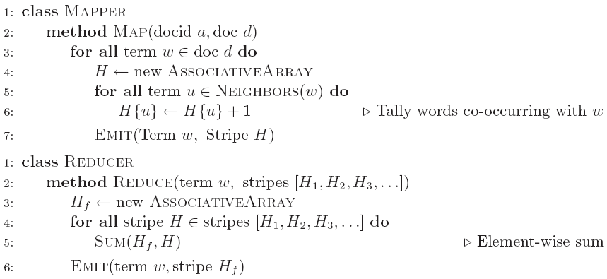
Stripes: Pseudo-Code

Slide 26
“Stripes” Analysis
Advantages
  Far less sorting and shuffling of key-value pairs
  Can make better use of combiners
Disadvantages
  More difficult to implement
  Underlying object more heavyweight
  Fundamental limitation in terms of size of event space

Slide 27
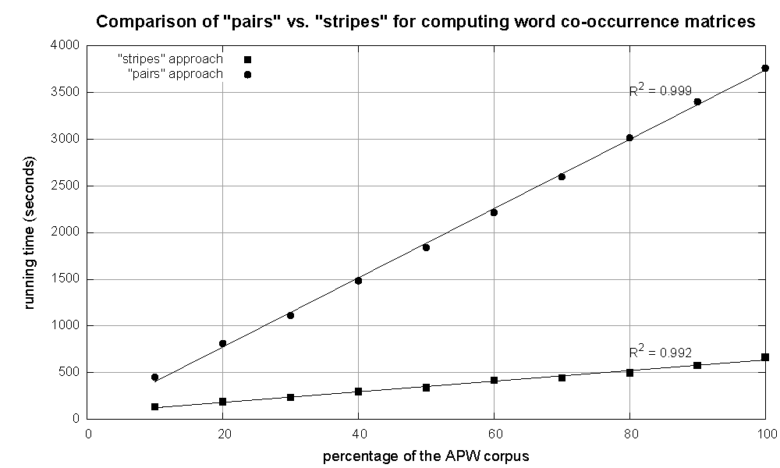
Cluster size: 38 cores
Data Source: Associated Press Worldstream (APW) of the English Gigaword Corpus (v3), which contains 2.27 million documents (1.8 GB compressed, 5.7 GB uncompressed)

Slide 28
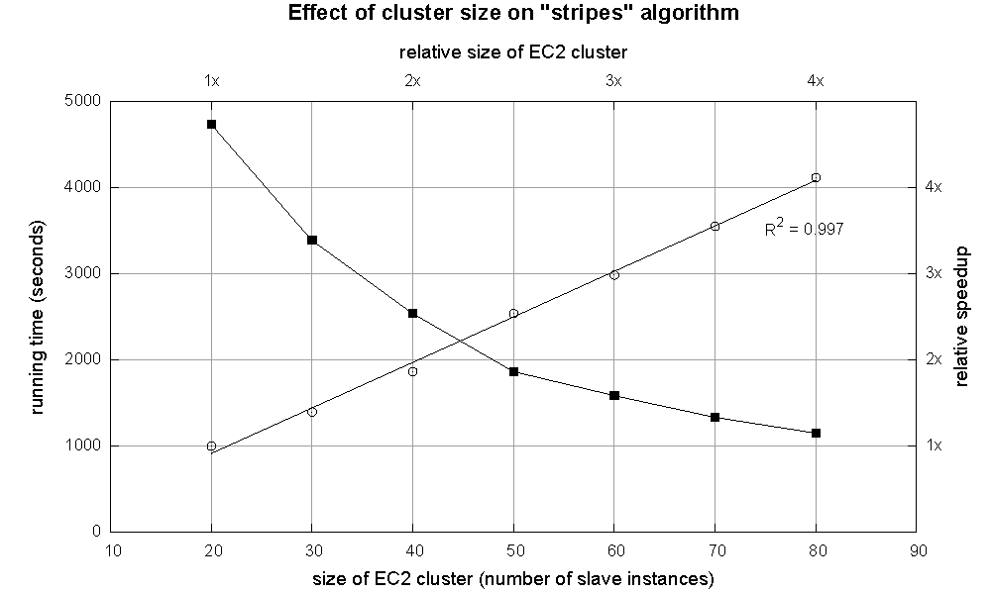

Slide 29
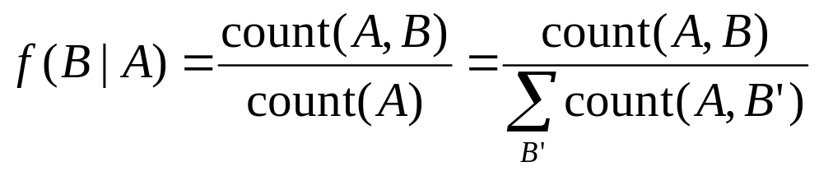
Relative Frequencies
How do we estimate relative frequencies from counts?
Why do we want to do this?
How do we do this with MapReduce?

Slide 30
f(B|A): “Stripes”
a → {b₁:3, b₂ :12, b₃ :7, b₄ :1, … }
Easy!
  One pass to compute (a, *)
  Another pass to directly compute f(B|A)

Slide 31
f(B|A): “Pairs”
For this to work:
  Must emit extra (a, *) for every b_{n} in mapper
  Must make sure all a’s get sent to same reducer (use partitioner)
  Must make sure (a, *) comes first (define sort order)
  Must hold state in reducer across different key-value pairs
(a, *) → 32
Reducer holds this value in memory
(a, b₁) → 3
(a, b₂) → 12
(a, b₃) → 7
(a, b₄) → 1
…
(a, b₁) → 3 / 32
(a, b₂) → 12 / 32
(a, b₃) → 7 / 32
(a, b₄) → 1 / 32
…

Slide 32
“Order Inversion”
Common design pattern
  Computing relative frequencies requires marginal counts
  But marginal cannot be computed until you see all counts
  Buffering is a bad idea!
  Trick: getting the marginal counts to arrive at the reducer before the joint counts
Optimizations
  Apply in-memory combining pattern to accumulate marginal counts
  Should we apply combiners?

Slide 33
Synchronization: Pairs vs. Stripes
Approach 1: turn synchronization into an ordering problem
  Sort keys into correct order of computation
  Partition key space so that each reducer gets the appropriate set of partial results
  Hold state in reducer across multiple key-value pairs to perform computation
  Illustrated by the “pairs” approach
Approach 2: construct data structures that bring partial results together
  Each reducer receives all the data it needs to complete the computation
  Illustrated by the “stripes” approach

Slide 34
Secondary Sorting
MapReduce sorts input to reducers by key
  Values may be arbitrarily ordered
What if want to sort value also?
  E.g., k → (v₁, r), (v₃, r), (v₄, r), (v₈, r)…

Slide 35
Secondary Sorting: Solutions
Solution 1:
  Buffer values in memory, then sort
  Why is this a bad idea?
Solution 2:
  “Value-to-key conversion” design pattern: form composite intermediate key, (k, v₁)
  Let execution framework do the sorting
  Preserve state across multiple key-value pairs to handle processing
  Anything else we need to do?

Slide 36
Recap: Tools for Synchronization
Cleverly-constructed data structures
  Bring data together
Sort order of intermediate keys
  Control order in which reducers process keys
Partitioner
  Control which reducer processes which keys
Preserving state in mappers and reducers
  Capture dependencies across multiple keys and values

Slide 37
Issues and Tradeoffs
Number of key-value pairs
  Object creation overhead
  Time for sorting and shuffling pairs across the network
Size of each key-value pair
  De/serialization overhead
Local aggregation
  Opportunities to perform local aggregation varies
  Combiners make a big difference
  Combiners vs. in-mapper combining
  RAM vs. disk vs. network

