Slide 1
CS240
Recursion & Sorting
addenda

Slide 2
A Bad Use of Recursion
Fibonacci numbers
1, 1, 2, 3, 5, 8, 13, 21, 34
f₁ = 1, f₂ = 1 … f_{n} = f_{n -2} + f_{n -1}
  A recursive function
  double Fib (unsigned n)
  { if (n <= 2) return 1;
  else
  return Fib (n – 1) + Fib (n – 2); }

Slide 3
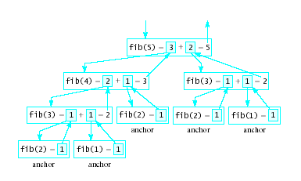
A Bad Use of Recursion
Why is this inefficient?
  Note the recursion tree

Slide 4
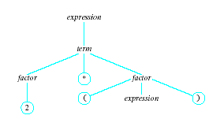
Recursion Example: Parsing
Parser generates a
parse tree using the
tokens according to
rules below:
An expression:
term + term | term – term | term
A term:
factor * factor | factor / factor | factor
A factor:
( expression ) | letter | digit
Note the indirect recursion

Slide 5
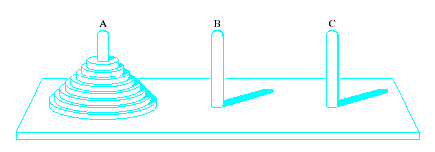
Recursion Example:
Towers of Hanoi
Recursive algorithm especially appropriate for solution by recursion
Task
  Move disks from left peg to right peg
  When disk moved, must be placed on a peg
  Only one disk (top disk on a peg) moved at a time
  Larger disk may never be placed on a smaller disk

Slide 6
Recursion Example:
Towers of Hanoi
Identify base case:
If there is one disk move from A to C
Inductive solution for n > 1 disks
  Move topmost n – 1 disks from A to B, using C for temporary storage
  Move final disk remaining on A to C
  Move the n – 1 disk from B to C using A for temporary storage
View code for solution, Fig 10.4

Slide 7
Algorithm Efficiency
How do we measure efficiency
  Space utilization – amount of memory required
  Time required to accomplish the task
Time efficiency depends on :
  size of input
  speed of machine
  quality of source code
  quality of compiler
These vary from one platform to another

Slide 8
Algorithm Efficiency
We can count the number of times instructions are executed
  This gives us a measure of efficiency of an algorithm
So we measure computing time as:
T(n) = computing time of an algorithm for input of size n
= number of times the instructions are executed

Slide 9
Example: Calculating the Mean
Task # times executed
Initialize the sum to 0 1
Initialize index i to 0 1
While i < n do following n+1
a) Add x[i] to sum n
b) Increment i by 1 n
Return mean = sum/n 1
Total 3n + 4

Slide 10
Sorting

Slide 11
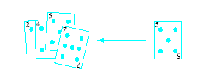
Categories of Sorting Algorithms
Insertion sort
  Repeatedly insert a new element into an already sorted list
  Note this works well with a linked list implementation

Slide 12


Categories of Sorting Algorithms
Exchange sort
  Systematically interchange pairs of elements which are out of order
  Bubble sort does this
Out of order, exchange
In order, do not exchange

Slide 13
Bubble Sort Algorithm
1. Initialize numCompares to n - 1
2. While numCompares != 0, do following
a. Set last = 1 // location of last element in a swap
b. For i = 1 to numPairs
if x_{i} > x_{i + 1}
Swap x_{i} and x_{i} ₊ ₁ and set last = i
c. Set numCompares = last – 1
End while

Slide 14
Algorithm for Linear Insertion Sort
For i = 2 to n do the following
set NextElement = x[i] and
x[0] = nextElement
set j = i
While nextElement < x[j – 1] do following
set x[j] equal to x[j – 1]
increment j by 1
End wile
set x[j] equal to nextElement
End for

Slide 15
Code for Insertion Sort
void insertion(int X[], int X_size)
{ int i, j, index;
for (i=1; i < X_size; i++)
{ index = X[ i ];
j = i;
while ((j > 0) && (X[ j-1] > index))
{ X[ j ] = X[ j-1];
j = j - 1;
}
X[j] = index;
}
}

Slide 16
Selection Sort
void selection (int X[ ], int X_size)
{ int i, j; int min, temp;
for (i = 0; i < X_size - 1; i++)
{ min = i;
for (j = i+1; j < X_size; j++)
{ if (X[ j ] < X[min])
min = j;
}
temp = X[ i ];
X[ i ] = X[min];
X[min] = temp;
}
}

Slide 17
Shellsort (D.L.Shell)
void shellsort (int[ ] a, int n)
{ int i, j, k, h, v; int [ ] cols = {1391376, 463792, 198768, 86961, 33936, 13776, 4592, 1968, 861, 336, 112, 48, 21, 7, 3, 1}
for (k=0; k<16; k++)
{ h=cols[k];
for (i=h; i<n; i++)
{ v=a[i];
j=i;
while (j>=h && a[j-h]>v)
{ a[j]=a[j-h];
j=j-h;
}
a[j]=v;
}
}
}

Slide 18
Bubble Sort
void bubble(int X[ ], int X_size)
{ int i, j, temp;
for (i = (X_size - 1); i >= 0; i--)
{ for ( j = 1; j <= i; j++)
{ if (X[j-1] > X[ j ])
{ temp = X[ j-1];
X[ j-1] = X[ j ];
X[ j ] = temp;
}
}
}
}

Slide 19
Stable sorts
If A & B have equal keys
And A precedes B in the original data
A will precede B in the sorted data
On next slide,
highlighted sorts are NOT stable

Slide 20
Comparisons of Sorts
Sorting a randomly generated list of 500 items
  Note: times based on 1970's hardware
Name | Type | Relative speed | O(n)
Quicksort | Exchange | 6 | n log₂n
Shellsort | Insertion | 11 | n log₂n² to n²
Heapsort | Selection | 18 | n log₂n
Binary Insertion | Insertion | 37 | n²
Linear Insertion | Insertion | 66 | n²
Simple Selection | selection | 69 | n²
2 Way Bubble Sort | Exchange | 141 | n²
Bubble Sort | Exchange | 165 | n²

Slide 21
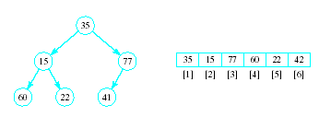
Implementing a Heap
Note the placement of the nodes in the array

Slide 22
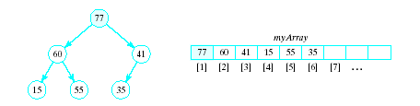
Implementing a Heap
In an array implementation children of i^{th} node are at myArray[2*i] and
myArray[2*i+1]
Parent of the i^{th} node is at myArray[i/2]

Slide 23
Percolate Down Algorithm
Initialize: c = 2 * r // r=root of subtree
While r <= n/2 do following
If c < n and myArray[c] < myArray[c + 1]
Increment c by 1
If myArray[r] < myArray[c]
Swap myArray[r] and myArray[c]
r = c
c = 2 * c
else
end
End while

Slide 24
Heapsort
Algorithm for converting a complete binary tree to a heap – called "heapify"
For r = n/2 down to 1:
Apply percolate_down to the subtree
in myArray[r] , … myArray[n]
End for
Puts largest element at root

Slide 25
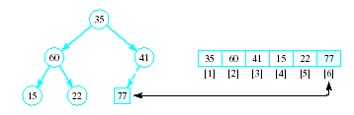
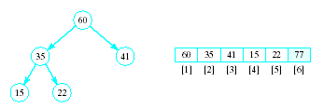
Heapsort
Now swap element 1 (root of tree) with last element
  This puts largest element in correct location
Use percolate down on remaining sublist
  Converts from semi-heap to heap

Slide 26
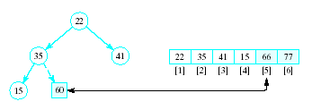
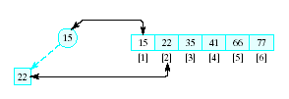
Heapsort
Again swap root with rightmost leaf
Continue this process with shrinking sublist

Slide 27
Heapsort Algorithm
1. Consider x as a complete binary tree, use heapify to convert this tree to a heap
2. for i = n down to 2:
a. Interchange x[1] and x[i]
(puts largest element at end)
b. Apply percolate_down to convert binary
tree corresponding to sublist in
x[1] .. x[i-1]

Slide 28
Priority Queue
Implementation possibilities
  As a list (array, vector, linked list)
  As an ordered list
  Best is to use a heap
  Basic operations have O(log₂n) time
STL priority queue adapter uses heap
  Note operations in table of Fig. 13.2 in text, page 766

Slide 29
Quicksort
Choose some element called a pivot
Perform a sequence of exchanges so that
  All elements that are less than this pivot are to its left and
  All elements that are greater than the pivot are to its right.
Divides the (sub)list into two smaller sub lists,
Each of which may then be sorted independently in the same way.

Slide 30
Quicksort
If the list has 0 or 1 elements,
return. // the list is sorted
Else do:
Pick an element in the list to use as the pivot.
Split the remaining elements into two disjoint groups:
  SmallerThanPivot = {all elements < pivot}
  LargerThanPivot = {all elements > pivot}
Return the list rearranged as:
Quicksort(SmallerThanPivot),
pivot,
Quicksort(LargerThanPivot).

Slide 31
Quicksort Example
Given to sort:
75, 70, 65, , 98, 78, 100, 93, 55, 61, 81,
Select, arbitrarily, the first element, 75, as pivot.
Search from right for elements <= 75, stop at first element <75
Search from left for elements > 75, stop at first element >=75
Swap these two elements, and then repeat this process
84
68

Slide 32
Quicksort Example
75, 70, 65, 68, 61, 55, 100, 93, 78, 98, 81, 84
When done, swap with pivot
This SPLIT operation placed pivot 75 so that all elements to the left were <= 75 and all elements to the right were >75.
  View code for split() template
75 is now placed appropriately
Need to sort sublists on either side of 75

Slide 33
Quicksort Example
Need to sort (independently):
55, 70, 65, 68, 61 and
100, 93, 78, 98, 81, 84
Let pivot be 55, look from each end for values larger/smaller than 55, swap
Same for 2nd list, pivot is 100
Sort the resulting sublists in the same manner until sublist is trivial (size 0 or 1)
View quicksort() recursive function

Slide 34
Quicksort Performance
O(log₂n) is the average case computing time
  If the pivot results in sublists of approximately the same size.
O(n²) worst-case
  List already ordered, elements in reverse
  When Split() repetitively results, for example, in one empty sublist

Slide 35
Improvements to Quicksort
Another improvement aimed at reducing the overhead of recursion is to use an iterative version of Quicksort()
To do so, use a stack to store the first and last positions of the sublists sorted "recursively".

Slide 36
Improvements to Quicksort
An arbitrary pivot gives a poor partition for nearly sorted lists (or lists in reverse)
Virtually all the elements go into either SmallerThanPivot or LargerThanPivot
  all through the recursive calls.
Quicksort takes quadratic time to do essentially nothing at all.

Slide 37
Improvements to Quicksort
Better method for selecting the pivot is the median-of-three rule,
  Select the median of the first, middle, and last elements in each sublist as the pivot.
Often the list to be sorted is already partially ordered
Median-of-three rule will select a pivot closer to the middle of the sublist than will the “first-element” rule.

Slide 38
Mergesort
Sorting schemes are either …
  internal -- designed for data items stored in main memory
  external -- designed for data items stored in secondary memory.
Previous sorting schemes were all internal sorting algorithms:
  required direct access to list elements
    not possible for sequential files
  made many passes through the list
    not practical for files

Slide 39
Mergesort
Mergesort can be used both as an internal and an external sort.
Basic operation in mergesort is merging,
  combining two lists that have previously been sorted
  resulting list is also sorted.

Slide 40
Merge Algorithm
1. Open File1 and File2 for input, File3 for output
2. Read first element x from File1 and
first element y from File2
3. While neither eof File1 or eof File2
If x < y then
a. Write x to File3
b. Read a new x value from File1
Otherwise
a. Write y to File3
b. Read a new y from File2
End while
4. If eof File1 encountered copy rest of of File2 into File3. If eof File2 encountered, copy rest of File1 into File3

Slide 41


Binary Merge Sort
Merge first one-element "subfile" of F1 with first one-element subfile of F2
  Gives a sorted two-element subfile of F
Continue with rest of one-element subfiles

Slide 42



Binary Merge Sort
Split again
Merge again as before
Each time, the size of the sorted subgroups doubles

Slide 43


Binary Merge Sort
Last splitting gives two files each in order
Last merging yields a single file, entirely in order
Note we always are limited to subfiles of some power of 2

Slide 44
Radix Sort
Based on examining digits in some base-b numeric representation of items (or keys)
Least significant digit radix sort
  Processes digits from right to left
  Used in early punched-card sorting machines
Create groupings of items with same value in specified digit
  Collect in order and create grouping with next significant digit

