Slide 1
SORTING
By Hu,Huan

Slide 2
Agenda
Basic terminologies in sorting
Explore the sorting algorithms
Explore the external sorting algorithms
Practical usage for sorting algorithms

Slide 3
Basic terminologies in sorting
Record, File, and Key:
We are given N items R1, R2, …, RN to be sorted; we shall
call them records, and the entire collection of N records will be called a file.
Each record Rj has a key, Kj, which governs the sorting process.
Additional data:
Additional data, besides the key, is usually also present; this extra “satellite information” has no effect on sorting except that it must be carried along as part of each record.

Slide 4
Basic terminologies in sorting
Stable:
Stable sorting algorithms maintain the relative order of records with equal keys (i.e. values). That is, a sorting algorithm is stable if whenever there are two records R and S with the same key and with R appearing before S in the original list, R will appear before S in the sorted list.
ex: The initial file is (4, 1) (3, 7) (3, 1) (5, 6)
After sorting:
(3, 7) (3, 1) (4, 1) (5, 6) (order maintained, stable)
(3, 1) (3, 7) (4, 1) (5, 6) (order changed)

Slide 5
Basic terminologies in sorting
Internal and external sorting:
  Internal sorting:
An internal sort is any data sorting process that takes place entirely within the main memory of a computer. This is possible whenever the data to be sorted is small enough to all be held in the main memory.
  External sorting:
External sorting is required when the data being sorted does not fit into the main memory of a computing device (usually RAM) and a slower kind of memory (usually a hard drive) needs to be used.

Slide 6
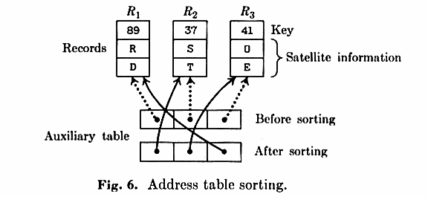
Basic terminologies in sorting
Address table sorting
Notes:
A In some cases we want to records to be physically rearranged in memory so that their keys are in order, B while in other cases it may be sufficient merely to have an auxiliary table of some sort that specifies the permutation. If the records and/ or the keys each take up quite a few words of computer memory, it is often better to make up a new table of link address that point to the records, and to manipulate these link address instead of moving the bulky records around. This method is called address table sorting(Figure 6 p75) If the key is short but the satellite information of the records is long, the key may be placed with the link addresses for greater speed; this is called keysorting.

Slide 7
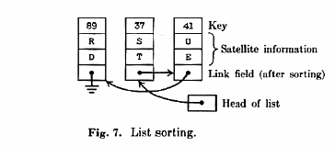
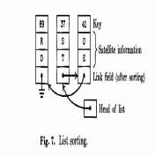
Basic terminologies in sorting
List sorting
Notes:
Other sorting schemes utilize an auxiliary line field that is included in each record; these links are manipulated in such a way that, in the final result, the records are linked together to form a straight linear list, with each link pointing to the following record. This is called list sorting(Figure 7 p75)

Slide 8
Basic terminologies in sorting
Problem conquer strategies
  Decrease-and-Conquer
  Divide-and-Conquer
  Transform-and-Conquer
N.B. Divide-and-Conquer and Transform-and-Conquer are
frequently used in the field of sorting. Most efficient
sorting algorithms are based on them.

Slide 9
Explore the sorting algorithms
Three major sorting algorithm category:
Insertion sort
Exchange sort
Selection sort
N.B. No matter how sophisticated the sorting algorithm is, it
must be related to one of the three major sorting
algorithm categories.

Slide 10
Explore the sorting algorithms
Since we had already known some of the algorithms in the
data structure such as bubble sort, insert sort, select sort,
and so on, in this class I will not repeat them again. And also
because some sorting algorithms are not so efficient in terms
of the big-O, such as cocktail sort, gnome sort, I will go over
them very briefly. By now, I will spend most of the time to
introduce six efficient sorting algorithms which are Shell
sort, Comb sort, Quick sort, Heap sort, Radix sort, and Merge
sort.

Slide 11
Explore the sorting algorithms
Some notations for introduce the major sorting algorithms:
The idea of the algorithm
The description of the algorithm
Examples (option)
Performance/advantage/disadvantage analysis

Slide 12
Shell sort
The idea:
Shell sort improves insertion sort by comparing elements separated by a gap of several positions. This lets an element take "bigger steps" toward its expected position. Multiple passes over the data are taken with smaller and smaller gap sizes. The last step of Shell sort is a plain insertion sort, but by then, the array of data is guaranteed to be almost sorted.
N.B. Shell sort is a sorting algorithm based on insertion sorting strategy.
Notes:
The Shell sort is named after its inventor, Donald Shell, who published it in 1959.

Slide 13
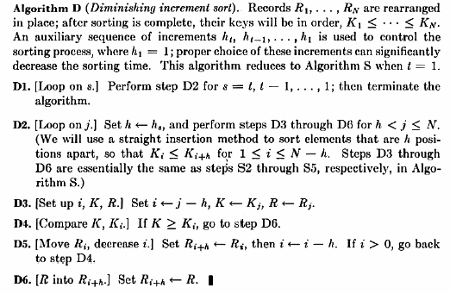
Shell sort
The description:

Slide 14
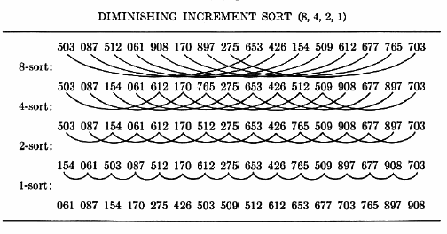
Shell sort
Examples:

Slide 15
Shell sort
The Analysis
In shell sort, the choice of the gap is very important, it will
highly effect the performance of the algorithm. Therefore,
there is a short discuss for this issue.(All the information
you can get from wiki as well)
Prior to that, let me introduce what is a gap sequence.

Slide 16
Shell sort
Gap sequence
The gap sequence is an integral part of the shellsort algorithm. Any increment sequence will work, so long as the last element is 1. The algorithm begins by performing a gap insertion sort, with the gap being the first number in the gap sequence. It continues to perform a gap insertion sort for each number in the sequence, until it finishes with a gap of 1. When the gap is 1, the gap insertion sort is simply an ordinary insertion sort, guaranteeing that the final list is sorted.

Slide 17
Shell sort
How to choose a better gap sequence?
The gap sequence that was originally suggested by Donald Shell was to begin with N / 2 and to halve the number until it reaches 1. While this sequence provides significant performance enhancements over the quadratic algorithms such as insertion sort, it can be changed slightly to further decrease the average and worst-case running times. Weiss' textbook demonstrates that this sequence allows a worst case O(n2) sort, if the data is initially in the array as (small_1, large_1, small_2, large_2, ...) - that is, the upper half of the numbers are placed, in sorted order, in the even index locations and the lower end of the numbers are placed similarly in the odd indexed locations.
The worst case running time of it is O(n^2)

Slide 18
Shell sort
The other better gap sequence selection
  Hibbard suggested a better sequence; 1, 3, 7,...2k - 1.
  The sequence 1, 4, 13, 40, 121, 364,1093, 3280, 9841 ... was recommended by Knuth in 1969. It is easy to compute (start with 1, generate the next increment by multiplying by 3 and adding 1) and leads to a relatively efficient sort, even for moderately large files.
  Robert Sedgewick proposed sequence 1, 8, 23, 77, 281, 1073, 4193, 16577..., ( 4i+1 + 3·2i + 1 ) for i > 0 that he claims is faster then Knuth's 20-30%
  Some subsets of Fibonacci numbers and prime numbers might be good candidates too.
Notes:
For some unexplained reason, when the increment is divided by 2.2 as opposed to being continuously halved, this algorithm works about 25 to 30 percent faster on large inputs.
O(n^{3 / 2}) (using Hibbard's increments of 2^{k} − 1)
O(n^{4 / 3}) (using Sedgewick's increments of 9(4^{i}) − 9(2^{i}) + 1, or 4^{i + 1} + 3(2^{i}) + 1)
O(nlog²n)
possibly unproven better running times.
The existence of an O(nlogn) worst-case implementation of Shellsort remains an open research question

Slide 19
Shell sort
Advantage and Disadvantage:
  Advantage:
  Shell sort is a huge progress to the elementary sorting algorithms such as bubble sort, insert sort, which have a O(n^2) running time. Shell is proved to be very efficient for medium size lists.
  Disadvantage:
  Although shell sort is efficient, it is still slower than heap sort, quick sort, merge sort, and comb sort, which have a better big-O with O(nlogn), in the long run.
  It is hard to find the average case performance for the shell sort
Notes:
Shell sort has been proven faster than heap sort with a considerable list size.

Slide 20
Comb sort
The idea
In bubble sort, when any two elements are compared, they always have a gap (distance from each other) of 1. The basic idea of comb sort is that the gap can be much more than one. (Shell sort is also based on this idea, but it is a modification of insertion sort rather than bubble sort.)
N.B. Comb sort is based on the exchange sorting strategy
Notes:
Comb sort is designed by Stephen Lacey and Richard Box, who described it in Byte Magazine in April 1991.

Slide 21
Comb sort
The descriptions
The gap starts out as the length of the list being sorted divided by the shrink factor and the list is sorted with that value (rounded down to an integer if needed) for the gap. Then the gap is divided by the shrink factor again, the list is sorted with this new gap, and the process repeats until the gap is 1. At this point, comb sort continues using a gap of 1 until the list is fully sorted. The final stage of the sort is thus equivalent to a bubble sort, but by this time most turtles have been dealt with, so a bubble sort will be efficient.

Slide 22
Comb sort
Algorithm C (comb sort)
S1 Set gap=input.size, swap=1, shrink= 1.3
S2 If gap==1 and swap==0, then terminate
S3 If gap>1, set gap = floor(gap/shrink)
S4 Set j=0, swap=0
S5 If j+gap>=input.size go to S2
S6 If input[j]>input[j+gap], Set temp=input[j], input[j]=input[j+gap], input[j+gap]=input[j], swap=swap+1
S7 j=j+1, go to S5
Notes:
The initial value of swap can be any positive integer.
The initial value of shrink can be any positive real number.

Slide 23
Comb sort
Analysis:
Shrink Factor:
The shrink factor has a great effect on the efficiency of comb sort. In the original article, the authors suggested 1.3 after trying some random lists and finding it to be generally the most effective. A value too small slows the algorithm down because more comparisons must be made, whereas a value too large may not kill enough turtles to be practical.
Text describes an improvement to comb sort using the base value 1/(1-1/e^ϕ )=1.247330950103979 as the shrink factor. So normally, people will select 1.3 as the shrink factor

Slide 24
Comb sort
The magic 11:
With a shrink factor around 1.3, there are only three possible ways for the list of gaps to end: (9, 6, 4, 3, 2, 1), (10, 7, 5, 3, 2, 1), or (11, 8, 6, 4, 3, 2, 1). Only the last of those endings kills all turtles before the gap becomes 1.Therefore, significant speed improvements can be made if the gap is set to 11 whenever it would otherwise become 9 or 10. This variation is called Combsort11.
If either of the sequences beginning with 9 or 10 were used, the final pass with a gap of 1 is less likely to completely sort the data, necessitating another pass with a gap of 1. The data is sorted when no swaps were done during a pass with gap = 1.

Slide 25
Comb sort
The advantage and disadvantage:
The advantage:
Comb sort is a pretty advanced sorting algorithm with average and worst case both under O(nlogn), it is reliable, and unlike other high level sorting algorithm, it is relatively simplistic.
The advantage:
Although comb sort is under O(nlogn), its performance is not as good as expected. It is even slower than its brother, shell sort, which with the O(n^3/2) in the most case.

Slide 26
Quick sort
The idea:
Quicksort sorts by employing a divide and conquer strategy to divide a list into two sub-lists.
The steps are:
1. Pick an element, called a pivot, from the list.
2. Reorder the list so that all elements which are less than the pivot come before the pivot and so that all elements greater than the pivot come after it (equal values can go either way). After this partitioning, the pivot is in its final position. This is called the partition operation.
3. Recursively sort the sub-list of lesser elements and the sub-list of greater elements.
N.B. Quick sort is based on the exchange sort strategy.
Notes:
Quicksort is a well-known sorting algorithm developed by C. A. R. Hoare

Slide 27
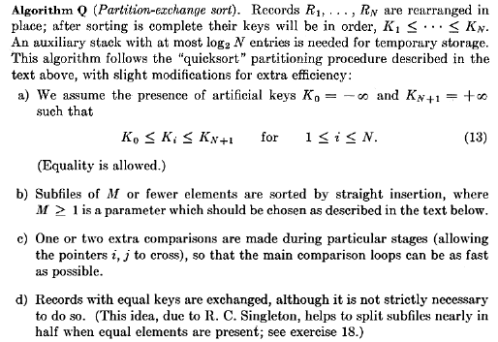
Quick sort
The description:

Slide 28
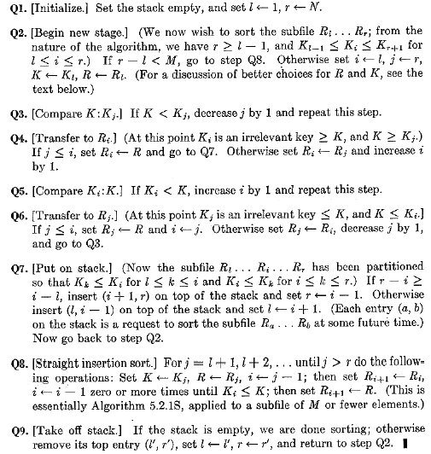
Quick sort

Slide 29
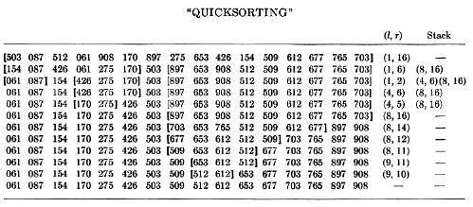
Quick sort
Example:

Slide 30
Quick sort
Analysis:
How to find a good pivot point?
The pivot point is a key to any quick sort. A bad pivot selection could let the algorithm with complexity O(n^2), whereas the average complexity of a quick sort is O(nlogn).
To find a good pivot, we begin by dividing the list into groups of five elements. Any left over are ignored for now. Then, for each of these, we find the median of the group of five, an operation that can be made very fast by loading all five values into the register set and comparing them (provided the values are of simple types). We move all these medians into one contiguous block in the list, and proceed to invoke select recursively on this sublist of n/5 elements to find its median value. Then, we use this "median of medians" for our pivot.

Slide 31
Quick sort
Advantage/disadvantage analysis:
  Advantage:
Typically, quick sort is significantly faster in practice than other Θ(n log n) algorithms, because its inner loop can be efficiently implemented on most architectures, and in most real-world data it is possible to make design choices which minimize the possibility of requiring quadratic time.
  Disadvantage:
In the worst case, it makes O(n^2) comparisons, whereas heap sort and merge sort are O(nlogn)
The quicksort algorithm also requires Ω(log n) extra storage space.

Slide 32
Heap sort
The idea:
The idea is simple: Employ the transform and conquer strategy, change the linear data structure to another form called heap and then overcome the problem.
N.B. Heap sort is a selection sort.
Notes:
Heap: a heap is a specialized tree-based data structure that satisfies the heap property: if B is a child node of A, then key(A) ≥ key(B). This implies that the element with the greatest key is always in the root node, and so such a heap is sometimes called a max heap. (Alternatively, if the comparison is reversed, the smallest element is always in the root node, which results in a min heap.) This is why heaps are used to implement priority queues. The efficiency of heap operations is crucial in several graph algorithms.

Slide 33
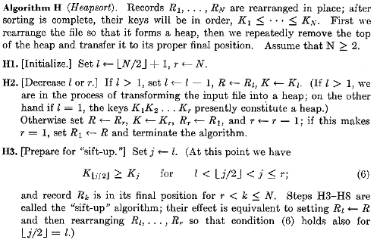
Heap sort
Description:

Slide 34
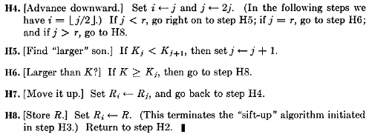
Heap sort

Slide 35
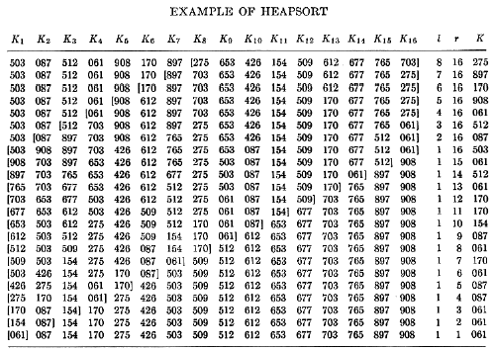
Heap sort
Example:

Slide 36
Heap sort
Analysis:
Advantage and disadvantage analysis:
  Advantage:
    Avoid the major problem of the worst case of quick sort where the complexity is O(n^2), and is unacceptable for large data sets and can be deliberately triggered given enough knowledge of the implementation, creating a security risk.
    The quick sort algorithm also requires Ω(log n) extra storage space, whereas heap sort only with O(1)
    Compare to the merge sort, which requires Ω(n) auxiliary space, it occupies also less space.
    Heap sort is faster than the merge sort in practice on machines with small or slow data caches.

Slide 37
Heap sort
  Disadvantage:
    In most cases, it is much slower in practice than the quick sort.
    It is a instable sort, whereas merge sort is stable
    Like quick sort, merge sort on arrays has considerably better data cache performance, often outperforming heap sort on a modern desktop PC, because it accesses the elements in order.

Slide 38
Radix sort
The idea: (We now only concerning the MSD(Most Significant Digit) Radix Sorts)
  Take the Most significant digit (or group of bits, both being examples of radices) of each key.
  Group the keys based on that digit.
  Repeat the grouping process with each less significant digit.
  N.B. It is based on the exchange sort strategy.
Notes:
MSD and LSD

Slide 39
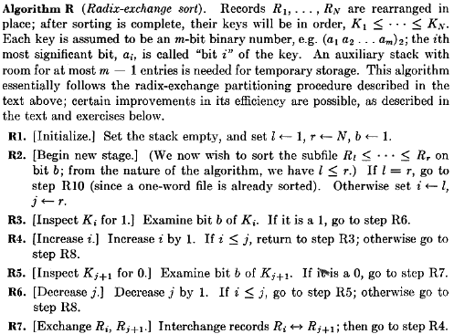
Radix sort
Description:

Slide 40
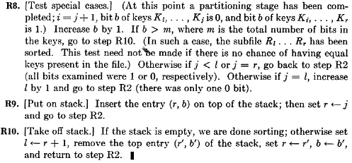
Radix sort

Slide 41
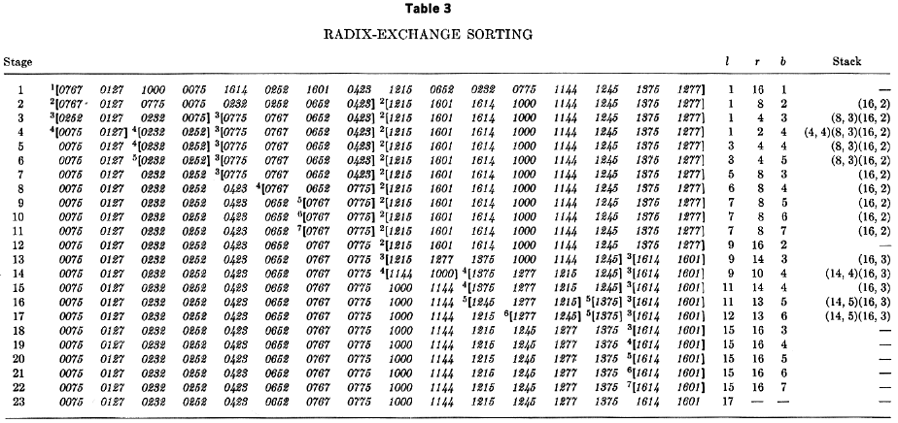
Radix sort
Example:

Slide 42
Radix sort
Analysis:
LSD(least significant digit) and MSD
Name | Best | Average | Worst | Memory | Stable
LSD | O(n·k/s) | O(n·k/s) | O(n·k/s) | O(n) | Yes
MSD | O(n·k/s) | O(n·k/s) | O(n·(k/s)·2^{s}) | O((k/s)·2^{s}) | No
Notes:
K = the length of k
S = base

Slide 43
Radix sort
Restriction:
Only integers can be applied to this algorithm
Interesting Issue:
Neither version of the radix sort is very efficient when the data is almost completely sorted to begin with, since they would both ignore this fact and sort all the data again.

Slide 44
Merge sort
The idea:
Merge sort is based on two main ideas to improve its runtime:
  A small list will take fewer steps to sort than a large list.
  Fewer steps are required to construct a sorted list from two sorted lists than two unsorted lists. For example, you only have to traverse each list once if they're already sorted
  N.B. Merge sort is a classical divide and conquer strategy presentation.

Slide 45
Merge sort
The description:
(Rather than use the description on the Knuth, I employ the algorithm on wiki, which is much easier to understand)
Conceptually, merge sort works as follows:
1. Divide the unsorted list into two sublists of about half the size
2. Sort each of the two sublists recursively until we have list sizes of length 1, in which case the list itself is returned
3. Merge the two sorted sublists back into one sorted list.

Slide 46
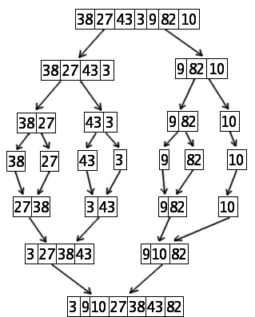
Merge sort
Example:

Slide 47
Merge sort
Analysis
Compare to quick sort
In sorting n items, merge sort has an average and worst-case performance of O(n log n).
In the worst case, merge sort does about 39% fewer comparisons than quick sort does in the average case; merge sort always makes fewer comparisons than quick sort, except in extremely rare cases, when they tie, where merge sort's worst case is found simultaneously with quick sort's best case. In terms of moves, merge sort's worst case complexity is O(n log n)—the same complexity as quick sort's best case, and merge sort's best case takes about half as many iterations as the worst case.
Merge sort is more efficient than quick sort for some types of lists if the data to be sorted can only be efficiently accessed sequentially, and is thus popular in languages such as Lisp, where sequentially accessed data structures are very common. Unlike some (efficient) implementations of quick sort, merge sort is a stable sort as long as the merge operation is implemented properly

Slide 48
Merge sort
Compare to heap sort
merge sort has several advantages over heap sort:
  Like quick sort, merge sort on arrays has considerably better data cache performance, often outperforming heap sort on a modern desktop PC, because it accesses the elements in order.
  Merge sort is a stable sort.
  Merge sort parallelises better; the most trivial way of parallelising merge sort achieves close to linear speedup, while there is no obvious way to parallelise heap sort at all.
  Merge sort can be easily adapted to operate on linked lists and very large lists stored on slow-to-access media such as disk storage or network attached storage. Heap sort relies strongly on random access, and its poor locality of reference makes it very slow on media with long access times.

Slide 49
Merge sort
External sort:
Merge sort is the only sorting algorithm that could be used for huge list sort.

Slide 50
Explore the sorting algorithms
The other sorting algorithms:
In this section, we will briefly explore some less efficient sorting algorithms. Although they are not so efficient in practice, but they can provide some different ways to thought.
The algorithms will be introduced in this section are:
Cocktail sorting algorithm
Gnome sorting algorithm
Bucket sorting algorithm
Library sorting algorithm

Slide 51
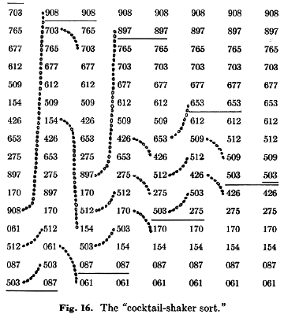
Cocktail sort
A double way bubble sort
Notes:
Cocktail sort doubles the speed of bubble sort on average.

Slide 52
Gnome sort
Description:
The Gnome Sort algorithm is the simplest sorting algorithm. It works similarly to the Insertion Sort, but has no nested loops. It simply moves forward until something is out of order. When one is found, it swaps the element back until it is in its place. Then, it continues traversing from that point. Thus, it is highly inefficient. (O(n^2))
The pseudocode
function gnomeSort(a[0..size-1])
{ i := 1, j := 2
while i ≤ size - 1
if a[i-1] ≤ a[i]
i := j, j := j + 1
else
swap a[i-1] and a[i]
i := i - 1
if i = 0
i := 1
}
Notes:
The running time is O(n²), and in practice the algorithm has been reported to generally run as fast as Insertion sort, although this depends on the details of the architecture and the implementation.
In some book, O(n³).

Slide 53
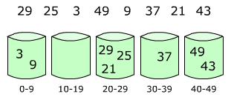
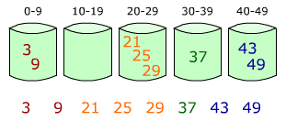
Bucket sort
Bucket sort works as follows:
  Set up an array of initially empty "buckets" the size of the range.
  Go over the original array, putting each object in its bucket.
  Sort each non-empty bucket.
  Put elements from non-empty buckets back into the original array

Slide 54
Library sort
Library sort, or gapped insertion sort is a sorting algorithm that uses an insertion sort, but with gaps in the array to accelerate subsequent insertions. The name comes from an analogy:
Suppose a librarian were to store his books alphabetically on a long shelf, starting with the As at the left end, and continuing to the right along the shelf with no spaces between the books until the end of the Zs. If the librarian acquired a new book that belongs to the B section, once he finds the correct space in the B section, he will have to move every book over, from the middle of the Bs all the way down to the Zs in order to make room for the new book. This is an insertion sort. However, if he were to leave a space after every letter, as long as there was still space after B, he would only have to move a few books to make room for the new one. This is the basic principle of the Library Sort.
Library sort has a acceptable running time with O(nlogn) on average and O(n^2) on worst. But it is very space inefficient O(n).

Slide 55
Explore the external sorting algorithms
As I introduced before, merge sort and its variants could be
the only sorting algorithms using for external sort.
On the next page, I will show a example to introduce how to
sort externally by employing the merge scheme.

Slide 56
External merge sort
For example, for sorting 900 megabytes of data using only 100 megabytes
of RAM:
Read 100 MB of the data in main memory and sort by some conventional method (usually quicksort).
Write the sorted data to disk.
Repeat steps 1 and 2 until all of the data is sorted in 100 MB chunks, which now need to be merged into one single output file.
Read the first 10 MB of each sorted chunk (call them input buffers) in main memory (90 MB total) and allocate the remaining 10 MB for output buffer.
Perform a 9-way merging and store the result in the output buffer. If the output buffer is full, write it to the final sorted file. If any of the 9 input buffers gets empty, fill it with the next 10 MB of its associated 100 MB sorted chunk or otherwise mark it as exhausted if there is no more data in the sorted chunk and do not use it for merging.

Slide 57
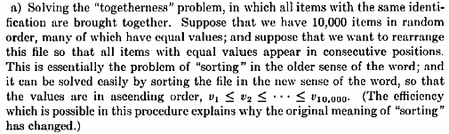
Practical usage for sorting algorithms

Slide 58
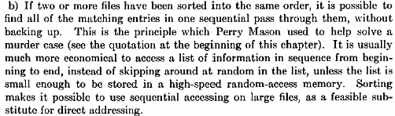
Practical usage for sorting algorithms

Slide 59

Practical usage for sorting algorithms

