Slide 1
Sorting Algorithms:
Selection, Insertion and Bubble

Slide 2
Lecture Objectives
Learn how to implement the simple sorting algorithms (selection, bubble and insertion)
Learn how to implement the selection, insertion and bubble sort algorithms
To learn how to estimate and compare the performance of basic sorting algorithms
To appreciate that algorithms for the same task can differ widely in performance
To learn how to estimate and compare the performance of sorting algorithms

Slide 3
Selection Sort Algorithm
List is sorted by selecting list element and moving it to its proper position
Algorithm finds position of smallest element and moves it to top of unsorted portion of list
Repeats process above until entire list is sorted

Slide 4
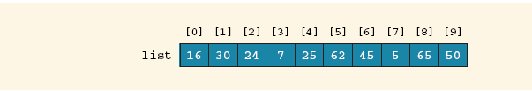
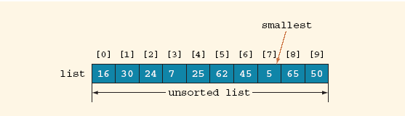
Selection Sort Algorithm (Cont’d)
Figure 1: An array of 10 elements
Figure 2: Smallest element of unsorted array

Slide 5
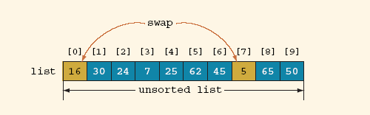
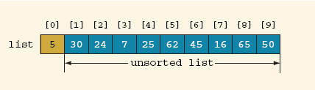
Selection Sort Algorithm (Cont’d)
Figure 3: Swap elements list[0] and list[7]
Figure 4: Array after swapping list[0] and list[7]

Slide 6
Selection Sort Algorithm (Cont’d)
public static void selectionSort(int[] list, int listLength) {
int index;
int smallestIndex;
int minIndex;
int temp;
for (index = 0; index < listLength – 1; index++) {
smallestIndex = index;
for (minIndex = index + 1;
minIndex < listLength; minIndex++)
if (list[minIndex] < list[smallestIndex])
smallestIndex = minIndex;
temp = list[smallestIndex];
list[smallestIndex] = list[index];
list[index] = temp;
}
}

Slide 7
Selection Sort Algorithm (Cont’d)
It is known that for a list of length n, on an average selection sort makes n(n – 1) / 2 key comparisons and 3(n – 1) item assignments
Therefore, if n = 1000, then to sort the list selection sort makes about 500,000 key comparisons and about 3000 item assignments

Slide 8
Selection Sort on Various Size Arrays*
n | Milliseconds
10,000 | 772
20,000 | 3,051
30,000 | 6,846
40,000 | 12,188
50,000 | 19,015
60,000 | 27,359
*Obtained with a Pentium processor, 1.2 GHz, Java 5.0, Linux

Slide 9
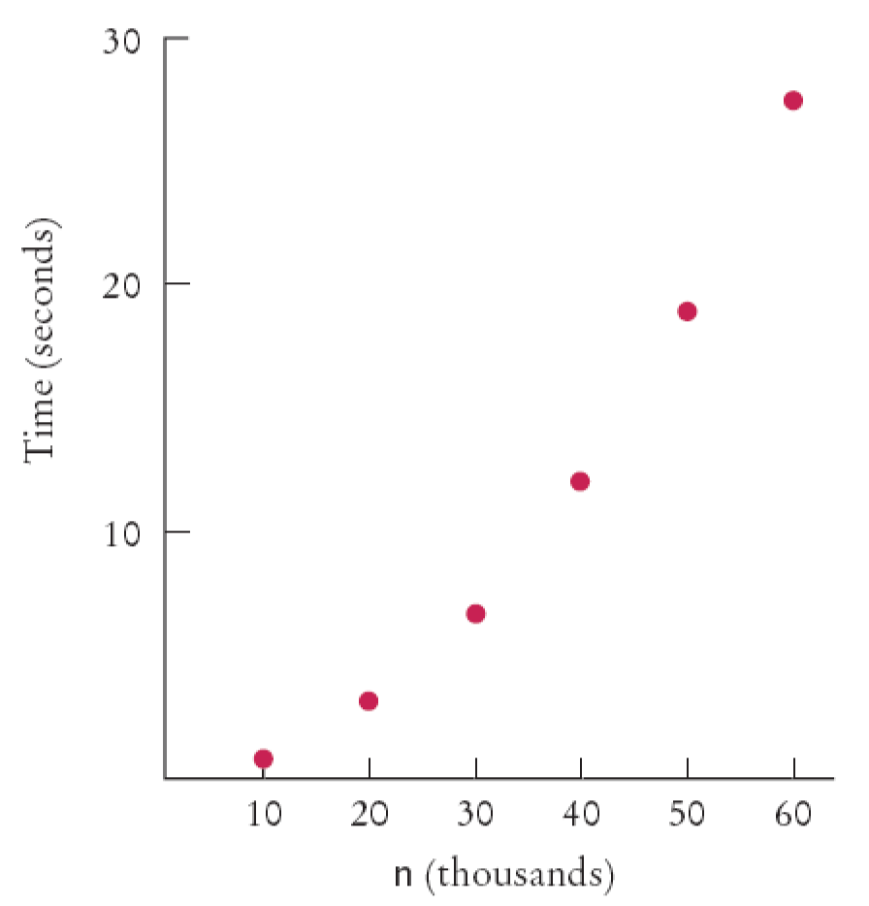
Selection Sort on Various Size Arrays (Cont’d)
Figure 5: Time Taken by Selection Sort
Doubling the size of the array more than doubles the time needed to sort it!

Slide 10
Profiling the Selection Sort Algorithm
We want to measure the time the algorithm takes to execute
  Exclude the time the program takes to load
  Exclude output time
Create a StopWatch class to measure execution time of an algorithm
  It can start, stop and give elapsed time
  Use System.currentTimeMillis method

Slide 11
Profiling the Selection Sort Algorithm (Cont’d)
Create a StopWatch object
  Start the stopwatch just before the sort
  Stop the stopwatch just after the sort
  Read the elapsed time

Slide 12
File StopWatch.java
01: /**
02: A stopwatch accumulates time when it is running. You can
03: repeatedly start and stop the stopwatch. You can use a
04: stopwatch to measure the running time of a program.
05: */
06: public class StopWatch
07: {
08: /**
09: Constructs a stopwatch that is in the stopped state
10: and has no time accumulated.
11: */
12: public StopWatch()
13: {
14: reset();
15: }
16:
Continued

Slide 13
File StopWatch.java (Cont’d)
17: /**
18: Starts the stopwatch. Time starts accumulating now.
19: */
20: public void start()
21: {
22: if (isRunning) return;
23: isRunning = true;
24: startTime = System.currentTimeMillis();
25: }
26:
27: /**
28: Stops the stopwatch. Time stops accumulating and is
29: is added to the elapsed time.
30: */
31: public void stop()
32: {
Continued

Slide 14
File StopWatch.java (Cont’d)
33: if (!isRunning) return;
34: isRunning = false;
35: long endTime = System.currentTimeMillis();
36: elapsedTime = elapsedTime + endTime - startTime;
37: }
38:
39: /**
40: Returns the total elapsed time.
41: @return the total elapsed time
42: */
43: public long getElapsedTime()
44: {
45: if (isRunning)
46: {
47: long endTime = System.currentTimeMillis();
48: return elapsedTime + endTime - startTime;
49: }
Continued

Slide 15
File StopWatch.java (Cont’d)
50: else
51: return elapsedTime;
52: }
53:
54: /**
55: Stops the watch and resets the elapsed time to 0.
56: */
57: public void reset()
58: {
59: elapsedTime = 0;
60: isRunning = false;
61: }
62:
63: private long elapsedTime;
64: private long startTime;
65: private boolean isRunning;
66: }

Slide 16
File SelectionSortTimer.java
01: import java.util.Scanner;
02:
03: /**
04: This program measures how long it takes to sort an
05: array of a user-specified size with the selection
06: sort algorithm.
07: */
08: public class SelectionSortTimer
09: {
10: public static void main(String[] args)
11: {
12: Scanner in = new Scanner(System.in);
13: System.out.print("Enter array size: ");
14: int n = in.nextInt();
15:
16: // Construct random array
17:
Continued

Slide 17
File SelectionSortTimer.java (Cont’d)
18: int[] a = ArrayUtil.randomIntArray(n, 100);
19: SelectionSorter sorter = new SelectionSorter(a);
20:
21: // Use stopwatch to time selection sort
22:
23: StopWatch timer = new StopWatch();
24:
25: timer.start();
26: sorter.sort();
27: timer.stop();
28:
29: System.out.println("Elapsed time: "
30: + timer.getElapsedTime() + " milliseconds");
31: }
32: }
33:
34:
Continued

Slide 18
File SelectionSortTimer.java(Cont’d)
Output:
Enter array size: 100000
Elapsed time: 27880 milliseconds

Slide 19

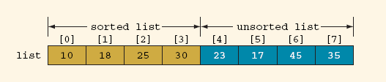
Insertion Sort Algorithm
The insertion sort algorithm sorts the list by moving each element to its proper place
Figure 6: Array list to be sorted
Figure 7: Sorted and unsorted portions of the array list

Slide 20
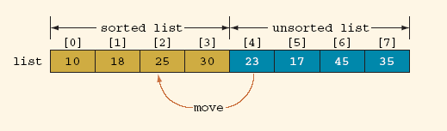
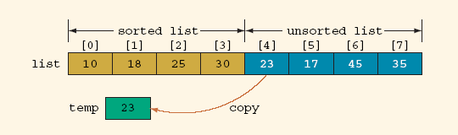
Insertion Sort Algorithm (Cont’d)
Figure 8: Move list[4] into list[2]
Figure 9: Copy list[4] into temp

Slide 21
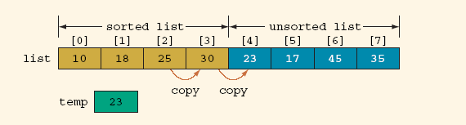
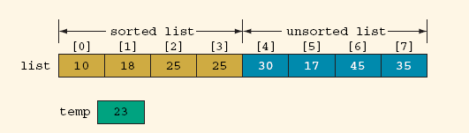
Insertion Sort Algorithm (Cont’d)
Figure 10: Array list before copying list[3] into list[4], then list[2] into list[3]
Figure 11: Array list after copying list[3] into list[4], and then list[2] into list[3]

Slide 22
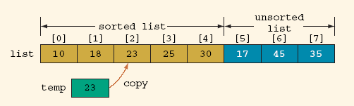
Insertion Sort Algorithm (Cont’d)
Figure 12: Array list after copying temp into list[2]

Slide 23
Insertion Sort Algorithm (Cont’d)
public static void insertionSort(int[] list, int listLength) {
int firstOutOfOrder, location;
int temp;
for (firstOutOfOrder = 1;
firstOutOfOrder < listLength;
firstOutOfOrder++)
if (list[firstOutOfOrder] < list[firstOutOfOrder - 1]) {
temp = list[firstOutOfOrder];
location = firstOutOfOrder;
do {
list[location] = list[location - 1];
location--;
}
while(location > 0 && list[location - 1] > temp);
list[location] = temp;
}
} //end insertionSort

Slide 24
Insertion Sort Algorithm (Cont’d)
It is known that for a list of length N, on average, the insertion sort makes (N² + 3N – 4) / 4 key comparisons and about N(N – 1) / 4 item assignments
Therefore, if N = 1000, then to sort the list, the insertion sort makes about 250,000 key comparisons and about 250,000 item assignments

Slide 25
File InsertionSorter.java
01: /**
02: This class sorts an array, using the insertion sort
03: algorithm
04: */
05: public class InsertionSorter
06: {
07: /**
08: Constructs an insertion sorter.
09: @param anArray the array to sort
10: */
11: public InsertionSorter(int[] anArray)
12: {
13: a = anArray;
14: }
15:
16: /**
17: Sorts the array managed by this insertion sorter
18: */
Continued

Slide 26
File InsertionSorter.java (Cont’d)
19: public void sort()
20: {
21: for (int i = 1; i < a.length; i++)
22: {
23: int next = a[i];
24: // Move all larger elements up
25: int j = i;
26: while (j > 0 && a[j - 1] > next)
27: {
28: a[j] = a[j - 1];
29: j--;
30: }
31: // Insert the element
32: a[j] = next;
33: }
34: }
35:
36: private int[] a;
37: }

Slide 27
Bubble Sort Algorithm
Bubble sort algorithm:
  Suppose list[0...N - 1] is a list of n elements, indexed 0 to N - 1
  We want to rearrange; that is, sort, the elements of list in increasing order
  The bubble sort algorithm works as follows:
    In a series of N - 1 iterations, the successive elements, list[index] and list[index + 1] of list are compared
    If list[index] is greater than list[index + 1], then the elements list[index] and list[index + 1] are swapped, that is, interchanged

Slide 28
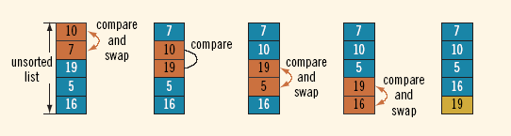
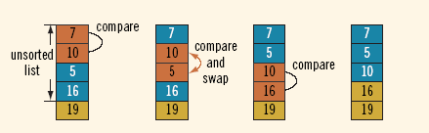
Bubble Sort Algorithm (Cont’d)
Figure 13: Elements of array list during the first iteration
Figure 14: Elements of array list during the second iteration

Slide 29
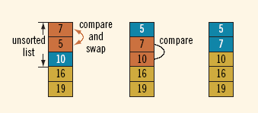
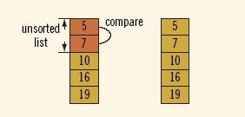
Bubble Sort Algorithm (Cont’d)
Figure 15: Elements of array list during the third iteration
Figure 16: Elements of array list during the fourth iteration

Slide 30
Bubble Sort Algorithm (Cont’d)
public static void bubbleSort(int[] list, int listLength) {
int temp, counter, index;
int temp;
for (counter = 0; counter < listLength; counter++) {
for (index = 0; index < listLength – 1 - counter; index++) {
if(list[index] > list[index+1]) {
temp = list[index];
list[index] = list[index+1];
list[index] = temp;
}
}
}
} //end bubbleSort

Slide 31
Bubble Sort Algorithm (Cont’d)
It is known that for a list of length N, on average bubble sort makes N(N – 1) / 2 key comparisons and about N(N – 1) / 4 item assignments
Therefore, if N = 1000, then to sort the list bubble sort makes about 500,000 key comparisons and about 250,000 item assignments

