Slide 1
CSCE 3110
Data Structures &
Algorithm Analysis
Rada Mihalcea
http://www.cs.unt.edu/~rada/CSCE3110
Sorting (I)
Reading: Chap.7, Weiss

Slide 2

Sorting
Given a set (container) of n elements
  E.g. array, set of words, etc.
Suppose there is an order relation that can be set across the elements
Goal Arrange the elements in ascending order
  Start → 1 23 2 56 9 8 10 100
  End → 1 2 8 9 10 23 56 100

Slide 3
Bubble Sort
Simplest sorting algorithm
Idea:
  1. Set flag = false
  2. Traverse the array and compare pairs of two elements
    1.1 If E1 ≤ E2 - OK
    1.2 If E1 > E2 then Switch(E1, E2) and set flag = true
  3. If flag = true goto 1.
What happens?

Slide 4
Bubble Sort
1 23 2 56 9 8 10 100
1 2 23 56 9 8 10 100
1 2 23 9 56 8 10 100
1 2 23 9 8 56 10 100
1 2 23 9 8 10 56 100
---- finish the first traversal ----
---- start again ----
1 2 23 9 8 10 56 100
1 2 9 23 8 10 56 100
1 2 9 8 23 10 56 100
1 2 9 8 10 23 56 100
---- finish the second traversal ----
---- start again ----
………………….
Why Bubble Sort ?

Slide 5
Implement Bubble Sort with an Array
void bubbleSort (Array S, length n) {
boolean isSorted = false;
while(!isSorted) {
isSorted = true;
for(i = 0; i<n; i++) {
if(S[i] > S[i+1]) {
int aux = S[i];
S[i] = S[i+1]; S[i+1] = aux; isSorted = false;
}
}
}

Slide 6
Running Time for Bubble Sort
One traversal = move the maximum element at the end
Traversal #i : n – i + 1 operations
Running time:
(n – 1) + (n – 2) + … + 1 = (n – 1) n / 2 = O(n ²)
When does the worst case occur ?
Best case ?

Slide 7

Sorting Algorithms Using Priority Queues
Remember Priority Queues = queue where the dequeue operation always removes the element with the smallest key → removeMin
Selection Sort
  insert elements in a priority queue implemented with an unsorted sequence
  remove them one by one to create the sorted sequence
Insertion Sort
  insert elements in a priority queue implemented with a sorted sequence
  remove them one by one to create the sorted sequence

Slide 8
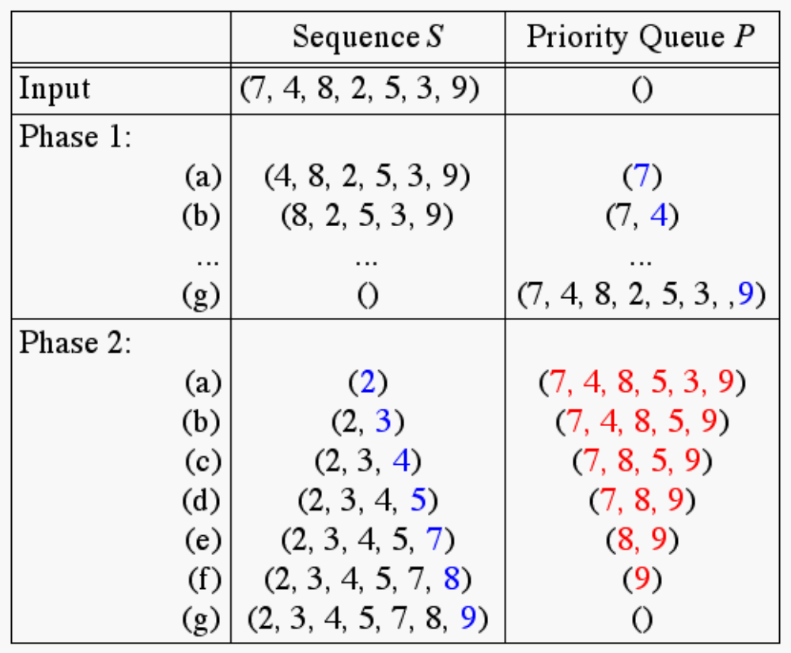
Selection Sort
insertion: O(1 + 1 + … + 1) = O(n)
selection: O(n + (n-1) + (n-2) + … + 1) = O(n²)

Slide 9
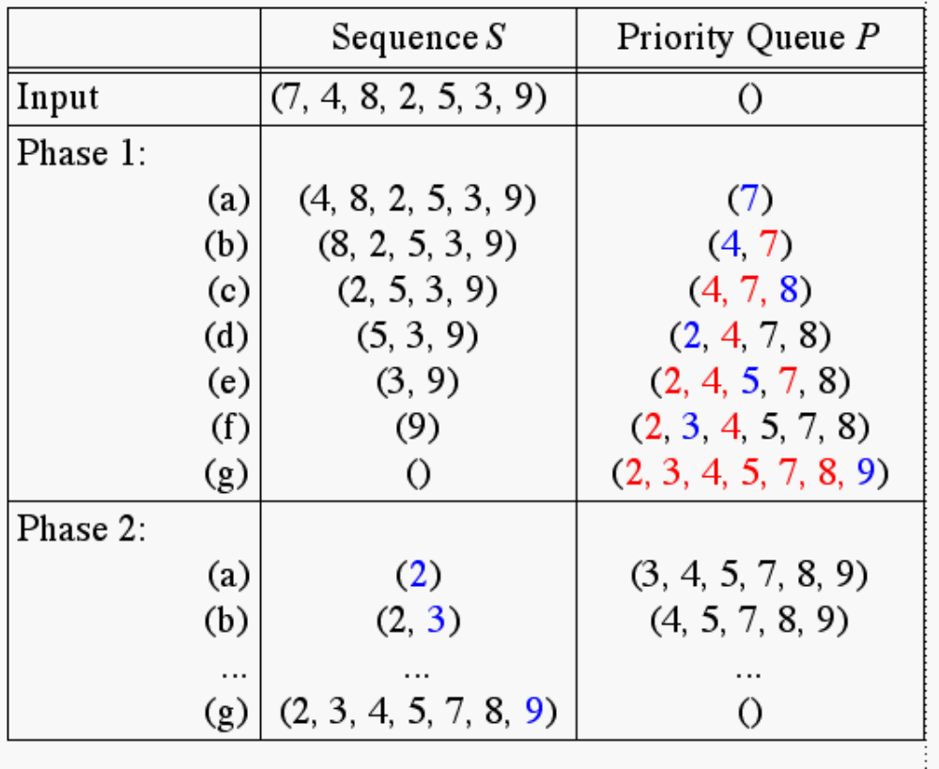
Insertion Sort
insertion: O(1 + 2 + … + n) = O(n²)
selection: O(1 + 1 + … + 1) = O(n)

Slide 10
Sorting with Binary Trees
Using heaps (see lecture on heaps)
  How to sort using a minHeap ?
Using binary search trees (see lecture on BST)
  How to sort using BST?

Slide 11
Heap Sorting
Step 1: Build a heap
Step 2: removeMin( )

Slide 12
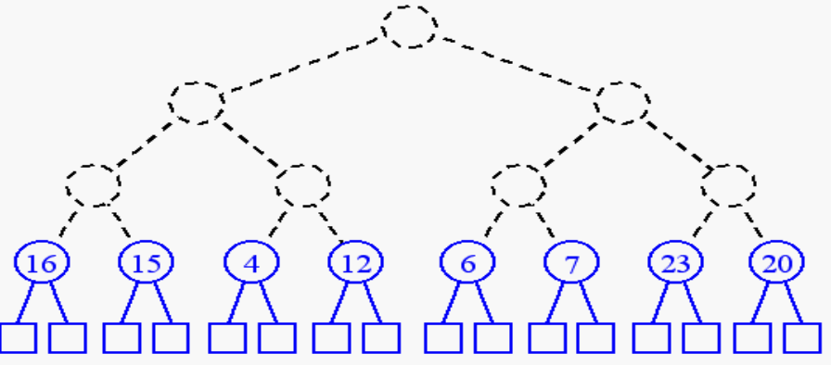
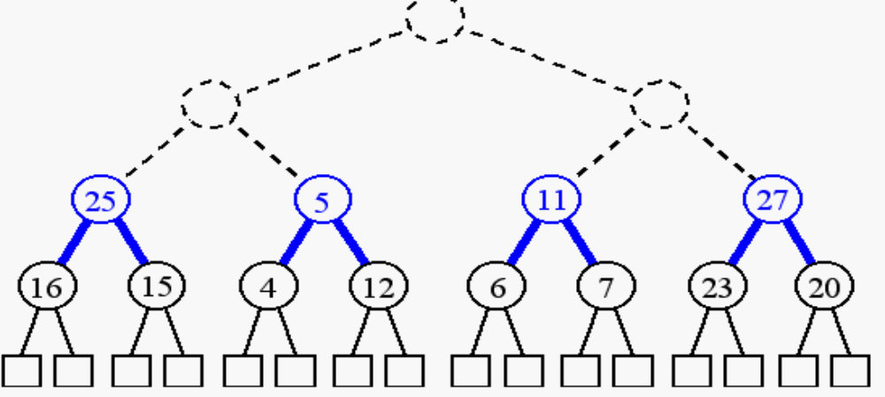
Recall: Building a Heap
build (n + 1)/2 trivial one-element heaps
build three-element heaps on top of them

Slide 13
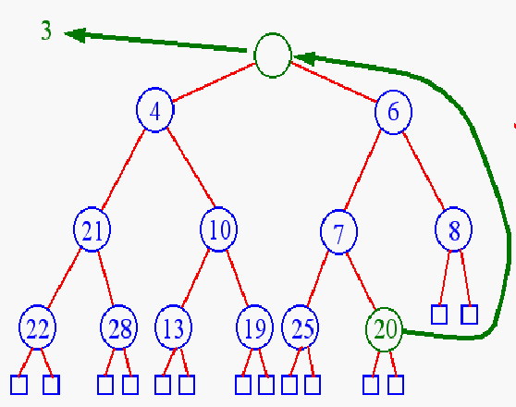
Recall: Heap Removal
Remove element
from priority queues?
removeMin( )

Slide 14
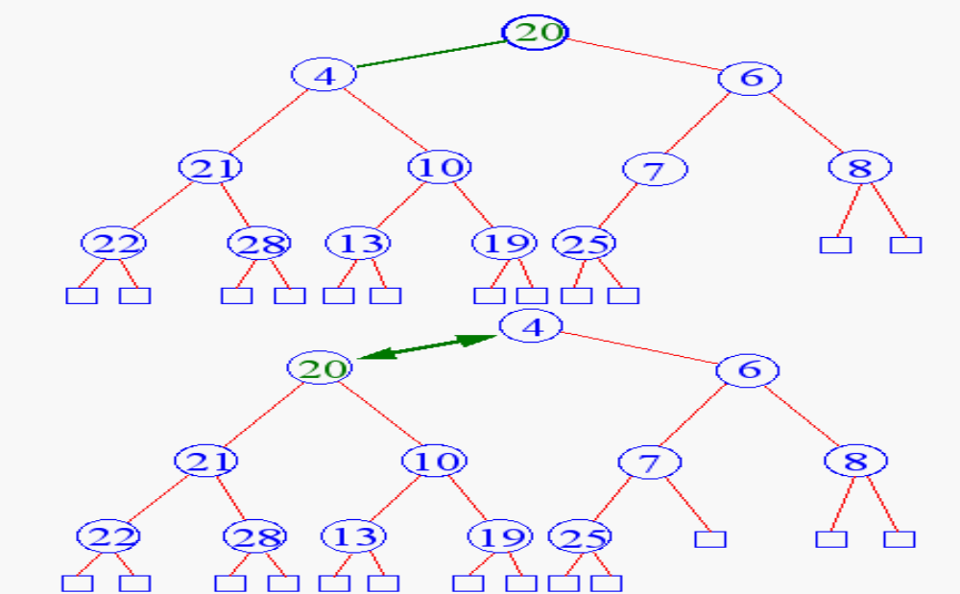
Recall: Heap Removal
Begin downheap

Slide 15
Sorting with BST
Use binary search trees for sorting
Start with unsorted sequence
Insert all elements in a BST
Traverse the tree…. how ?
Running time?

Slide 16
Next
Sorting algorithms that rely on the “DIVIDE AND CONQUER” paradigm
  One of the most widely used paradigms
  Divide a problem into smaller sub problems, solve the sub problems, and combine the solutions
  Learned from real life ways of solving problems

Slide 17
Divide-and-Conquer
Divide and Conquer is a method of algorithm design that has created such efficient algorithms as Merge Sort.
In terms or algorithms, this method has three distinct steps:
  Divide: If the input size is too large to deal with in a straightforward manner, divide the data into two or more disjoint subsets.
  Recur: Use divide and conquer to solve the subproblems associated with the data subsets.
  Conquer: Take the solutions to the subproblems and “merge” these solutions into a solution for the original problem.

Slide 18
Merge-Sort
Algorithm:
  Divide: If S has at leas two elements (nothing needs to be done if S has zero or one elements), remove all the elements from S and put them into two sequences, S₁ and S₂, each containing about half of the elements of S. (i.e. S₁ contains the first ⎡n/2⎤ elements and S₂ contains the remaining ⎣n/2⎦ elements.
  Recur: Recursive sort sequences S₁ and S₂.
  Conquer: Put back the elements into S by merging the sorted sequences S₁ and S₂ into a unique sorted sequence.
Merge Sort Tree:
  Take a binary tree T
  Each node of T represents a recursive call of the merge sort algorithm.
  We associate with each node v of T a the set of input passed to the invocation v represents.
  The external nodes are associated with individual elements of S, upon which no recursion is called.

Slide 19
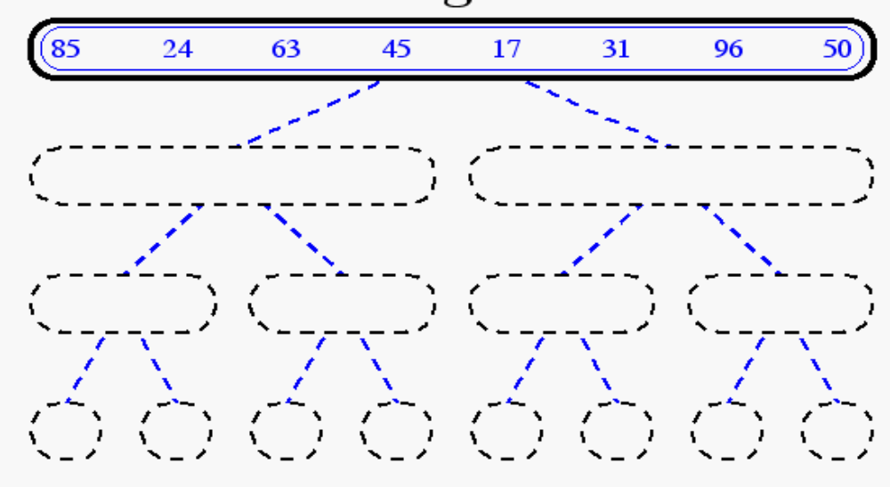
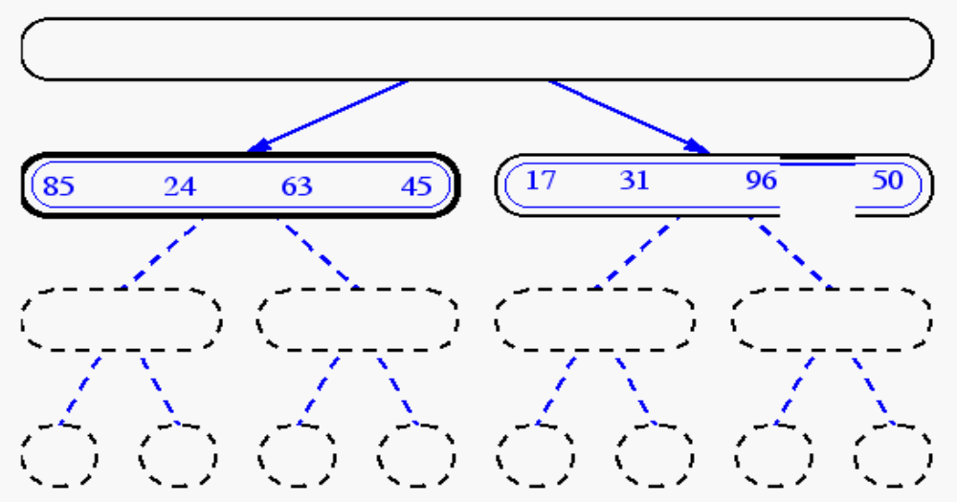
Merge-Sort

Slide 20
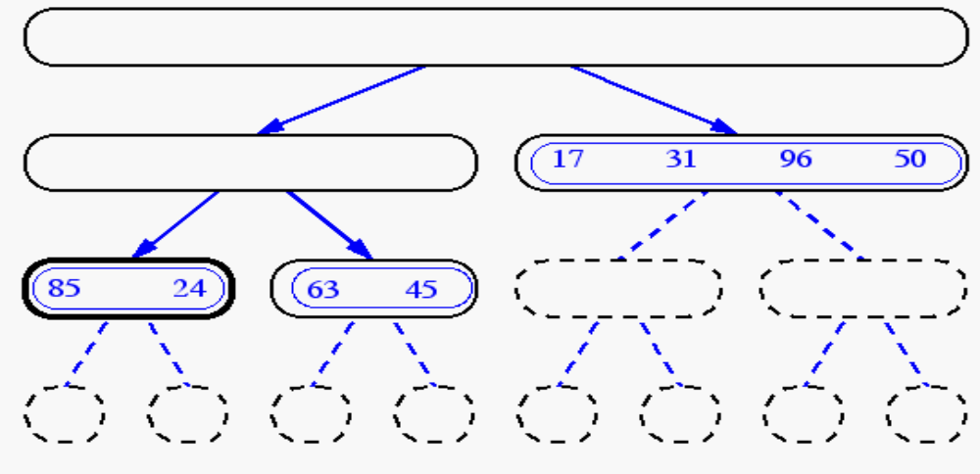
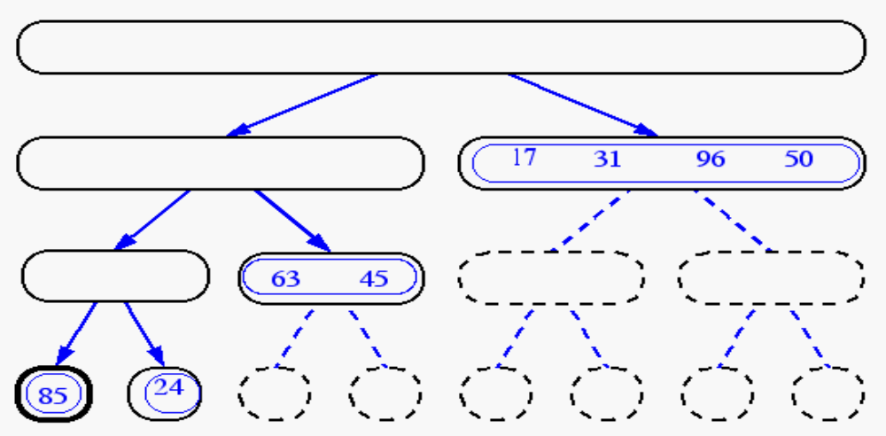
Merge-Sort(cont.)

Slide 21
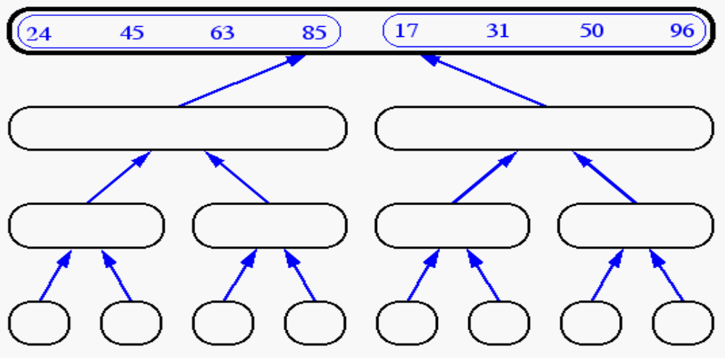
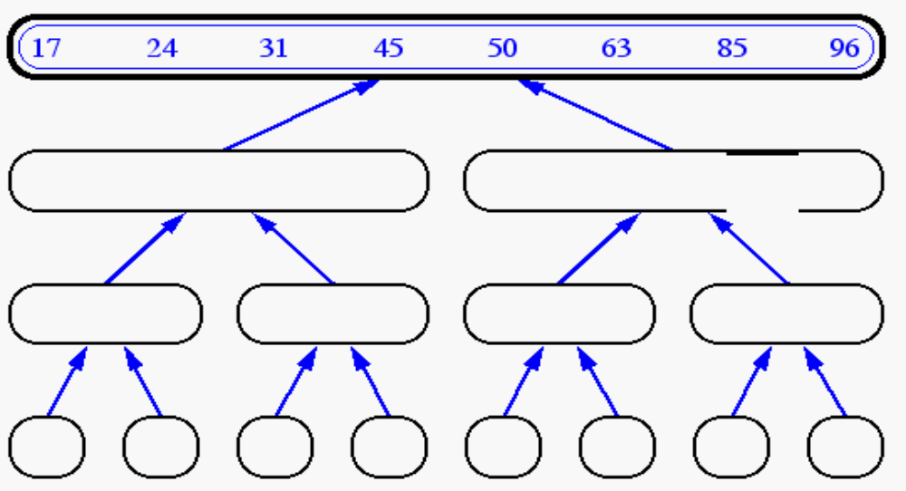
Merge-Sort (cont’d)

Slide 22
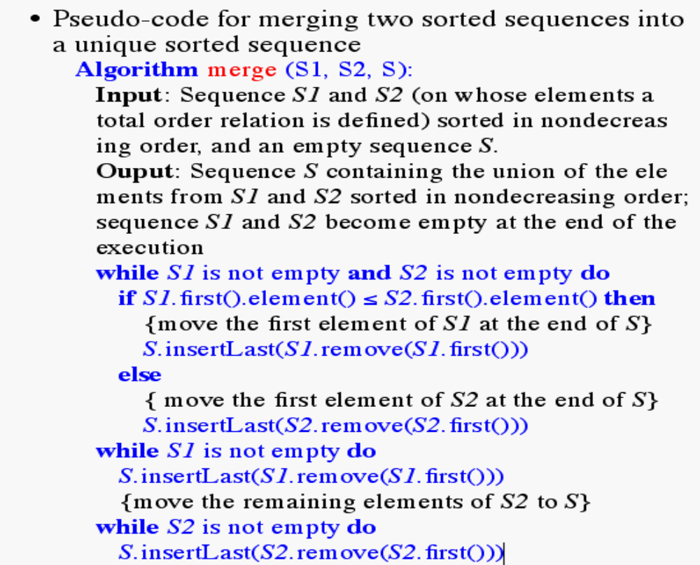
Merging Two Sequences

Slide 23
Quick-Sort
Another divide-and-conquer sorting algorihm
To understand quick-sort, let’s look at a high-level description of the algorithm
1) Divide : If the sequence S has 2 or more elements, select an element x from S to be your pivot. Any arbitrary element, like the last, will do. Remove all the elements of S and divide them into 3 sequences:
  L, holds S’s elements less than x
  E, holds S’s elements equal to x
  G, holds S’s elements greater than x
2) Recurse: Recursively sort L and G
3) Conquer: Finally, to put elements back into S in order, first inserts the elements of L, then those of E, and those of G.
Here are some diagrams....

Slide 24
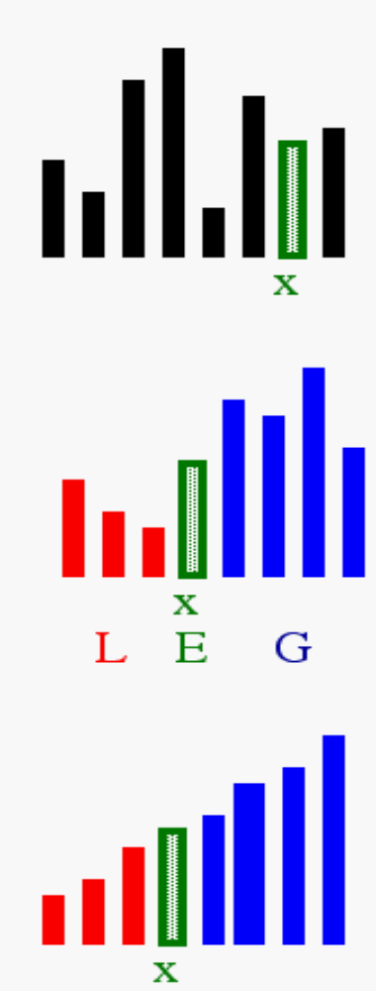
Idea of Quick Sort
1) Select: pick an element
2) Divide: rearrange elements so that x goes to its final position E
3) Recurse and Conquer: recursively sort

Slide 25
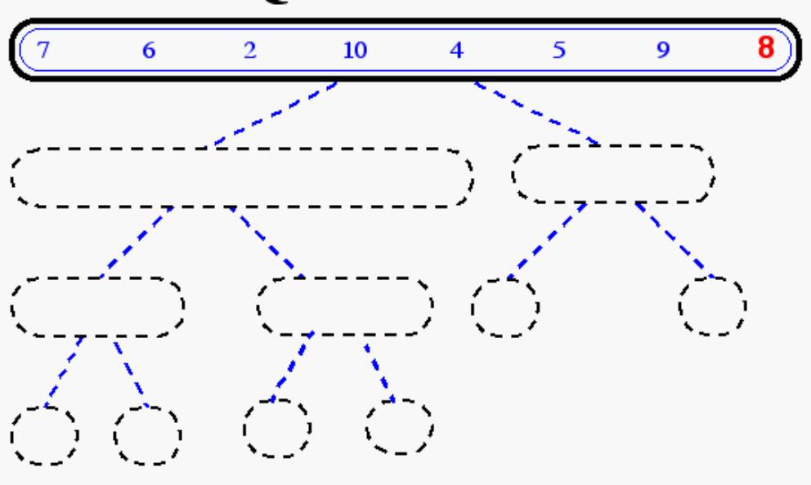
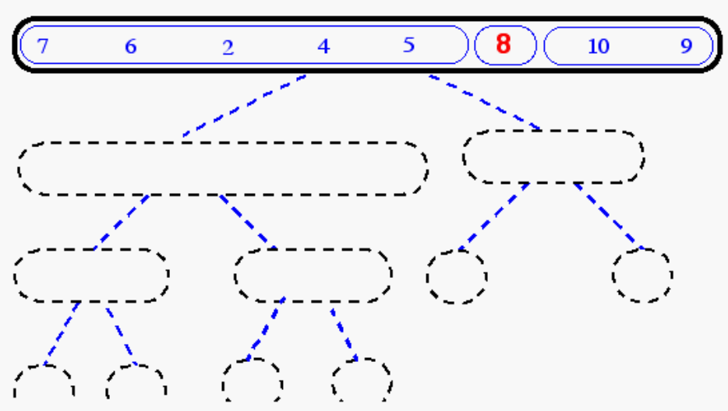
Quick-Sort Tree

Slide 26
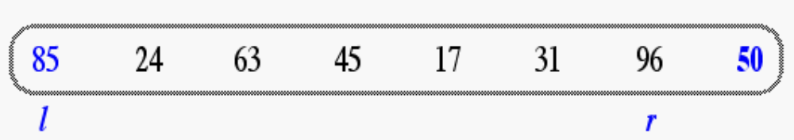
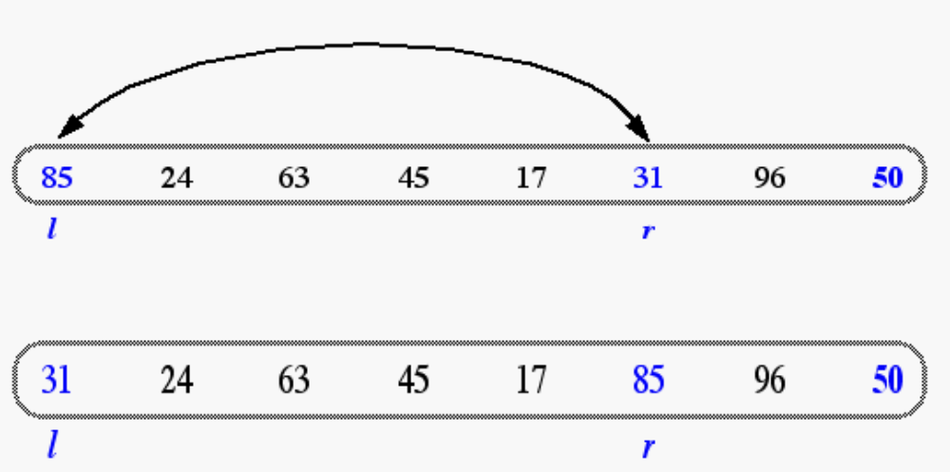
In-Place Quick-Sort
Divide step: l scans the sequence from the left, and r from the right.
A swap is performed when l is at an element larger than the pivot and r is at one smaller than the pivot.

Slide 27
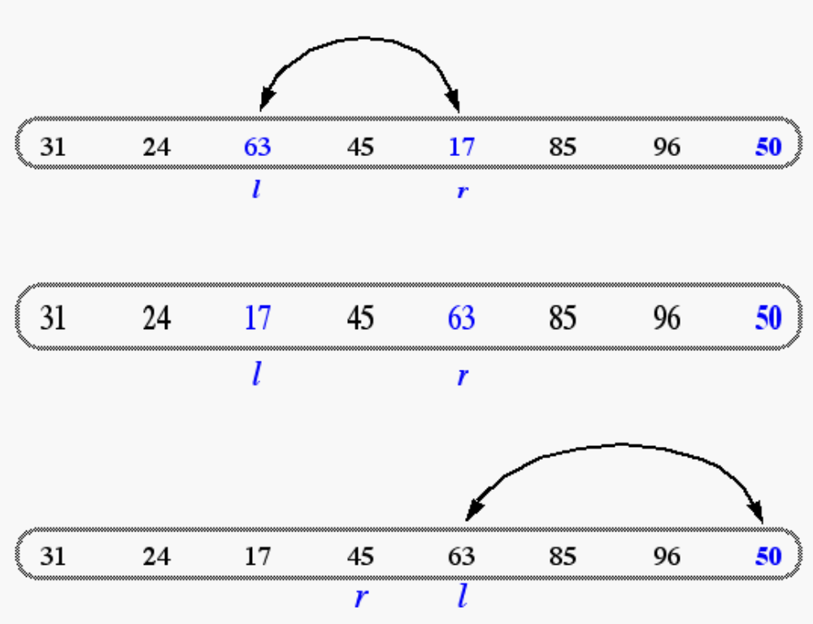
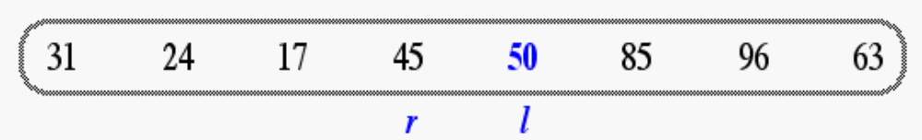
In Place Quick Sort (cont’d)
A final swap with the pivot completes the divide step

Slide 28
Running time analysis
Average case analysis
Worst case analysis
What is the worst case for quick-sort?
Running time?

