Slide 1
CSCE 3110
Data Structures &
Algorithm Analysis
Rada Mihalcea
http://www.cs.unt.edu/~rada/CSCE3110
Sorting (II)
Reading: Chap.7, Weiss

Slide 2

Today…
Quick Review
  Divide and Conquer paradigm
  Merge Sort
  Quick Sort
Two more sorting algorithms
  Bucket Sort
  Radix Sort

Slide 3
Divide-and-Conquer
Divide and Conquer is a method of algorithm design.
This method has three distinct steps:
  Divide: If the input size is too large to deal with in a straightforward manner, divide the data into two or more disjoint subsets.
  Recur: Use divide and conquer to solve the subproblems associated with the data subsets.
  Conquer: Take the solutions to the subproblems and “merge” these solutions into a solution for the original problem.

Slide 4
Merge-Sort
Algorithm:
  Divide: If S has at leas two elements (nothing needs to be done if S has zero or one elements), remove all the elements from S and put them into two sequences, S₁ and S₂, each containing about half of the elements of S. (i.e. S₁ contains the first ⎡n/2⎤ elements and S₂ contains the remaining ⎣n/2⎦ elements.
  Recur: Recursive sort sequences S₁ and S₂.
  Conquer: Put back the elements into S by merging the sorted sequences S₁ and S₂ into a unique sorted sequence.

Slide 5
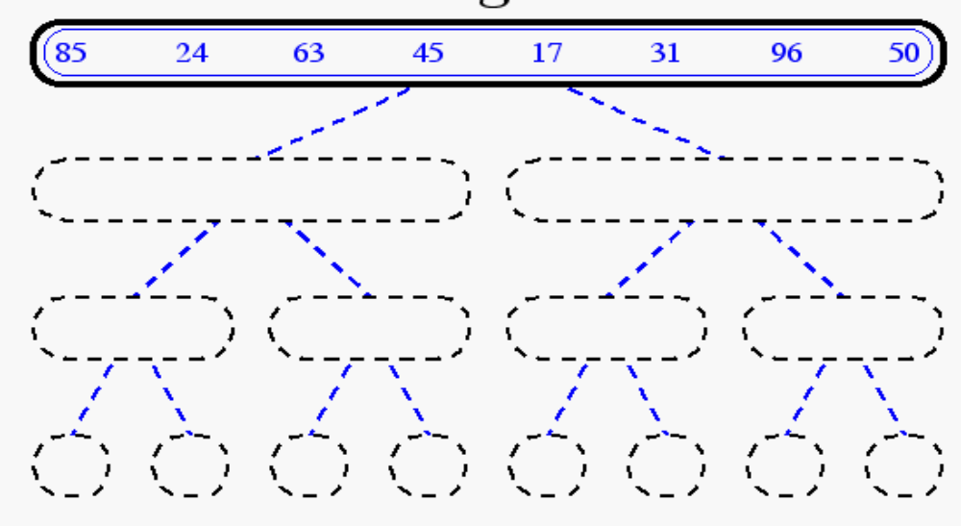
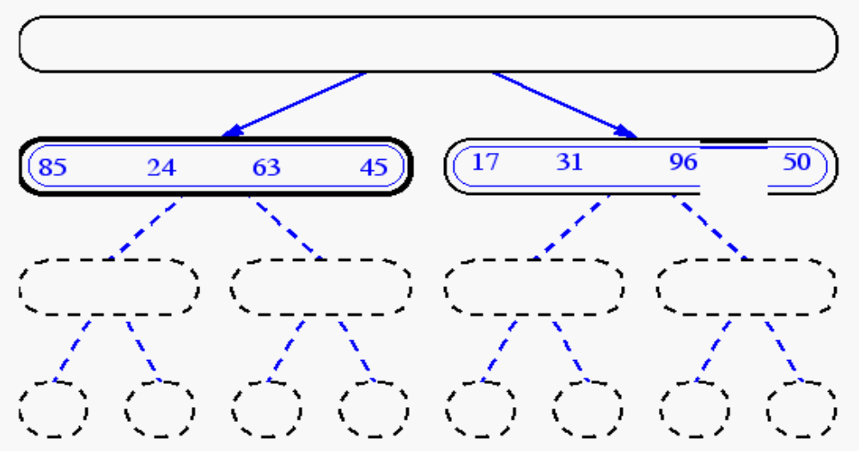
Merge-Sort Example

Slide 6
Running Time of Merge-Sort
At each level in the binary tree created for Merge Sort, there are n elements, with O(1) time spent at each element
  → O(n) running time for processing one level
The height of the tree is O(log n)
Therefore, the time complexity is O(nlog n)

Slide 7
Quick-Sort
1) Divide : If the sequence S has 2 or more elements, select an element x from S to be your pivot. Any arbitrary element, like the last, will do. Remove all the elements of S and divide them into 3 sequences:
  L, holds S’s elements less than x
  E, holds S’s elements equal to x
  G, holds S’s elements greater than x
2) Recurse: Recursively sort L and G
3) Conquer: Finally, to put elements back into S in order, first inserts the elements of L, then those of E, and those of G.

Slide 8
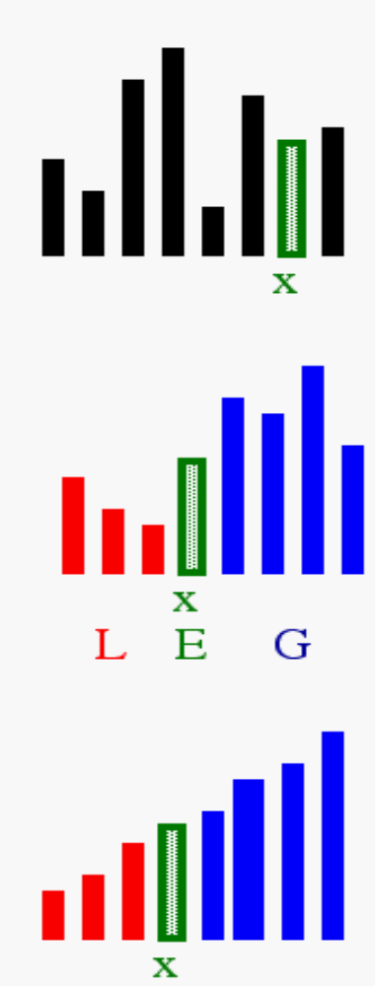
Idea of Quick Sort
1) Select: pick an element
2) Divide: rearrange elements so that x goes to its final position E
3) Recurse and Conquer: recursively sort

Slide 9
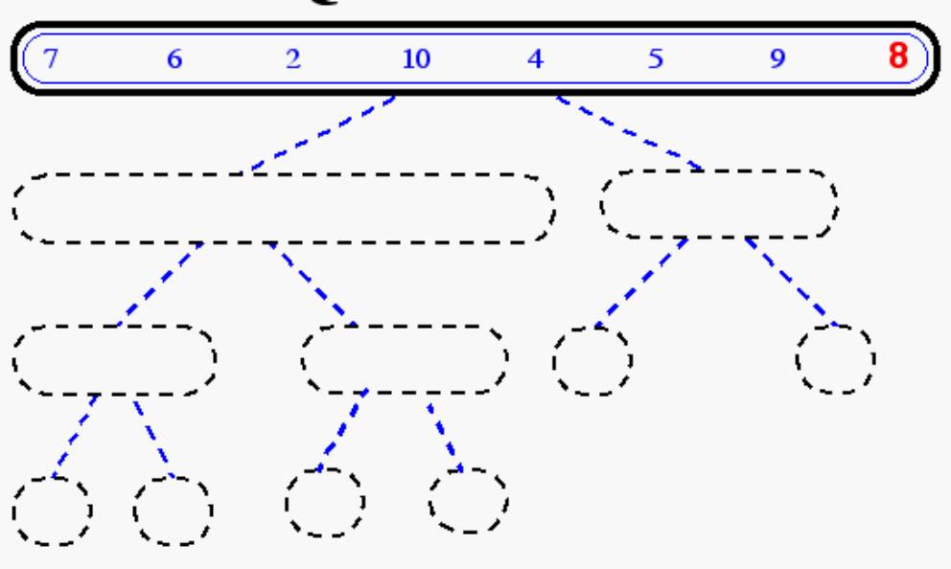
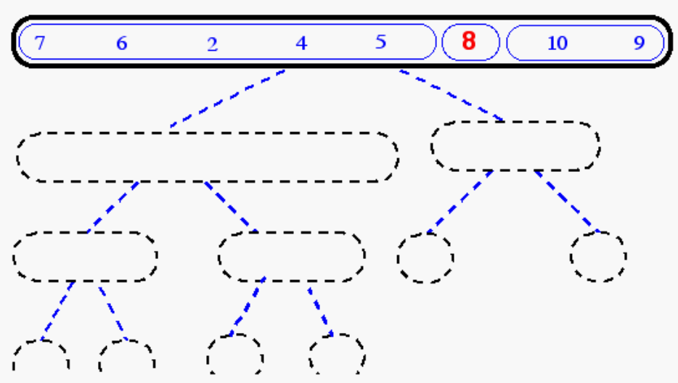
Quick-Sort Tree

Slide 10
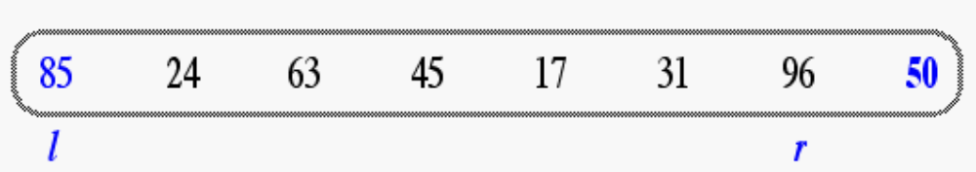
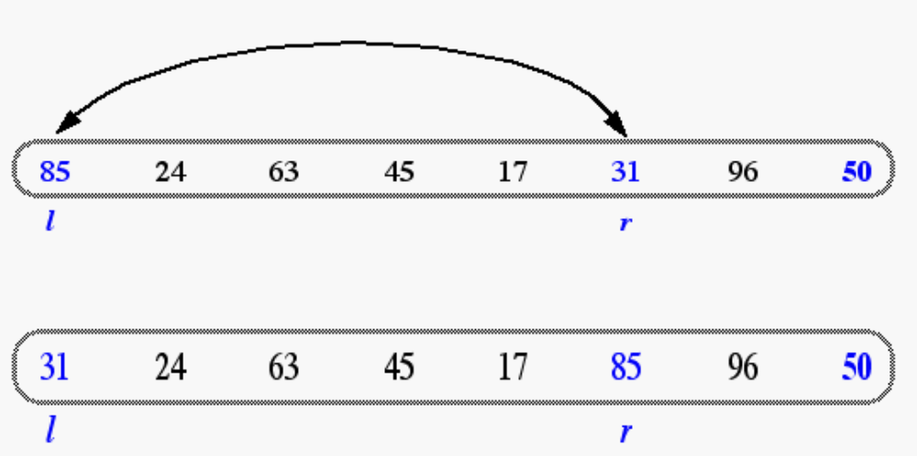
In-Place Quick-Sort
Divide step: l scans the sequence from the left, and r from the right.
A swap is performed when l is at an element larger than the pivot and r is at one smaller than the pivot.

Slide 11
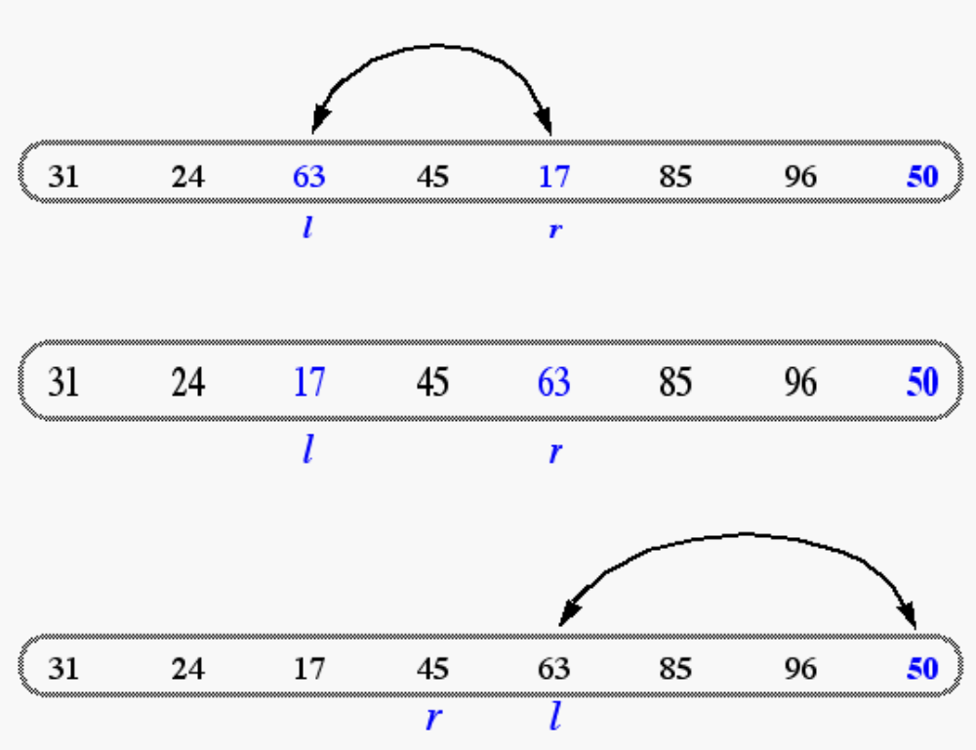
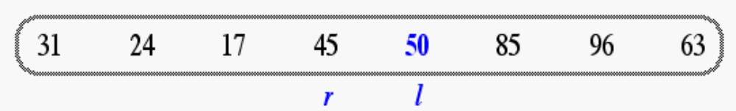
In Place Quick Sort (cont’d)
A final swap with the pivot completes the divide step

Slide 12
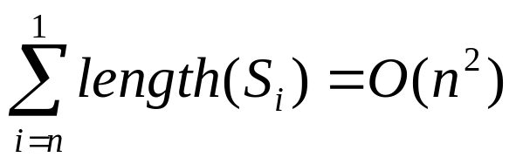

Quick Sort Running Time
Worst case: when the pivot does not divide the sequence in two
At each step, the length of the sequence is only reduced by 1
Total running time
General case:
  Time spent at level i in the tree is O(n)
  Running time: O(n) * O(height)
Average case:
  O(n log n)

Slide 13
More Sorting Algorithms
Bucket Sort
Radix Sort
Stable sort
  A sorting algorithm where the order of elements having the same key is not changed in the final sequence
  Is bubble sort stable?
  Is merge sort stable?

Slide 14


Bucket Sort
Bucket sort
  Assumption: the keys are in the range [0, N)
  Basic idea:
    1. Create N linked lists (buckets) to divide interval [0,N) into subintervals of size 1
    2. Add each input element to appropriate bucket
    3. Concatenate the buckets
  Expected total time is O(n + N), with n = size of original sequence
    if N is O(n) → sorting algorithm in O(n) !

Slide 15
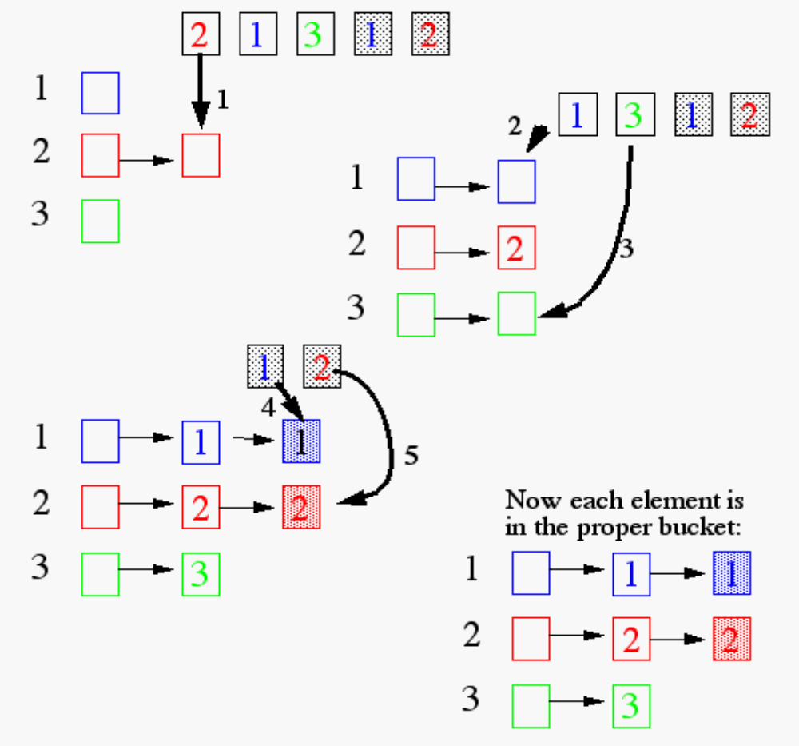
Bucket Sort
Each element of the array is put in one of the N “buckets”

Slide 16
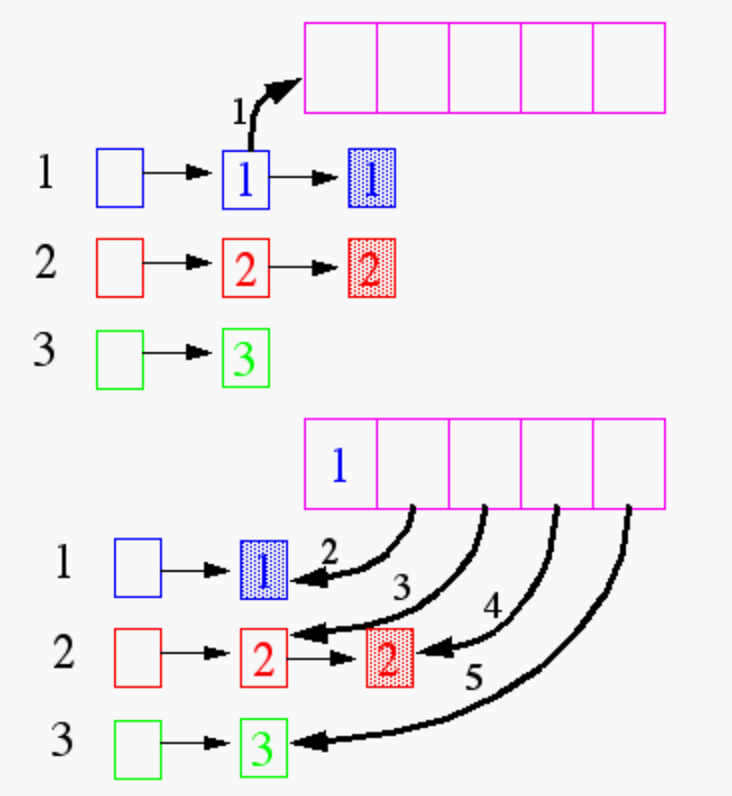
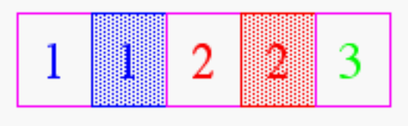
Bucket Sort
Now, pull the elements from the buckets into the array
At last, the sorted array
(sorted in a stable way):

Slide 17
Does it Work for Real Numbers?
What if keys are not integers?
  Assumption: input is n reals from [0, 1)
  Basic idea:
    Create N linked lists (buckets) to divide interval [0,1) into subintervals of size 1/N
    Add each input element to appropriate bucket and sort buckets with insertion sort
  Uniform input distribution → O(1) bucket size
    Therefore the expected total time is O(n)
  Distribution of keys in buckets similar with …. ?

Slide 18
Radix Sort
How did IBM get rich originally?
Answer: punched card readers for census tabulation in early 1900’s.
  In particular, a card sorter that could sort cards into different bins
    Each column can be punched in 12 places
    (Decimal digits use only 10 places!)
  Problem: only one column can be sorted on at a time

Slide 19
Radix Sort
Intuitively, you might sort on the most significant digit, then the second most significant, etc.
Problem: lots of intermediate piles of cards to keep track of
Key idea: sort the least significant digit first
  RadixSort(A, d)
  for i=1 to d
  StableSort(A) on digit i

Slide 20
Radix Sort
Can we prove it will work?
Inductive argument:
  Assume lower-order digits {j: j<i}are sorted
  Show that sorting next digit i leaves array correctly sorted
    If two digits at position i are different, ordering numbers by that digit is correct (lower-order digits irrelevant)
    If they are the same, numbers are already sorted on the lower-order digits. Since we use a stable sort, the numbers stay in the right order

Slide 21
Radix Sort
What sort will we use to sort on digits?
Bucket sort is a good choice:
  Sort n numbers on digits that range from 1..N
  Time: O(n + N)
Each pass over n numbers with d digits takes time O(n+k), so total time O(dn+dk)
  When d is constant and k=O(n), takes O(n) time

Slide 22
Radix Sort Example
Problem: sort 1 million 64-bit numbers
  Treat as four-digit radix 2¹⁶ numbers
  Can sort in just four passes with radix sort!
  Running time: 4( 1 million + 2¹⁶ ) ≈ 4 million operations
Compare with typical O(n lg n) comparison sort
  Requires approx lg n = 20 operations per number being sorted
  Total running time ≈ 20 million operations

Slide 23
Radix Sort
In general, radix sort based on bucket sort is
  Asymptotically fast (i.e., O(n))
  Simple to code
  A good choice
Can radix sort be used on floating-point numbers?

Slide 24
Summary: Radix Sort
Radix sort:
  Assumption: input has d digits ranging from 0 to k
  Basic idea:
    Sort elements by digit starting with least significant
    Use a stable sort (like bucket sort) for each stage
  Each pass over n numbers with 1 digit takes time O(n+k), so total time O(dn+dk)
    When d is constant and k=O(n), takes O(n) time
  Fast, Stable, Simple
  Doesn’t sort in place

Slide 25
Sorting Algorithms:
Running Time
Assuming an input sequence of length n
  Bubble sort
  Insertion sort
  Selection sort
  Heap sort
  Merge sort
  Quick sort
  Bucket sort
  Radix sort

Slide 26
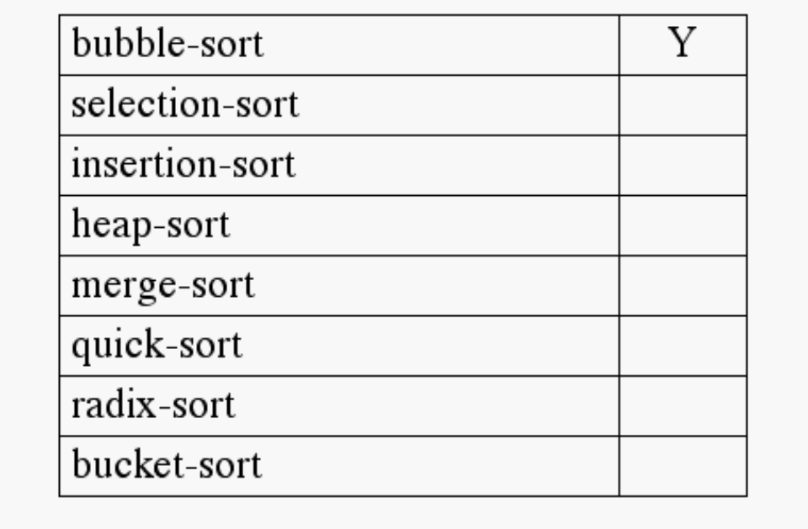
Sorting Algorithms:
In-Place Sorting
A sorting algorithm is said to be in-place if
  it uses no auxiliary data structures (however, O(1) auxiliary variables are allowed)
  it updates the input sequence only by means of operations replaceElement and swapElements
Which sorting algorithms seen so far can be made to work in place?

