Slide 1
Sorting
Chapter 10

Slide 2
Chapter Objectives
To learn how to use the standard sorting methods in the Java API
To learn how to implement the following sorting algorithms: selection sort, bubble sort, insertion sort, Shell sort, merge sort, heapsort, and quicksort
To understand the difference in performance of these algorithms, and which to use for small arrays, which to use for medium arrays, and which to use for large arrays

Slide 3
Using Java Sorting Methods
Java API provides a class Arrays with several overloaded sort methods for different array types
The Collections class provides similar sorting methods
Sorting methods for arrays of primitive types are based on quicksort algorithm
Method of sorting for arrays of objects and Lists based on mergesort

Slide 4
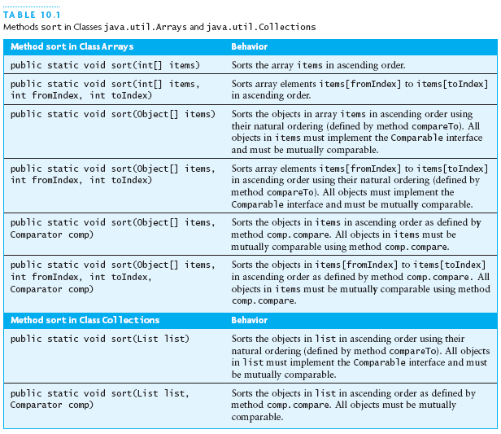
Using Java Sorting Methods (continued)

Slide 5
Selection Sort
Selection sort is a relatively easy to understand algorithm
Sorts an array by making several passes through the array, selecting the next smallest item in the array each time and placing it where it belongs in the array
Efficiency is O(n*n)

Slide 6


Selection Sort (continued)
Selection sort is called a quadratic sort
  Number of comparisons is O(n*n)
  Number of exchanges is O(n)

Slide 7
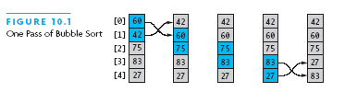
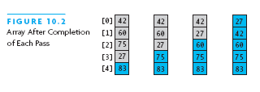
Bubble Sort
Compares adjacent array elements and exchanges their values if they are out of order
Smaller values bubble up to the top of the array and larger values sink to the bottom

Slide 8
Analysis of Bubble Sort
Provides excellent performance in some cases and very poor performances in other cases
Works best when array is nearly sorted to begin with
Worst case number of comparisons is O(n*n)
Worst case number of exchanges is O(n*n)
Best case occurs when the array is already sorted
  O(n) comparisons
  O(1) exchanges

Slide 9
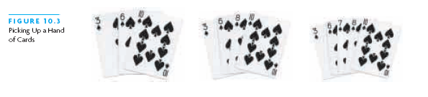
Insertion Sort
Based on the technique used by card players to arrange a hand of cards
  Player keeps the cards that have been picked up so far in sorted order
  When the player picks up a new card, he makes room for the new card and then inserts it in its proper place

Slide 10
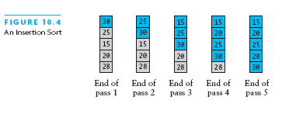
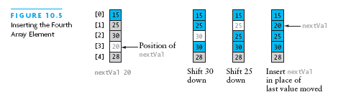
Insertion Sort Algorithm
For each array element from the second to the last (nextPos = 1)
  Insert the element at nextPos where it belongs in the array, increasing the length of the sorted subarray by 1

Slide 11
Analysis of Insertion Sort
Maximum number of comparisons is O(n*n)
In the best case, number of comparisons is O(n)
The number of shifts performed during an insertion is one less than the number of comparisons or, when the new value is the smallest so far, the same as the number of comparisons
A shift in an insertion sort requires the movement of only one item whereas in a bubble or selection sort an exchange involves a temporary item and requires the movement of three items

Slide 12
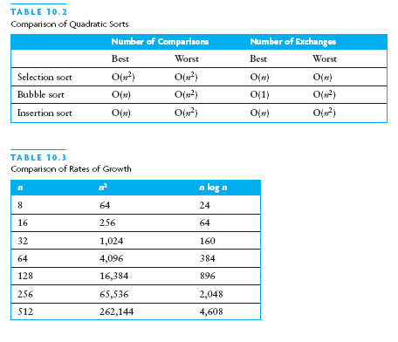
Comparison of Quadratic Sorts
None of the algorithms are particularly good for large arrays

Slide 13




Shell Sort: A Better Insertion Sort
Shell sort is a type of insertion sort but with O(n^(3/2)) or better performance
Named after its discoverer, Donald Shell
Divide and conquer approach to insertion sort
Instead of sorting the entire array, sort many smaller subarrays using insertion sort before sorting the entire array

Slide 14
Analysis of Shell Sort
A general analysis of Shell sort is an open research problem in computer science
Performance depends on how the decreasing sequence of values for gap is chosen
If successive powers of two are used for gap, performance is O(n*n)
If Hibbard’s sequence is used, performance is O(n^(3/2))

Slide 15
Merge Sort
A merge is a common data processing operation that is performed on two sequences of data with the following characteristics
  Both sequences contain items with a common compareTo method
  The objects in both sequences are ordered in accordance with this compareTo method

Slide 16
Merge Algorithm
Merge Algorithm
  Access the first item from both sequences
  While not finished with either sequence
    Compare the current items from the two sequences, copy the smaller current item to the output sequence, and access the next item from the input sequence whose item was copied
  Copy any remaining items from the first sequence to the output sequence
  Copy any remaining items from the second sequence to the output sequence

Slide 17
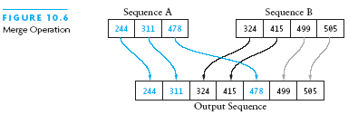
Analysis of Merge
For two input sequences that contain a total of n elements, we need to move each element’s input sequence to its output sequence
  Merge time is O(n)
We need to be able to store both initial sequences and the output sequence
  The array cannot be merged in place
  Additional space usage is O(n)

Slide 18
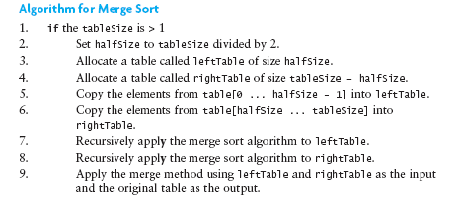
Algorithm and Trace of Merge Sort

Slide 19
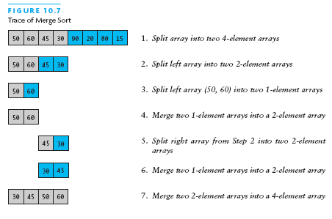
Algorithm and Trace of Merge Sort (continued)

Slide 20
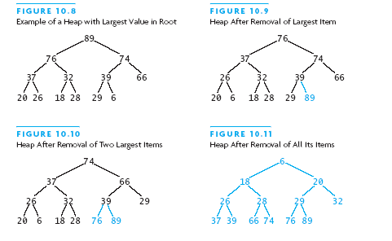
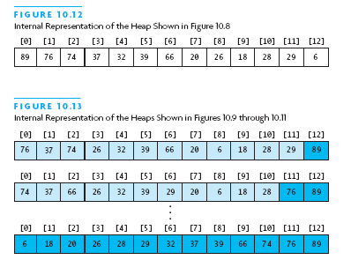
Heapsort
Merge sort time is O(n log n) but still requires, temporarily, n extra storage items
Heapsort does not require any additional storage

Slide 21
Algorithm for In-Place Heapsort
Build a heap by arranging the elements in an unsorted array
While the heap is not empty
  Remove the first item from the heap by swapping it with the last item and restoring the heap property

Slide 22
Quicksort
Developed in 1962
Quicksort rearranges an array into two parts so that all the elements in the left subarray are less than or equal to a specified value, called the pivot
Quicksort ensures that the elements in the right subarray are larger than the pivot
Average case for Quicksort is O(n log n)

Slide 23




Quicksort (continued)

Slide 24
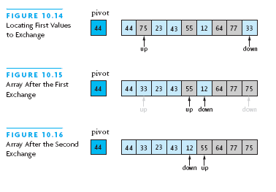
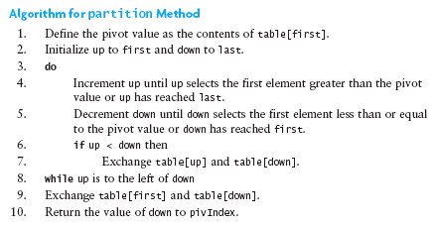

Algorithm for Partitioning

Slide 25
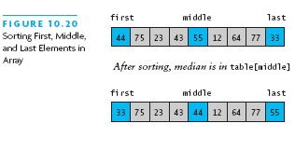
Revised Partition Algorithm
Quicksort is O(n*n) when each split yields one empty subarray, which is the case when the array is presorted
Best solution is to pick the pivot value in a way that is less likely to lead to a bad split
  Requires three markers
    First, middle, last
  Select the median of the these items as the pivot

Slide 26
Testing the Sort Algorithms
Need to use a variety of test cases
  Small and large arrays
  Arrays in random order
  Arrays that are already sorted
  Arrays with duplicate values
Compare performance on each type of array

Slide 27
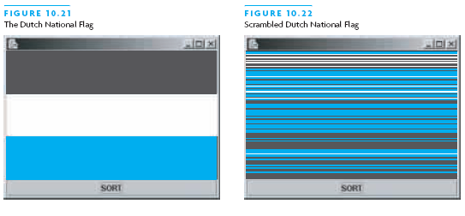
The Dutch National Flag Problem
A variety of partitioning algorithms for quicksort have been published
A partitioning algorithm for partitioning an array into three segments was introduced by Edsger W. Dijkstra
Problem is to partition a disordered three-color flag into the appropriate three segments

Slide 28
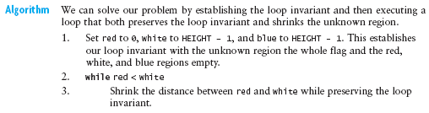
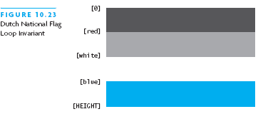
The Dutch National Flag Problem

Slide 29
Chapter Review
Comparison of several sorting algorithms were made
Three quadratic sorting algorithms are selection sort, bubble sort, and insertion sort
Shell sort gives satisfactory performance for arrays up to 5000 elements
Quicksort has an average-case performance of O(n log n), but if the pivot is picked poorly, the worst case performance is O(n*n)
Merge sort and heapsort have O(n log n) performance

Slide 30
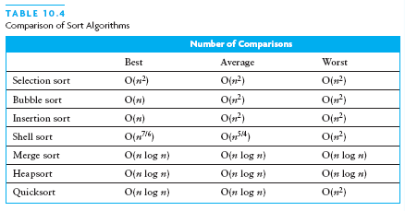
Chapter Review (continued)
The Java API contains “industrial strength” sort algorithms in the classes java.util.Arrays and java.util.Collections

