Slide 1
QuickSort Algorithm
Using Divide and Conquer for Sorting

Slide 2
Topics Covered
QuickSort algorithm
  analysis
Randomized Quick Sort
A Lower Bound on Comparison-Based Sorting

Slide 3
Quick Sort
Divide and conquer idea: Divide problem into two smaller sorting problems.
Divide:
  Select a splitting element (pivot)
  Rearrange the array (sequence/list)

Slide 4
Quick Sort
Result:
  All elements to the left of pivot are smaller or equal than pivot, and
  All elements to the right of pivot are greater or equal than pivot
  pivot in correct place in sorted array/list
Need: Clever split procedure (Hoare)

Slide 5
Quick Sort
Divide: Partition into subarrays (sub-lists)
Conquer: Recursively sort 2 subarrays
Combine: Trivial

Slide 6
QuickSort (Hoare 1962)
Problem: Sort n keys in nondecreasing order
Inputs: Positive integer n, array of keys S indexed from 1 to n
Output: The array S containing the keys in nondecreasing order.
quicksort ( low, high )
1. if high > low
2. then partition(low, high, pivotIndex)
3. quicksort(low, pivotIndex -1)
4. quicksort(pivotIndex +1, high)

Slide 7
Partition array for Quicksort
partition (low, high, pivot)
1. pivotitem = S [low]
2. k = low
3. for j = low +1 to high
4. do if S [ j ] < pivotitem
5. then k = k + 1
6. exchange S [ j ] and S [ k ]
7. pivot = k
8. exchange S[low] and S[pivot]

Slide 8
Input low =1, high = 4
pivotitem = S[1]= 5
after line3
5 3 6 2
5 3 6 2
5 3 6 2
k
j
k
j
k
j
5 3 6 2
after line5
5 3 6 2
j,k
k
j
5 3 2 6
after loop
after line6
5 3 6 2
5 3 2 6
j,k
k
j
pivot
k

Slide 9
Partition on a sorted list
after line3
3 4 6
3 4 6
k
j
k
j
after loop
3 4 6
pivot
k
How does partition work for
S = 7,5,3,1 ?
S= 4,2,3,1,6,7,5

Slide 10
Worst Case Call Tree (N=4)
S =[ 1,3,5,7 ]
Q(1,4)
Left=1, pivotitem = 1, Right =4
Q(1,0)
Q(2,4)
Left =2,pivotItem=3
S =[ 3,5,7 ]
Q(2,1)
Q(3,4)
pivotItem = 5, Left = 3
S =[ 5,7 ]
Q(3,2)
Q(4,4)
S =[ 7 ]
Q(4,3)
Q(5,4)

Slide 11
Worst Case Intuition
n-1
n-1
t(n) =
0
n-2
n-2
0
n-3
n-3
0
n-4
n-4
.
.
.
0
1
1
n
Total =
∑
k = (n+1)n/2
0
0
0
k = 1

Slide 12
Recursion Tree for Best Case
Partition Comparisons
n
n
Nodes contain problem size
n
n/2
n/2
n/4
n/4
n/4
n/4
n
n/8
n/8
n/8
n/8
n/8
n/8
n/8
n
n/8
.
.
>
.
.
>
.
.
>
.
.
>
Sum =Θ(n lgn)

Slide 13
Another Example of O(n lg n) Comparisons
Assume each application of partition () partitions the list so that ≈(n/9) elements remain on the left side of the pivot and ≈(8n/9) elements remain on the right side of the pivot.
We will show that the longest path of calls to Quicksort is proportional to lgn and not n
The longest path has k+1 calls to Quicksort
= 1 + ⎡log _{9/8} n⎤ ≤ 1 + ⎡lgn / lg (9/8)⎤ = 1 + 6⎡lg n⎤
Let n = 1,000,000. The longest path has
1 + 6⎡lg n⎤ = 1 + 6∗20 = 121 << 1,000,000
calls to Quicksort.
  Note: best case is 1+ ⎡lg n⎤ = 1 +7 =8

Slide 14
Recursion Tree for
Magic pivot function that Partitions a “list” into 1/9 and 8/9 “lists”
n
n
n/9
8n/9
n
(log₉ n)
n/81
8n/81
8n/81
64n/81
n
(log_{9/8} n)
n/729
9n/729
256n/729
.
.
>
.
.
>
.
.
>
.
.
>
0/1
n
...
<n
0/1
0/1
<n
0/1

Slide 15
Intuition for the Average case worst partition followed by the best partition
n
Vs
n
1
n-1
1+(n-1)/2
(n-1)/2
(n-1)/2
(n-1)/2
This shows a bad split can be “absorbed” by a good split.
Therefore we feel running time for the average case is
O(n lg n)

Slide 16
Recurrence equation:
Worst case
T(n) = max ( T(q-1) + T(n - q) )+ Θ (n)
0 ≤ q ≤ n-1
Average case
n
A(n) = (1/n) ∑ (A(q -1) + A(n - q ) ) + Θ (n)
q = 1

Slide 17
Sorts and extra memory
When a sorting algorithm does not require more than Θ(1) extra memory we say that the algorithm sorts in-place.
The textbook implementation of Mergesort requires Θ(n) extra space
The textbook implementation of Heapsort is
in-place.
Our implement of Quick-Sort is in-place except for the stack.

Slide 18
Quicksort - enhancements
Choose “good” pivot (random, or mid value between first, last and middle)
When remaining array small use insertion sort

Slide 19
Randomized algorithms
Uses a randomizer (such as a random number generator)
Some of the decisions made in the algorithm are based on the output of the randomizer
The output of a randomized algorithm could change from run to run for the same input
The execution time of the algorithm could also vary from run to run for the same input

Slide 20
Randomized Quicksort
Choose the pivot randomly (or randomly permute the input array before sorting).
The running time of the algorithm is independent of input ordering.
No specific input elicits worst case behavior.
  The worst case depends on the random number generator.
We assume a random number generator Random. A call to Random(a, b) returns a random number between a and b.

Slide 21
RQuicksort-main procedure
// S is an instance "array/sequence"
// terminate recursionquicksort ( low, high )
1. if high > low
2a. then i=random(low, high);
2b. swap(S[high], S[I]);
2c. partition(low, high, pivotIndex)
3. quicksort(low, pivotIndex -1)
4. quicksort(pivotIndex +1, high)

Slide 22
Randomized Quicksort Analysis
We assume that all elements are distinct (to make analysis simpler).
We partition around a random element, all partitions from 0:n-1 to n-1:0 are equally likely
Probability of each partition is 1/n.

Slide 23
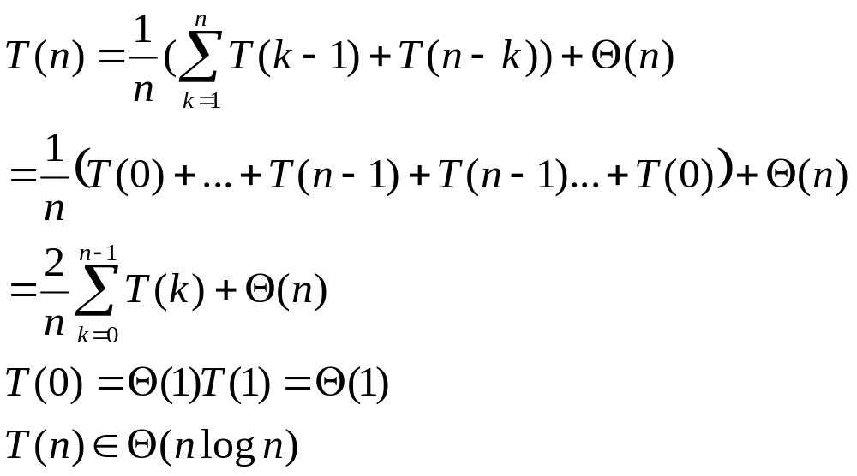
Average case time complexity

Slide 24
Summary of Worst Case Runtime
exchange/insertion/selection sort = Θ(n ²)
mergesort = Θ(n lg n )
quicksort = Θ(n ² )
  average case quicksort = Θ(n lg n )
heapsort = Θ(n lg n )

Slide 25
Sorting
So far, our best sorting algorithms can run in
Θ(n lg n) in the worst case.
CAN WE DO BETTER??

Slide 26
Goal
Show that any correct sorting algorithm based only on comparison of keys needs at least nlgn comparisons in the worst case.
Note: There is a linear general sorting algorithm that does arithmetic on keys. (not based on comparisons)
Outline:
1) Representing a sorting algorithm with a decision tree.
2) Cover the properties of these decision trees.
3) Prove that any correct sorting algorithm based on comparisons needs at least nlgn comparisons.

Slide 27
Decision Trees
A decision tree is a way to represent the working of an algorithm on all possible data of a given size.
  There are different decision trees for each algorithm.
    There is one tree for each input size n.
  Each internal node contains a test of some sort on the data.
  Each leaf contains an output.
  This will model only the comparisons and will ignore all other aspects of the algorithm.

Slide 28
For a particular sorting algorithm
One decision tree for each input size n.
We can view the tree paths as an unwinding of actual execution of the algorithm.
It is a tree of all possible execution traces.

Slide 29
sortThree
a<- S[1]; b<- S[2]; c<- S[3]
a<b
if a < b then
if b < c then
S is a,b,c
else if a < c then
S is a,c,b
else S is c,a,b
else if b < c then
if a < c then
S is b,a,c
else S is b,c,a
else S is c,b,a
yes
no
b<c
b<c
yes
no
yes
no
a,b,c
a<c
c,b,a
a<c
yes
no
yes
no
a,c,b
c,a,b
b,a,c
b,c,a
Decision tree for sortThree
Note: 3! leaves representing 6
permutations of 3 distinct numbers.
2 paths with 2 comparisons
4 paths with 3 comparisons
total 5 comparison

Slide 30
Exchange Sort
1. for (i = 1; i ≤ n -1; i++)
2. for (j = i + 1; j ≤ n ; j++)
3. if ( S[ j ] < S[ i ])
4. swap(S[ i ] ,S[ j ])
At end of i = 1 : S[1] = minS[i]
At end of i = 2 : S[2] = minS[i]
At end of i = 3 : S[3] = minS[i]
1≤ i ≤ n
2≤ i ≤ n
n- 1≤ i ≤ n

Slide 31
Decision Tree for Exchange Sort for N=3
Example =(7,3,5) a,b,c
s[2]<s[1]
i=1
3 7 5
b,a,c
a,b,c
a↔b
s[3]<s[1]
s[3]<s[1]
3 7 5
b,a,c
c,a,b
c↔b
c,b,a
c↔a
a,b,c
s[3]<s[2]
s[3]<s[2]
s[3]<s[2]
s[3]<s[2]
a↔b
c↔a
a↔b
c↔b
c,b,a
c,a,b
b,c,a
b,a,c
c,a,b
c,b,a
a,c,b
a,b,c
3 5 7
Every path and 3 comparisons
Total 7 comparisons
8 leaves ((c,b,a) and (c,a,b) appear twice.

Slide 32
Questions about the Decision Tree
For a Correct Sorting Algorithm
Based ONLY on Comparison of Keys
What is the length of longest path in an insertion sort decision tree? merge sort decision tree?
How many different permutation of a sequence of n elements are there?
How many leaves must a decision tree for a correct sorting algorithm have?
  Number of leaves ≥ n !
What does it mean if there are more than n! leaves?

Slide 33
Proposition: Any decision tree that sorts n elements has depth Ω(n lg n ).
Consider a decision tree for the best sorting algorithm (based on comparison).
It has exactly n! leaves. If it had more than n! leaves then there would be more than one path from the root to a particular permutation. So you can find a better algorithm with n! leaves.
We will show there is a path from the root to a leaf in the decision tree with nlgn comparison nodes.
The best sorting algorithm will have the "shallowest tree"

Slide 34
Proposition: Any Decision Tree that Sorts n Elements has Depth Ω(n lg n ).
Depth of root is 0
Assume that the depth of the "shallowest tree" is d (i.e. there are d comparisons on the longest from the root to a leaf ).
A binary tree of depth d can have at most 2^{d} leaves.
Thus we have :
    n! ≤ 2^{d} ,, taking lg of both sides we get
    d ≥ lg (n!).
  It can be shown that lg (n !) = Ω(n lg n ).
  QED

Slide 35
Implications
The running time of any whole key-comparison based algorithm for sorting an n-element sequence is Ω(n lg n ) in the worst case.
Are there other kinds of sorting algorithms that can run asymptotically faster than comparison based algorithms?

