Slide 1
Sorting
Practice with Analysis

Slide 2
Repeated Minimum
Search the list for the minimum element.
Place the minimum element in the first position.
Repeat for other n-1 keys.
Use current position to hold current minimum to avoid large-scale movement of keys.

Slide 3
Repeated Minimum: Code
Fixed n-1 iterations
for i := 1 to n-1 do
for j := i+1 to n do
if L[i] > L[j] then
Temp = L[i];
L[i] := L[j];
L[j] := Temp;
endif
endfor
endfor
Fixed n-i iterations

Slide 4
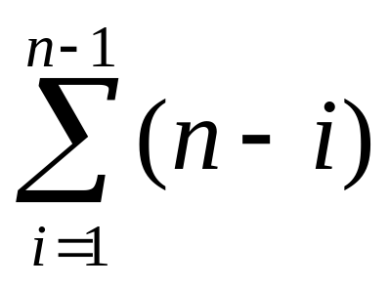
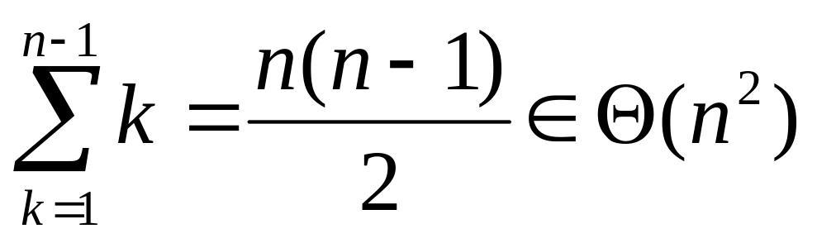
Repeated Minimum: Analysis
Doing it the dumb way:
The smart way: I do one comparison when i=n-1,
two when i=n-2, … , n-1 when i=1.

Slide 5
Bubble Sort
Search for adjacent pairs that are out of order.
Switch the out-of-order keys.
Repeat this n-1 times.
After the first iteration, the last key is guaranteed to be the largest.
If no switches are done in an iteration, we can stop.

Slide 6
Bubble Sort: Code
for i := 1 to n-1 do
Switch := False;
for j := 1 to n-i do
if L[j] > L[j+1] then
Temp = L[j];
L[j] := L[j+1];
L[j+1] := Temp;
Switch := True;
endif
endfor
if Not Switch then break;
endfor
Worst case n-1 iterations
Fixed n-i iterations

Slide 7
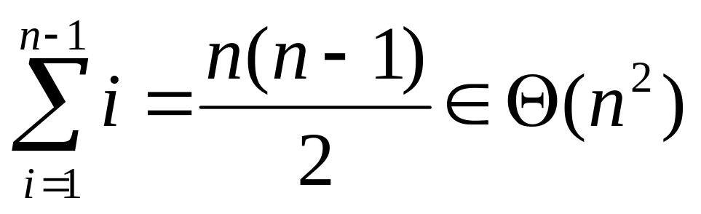
Bubble Sort Analysis
Being smart right from the beginning:

Slide 8
Insertion Sort I
The list is assumed to be broken into a sorted portion and an unsorted portion
Keys will be inserted from the unsorted portion into the sorted portion.
Sorted
Unsorted

Slide 9
Insertion Sort II
For each new key, search backward through sorted keys
Move keys until proper position is found
Place key in proper position
Moved

Slide 10
Insertion Sort: Code
Fixed n-1 iterations
for i:= 2 to n do
x := L[i];
j := i-1;
while j<0 and x < L[j] do
L[j-1] := L[j];
j := j-1;
endwhile
L[j+1] := x;
endfor
Worst case i-1 comparisons

Slide 11
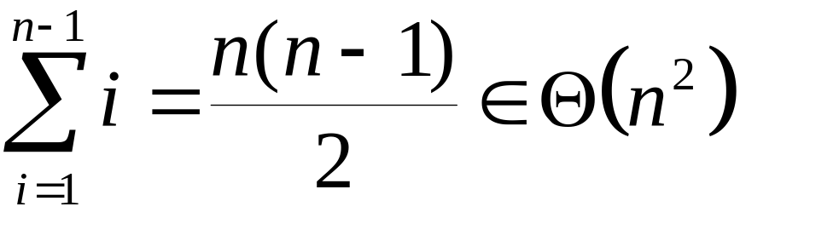
Insertion Sort: Analysis
Worst Case: Keys are in reverse order
Do i-1 comparisons for each new key, where i runs from 2 to n.
Total Comparisons: 1+2+3+ … + n-1

Slide 12
Insertion Sort: Average I
Assume: When a key is moved by the While loop, all positions are equally likely.
There are i positions (i is loop variable of for loop) (Probability of each: 1/i.)
One comparison is needed to leave the key in its present position.
Two comparisons are needed to move key over one position.

Slide 13
Insertion Sort Average II
In general: k comparisons are required to move the key over k-1 positions.
Exception: Both first and second positions require i-1 comparisons.
Position
1
2
3
...
i-2
i-1
i
...
i-1
i-1
i-2
...
3
2
1
Comparisons necessary to place key in this position.

Slide 14
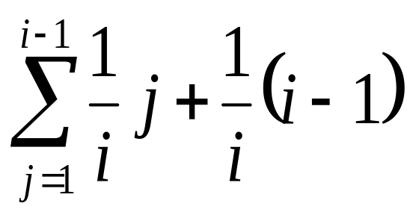
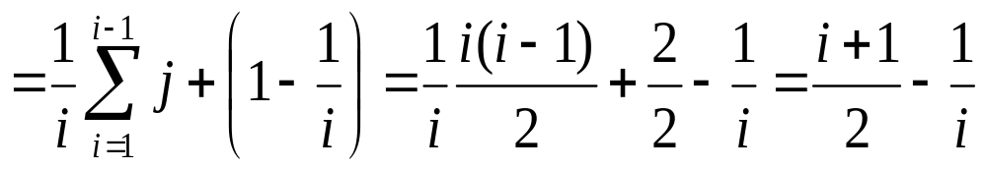
Insertion Sort Average III
Average Comparisons to place one key
Solving

Slide 15
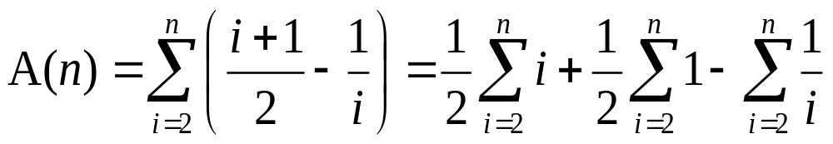
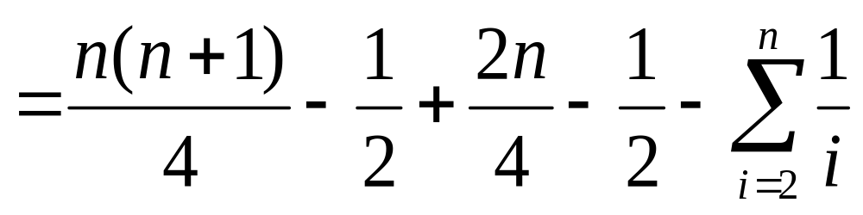
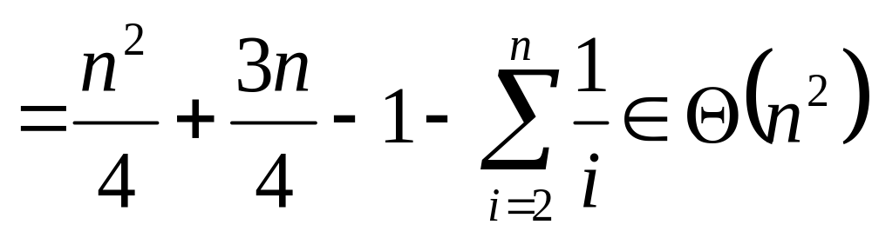
Insertion Sort Average IV
For All Keys:

Slide 16
Optimality Analysis I
To discover an optimal algorithm we need to find an upper and lower asymptotic bound for a problem.
An algorithm gives us an upper bound. The worst case for sorting cannot exceed Θ(n²) because we have Insertion Sort that runs that fast.
Lower bounds require mathematical arguments.

Slide 17
Optimality Analysis II
Making mathematical arguments usually involves assumptions about how the problem will be solved.
Invalidating the assumptions invalidates the lower bound.
Sorting an array of numbers requires at least Θ(n) time, because it would take that much time to rearrange a list that was rotated one element out of position.

Slide 18
Rotating One Element
Assumptions:
Keys must be moved
one at a time
All key movements take
the same amount of time
The amount of time
needed to move one key
is not dependent on n.
2nd
1st
3rd
n keys must
be moved
2nd
4th
3rd
Θ(n) time
nth
n-1st
1st
nth

Slide 19
Other Assumptions
The only operation used for sorting the list is swapping two keys.
Only adjacent keys can be swapped.
This is true for Insertion Sort and Bubble Sort.
Is it true for Repeated Minimum? What about if we search the remainder of the list in reverse order?

Slide 20
Inversions
Suppose we are given a list of elements L, of size n.
Let i, and j be chosen so 1≤i<j≤n.
If L[i]>L[j] then the pair (i,j) is an inversion.
Not an Inversion
1
2
3
5
4
10
6
7
8
9
Inversion
Inversion
Inversion

Slide 21
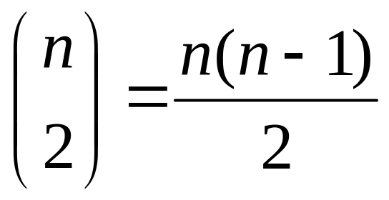
Maximum Inversions
The total number of pairs is:
This is the maximum number of inversions in any list.
Exchanging adjacent pairs of keys removes at most one inversion.

Slide 22
Swapping Adjacent Pairs
The only inversion
that could be removed
is the (possible) one
between the red and
green keys.
Swap Red and Green
The relative position of the Red
and blue areas has not changed.
No inversions between the red key
and the blue area have been removed.
The same is true for the red key and
the orange area. The same analysis can
be done for the green key.

Slide 23
Lower Bound Argument
A sorted list has no inversions.
A reverse-order list has the maximum number of inversions, Θ(n²) inversions.
A sorting algorithm must exchange Θ(n²) adjacent pairs to sort a list.
A sort algorithm that operates by exchanging adjacent pairs of keys must have a time bound of at least Θ(n²).

Slide 24
Lower Bound For Average I
There are n! ways to rearrange a list of n elements.
Recall that a rearrangement is called a permutation.
If we reverse a rearranged list, every pair that used to be an inversion will no longer be an inversion.
By the same token, all non-inversions become inversions.

Slide 25
Lower Bound For Average II
There are n(n-1)/2 inversions in a permutation and its reverse.
Assuming that all n! permutations are equally likely, there are n(n-1)/4 inversions in a permutation, on the average.
The average performance of a “swap-adjacent-pairs” sorting algorithm will be Θ(n²).

Slide 26
Quick Sort I
Split List into “Big” and “Little” keys
Put the Little keys first, Big keys second
Recursively sort the Big and Little keys
Little
Big
Pivot Point

Slide 27
Quicksort II
Big is defined as “bigger than the pivot point”
Little is defined as “smaller than the pivot point”
The pivot point is chosen “at random”
Since the list is assumed to be in random order, the first element of the list is chosen as the pivot point

Slide 28
Quicksort Split: Code
Points to last element
in “Small” section.
Split(First,Last)
SplitPoint := 1;
for i := 2 to n do
if L[i] < L[1] then
SplitPoint := SplitPoint + 1;
Exchange(L[SplitPoint],L[i]);
endif
endfor
Exchange(L[SplitPoint],L[1]);
return SplitPoint;
End Split
Fixed n-1 iterations
Make “Small” section
bigger and move key
into it.
Else the “Big” section
gets bigger.

Slide 29
Quicksort III
Pivot point may not be the exact median
Finding the precise median is hard
If we “get lucky”, the following recurrence applies (n/2 is approximate)

Slide 30
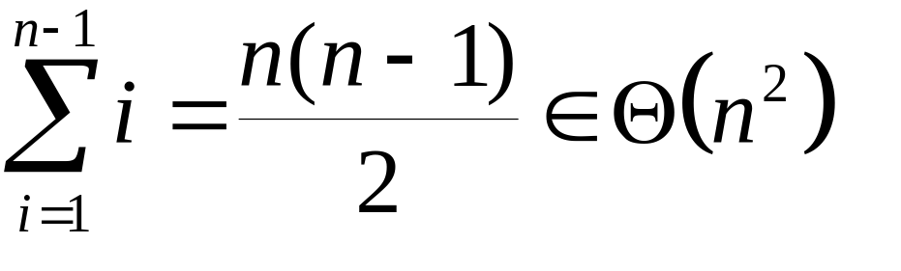
Quicksort IV
If the keys are in order, “Big” portion will have n-1 keys, “Small” portion will be empty.
N-1 comparisons are done for first key
N-2 comparisons for second key, etc.
Result:

Slide 31
QS Avg. Case: Assumptions
Average will be taken over Location of Pivot
All Pivot Positions are equally likely
Pivot positions in each call are independent of one another

Slide 32
QS Avg: Formulation
A(0) = 0
If the pivot appears at position i, 1≤i≤n then A(i-1) comparisons are done on the left hand list and A(n-i) are done on the right hand list.
n-1 comparisons are needed to split the list

Slide 33
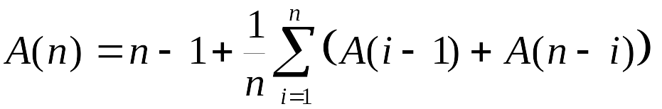
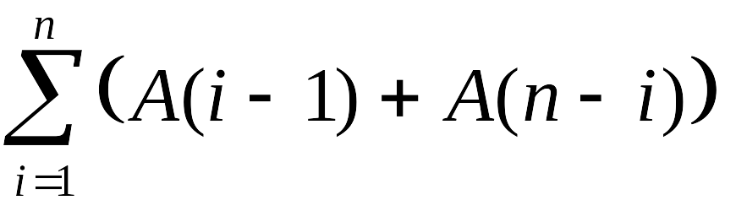

QS Avg: Recurrence

Slide 34
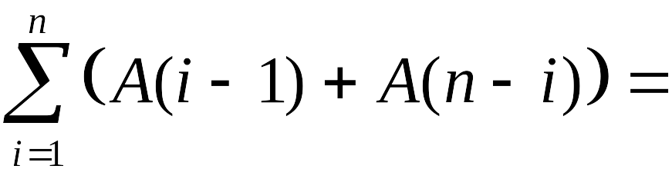
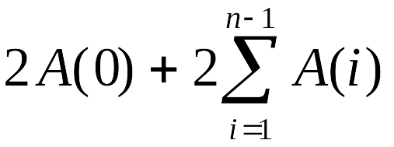
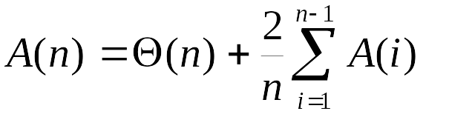
QS Avg: Recurrence II

Slide 35
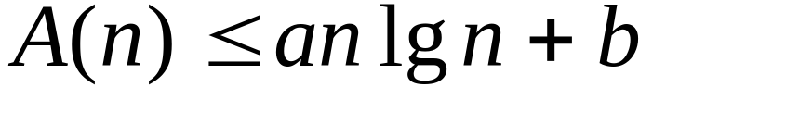
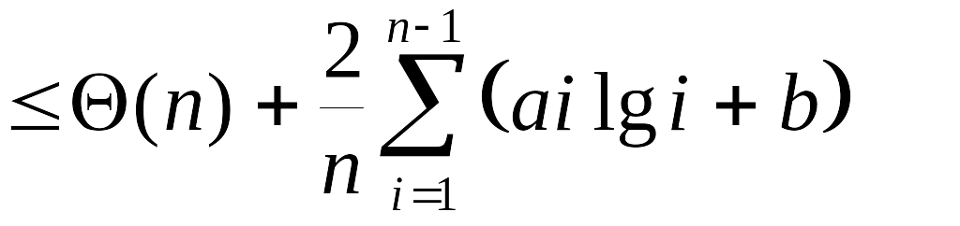
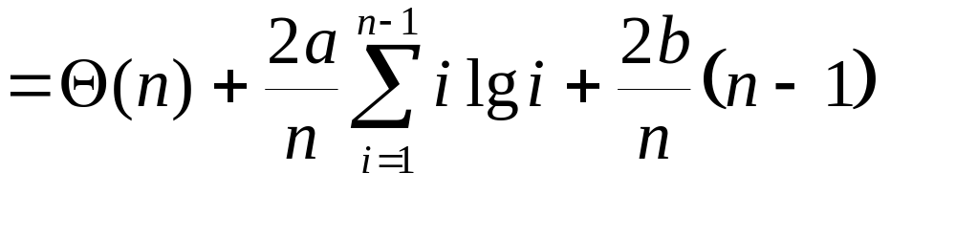
QS Avg: Solving Recurr.
Guess:
a>0, b>0

Slide 36
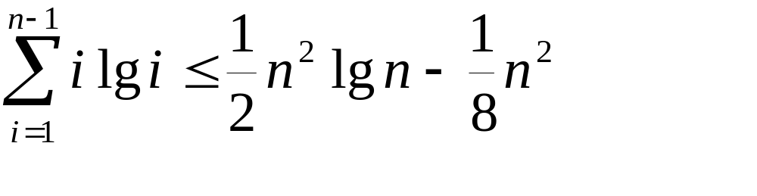
QS Avg: Continuing
By Integration:

Slide 37
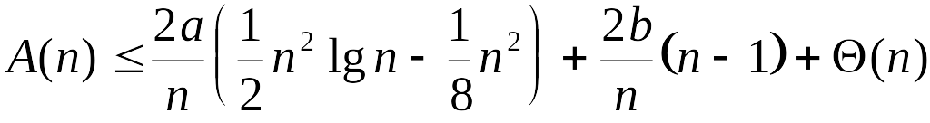
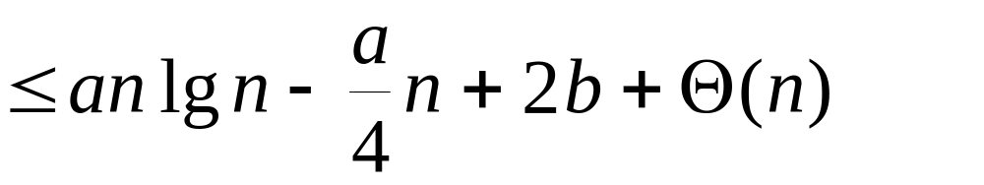
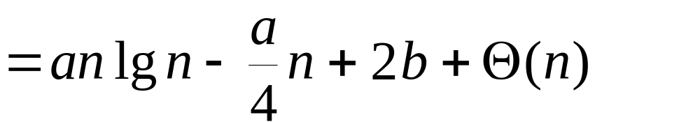
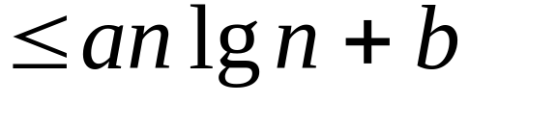
QS Avg: Finally

Slide 38
Merge Sort
If List has only one Element, do nothing
Otherwise, Split List in Half
Recursively Sort Both Lists
Merge Sorted Lists

Slide 39
The Merge Algorithm
Assume we are merging lists A and B into list C.
Ax := 1; Bx := 1; Cx := 1;
while Ax ≤ n and Bx ≤ n do
if A[Ax] < B[Bx] then
C[Cx] := A[Ax];
Ax := Ax + 1;
else
C[Cx] := B[Bx];
Bx := Bx + 1;
endif
Cx := Cx + 1;
endwhile
while Ax ≤ n do
C[Cx] := A[Ax];
Ax := Ax + 1;
Cx := Cx + 1;
endwhile
while Bx ≤ n do
C[Cx] := B[Bx];
Bx := Bx + 1;
Cx := Cx + 1;
endwhile

Slide 40
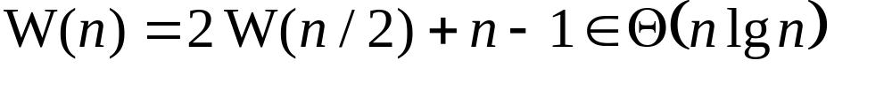
Merge Sort: Analysis
Sorting requires no comparisons
Merging requires n-1 comparisons in the worst case, where n is the total size of both lists (n key movements are required in all cases)
Recurrence relation:

Slide 41
Merge Sort: Space
Merging cannot be done in place
In the simplest case, a separate list of size n is required for merging
It is possible to reduce the size of the extra space, but it will still be Θ(n)

Slide 42
Heapsort: Heaps
Geometrically, a heap is an “almost complete” binary tree.
Vertices must be added one level at a time from right to left.
Leaves must be on the lowest or second lowest level.
All vertices, except one must have either zero or two children.

Slide 43
Heapsort: Heaps II
If there is a vertex with only one child, it must be a left child, and the child must be the rightmost vertex on the lowest level.
For a given number of vertices, there is only one legal structure

Slide 44
Heapsort: Heap examples

Slide 45
Heapsort: Heap Values
Each vertex in a heap contains a value
If a vertex has children, the value in the vertex must be larger than the value in either child.
Example:
20
19
7
12
2
5
6
10
3

Slide 46
Heapsort: Heap Properties
The largest value is in the root
Any subtree of a heap is itself a heap
A heap can be stored in an array by indexing the vertices thus:
The left child of vertex
v has index 2v and
the right child has
index 2v+1
1
2
3
4
5
6
7
8
9

Slide 47
Heapsort: FixHeap
The FixHeap routine is applied to a heap that is geometrically correct, and has the correct key relationship everywhere except the root.
FixHeap is applied first at the root and then iteratively to one child.

Slide 48
Heapsort FixHeap Code
FixHeap(StartVertex)
v := StartVertex;
while 2*v ≤ n do
LargestChild := 2*v;
if 2*v < n then
if L[2*v] < L[2*v+1] then
LargestChild := 2*v+1;
endif
endif
if L[v] < L[LargestChild] Then
Exchange(L[v],L[LargestChild]);
v := LargestChild
else
v := n;
endif
endwhile
end FixHeap
n is the size of the heap
Worst case run time is
Θ(lg n)

Slide 49
Heapsort: Creating a Heap
An arbitrary list can be turned into a heap by calling FixHeap on each non-leaf in reverse order.
If n is the size of the heap, the non-leaf with the highest index has index n/2.
Creating a heap is obviously O(n lg n).
A more careful analysis would show a true time bound of Θ(n)

Slide 50
Heap Sort: Sorting
Turn List into a Heap
Swap head of list with last key in heap
Reduce heap size by one
Call FixHeap on the root
Repeat for all keys until list is sorted

Slide 51
Sorting Example I
20
3
19
7
19
7
12
2
5
6
12
2
5
6
10
3
10
20
19
7
12
2
5
6
10
3
3
19
7
12
2
5
6
10
20

Slide 52
Sorting Example II
19
19
3
7
12
7
12
2
5
6
3
2
5
6
10
10
19
3
7
12
2
5
6
10
20
19
12
7
3
2
5
6
10
20

Slide 53
Sorting Example III
19
12
7
Ready to swap 3 and 19.
10
2
5
6
3
19
12
7
10
2
5
6
3
20

Slide 54
Heap Sort: Analysis
Creating the heap takes Θ(n) time.
The sort portion is Obviously Ο(nlgn)
A more careful analysis would show an exact time bound of Θ(nlgn)
Average and worst case are the same
The algorithm runs in place

Slide 55
A Better Lower Bound
The Θ(n²) time bound does not apply to Quicksort, Mergesort, and Heapsort.
A better assumption is that keys can be moved an arbitrary distance.
However, we can still assume that the number of key-to-key comparisons is proportional to the run time of the algorithm.

Slide 56
Lower Bound Assumptions
Algorithms sort by performing key comparisons.
The contents of the list is arbitrary, so tricks based on the value of a key won’t work.
The only basis for making a decision in the algorithm is by analyzing the result of a comparison.

Slide 57
Lower Bound Assumptions II
Assume that all keys are distinct, since all sort algorithms must handle this case.
Because there are no “tricks” that work, the only information we can get from a key comparison is:
Which key is larger

Slide 58
Lower Bound Assumptions III
The choice of which key is larger is the only point at which two “runs” of an algorithm can exhibit divergent behavior.
Divergent behavior includes, rearranging the keys in two different ways.

Slide 59
Lower Bound Analysis
We can analyze the behavior of a particular algorithm on an arbitrary list by using a tree.
i,j
L[i]<L[j]
L[i]>L[j]
k,l
m,n
L[k]<L[l]
L[k]>L[l]
L[m]<L[n]
L[m]>L[n]
q,p
t,s
r,w
x,y

Slide 60
Lower Bound Analysis
In the tree we put the indices of the elements being compared.
Key rearrangements are assumed, but not explicitly shown.
Although a comparison is an opportunity for divergent behavior, the algorithm does not need to take advantage of this opportunity.

Slide 61
The leaf nodes
In the leaf nodes, we put a summary of all the key rearrangements that have been done along the path from root to leaf.
1->2
2->3
3->1
2->3
3->2
1->2
2->1

Slide 62
The Leaf Nodes II
Each Leaf node represents a permutation of the list.
Since there are n! initial configurations, and one final configuration, there must be n! ways to reconfigure the input.
There must be at least n! leaf nodes.

Slide 63
Lower Bound: More Analysis
Since we are working on a lower bound, in any tree, we must find the longest path from root to leaf. This is the worst case.
The most efficient algorithm would minimize the length of the longest path.
This happens when the tree is as close as possible to a complete binary tree

Slide 64
Lower Bound: Final
A Binary Tree with k leaves must have height at least lg k.
The height of the tree is the length of the longest path from root to leaf.
A binary tree with n! leaves must have height at least lg n!

Slide 65
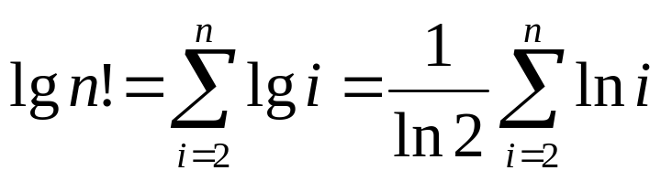
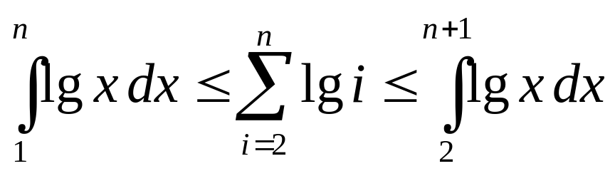
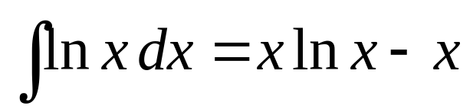
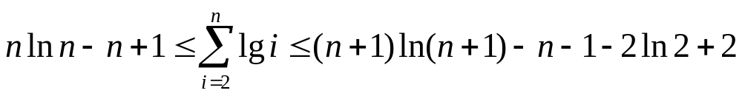
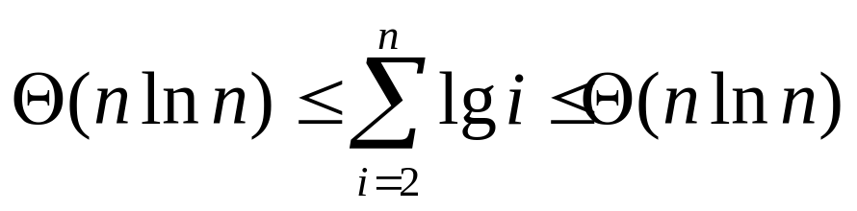
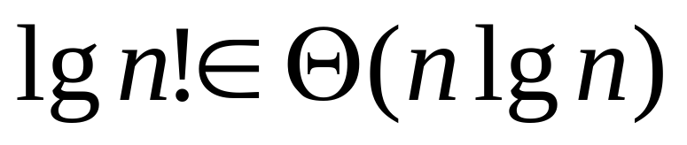
Lower Bound: Algebra

Slide 66
Lower Bound Average Case
Cannot be worse than worst case
Θ(n lg n)
Can it be better?
To find average case, add up the lengths of all paths in the decision tree, and divide by the number of leaves.

Slide 67
Lower Bound Avg. II
Because all non-leaves have two children, compressing the tree to make it more balanced will reduce the total sum of all path lengths.
Switch X and C
X
C
C
A
B
X
Path from root to C increases by 1,
Path from root to A&B decreases by 1,
Net reduction of 1 in the total.
A
B

Slide 68
Lower Bound Avg. III
Algorithms with balanced decision trees perform better, on the average than algorithms with unbalanced trees.
In a balanced tree with as few leaves as possible, there will be n! leaves and the path lengths will all be of length lg n!.
The average will be lg n!, which is
Θ(n lg n)

Slide 69
Radix Sort
Start with least significant digit
Separate keys into groups based on value of current digit
Make sure not to disturb original order of keys
Combine separate groups in ascending order
Repeat, scanning digits in reverse order

Slide 70
Radix Sort: Example
0 0 0
1 0 0
0 1 0
0 1 0
1 0 0
0 1 1
0 0 1
0 0 0
1 0 0
1 0 0
0 0 0
0 1 0
0 1 0
1 0 1
1 1 0
1 1 0
1 0 1
1 0 0
0 1 1
0 0 1
0 0 0
0 0 0
0 0 1
1 0 1
0 1 1
0 1 0
1 1 0
0 1 0
1 0 0
0 1 1
1 0 1
1 1 0
0 0 0
1 1 0
1 0 1
1 0 1
0 0 1
0 1 1
0 0 1
0 1 1
1 1 0
0 0 1
1 1 1
1 1 1
1 1 1
1 1 1
1 1 1
1 1 1

Slide 71
Radix Sort: Analysis
Each digit requires n comparisons
The algorithm is Θ(n)
The preceding lower bound analysis does not apply, because Radix Sort does not compare keys.
Radix Sort is sometimes known as bucket sort. (Any distinction between the two is unimportant
Alg. was used by operators of card sorters.

