Slide 1
Sorting Algorithms
Cpt S 223. School of EECS, WSU
Notes:
Cpt S 223
Washington State University

Slide 2
Sorting methods
Comparison based sorting
  O(n²) methods
    E.g., Insertion, bubble
  Average time O(n log n) methods
    E.g., quick sort
  O(n logn) methods
    E.g., Merge sort, heap sort
Non-comparison based sorting
  Integer sorting: linear time
    E.g., Counting sort, bin sort
  Radix sort, bucket sort
Stable vs. non-stable sorting
Cpt S 223. School of EECS, WSU
Notes:
Cpt S 223
Washington State University

Slide 3
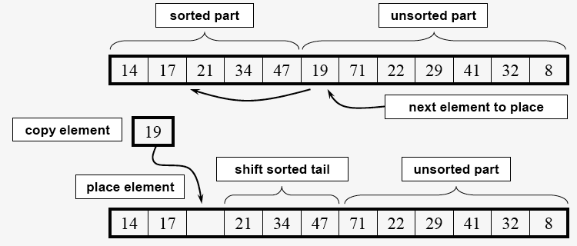
Insertion sort: snapshot at a given iteration
comparisons
Worst-case run-time complexity: Θ(n²)
Best-case run-time complexity: Θ(n)
When?
When?
Cpt S 223. School of EECS, WSU
Image courtesy: McQuain WD, VA Tech, 2004
Notes:
Cpt S 223
Washington State University

Slide 4
The Divide and Conquer Technique
Input: A problem of size n
Recursive
At each level of recursion:
  (Divide)
    Split the problem of size n into a fixed number of sub-problems of smaller sizes, and solve each sub-problem recursively
  (Conquer)
    Merge the answers to the sub-problems
Cpt S 223. School of EECS, WSU
Notes:
Cpt S 223
Washington State University

Slide 5
Two Divide & Conquer sorts
Merge sort
  Divide is trivial
  Merge (i.e, conquer) does all the work
Quick sort
  Partition (i.e, Divide) does all the work
  Merge (i.e, conquer) is trivial
Cpt S 223. School of EECS, WSU
Notes:
Cpt S 223
Washington State University

Slide 6
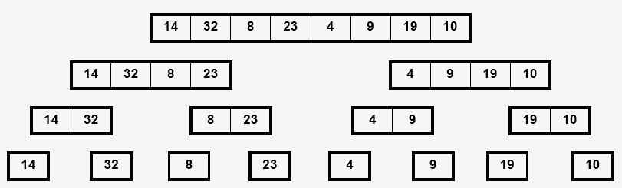
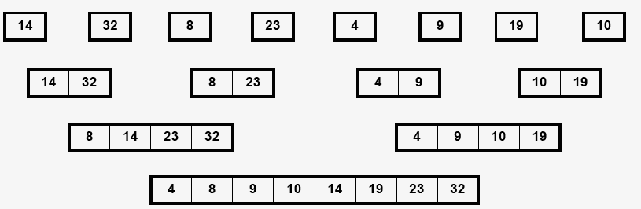
Merge Sort
Main idea:
Dividing is trivial
Merging is non-trivial
Input
(divide)
O(lg n)
steps
How much work
at every step?
O(n) sub-problems
(conquer)
O(lg n)
steps
How much work
at every step?
Cpt S 223. School of EECS, WSU
Image courtesy: McQuain WD, VA Tech, 2004
Notes:
Cpt S 223
Washington State University

Slide 7
How to merge two sorted arrays?
i
j
A1
8 | 14 | 23 | 32
A2
4 | 9 | 10 | 19
1. B[k++] =Populate min{ A1[i], A2[j] }
2. Advance the minimum contributing pointer
B
4
8
9
10
14
19
23
32
Temporary
array to hold
the output
k
Θ(n) time
Do you always need the temporary array B to store the output, or can you do this inplace?
Cpt S 223. School of EECS, WSU
Notes:
Cpt S 223
Washington State University

Slide 8
Merge Sort : Analysis
Merge Sort takes Θ(n lg n) time
Proof:
  Let T(n) be the time taken to merge sort n elements
  Time for each comparison operation=O(1)
  Main observation: To merge two sorted arrays of size n/2, it takes n comparisons at most.
  Therefore:
  T(n) = 2 T(n/2) + n
  Solving the above recurrence:
    T(n) = 2 [ 2 T(n/2²) + n/2 ] + n
    = 2² T(n/2²) + 2n
    … (k times)
    = 2^{k} T(n/2^{k}) + kn
    At k = lg n, T(n/2^{k}) = T(1) = 1 (termination case)
    ==> T(n) = Θ(n lg n)
Cpt S 223. School of EECS, WSU
Notes:
Cpt S 223
Washington State University

Slide 9
QuickSort
Main idea:
Dividing (“partitioning”) is non-trivial
Merging is trivial
Divide-and-conquer approach to sorting
Like MergeSort, except
  Don’t divide the array in half
  Partition the array based elements being less than or greater than some element of the array (the pivot)
  i.e., divide phase does all the work; merge phase is trivial.
Worst case running time O(N²)
Average case running time O(N log N)
Fastest generic sorting algorithm in practice
Even faster if use simple sort (e.g., InsertionSort) when array becomes small
Cpt S 223. School of EECS, WSU
Notes:
Cpt S 223
Washington State University

Slide 10
QuickSort Algorithm
QuickSort( Array: S)
  If size of S is 0 or 1, return
  Pivot = Pick an element v in S
  Partition S – {v} into two disjoint groups
    S1 = {x ∈ (S – {v}) | x < v}
    S2 = {x ∈ (S – {v}) | x > v}
  Return QuickSort(S1), followed by v, followed by QuickSort(S2)
Q) What’s the best way to pick this element? (arbitrary? Median? etc)
Cpt S 223. School of EECS, WSU
Notes:
Cpt S 223
Washington State University

Slide 11
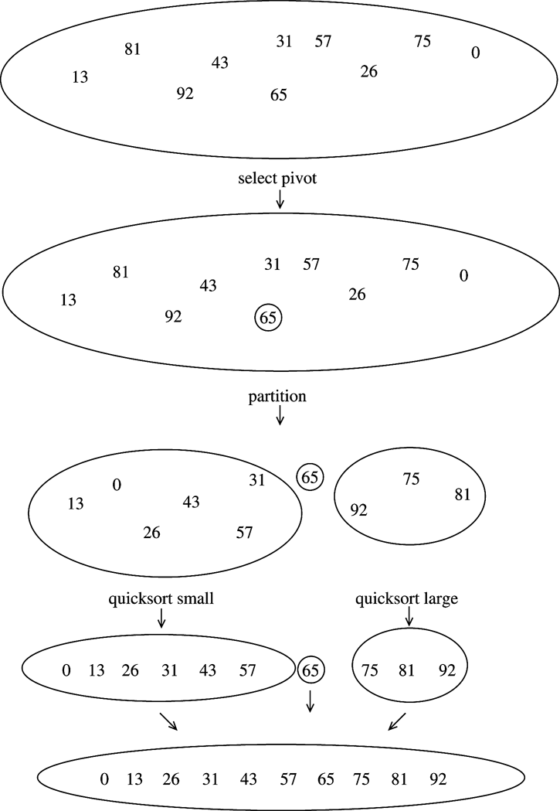
QuickSort Example
Cpt S 223. School of EECS, WSU
Notes:
Cpt S 223
Washington State University

Slide 12
QuickSort vs. MergeSort
Main problem with quicksort:
  QuickSort may end up dividing the input array into subproblems of size 1 and N-1 in the worst case, at every recursive step (unlike merge sort which always divides into two halves)
    When can this happen?
    Leading to O(N²) performance
  =>Need to choose pivot wisely (but efficiently)
MergeSort is typically implemented using a temporary array (for merge step)
  QuickSort can partition the array “in place”
Cpt S 223. School of EECS, WSU
Notes:
Cpt S 223
Washington State University

Slide 13
Picking the Pivot
Goal: A “good” pivot is one that creates two even sized partitions
=> Median will be best, but finding median
could be as tough as sorting itself
How about choosing the first element?
  What if array already or nearly sorted?
  Good for a randomly populated array
How about choosing a random element?
  Good in practice if “truly random”
  Still possible to get some bad choices
  Requires execution of random number generator
Cpt S 223. School of EECS, WSU
Notes:
Cpt S 223
Washington State University

Slide 14
Picking the Pivot
8 1 4 9 0 3 5 2 7 6
Best choice of pivot
  Median of array
  But median is expensive to calculate
Next strategy: Approximate the median
  Estimate median as the median of any three elements
    Median = median {first, middle, last}
    Has been shown to reduce
    running time (comparisons) by 14%
will result in
1 0 3 2 4 8 9 5 7 6
pivot
8 1 4 9 0 3 5 2 7 6
will result in
1 4 0 3 5 2 6 8 9 7
Cpt S 223. School of EECS, WSU
Notes:
Cpt S 223
Washington State University

Slide 15
How to write the partitioning code?
6 1 4 9 0 3 5 2 7 8
should result in
1 4 0 3 5 2 6 9 7 8
Goal of partitioning:
  i) Move all elements < pivot to the left of pivot
  ii) Move all elements > pivot to the right of pivot
Partitioning is conceptually straightforward, but easy to do inefficiently
One bad way:
  Do one pass to figure out how many elements should be on either side of pivot
  Then create a temp array to copy elements relative to pivot
Cpt S 223. School of EECS, WSU
Notes:
Cpt S 223
Washington State University

Slide 16
Partitioning strategy
6 1 4 9 0 3 5 2 7 8
should result in
1 4 0 3 5 2 6 9 7 8
A good strategy to do partition : do it in place
  // Swap pivot with last element S[right]
  i = left
  j = (right – 1)
  While (i < j) {
    // advance i until first element > pivot
    // decrement j until first element < pivot
    // swap A[i] & A[j] (only if i<j)
  }
  Swap ( pivot , S[i] )
OK to also swap with S[left] but then the rest of the code should change accordingly
This is called
“in place” because
all operations are done
in place of the input
array (i.e., without
creating temp array)
Cpt S 223. School of EECS, WSU
Notes:
Cpt S 223
Washington State University

Slide 17
Partitioning Strategy
An in place partitioning algorithm
  Swap pivot with last element S[right]
  i = left
  j = (right – 1)
  while (i < j)
    { i++; } until S[i] > pivot
    { j--; } until S[j] < pivot
    If (i < j), then swap( S[i] , S[j] )
  Swap ( pivot , S[i] )
Needs a few
boundary case
handling
Cpt S 223. School of EECS, WSU
Notes:
Cpt S 223
Washington State University

Slide 18
Partitioning Example
“Median of three” approach to picking the pivot:
=> compares the first, last and middle elements and pick the median of those three
pivot = min{8,6,0} = 6
  Swap pivot with last element S[right]
  i = left
  j = (right – 1)
left
right
8 1 4 9 6 3 5 2 7 0 Initial array
8 1 4 9 0 3 5 2 7 6 Swap pivot; initialize i and j
i j
8 1 4 9 0 3 5 2 7 6 Move i and j inwards until conditions violated
i j
2 1 4 9 0 3 5 8 7 6 After first swap
i j
Positioned to swap
swapped
  While (i < j) {
    { i++; } until S[i] > pivot
    { j--; } until S[j] < pivot
    If (i < j), then swap( S[i] , S[j] )
    }
Cpt S 223. School of EECS, WSU
Notes:
Cpt S 223
Washington State University

Slide 19
Partitioning Example (cont.)
After a few steps …
2 1 4 9 0 3 5 8 7 6 Before second swap
i j
2 1 4 5 0 3 9 8 7 6 After second swap
i j
2 1 4 5 0 3 9 8 7 6 i has crossed j
j i
2 1 4 5 0 3 6 8 7 9 After final swap with pivot
i p
Swap (pivot , S[i] )
Cpt S 223. School of EECS, WSU
Notes:
Cpt S 223
Washington State University

Slide 20
Handling Duplicates
What happens if all input elements are equal?
Current approach:
    { i++; } until S[i] > pivot
    { j--; } until S[j] < pivot
What will happen?
  i will advance all the way to the right end
  j will advance all the way to the left end
  => pivot will remain in the right position, creating the left partition to contain N-1 elements and empty right partition
      Worst case O(N²) performance
Special case: 6 6 6 6 6 6 6 6 6 6 6 6 6 6 6 6
Cpt S 223. School of EECS, WSU
Notes:
Cpt S 223
Washington State University

Slide 21
Handling Duplicates
A better code
  Don’t skip elements equal to pivot
    { i++; } until S[i] ≥ pivot
    { j--; } until S[j] ≤ pivot
  Adds some unnecessary swaps
  But results in perfect partitioning for array of identical elements
    Unlikely for input array, but more likely for recursive calls to QuickSort
Special case: 6 6 6 6 6 6 6 6 6 6 6 6 6 6 6 6
What will happen now?
Cpt S 223. School of EECS, WSU
Notes:
Cpt S 223
Washington State University

Slide 22
Small Arrays
When S is small, recursive calls become expensive (overheads)
General strategy
  When size < threshold, use a sort more efficient for small arrays (e.g., InsertionSort)
  Good thresholds range from 5 to 20
  Also avoids issue with finding median-of-three pivot for array of size 2 or less
  Has been shown to reduce running time by 15%
Cpt S 223. School of EECS, WSU
Notes:
Cpt S 223
Washington State University

Slide 23
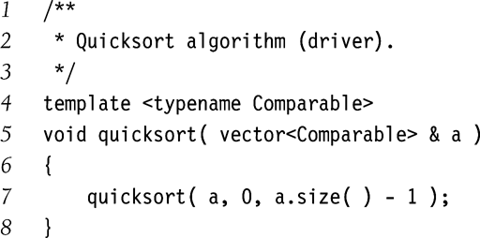
QuickSort Implementation
left
right
Cpt S 223. School of EECS, WSU
Notes:
Cpt S 223
Washington State University

Slide 24
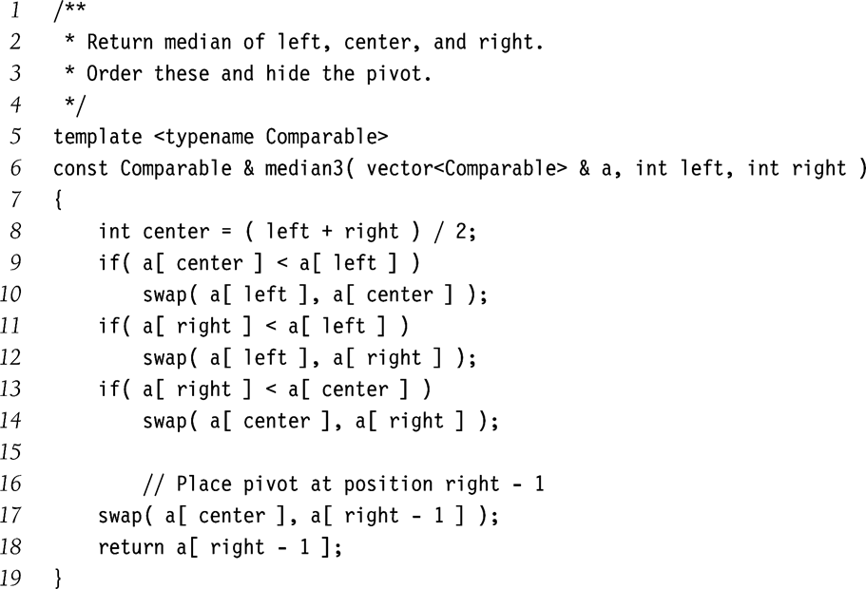
QuickSort Implementation
8 1 4 9 6 3 5 2 7 0
L C R
6 1 4 9 8 3 5 2 7 0
L C R
0 1 4 9 8 3 5 2 7 6
L C R
0 1 4 9 6 3 5 2 7 8
L C R
0 1 4 9 7 3 5 2 6 8
L C P R
Cpt S 223. School of EECS, WSU
Notes:
Cpt S 223
Washington State University

Slide 25
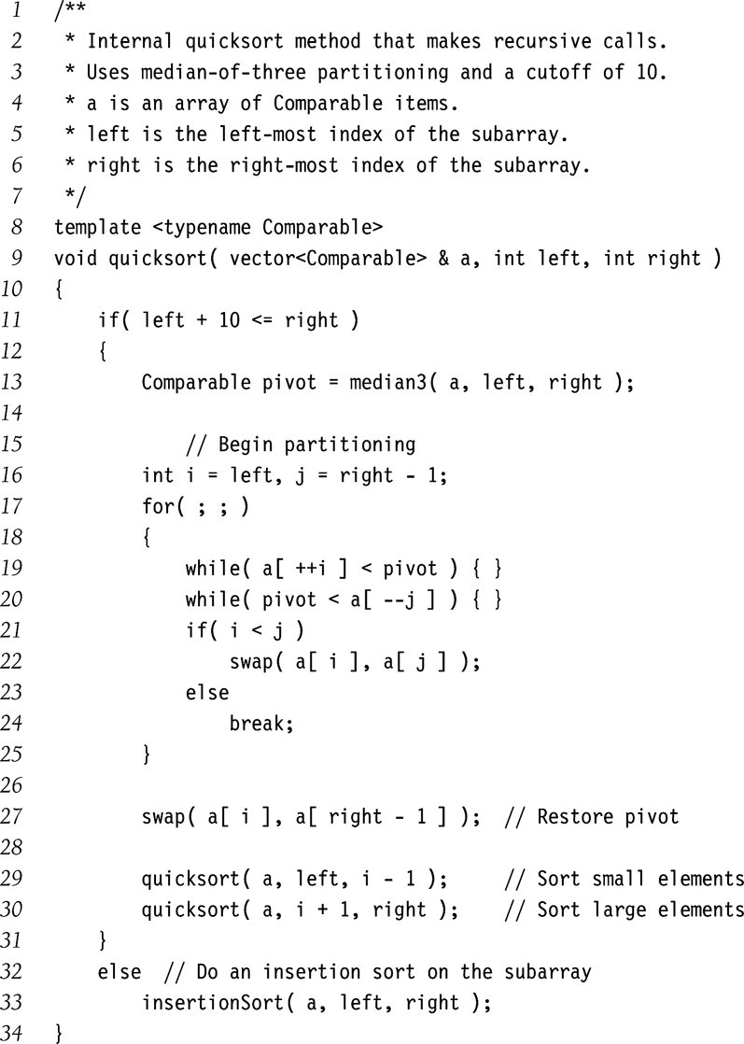
Assign pivot as median of 3
partition based on pivot
Swap should be compiled inline.
Recursively sort
partitions
Cpt S 223. School of EECS, WSU
Notes:
Cpt S 223
Washington State University

Slide 26
Analysis of QuickSort
Let T(N) = time to quicksort N elements
Let L = #elements in left partition
=> #elements in right partition = N-L-1
Base: T(0) = T(1) = O(1)
T(N) = T(L) + T(N – L – 1) + O(N)
Time to sort left
partition
Time to sort right
partition
Time for partitioning at current recursive step
Cpt S 223. School of EECS, WSU
Notes:
Cpt S 223
Washington State University

Slide 27
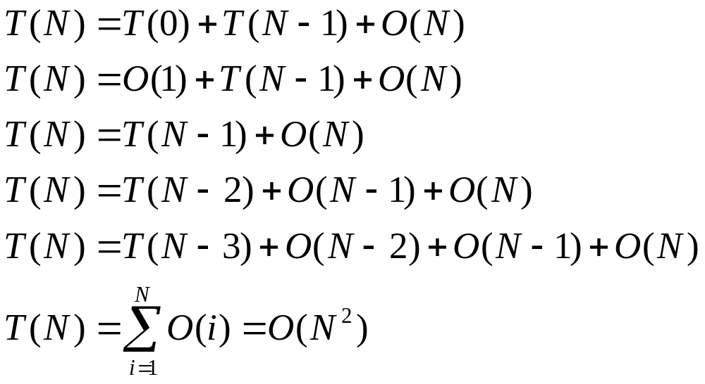
Analysis of QuickSort
Worst-case analysis
  Pivot is the smallest element (L = 0)
Cpt S 223. School of EECS, WSU
Notes:
Cpt S 223
Washington State University

Slide 28
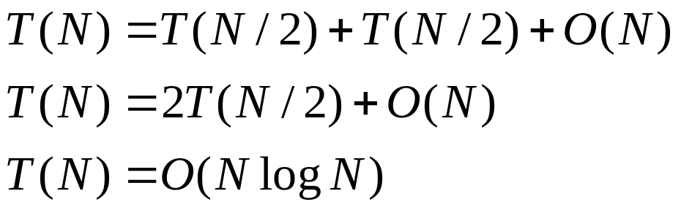
Analysis of QuickSort
Best-case analysis
  Pivot is the median (sorted rank = N/2)
Average-case analysis
  Assuming each partition equally likely
  T(N) = O(N log N)
HOW?
Cpt S 223. School of EECS, WSU
Notes:
Cpt S 223
Washington State University

Slide 29
QuickSort: Avg Case Analysis
T(N) = T(L) + T(N-L-1) + O(N)
All partition sizes are equally likely
  => Avg T(L) = Avg T(N-L-1) = 1/N ∑_{j=0}^{N-1} T(j)
  => Avg T(N) = 2/N [ ∑_{j=0}^{N-1} T(j) ] + cN
  => N T(N) = 2 [ ∑_{j=0}^{N-1} T(j) ] + cN² => (1)
  Substituting N by N-1 …
  =>(N-1) T(N-1) = 2 [ ∑_{j=0}^{N-2} T(j) ] + c(N-1)² => (2)
  (1)-(2)
    => NT(N) - (N-1)T(N-1)
    = 2 T(N-1) + c (2N-1)
Cpt S 223. School of EECS, WSU
Notes:
Cpt S 223
Washington State University

Slide 30
Avg case analysis …
NT(N) = (N+1)T(N-1) + c (2N-1)
T(N)/(N+1) ≈ T(N-1)/N + c2/(N+1)
Telescope, by substituting N with N-1, N-2, N-3, .. 2
…
T(N) = O(N log N)
Cpt S 223. School of EECS, WSU
Notes:
Cpt S 223
Washington State University

Slide 31
Comparison Sorting
Sort | Worst Case | Average Case | Best Case | Comments
InsertionSort | Θ(N²) | Θ(N²) | Θ(N) | Fast for small N
MergeSort | Θ(N log N) | Θ(N log N) | Θ(N log N) | Requires memory
HeapSort | Θ(N log N) | Θ(N log N) | Θ(N log N) | Large constants
QuickSort | Θ(N²) | Θ(N log N) | Θ(N log N) | Small constants
Cpt S 223. School of EECS, WSU
Notes:
Cpt S 223
Washington State University

Slide 32
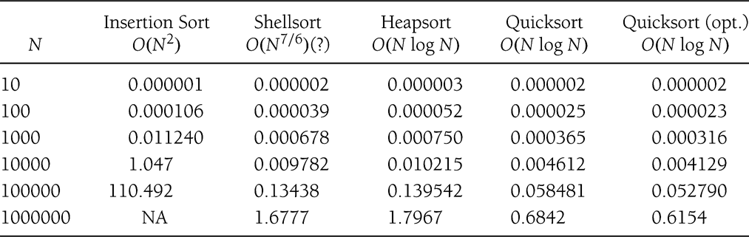
Comparison Sorting
Good sorting applets
http://www.cs.ubc.ca/~harrison/Java/sorting-demo.html
http://math.hws.edu/TMCM/java/xSortLab/
Sorting benchmark: http://sortbenchmark.org/
Cpt S 223. School of EECS, WSU
Notes:
Cpt S 223
Washington State University

Slide 33
Lower Bound on Sorting
What is the best we can do on comparison based sorting?
Best worst-case sorting algorithm (so far) is O(N log N)
  Can we do better?
Can we prove a lower bound on the sorting problem, independent of the algorithm?
  For comparison sorting, no, we can’t do better than
  O(N log N)
  Can show lower bound of Ω(N log N)
Cpt S 223. School of EECS, WSU
Notes:
Cpt S 223
Washington State University

Slide 34
Proving lower bound on sorting using “Decision Trees”
A decision tree is a binary tree where:
  Each node
    lists all left-out open possibilities (for deciding)
  Path of each node
    represents a decided sorted prefix of elements
  Each branch
    represents an outcome of a particular comparison
  Each leaf
    represents a particular ordering of the original array elements
Cpt S 223. School of EECS, WSU
Notes:
Cpt S 223
Washington State University

Slide 35
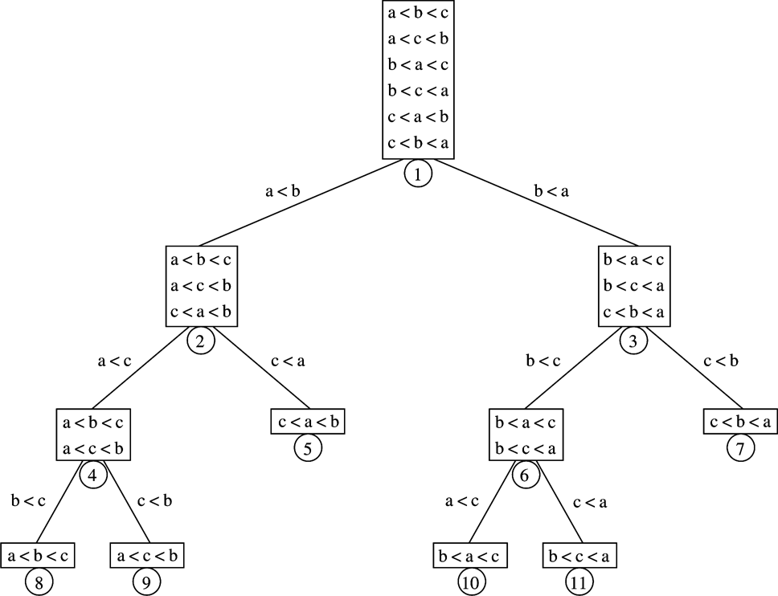
Root = all open possibilities
IF a<b:
possible
A decision tree to sort three elements {a,b,c}
(assuming no duplicates)
Height =
Ω(lg n!)
all remaining open possibilities
IF a<c:
possible
Worst-case
evaluation path
for any algorithm
n! leaves
in this tree
Notes:
Cpt S 223
Washington State University

Slide 36
Decision Tree for Sorting
The logic of any sorting algorithm that uses comparisons can be represented by a decision tree
In the worst case, the number of comparisons used by the algorithm equals the HEIGHT OF THE DECISION TREE
In the average case, the number of comparisons is the average of the depths of all leaves
There are N! different orderings of N elements
Cpt S 223. School of EECS, WSU
Notes:
Cpt S 223
Washington State University

Slide 37
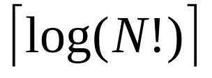
Lower Bound for
Comparison Sorting
Lemma: A binary tree with L leaves must have depth at least ceil(lg L)
Sorting’s decision tree has N! leaves
Theorem: Any comparison sort may require at least comparisons in the worst case
Cpt S 223. School of EECS, WSU
Notes:
Cpt S 223
Washington State University

Slide 38
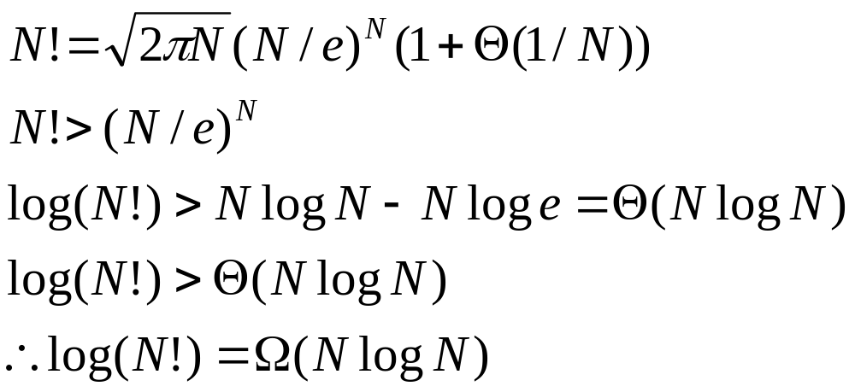
Lower Bound for
Comparison Sorting
Theorem: Any comparison sort requires Ω(N log N) comparisons
Proof (uses Stirling’s approximation)
≈
Cpt S 223. School of EECS, WSU
Notes:
Cpt S 223
Washington State University

Slide 39
Implications of the sorting lower bound theorem
Comparison based sorting cannot be achieved in less than (n lg n) steps
=> Merge sort, Heap sort are optimal
=> Quick sort is not optimal but pretty good as optimal in practice
=> Insertion sort, bubble sort are clearly sub-optimal, even in practice
Cpt S 223. School of EECS, WSU
Notes:
Cpt S 223
Washington State University

Slide 40
Non comparison based sorting
Integer sorting
e.g., Counting sort
Bucket sort
Radix sort
Cpt S 223. School of EECS, WSU
Notes:
Cpt S 223
Washington State University

Slide 41
Integer Sorting
Non comparison based
Some input properties allow to eliminate the need for comparison
  E.g., sorting an employee database by age of employees
Counting Sort
  Given array A[1..N], where 1 ≤ A[i] ≤ M
  Create array C of size M, where C[i] is the number of i’s in A
  Use C to place elements into new sorted array B
  Running time Θ(N+M) = Θ(N) if M = Θ(N)
Cpt S 223. School of EECS, WSU
Notes:
Cpt S 223
Washington State University

Slide 42
Counting Sort: Example
1 | 2 | 3 | 4 | 5 | 6 | 7 | 8 | 9 | 10
Input A:
0 | 3 | 2 | 1 | 3 | 2 | 1 | 2 | 2 | 3
N=10
M=4
(all elements in input between 0 and 3)
Count array C:
Output sorted array:
0
1
2
3
1
2
4
3
1
2
3
4
5
6
7
8
9
10
0
1
1
2
2
2
2
3
3
3
Time = O(N + M)
If (M < N), Time = O(N)
Cpt S 223. School of EECS, WSU
Notes:
Cpt S 223
Washington State University

Slide 43
Stable vs. nonstable sorting
A “stable” sorting method is one which preserves the original input order among duplicates in the output
Input:
0 | 3 | 2 | 1 | 3 | 2 | 1 | 2 | 2 | 3
Output:
0
1
1
2
2
2
2
3
3
3
Useful when each data is a struct of form { key, value }
Cpt S 223. School of EECS, WSU
Notes:
Cpt S 223
Washington State University

Slide 44
How to make counting sort “stable”? (one approach)
1 | 2 | 3 | 4 | 5 | 6 | 7 | 8 | 9 | 10
Input A:
0 | 3 | 2 | 1 | 3 | 2 | 1 | 2 | 2 | 3
N=10
M=4
(all elements in input between 0 and 3)
Count array C:
0
1
2
3
1
2
4
3
0
Output sorted array:
1
1
2
2
2
2
1
2
3
4
5
6
7
8
9
10
3
3
3
0
1
1
2
2
2
2
3
3
3
But this algorithm is NOT in-place!
Can we make counting sort in place?
(i.e., without using another array or linked list)
Cpt S 223. School of EECS, WSU
Notes:
Cpt S 223
Washington State University

Slide 45
How to make counting sort in place?
void CountingSort_InPlace(vector a, int n) {
1. First construct Count array C s.t C[i] stores the last index in the bin corresponding to key i, where the next instance of i should be written to. Then do the following:
i=0;
while(i<n) {
e=A[i];
if c[e] has gone below range, then continue after i++;
if(i==c[e]) i++;
tmp = A[c[e]];
A[c[e]--] = e;
A[i] = tmp;
}
}
Note: This code has to keep track
of the valid range for
each key
Cpt S 223. School of EECS, WSU
Notes:
Cpt S 223
Washington State University

Slide 46
0 | 1 | 2 | 3 | 4 | 5 | 6 | 7 | 8 | 9
End
points
A:
0 | 3 | 2 | 1 | 3 | 2 | 1 | 2 | 2 | 3
C:
0 | 3 | 2 | 1 | 3 | 2 | 1 | 2 | 2 | 3
0 | 3 | 2 | 1 | 3 | 2 | 1 | 2 | 2 | 3
0
1
2
3
1
2
4
3
0
2
6
9
-1
0 | 2 | 2 | 1 | 3 | 2 | 1 | 2 | 3 | 3
1
0
0 | 1 | 2 | 1 | 3 | 2 | 2 | 2 | 3 | 3
0 | 2 | 1 | 1 | 3 | 2 | 2 | 2 | 3 | 3
5
4
3
2
0 | 2 | 1 | 1 | 3 | 2 | 2 | 2 | 3 | 3
0 | 3 | 1 | 1 | 2 | 2 | 2 | 2 | 3 | 3
8
7
6
0 | 3 | 1 | 1 | 2 | 2 | 2 | 2 | 3 | 3
0 | 2 | 1 | 1 | 2 | 2 | 2 | 3 | 3 | 3
0 | 1 | 1 | 2 | 2 | 2 | 2 | 3 | 3 | 3
Cpt S 223. School of EECS, WSU
Notes:
Cpt S 223
Washington State University

Slide 47
Bucket sort
  Assume N elements of A uniformly distributed over the range [0,1]
  Create M equal-sized buckets over [0,1], s.t., M≤N
  Add each element of A into appropriate bucket
  Sort each bucket internally
    Can use recursion here, or
    Can use something like InsertionSort
  Return concatentation of buckets
  Average case running time Θ(N)
    assuming each bucket will contain Θ(1) elements
Cpt S 223. School of EECS, WSU
Notes:
Cpt S 223
Washington State University

Slide 48
Radix Sort
Radix sort achieves stable sorting
To sort each column, use counting sort (O(n))
  => To sort k columns, O(nk) time
Sort N numbers, each with k bits
E.g, input {4, 1, 0, 10, 5, 6, 1, 8}
4 0100
1 0001
0 0000
10 1010
5 0101
6 0110
1 0001
8 1000
0100
0000
1010
0110
1000
0001
0101
0001
0100
0000
1000
0001
0101
0001
1010
0110
0000
1000
0001
0001
1010
0100
0101
0110
0000 4
0001 1
0001 1
0100 4
0101 5
0110 6
1000 8
1010 10
lsb
msb
Cpt S 223. School of EECS, WSU
Notes:
Cpt S 223
Washington State University

Slide 49
External Sorting
What if the number of elements N we wish to sort do not fit in memory?
Obviously, our existing sort algorithms are inefficient
  Each comparison potentially requires a disk access
Once again, we want to minimize disk accesses
Cpt S 223. School of EECS, WSU
Notes:
Cpt S 223
Washington State University

Slide 50
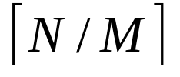
External MergeSort
N = number of elements in array A[1..N] to be sorted
M = number of elements that fit in memory at any given time
K =
RAM
CPU
Array: A [ 1 .. N]
disk
M
Cpt S 223. School of EECS, WSU
Notes:
Cpt S 223
Washington State University

Slide 51
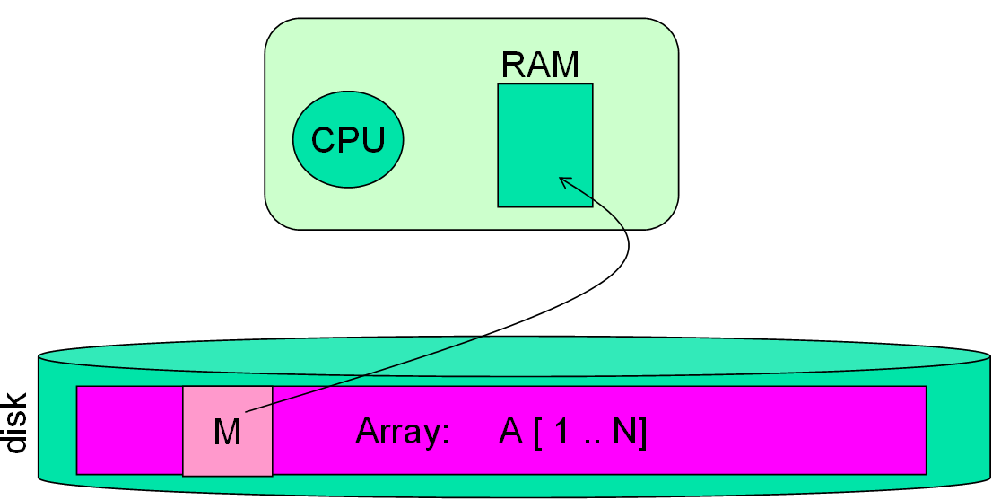
External MergeSort
O(M log M)
Approach
  Read in M amount of A, sort it using local sorting (e.g., quicksort), and write it back to disk
  Repeat above K times until all of A processed
  Create K input buffers and 1 output buffer, each of size M/(K+1)
  Perform a K-way merge:
    Update input buffers one disk-page at a time
    Write output buffer one disk-page at a time
O(KM log M)
O(N log k)
How?
…
K input buffers
1 output buffer
(1)
(4.2)
Cpt S 223. School of EECS, WSU
Notes:
Cpt S 223
Washington State University

Slide 52
K-way merge
Q) How to merge k sorted arrays of total size N in O(N lg k) time?
  For external merge sort:
  r = M/(k+1) and ∑_{i=0}^{k} |L_{i}| = M
In memory:
L₁
L₂
L₃
L_{k}
1
sorted
………
Merge & sort
???
r
1
r
output
Cpt S 223. School of EECS, WSU
Notes:
Cpt S 223
Washington State University

Slide 53
K-way merge – a simple algo
Input:
L₁
L₂
L₃
L₄
L_{k-1}
L_{k}
1
Sum of sorted list lengths
= N (= kr)
sorted
r
………
+
Q) What is the problem with this approach?
k-1 stages
Total time
= 2r + 3r + 4r + 5r + … + kr
= O(k²r)
= O(Nk)
Even worse, if individual input arrays are of
variable sizes
We can do better than this!
Output
merged
arrays
(temp)
2r
+
3r
+
Cpt S 223. School of EECS, WSU
….
Notes:
Cpt S 223
Washington State University

Slide 54
K-way merge – a better algo
Input:
L₁
L₂
L₃
L₄
L_{k-1}
L_{k}
1
Sum of sorted list lengths
= N (= kr)
sorted
r
………
+
+
+
2r
………
2r
Output
merged
arrays
(temp)
2r
Run-time Analysis
lg k stages
Total time
= (N) + (N) + … : lg k times
= O(N lg k)
+
+
4r
………
4r
Cpt S 223. School of EECS, WSU
+
….
Notes:
Cpt S 223
Washington State University

Slide 55
External MergeSort
Computational time T(N,M):
= O(K*M log M) + O(N log K)
= O((N/M)*M log M)+O(N log K)
= O(N log M + N log K)
= O(N log M)
Disk accesses (all sequential)
  P = page size
  Accesses = O(N/P)
Cpt S 223. School of EECS, WSU
Notes:
Cpt S 223
Washington State University

Slide 56
Sorting: Summary
Need for sorting is ubiquitous in software
Optimizing the sort algorithm to the domain is essential
Good general-purpose algorithms available
  QuickSort
Optimizations continue…
  Sort benchmarks
http://sortbenchmark.org/
http://research.microsoft.com/barc/sortbenchmark
Cpt S 223. School of EECS, WSU
Notes:
Cpt S 223
Washington State University

