Slide 1
BUY NOW
DealScout
WAIT
Watches the need, not the product.
An AI shopping scout built on Gemini and Google Cloud
FAKE DISCOUNT
Notes:
Hi, we're DealScout. One line: trackers watch a product, we watch a need.

Slide 2
Shopping on a budget means checking everywhere, all the time
5+
1
₹12,999
stores to check
link per tracker
was never the price
Amazon, Flipkart and niche music shops each list different models at different prices.
Price trackers only watch a product you already picked, so you never see the options you missed.
"35% off" is often measured against a price the product never sold at.
Notes:
Priya wants an audio interface under 15 thousand rupees. She checks five sites every few days. Trackers don't help, and the banner discount is often fake.

Slide 3
Describe the need. DealScout does the watching.
1
2
3
4
5
Describe
Spec
Discover
Track
Verdict
Plain English plus a budget
Gemini turns it into a watch spec
Google Search finds every match
Prices saved daily as history
Buy now or wait, with reasons
"2-input USB audio interface with phantom power, under ₹15k"
Notes:
Walk the five steps left to right. The quote is the exact request we type in the demo.

Slide 4
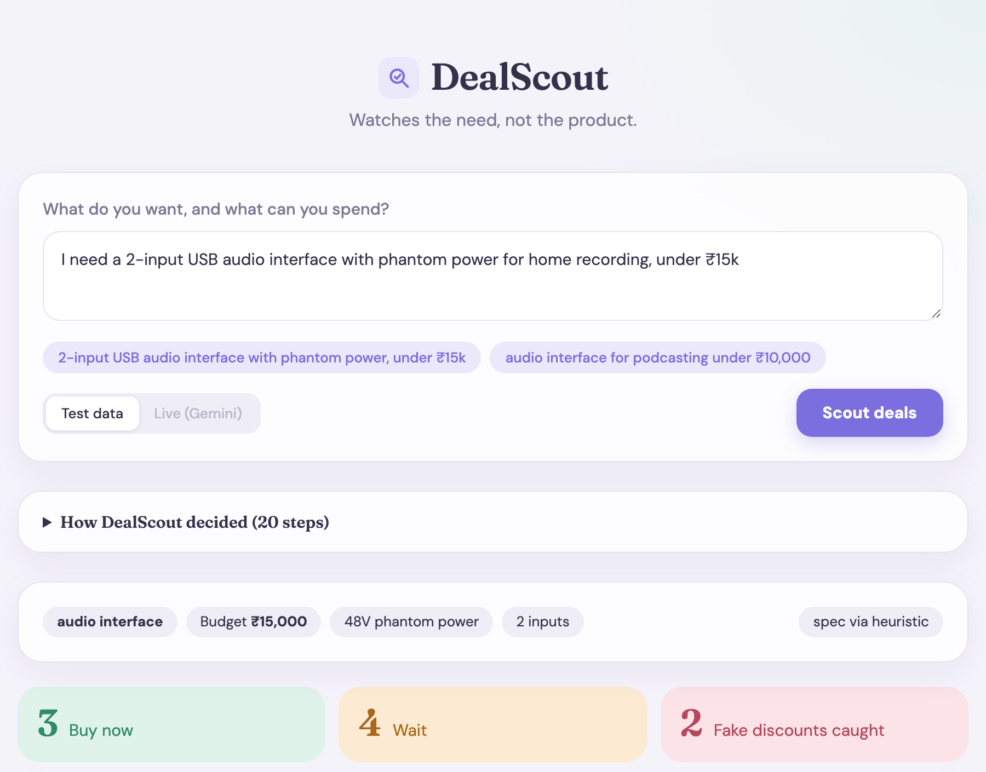
Describe the need, get a verdict on every match
Plain-English request and budget
Gemini builds the watch spec: category, budget, must-haves
Every match gets Buy now or Wait, with reasons
Fake discounts are counted and flagged
Screenshot of the working prototype, on test data
Notes:
This is the real UI. Run npm run ui, open localhost:3000, click Scout deals.

Slide 5
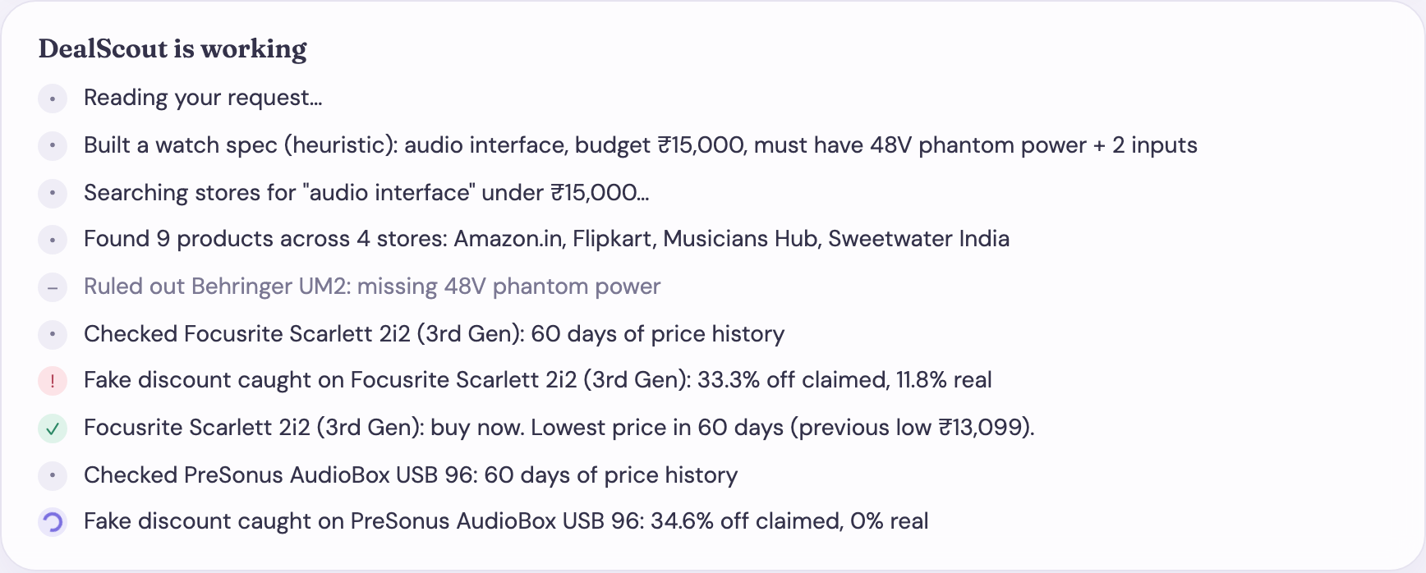
Watch the agent work
Every line is a real step. It rules out products, checks price history and catches fake discounts as it goes.
Notes:
Point at the red exclamation mark: the fake discount is caught live. The test-data run is instant, so the UI paces the lines so they can be read.

Slide 6
A 35% discount on a price that never moved
STORE CLAIMS
35% off ₹12,999
REALITY
₹8,199 to ₹8,699 for 60 days
DEALSCOUT SAYS
Wait. Not a real deal.
Notes:
PreSonus AudioBox on test data. The red line is the 'original price' the store shows. The green line is what it actually sold for. It never came close, so the discount is fake.

Slide 7
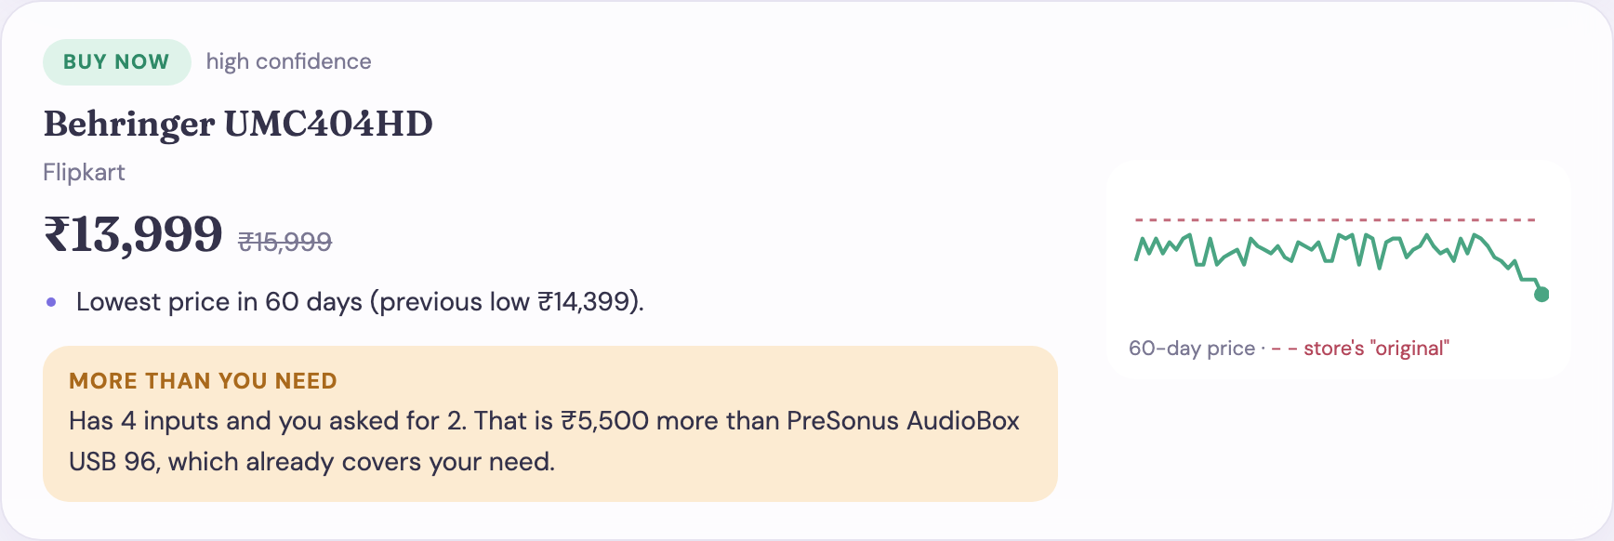
It checks the fit, not only the price
Asked for 2 inputs, this one has 4. DealScout shows the extra cost against the cheapest model that already covers the need.
Notes:
This is what a price tracker cannot do: it compares against what the buyer actually asked for.

Slide 8
Built on Gemini and Google Cloud
Cloud Scheduler
Cloud Run
Gemini
Firestore
Email
Triggers the daily run
→
Runs the scout service
→
Structured output + Google Search grounding
→
Daily price history
→
Firebase email digest
NEXT
NEXT
BUILT
NEXT
NEXT
One PriceSource interface: Google Search today, retailer APIs as we scale.
In the prototype, prices are saved to a local file and the digest is written as HTML.
Notes:
Be upfront: Gemini watch spec and discovery are written; deploy, Firestore and email sending are the next steps.

Slide 9
Working today, and what comes next
WORKING TODAY
NEXT
Fake-discount and verdict logic, 15 tests
Gemini watch spec from plain English
Live agent trace and need-aware fit check
Google Search discovery (not yet run live)
Web UI, plus digest as text and HTML
Deploy on Cloud Run with a daily Scheduler job
Store real price history in Firestore
Send the digest by email
Retailer APIs, more categories
Demo products and history are test data.
Notes:
Real price history takes days to accumulate, which is why the demo uses seeded history.

Slide 10
Trackers watch products.
DealScout watches your need.
Find the options you didn't know existed. Know whether the deal is real.
Notes:
Thank you. Questions?

