Slide 1

IILM UNIVERSITY, GREATER NOIDA
School of Computer Science and Engineering
I N T E R N S H I P P R E S E N T A T I O N
Frontend Web Development
Internship at CodSoft
STUDENT NAME
ENROLLMENT NUMBER
Amit Kumar
25SCS1003005483
PROGRAM & SEMESTER
ORGANIZATION
B.Tech CSE, 3rd Semester (Sec. 2CSE13)
CodSoft

Slide 2
O R G A N I Z A T I O N P R O F I L E
CodSoft
CodSoft is an ed-tech and technology solutions company offering free virtual internship programs, hands-on tasks, and project-based learning to students and early-career professionals across domains such as web development, Android development, data science, and artificial intelligence.
CS
CodSoft Frontend
Development Internship
Program:
Virtual Internship — Frontend Development Track
Role:
Frontend Development Intern
A self-paced virtual internship giving learners practical, task-based exposure to real-world frontend engineering problems using HTML, CSS, and JavaScript.
Duration:
20 Aug 2026 – 20 Sept 2026
Mode:
Remote / Virtual
“Real-world frontend engineering exposure for students.”
2

Slide 3
P R O B L E M S T A T E M E N T
Why This Project?
Individuals and early-career developers increasingly need a strong, demonstrable online presence and practical experience with everyday interactive tools. There was a clear need to design and build a set of polished, fully responsive frontend applications that showcase real UI/UX, validation, and data-handling skills.
👤
📋
💻
No Central Showcase
Manual Daily Tracking
Limited Hands-on Exposure
Skills and projects were scattered with no single, polished place to present them to recruiters.
Tasks and personal expenses were tracked manually, with no quick visual summary or persistence.
Classroom learning offered little practice building complete, responsive, interactive interfaces.
3

Slide 4
P R O J E C T O B J E C T I V E S
What The Project Set Out To Do
1
Design and build a fully responsive personal portfolio website with Home, About, Skills, Projects, Resume and Contact sections.
2
Develop a task management (To-Do List) app with add, edit, delete and completion-tracking features.
3
Build a personal expense tracker that records income/expenses and computes real-time balances.
4
Create a web-based music player with standard playback controls and a modern interface.
5
Develop a responsive blog website with categorized, searchable posts and individual article pages.
6
Apply consistent responsive design, animation, and validation principles across all five projects.
4

Slide 5
S C O P E O F T H E P R O J E C T
Scope & Boundaries
The project focused on building purely client-side, static frontend applications using HTML, CSS, and JavaScript — not a hosted, backend-driven, or cloud service.
IN SCOPE
OUT OF SCOPE
✓
Responsive portfolio, to-do, expense tracker, music player & blog website
✗
Backend server or database integration
✓
Local Storage-based data persistence for tasks and expenses
✗
Cloud or production deployment
✓
Responsive design, hover animations & form validation
✗
Native mobile app versions
✓
Cross-browser and cross-device testing
✓
Public GitHub repositories for each project
5

Slide 6
T E C H N O L O G I E S & T O O L S
Tech Stack
H
C
J
HTML5
CSS3
JavaScript (ES6+)
Semantic structure and layout for all five applications.
Responsive styling, Flexbox/Grid, animations & dark mode.
Interactivity, validation, DOM manipulation & app logic.
L
F
G
Local Storage API
Font Awesome / Fonts
Git & GitHub / VS Code
Client-side persistence of tasks, expenses & preferences.
Iconography and typography across interfaces.
Version control, hosting and development environment.
6

Slide 7
S Y S T E M A R C H I T E C T U R E
How It Works
1
2
3
4
Input
Process
Persist
Render
→
→
→
User interacts through a form or control — adding a task, expense, contact message, or search query.
JavaScript validates the input and updates the in-memory application state.
Local Storage reads/writes keep task, expense and preference data intact across page refreshes.
The DOM updates instantly, giving the user immediate, responsive visual feedback.
Each interface is implemented as an independent, self-contained project (HTML, CSS and JavaScript) with no shared backend dependency.
7

Slide 8
M E T H O D O L O G Y
Development Approach
1
Setup — Established a shared design language, colour palette and responsive breakpoints across all five projects.
2
Portfolio Website — Built a mobile-first responsive layout with smooth scrolling, hover animations, and a validated contact form.
3
To-Do & Expense Tracker — Implemented add/edit/delete/filter logic and Local Storage persistence for tasks and transactions.
4
Music Player — Built playback controls around the HTML5 Audio API, with a seekable progress bar and volume control.
5
Blog & Testing — Developed the blog website, then tested every project across screen sizes and browsers, and pushed each to a public GitHub repository.
8

Slide 9
E X P E C T E D O U T C O M E S
Results & Deliverables
✓
Fully responsive portfolio website showcasing skills and a downloadable resume.
✓
Working to-do list app with search/filter and Local Storage persistence.
✓
Functional expense tracker with accurate income, expense and balance summaries.
✓
Responsive, interactive music player with complete playback controls.
✓
Responsive blog website with categorized, searchable articles.
✓
Practical, hands-on experience with responsive design and JavaScript app logic.
9

Slide 10
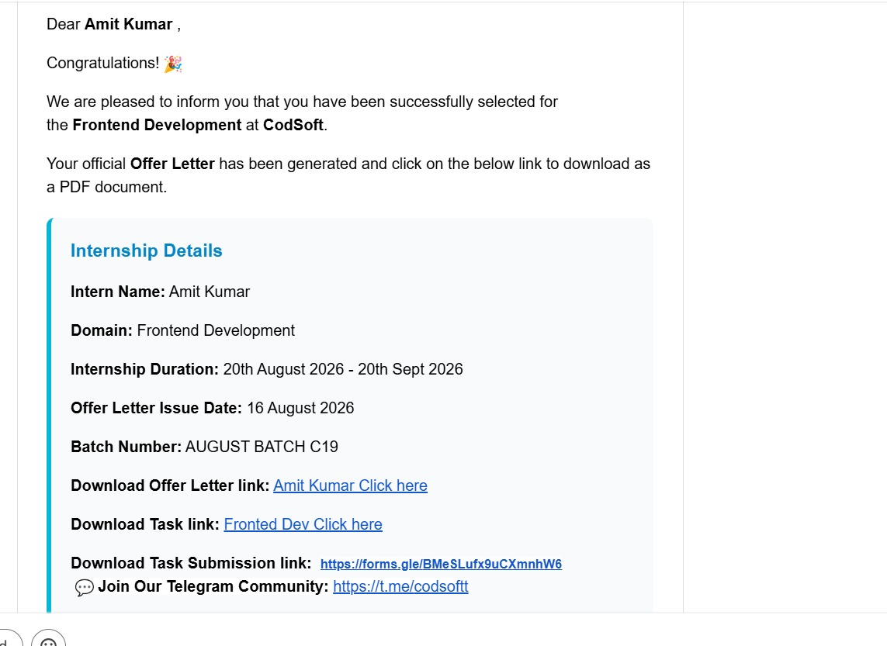
I N T E R N S H I P P R O O F
Offer & Communication Confirmation
OFFER LETTER
10

Slide 11
Thank You
Amit Kumar | 25SCS1003005483 | B.Tech CSE, 3rd Semester
CodSoft Frontend Development Internship

