Slide 1

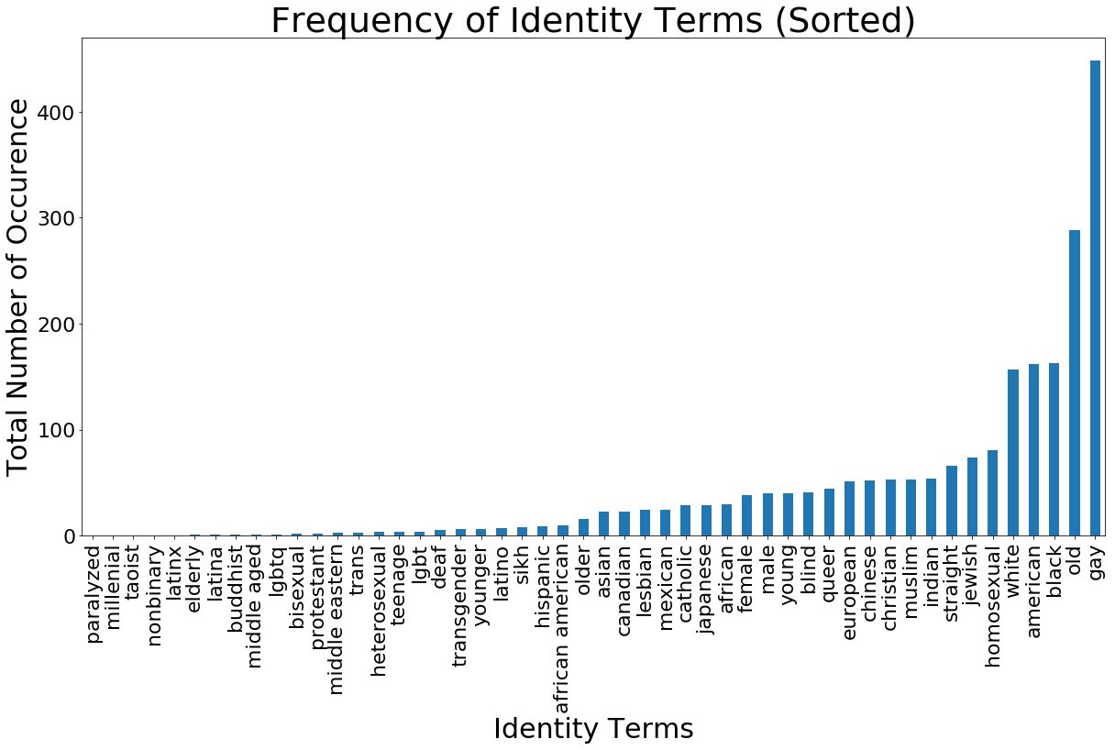
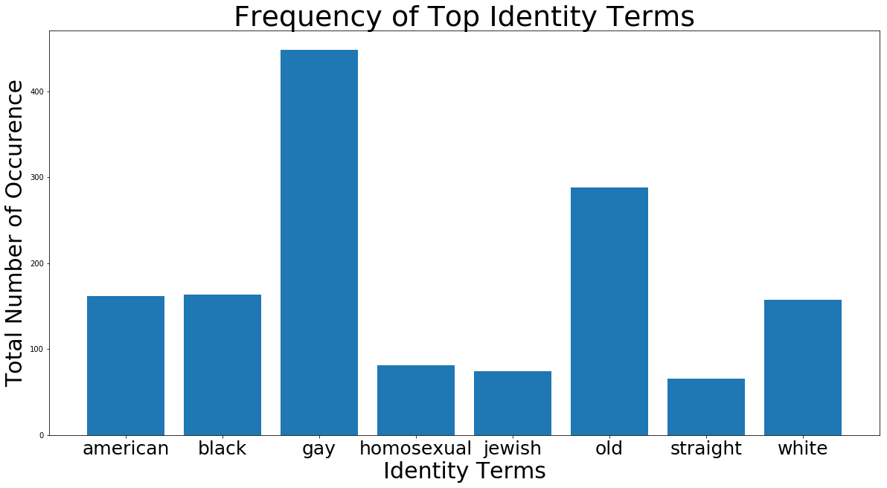
WHEN THE TRUTH IS NOT TRUE
A Study of Perturbations on “True” Toxicity in Text Classification
Neha Gupta, Yujing Ke, Neil Pruthi, Brandon Fain, Ashwin Machanavajjhala
Introduction
Mauris orci mi, varius id diam id, egestas auctor enim. Praesent ut massa nibh. Duis purus neque, facilisis cursus ultrices vel, ullamcorper ac augue. Donec semper lorem vitae urna pulvinar, in congue massa tristique. Sed in risus nibh. In nisl quam, aliquet sed nibh sit amet, faucibus.
Conclusion
Mauris orci mi, varius id diam id, egestas auctor enim. Praesent ut massa nibh. Duis purus neque, facilisis cursus ultrices vel, ullamcorper ac augue. Donec semper lorem:
Sed Risus Nibh: CiIn nisl quam, aliquet sed nibh sitamet, faucibus placerat dui augue scelerisque.
Curabitur Accumsan Nulla: Fusce quis augue urna scelerisque, luctus rum sed, ut dolor in pulvinar in eros.
Elementum Orci Dignissim: Proin semper ipsum finibus quam tempor, vitae consectetur.
Methods
Mauris orci mi, varius id diam id, egestas auctor enim. Praesent ut massa nibh. Duis purus neque, facilisis cursus ultrices vel, ullamcorper ac augue. Donec semper lorem vitae urna pulvinar, in congue massa tristique:
MAURIS ORCI VARIUS ID DIAM
Sed in risus nibh. In nisl quam, aliquet sed nibh sitamet, faucibus placerat dui.
Fusce quis augue scelerisque, luctus rum sed, ut in pulvinar urna in eros posuere.
EUISMOD JUSTO VITAE PURUS
Proin semper ipsum donec semper placerat.
Finibus quam tempor, vitae consectetur.
References
Dixon, Lucas, et al. "Measuring and mitigating unintended bias in text classification." available at: www.aies-conference. com/wp-content/papers/main/AIES_2018_paper_9. pdf (accessed 6 August 2018).[Google Scholar]. 2018.
Wulczyn, Ellery, Nithum Thain, and Lucas Dixon. "Ex machina: Personal attacks seen at scale." Proceedings of the 26th International Conference on World Wide Web. International World Wide Web Conferences Steering Committee, 2017.
Rudinger, Rachel, Chandler May, and Benjamin Van Durme. "Social bias in elicited natural language inferences." Proceedings of the First ACL Workshop on Ethics in Natural Language Processing. 2017.
Bolukbasi, Tolga, et al. "Man is to computer programmer as woman is to homemaker? debiasing word embeddings." Advances in Neural Information Processing Systems. 2016.
Hardt, Moritz, Eric Price, and Nati Srebro. "Equality of opportunity in supervised learning." Advances in neural information processing systems. 2016.
Kusner, Matt J et al. “Counterfactual Fairness.” available at http://papers.nips.cc/paper/6995-counterfactual-fairness.pdf (accessed 26 Nov 2018). 2018
Data Analysis
Mauris orci mi, varius id diam id, egestas auctor enim. Praesent ut massa nibh. Duis purus neque, facilisis cursus ultrices vel, ullamcorper ac augue [See Figure A]. Done:
Sed in risus nibh. In nisl quam, aliquet sed nibh sitamet, faucibus placerat dui.
Fusce quis augue scelerisque, luctus rum sed, ut dolor. pulvinar urna in eros posuere.
in elementum orci dignissim. Proin semper ipsum
Department of Computer Science Duke University
cs.duke.edu
Mauris orci mi, varius id diam id, egestas auctor enim.

