Slide 1


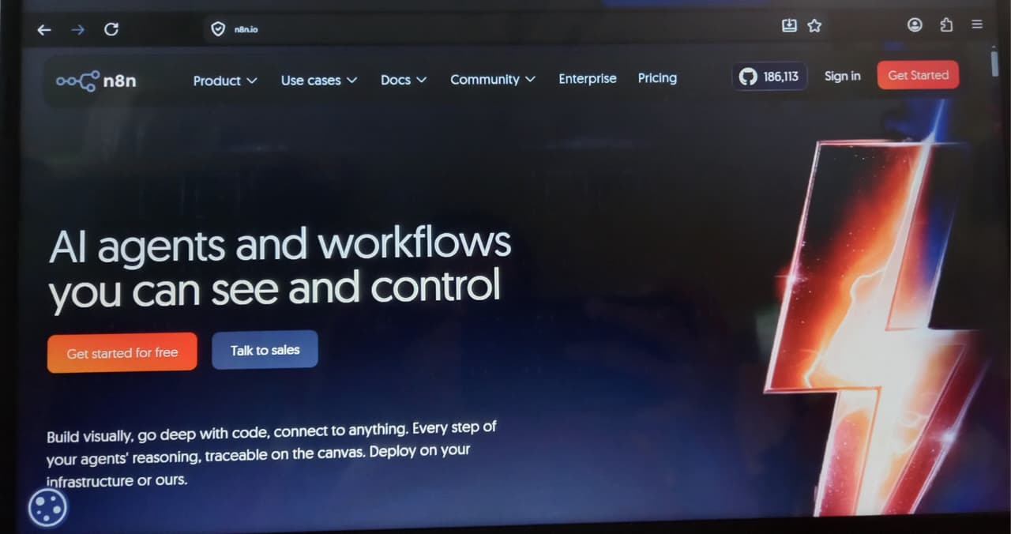
Expense Tracker Automation
Using n8n + Google Forms + Google Sheets to build a fully automated employee expense management workflow — from submission to real-time finance alerts.
Submitted By:
Niharika (2520982662)
Akhil (2520982511)
Harshit (2520982584)
Submitted To:
Lavanaya Srivastava

Slide 2
The Problem
Manual Expense Management Is Broken
⏳ Delayed Approvals
📂 Missing Records
Expense claims pile up in inboxes with no clear process for timely review.
Emails get lost, attachments go missing, and audit trails are incomplete.
✏️ Human Errors
📉 Poor Visibility
Manual data entry into spreadsheets introduces costly mistakes.
Finance teams lack real-time data, slowing the reimbursement cycle.
NIHARIKA

Slide 3

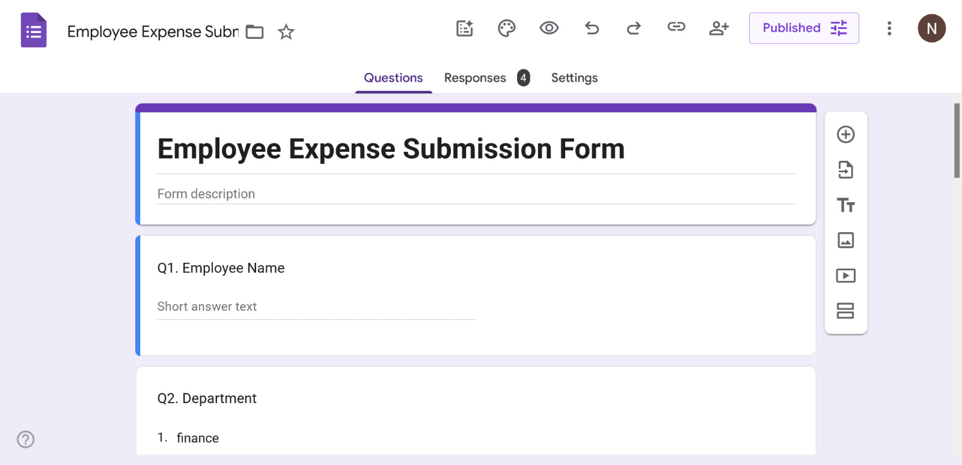
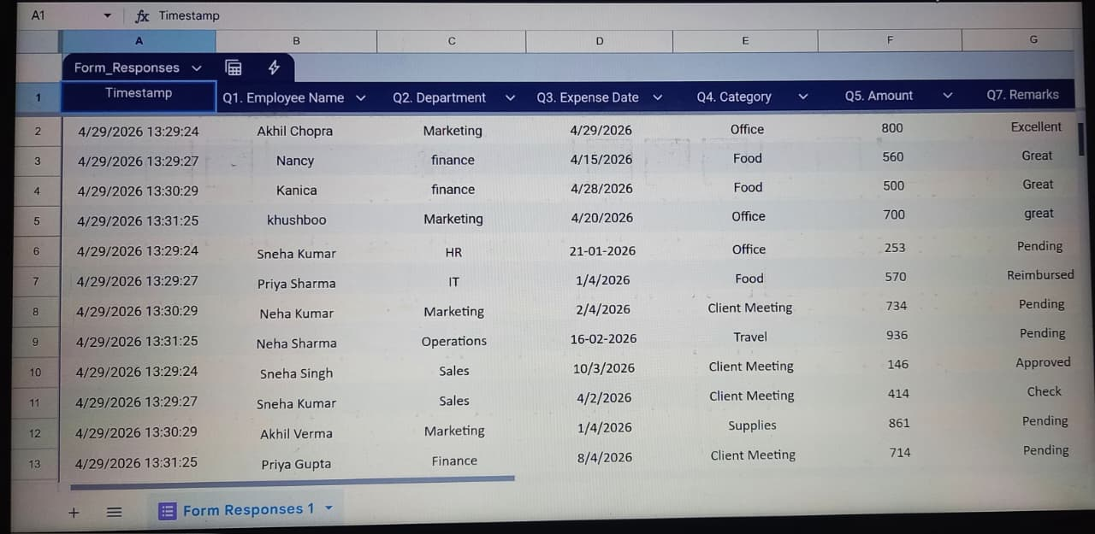
Part A — Workflow Design
The Automated Solution: End-to-End Flow
Submit Form
Store in Sheets
n8n Trigger
Process Data
Check Amount
NIHARIKA

Slide 4
Part B — Tools Used
Meet the Tech Stack
Google Forms
Google Sheets
Employee-facing interface for structured, standardized expense submissions — no spreadsheet access needed.
Acts as the live database, automatically storing every form response in real time with zero manual input.
n8n
Gmail Node
The automation engine — monitors Sheets, processes data, applies logic, and orchestrates the entire workflow.
Sends formatted email alerts to the finance team whenever a new or high-value expense is submitted.
Set Node
If Node
Extracts and formats specific data fields from the form response for use downstream in the workflow.
Applies conditional logic — routes the workflow based on whether an expense exceeds the defined threshold.
NIHARIKA

Slide 5
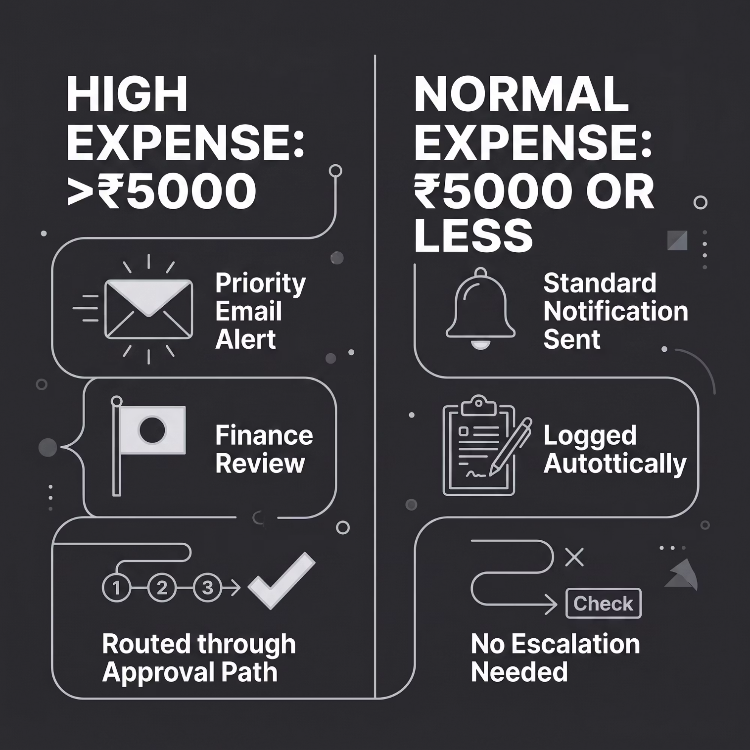



Part C — Finance Logic
How Expenses Are Classified
The If Node Logic
Inside n8n, the If Node evaluates every submission against a single condition:
Expense Amount > ₹5,000 → Route to HIGH expense branch and trigger a priority alert email to the finance team.
Expense Amount ≤ ₹5,000 → Route to NORMAL expense branch and log with a standard notification.
This ensures high-value claims receive immediate human attention while routine claims are processed without delay.
AKHIL

Slide 6

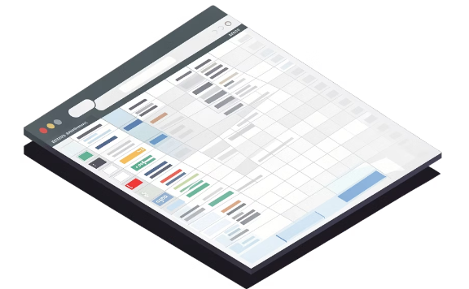
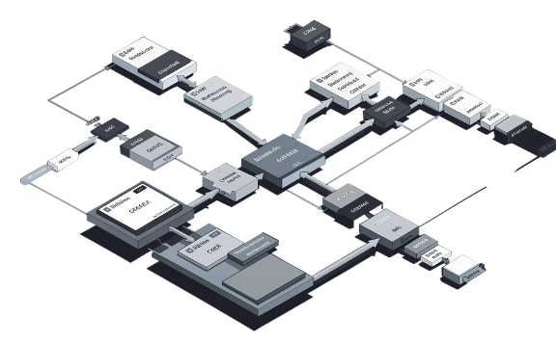

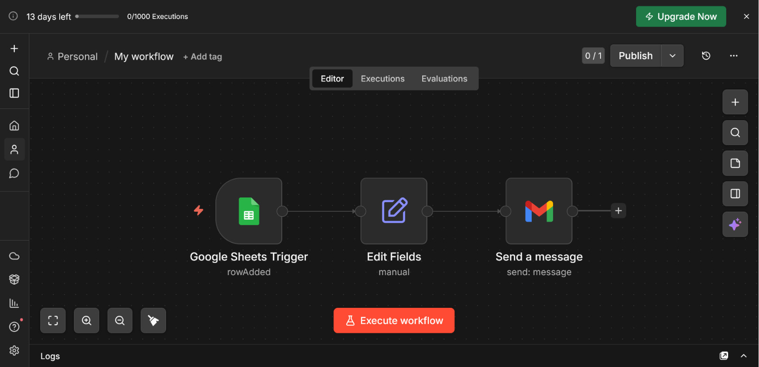
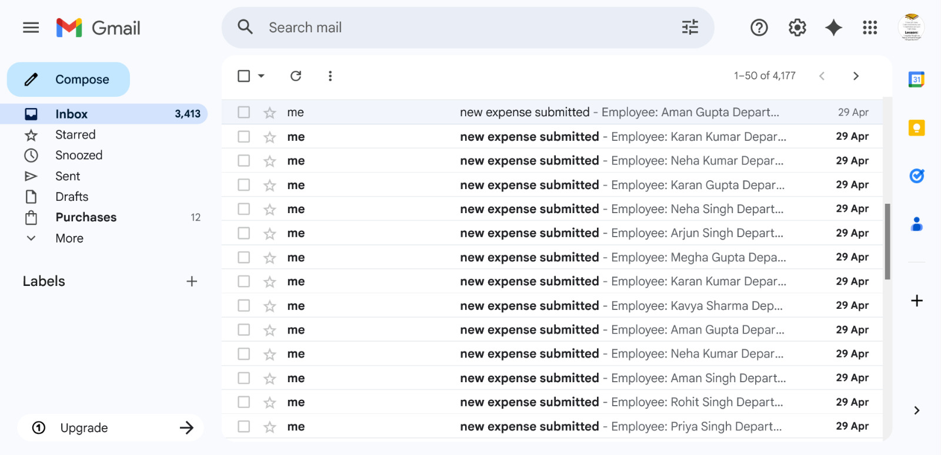
Part D — Output Demonstration
What the System Looks Like in Action
Google Form
Google Sheet Entries
n8n Workflow Canvas
Email Notification
Every submission populates a new row instantly — timestamped, labeled, and ready for finance review.
The visual workflow shows triggers, Set nodes, If nodes, and Gmail nodes connected in a clear automation chain.
Finance receives a formatted alert with employee name, amount, and expense category — instantly, every time.
Employee fills in name, department, amount, and category. Clean, guided, and accessible on any device.
AKHIL

Slide 7

Part E — Business Benefits
How Automation Transforms Finance Operations
⚡ Faster Processing
Expense claims are captured, classified, and escalated in seconds — not days. Reimbursement cycles shrink dramatically.
🎯 Better Control
The If Node ensures no high-value claim slips through unreviewed. Every rupee above ₹5,000 is automatically flagged.
📊 Real-Time Tracking
Google Sheets serves as a live dashboard — finance managers see every submission the moment it's made.
🤖 Reduced Manual Work
Data entry, email follow-ups, and manual categorization are eliminated entirely, freeing staff for higher-value tasks.
AKHIL

Slide 8
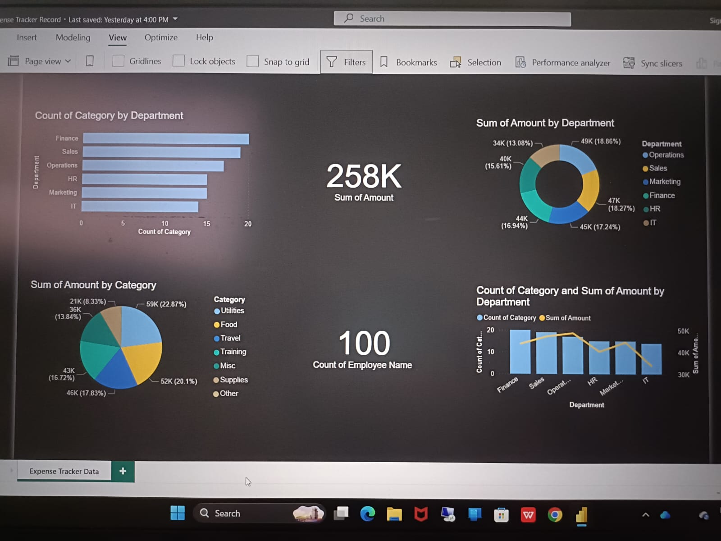
AKHIL
AKHIL

Slide 9
Comparing the Two Approaches
Before vs. After Automation
Dimension
Manual Process
Automated Workflow
Submission Method
Email / paper form
Google Form (structured)
Data Storage
Manual spreadsheet entry
Auto-populated Google Sheet
High-Value Flagging
Depends on reviewer
Automatic via If Node
Finance Notification
Manual email, often delayed
Instant Gmail alert via n8n
Error Rate
High (human entry)
Near zero (system-driven)
Processing Speed
Days to weeks
Seconds to minutes
HARSHIT

Slide 10
Summary
Key Takeaways
🔗 Connected Tools
🧠 Smart Logic
Google Forms + Sheets + n8n + Gmail form one seamless, no-code automation pipeline.
The If Node classifies every expense automatically — high-value claims are never missed.
📬 Instant Alerts
🚀 Real Business Value
Finance teams get real-time email notifications the moment a new expense is submitted.
Faster reimbursements, fewer errors, and full visibility — automation pays for itself immediately.
This workflow is not just a student project — it's a production-ready automation pattern used by finance teams worldwide. Understanding it puts you ahead of the curve.
HARSHIT

