Slide 1
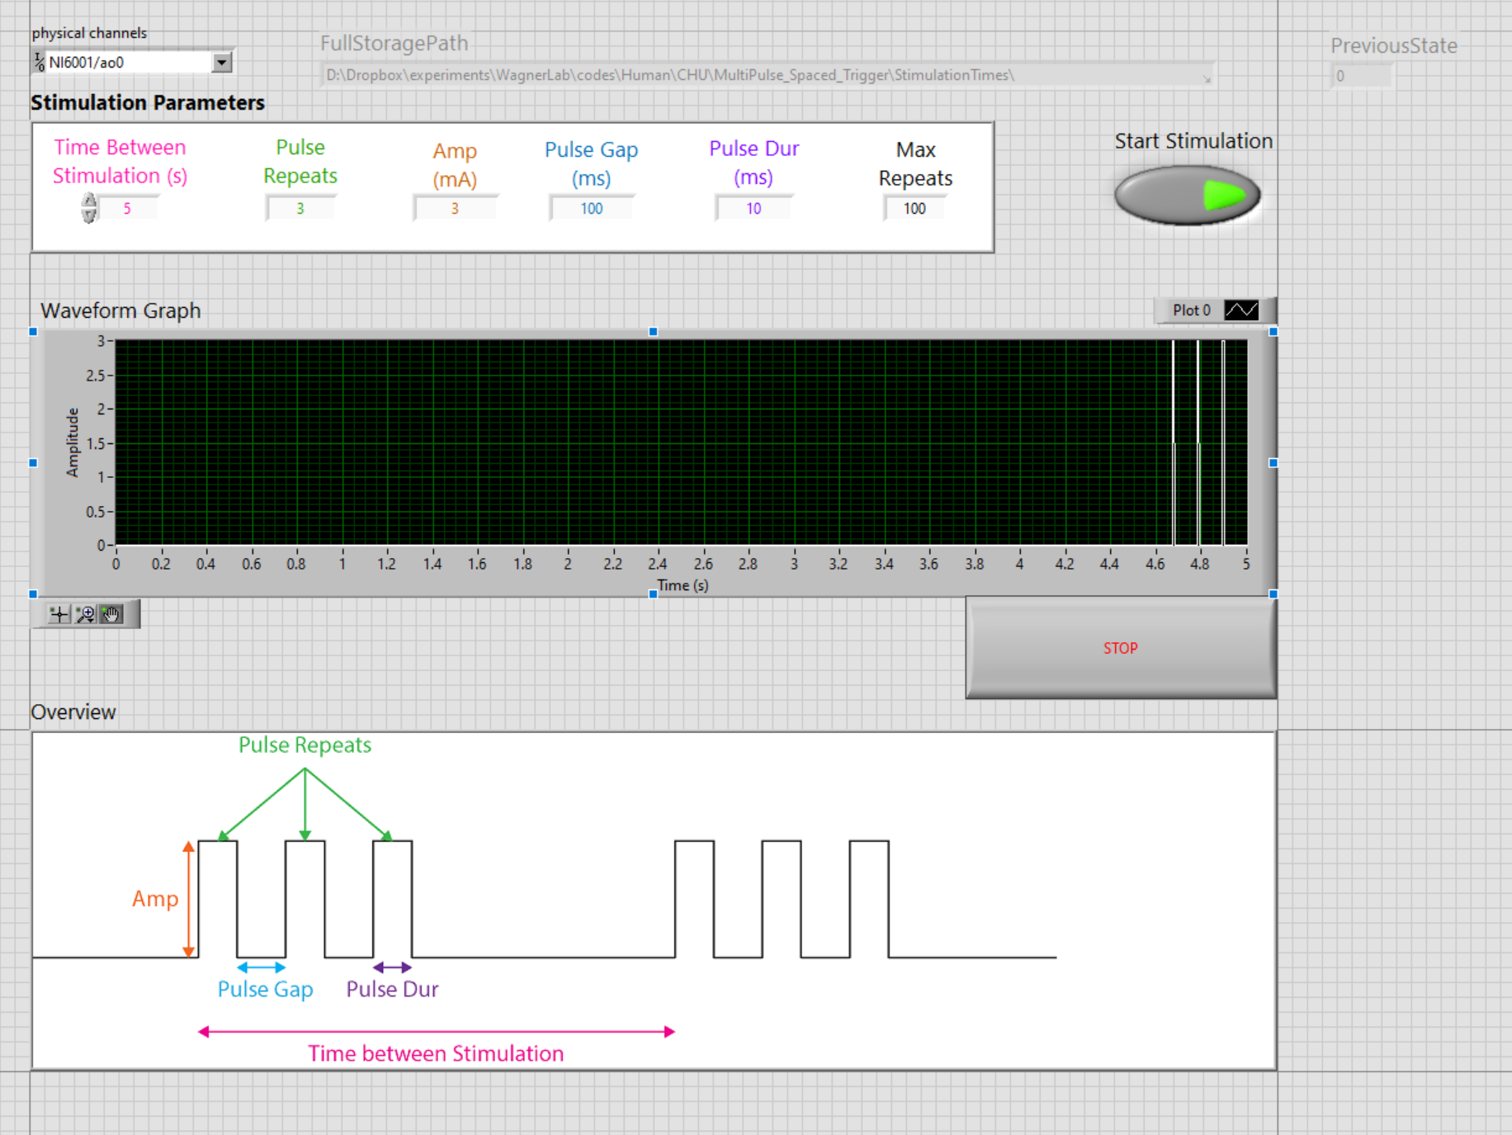
Stimulation state and relative timings are saved (when stimulation turns on or off it is logged)
Select device and analog output 0 or 1 (whichever port is connected to DS5)
How many times the stimulation will be delivered (not pulses) Current example: Time between stimulation* Max repeats = 500 s
Set these parameters
This will be
stimulation profile
What each parameters
mean

Slide 2
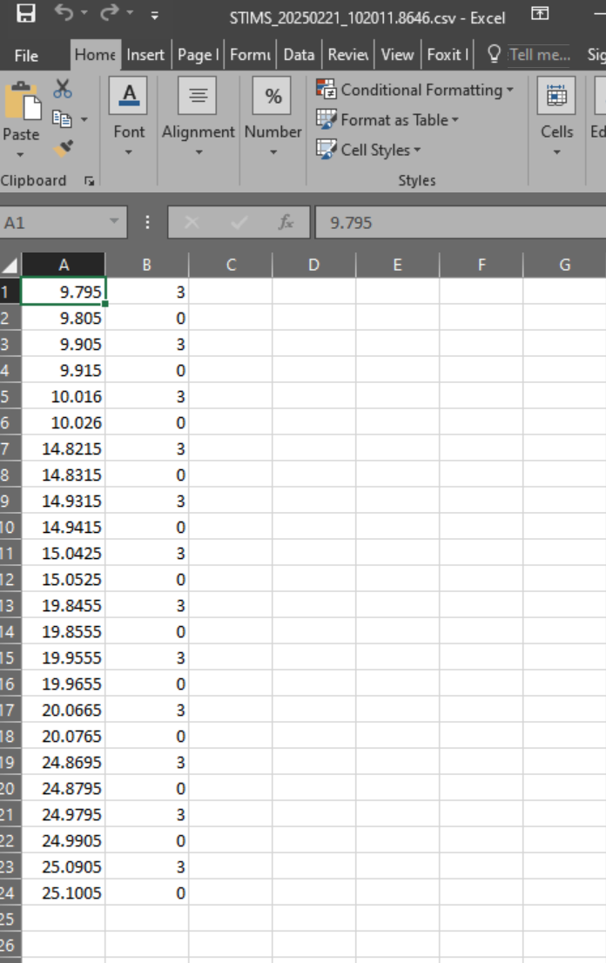
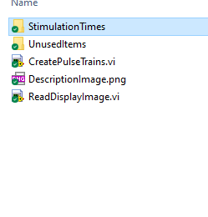
The stimulation timings file is located in
The Stimulation times folder where the program is stored
File name format: STIM_<date>_<system time upto 4 decimal places>
Program to run
First column stores relative time since the program was started (check the filename for system time)
Second column gives which stimulation amplitude is sent from DAQ
Example: stimulation pulse was delivered at 3V at 15.0425
And pulse was turned off at 15.0525

