Slide 1
FORWARD DEPLOYED ENGINEER • CASE STUDY
Adherence Reporting
Reconciliation
Explaining a 13-percentage-point gap between pharmacy-based PDC and a CRM refill indicator.
10,000 synthetic patients | Python + Gemini | Interactive HTML dashboard
Prepared as an analytical prototype • Synthetic data only
01

Slide 2
01 • BUILD
Solution architecture & data foundation
A reproducible patient-level dataset supports both quantitative reconciliation and note-level intelligence.
1 Synthetic source
2 Data generator
3 Analytics + LLM
4 Reconciliation UI
Synthea patients +
medication history
10,000 patients
52,200 hub fills
PDC, CRM flags,
Gemini note extraction
HTML / CSS / JS
filters, bridge, patient detail
Patient-level records
Normalized event tables
Reproducibility
Enrollment, medication start, refill dates, days supply, adherence and generated identifiers.
52,200 pharmacy fill rows and 20,000 quarterly CRM notes.
Deterministic demo mode; Synthea CSV input supported. Synthetic events are not real clinical observations.
Synthea provides synthetic clinical/medication history; the generator adds case-specific specialty-pharmacy and CRM events.
Synthetic demonstration • Not real patient data
2

Slide 3
02 • DIAGNOSE
The business problem: two systems, two definitions
PIPELINE • THIS QUARTER
CLIENT CRM • THIS QUARTER
OBSERVED GAP
LAST QUARTER GAP
58%
71%
+13.0 pp
+8.0 pp
PDC ≥ 80% among all enrolled patients
Case-manager refill-on-schedule flag
CRM minus pipeline
72% CRM vs 64% pipeline
Pipeline definition
CRM definition
Population: all enrolled patients
Measure: pharmacy-fill-derived PDC ≥ 80%
Source: specialty pharmacy hub fills
Population: patients with ≥1 specialty-pharmacy fill
Measure: case-manager refill-on-schedule flag
Source: CRM notes
Key insight: these are not like-for-like measures. A refill flag is not equivalent to medication coverage, and PDC does not prove ingestion.
Synthetic demonstration • Not real patient data
3

Slide 4
03 • RECONCILE
Gap bridge: quantify the sources of disagreement
Sequential decomposition; attribution depends on the order in which population, definition and source are changed.
Quarter
Observed gap
Population
Definition
Source
This quarter
+13.00 pp
0.00 pp
+6.41 pp
+6.59 pp
Last quarter
+8.00 pp
0.00 pp
+1.35 pp
+6.65 pp
CURRENT QUARTER • 13.0 PP TOTAL
Definition +6.41 pp
Source +6.59 pp
Population effect is 0 in this synthetic run because every generated patient has at least one specialty-pharmacy fill. This is a demo-data property—not evidence that real populations match.
Synthetic demonstration • Not real patient data
4

Slide 5
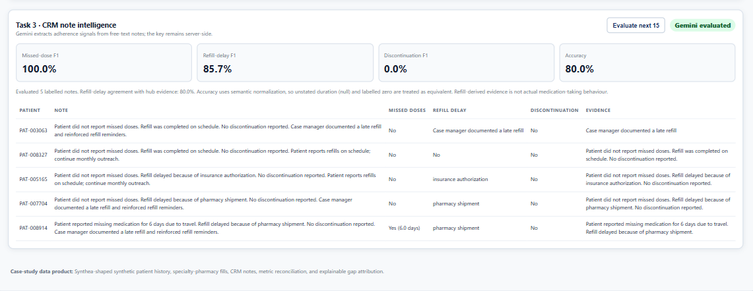
04 • EXTRACT & EVALUATE
LLM-powered CRM note intelligence
Initial smoke test: 5 labelled notes evaluated; missed-dose F1 100.0%, refill-delay F1 85.7%, discontinuation F1 0.0%, normalized accuracy 80.0% (strict exact-record accuracy 20.0%). The dashboard supports cumulative 15-note batches; treat this initial result as preliminary.
Synthetic demonstration • Not real patient data
5

Slide 6
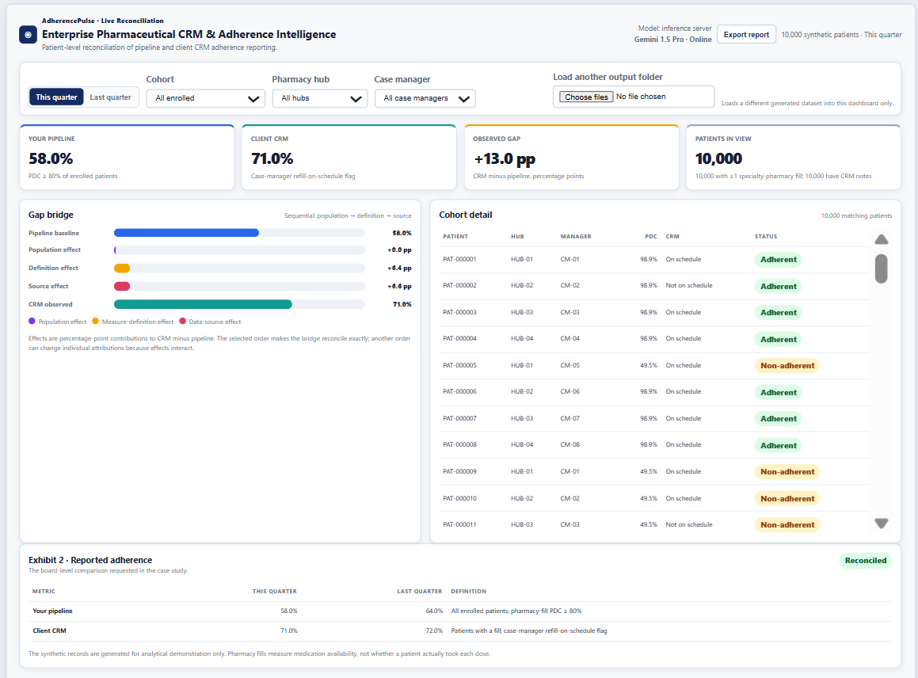
05 • DELIVER
Interactive reconciliation dashboard
Controls
Quarter toggle, cohort, pharmacy hub and case-manager filters.
Patient-level view
Cohort details, PDC, CRM flag and status.
LLM evidence
Extracted signals, evidence text and evaluation metrics.
Includes reported metrics, sequential gap bridge and patient-level cohort detail. The companion screenshot on the LLM slide shows Task 3.
Synthetic demonstration • Not real patient data
6

Slide 7
06 • STANDARDISE
Task 4: proposed unified adherence standard
Primary measure: patient-level PDC ≥ 80% over an approved eligible measurement period
Population
Primary data source
CRM role
Eligible enrolled patients who initiated the relevant therapy; eligibility and exclusions approved by client.
Validated specialty-pharmacy fill records with patient linkage, fill date and days supply.
Supporting context for delays, missed doses and discontinuation—not a replacement for PDC.
Data-quality controls
• Duplicate fills and patient IDs
• Missing IDs, dates or days supply
• Overlapping coverage and implausible values
• Unmatched hub/CRM patients and stale notes
• Explicit missing-data and discontinuation rules
• Quarterly reconciliation and exception review
Synthetic demonstration • Not real patient data
7

Slide 8
07 • DECISION & NEXT STEPS
Friday board recommendation
NEXT STEPS
REPORT BOTH FIGURES WITH THEIR DEFINITIONS
• Validate eligibility and pharmacy data completeness
• Approve a shared PDC definition and exception rules
• Expand and stratify the labelled LLM test set
• Add monitoring, auditability and privacy controls
58%
Provisional pharmacy-based PDC ≥80%
71%
CRM-reported refill-on-schedule indicator
Disclose the 13 pp discrepancy. Do not present the measures as equivalent or as proof of medication ingestion.
Conclusion: the discrepancy is explainable by population eligibility, different definitions and different data sources—not one unexplained error.
Synthetic analytical prototype • Not a production clinical decision-support system
08

