Slide 1
Comparison b/w SQL and NoSQL Databases- Implementation
Group Members:
Priya Gupta – 1911080
Aparna JadHav - 1911084

Slide 2
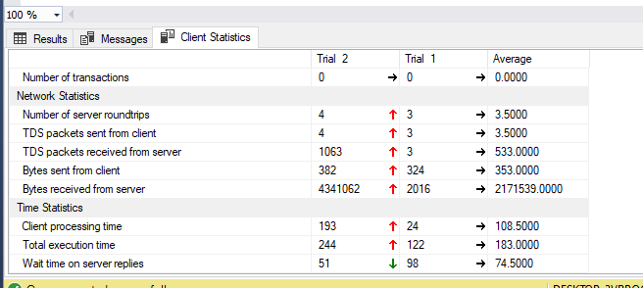
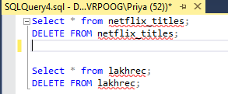
MsSQL

Slide 3
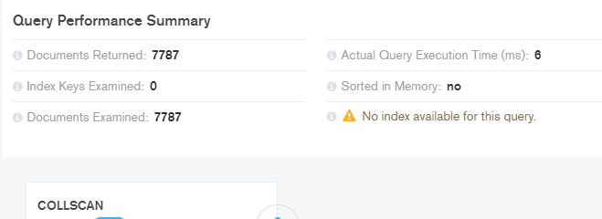
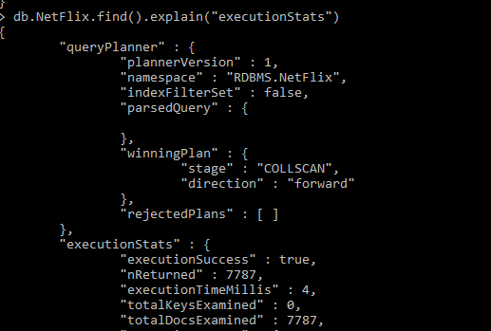

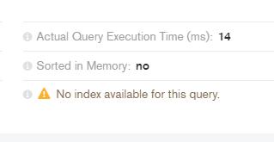
MongoDB

Slide 4
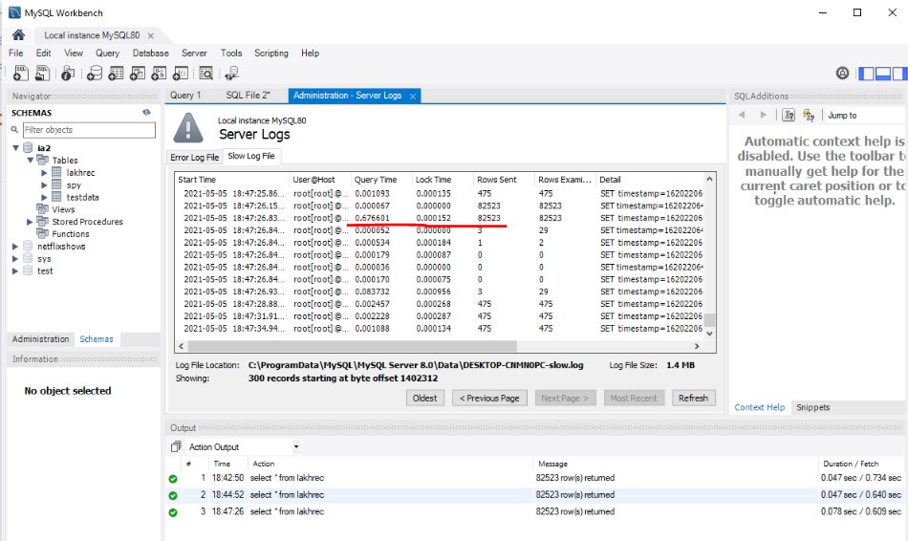
MySQL
The DB is inserted/ imported into the MySQL by using pandas in python.
To check query time in MySQL, the following queries are used before any CRUD operation :
set global slow_query_log = 'ON’;
set global long_query_time = 0;
This means all the (long)queries taking more than 0 secs will be logged into the server log.

Slide 5
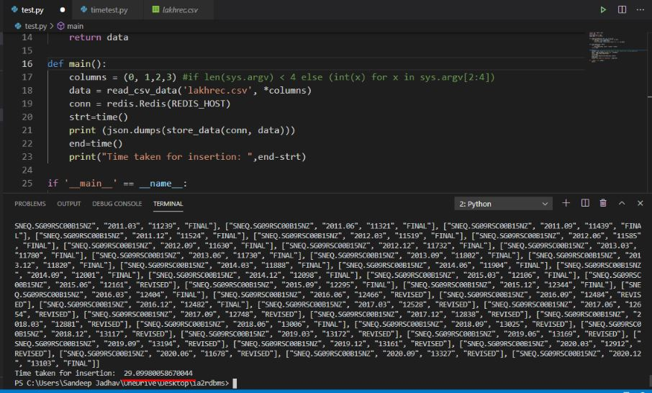
Redis - Insert
For insertion in Redis, the DB is first imported using a python program and using the time module in python , the insertion time is roughly noted.

Slide 6
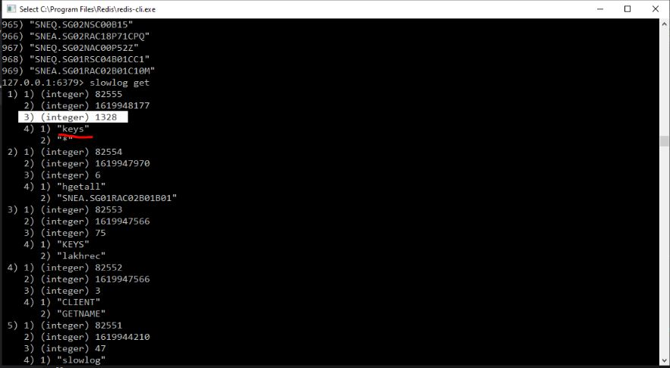
Redis - Select

Slide 7
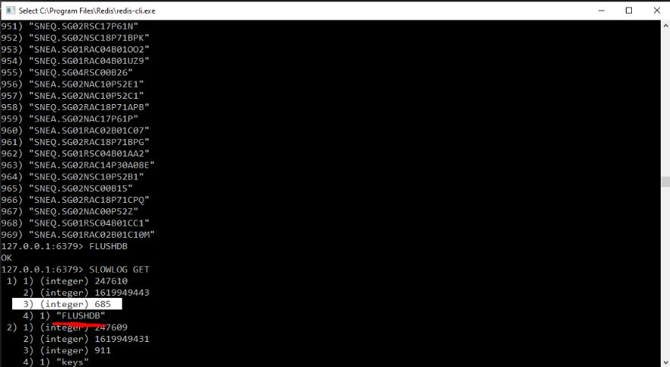
Redis - Delete
For other CRUD operations’ query time we use the command SLOWLOG GET in Redis
The third value is query time in microseconds.

Slide 8
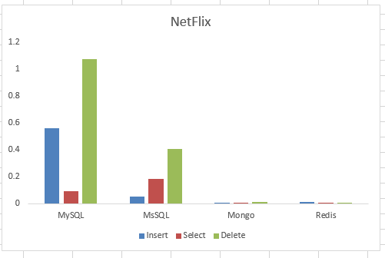
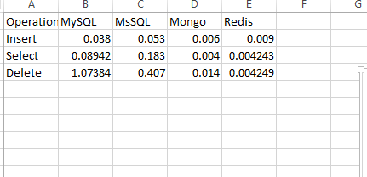
Graph
Comparison of a DB containing near about 10,000 records

Slide 9
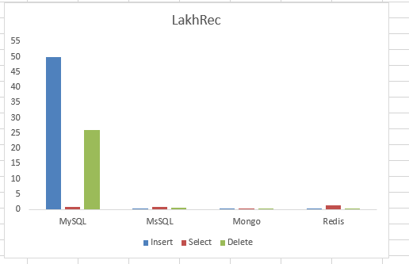
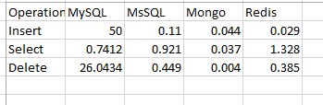
Graph
Comparison of a DB containing near about 1,00,000 records

Slide 10

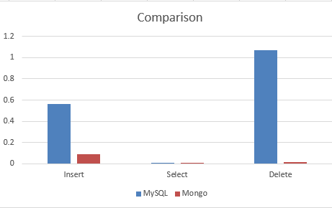
Graph - Comparison
Comparison of some of the CRUD operations of MySQL and MongoDB

