Slide 1
Objective
Implementing Terminal Mirroring using Messsage
Queue
We have to develop a system for multiple Terminals which will be interacting with each other using message queues.
The commands on a given Terminal will be Mirrored in the coupled Terminal along with the output
The system will have a server which will maintain a message queue and list of client Terminals

Slide 2
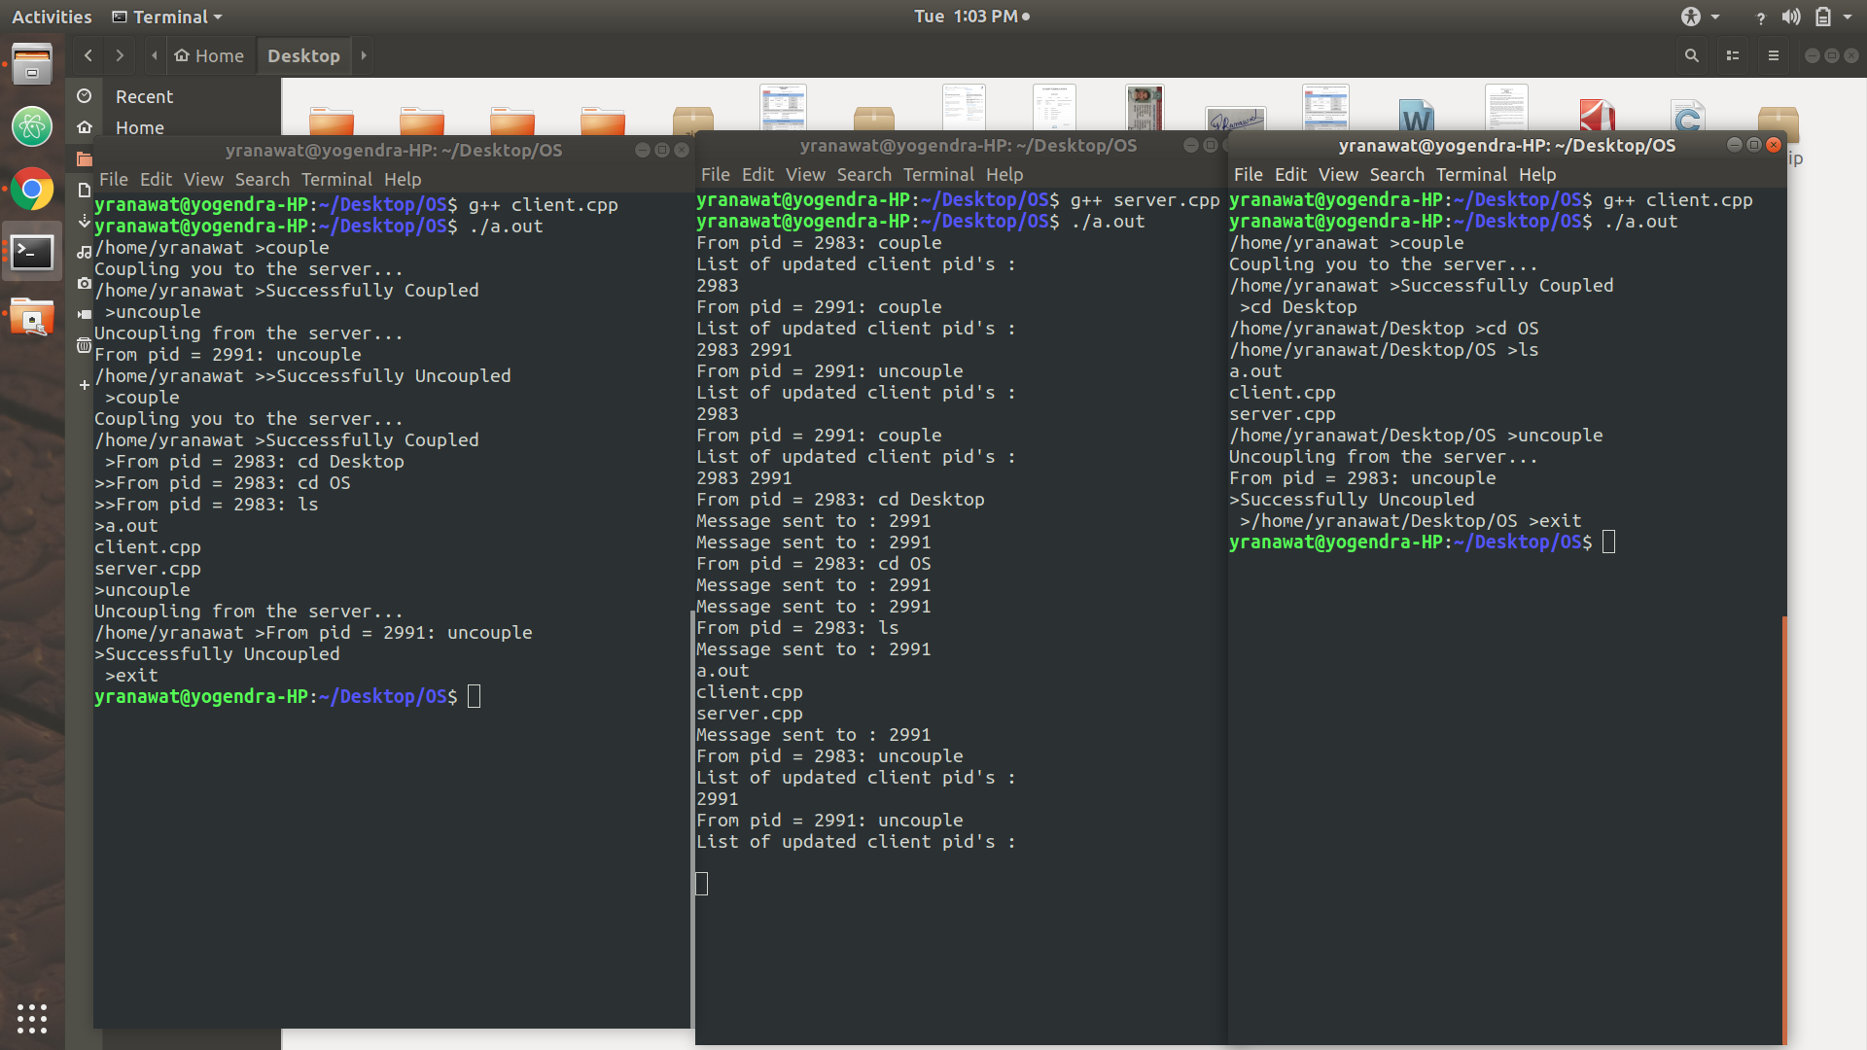
Terminal Mirroring
The commands on a given terminal (shell), will be mirrored in the coupled terminals along with output.
Server will receive the message from given terminal and broadcast the message to all the coupled Terminals.

Slide 3
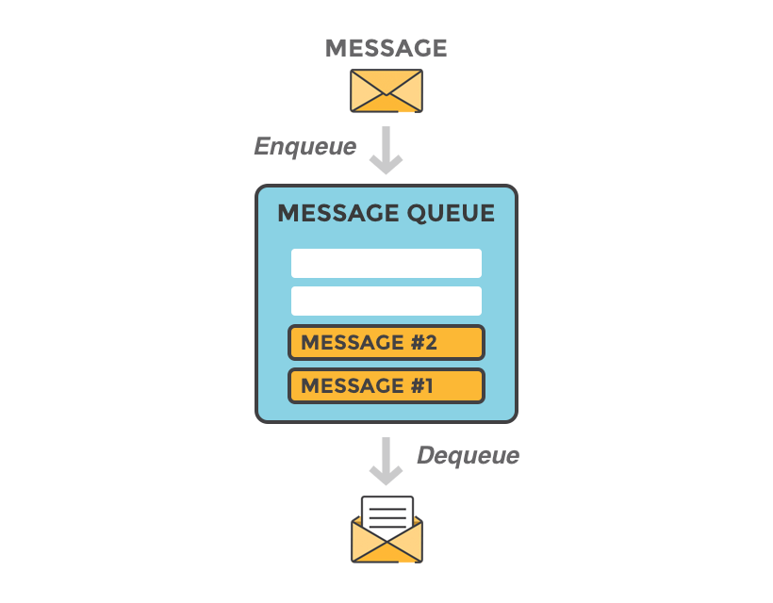
Message Queue
A message queue is a queue of messages sent between applications.
There are client applications that create messages and deliver them to the message queue.
Server connects to the queue and gets the messages to be processed. Messages placed onto the queue are stored until the consumer retrieves them.

Slide 4
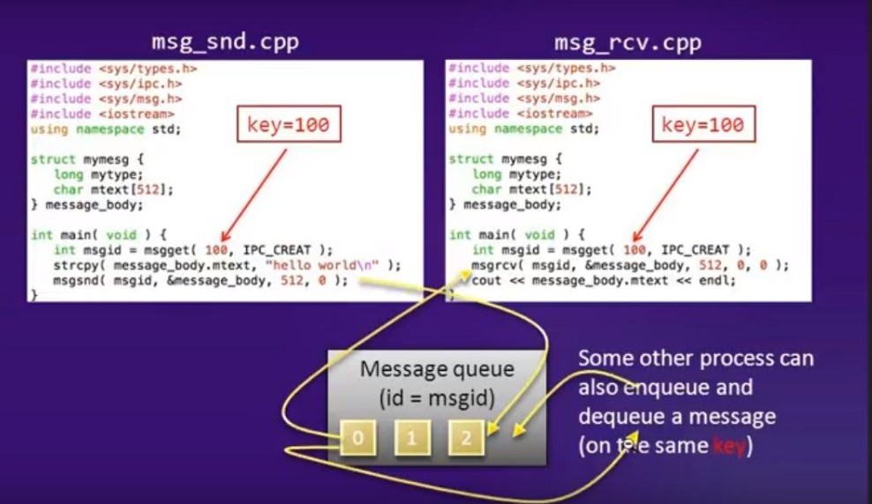
msgget(): A new queue is created or an existing queue opened. msgsnd(): Place data on to a message queue. msgrcv(): messages are retrieved from a queue.

Slide 5
Function Description:
Extract:
Input: A char array which is basically, client id and the message in the form of string
Processes: “pid” is used to store the client id and “msg_new” the message store after it
Output: the client id and the message is returned after separating as a pair of key and integer
Escape:
Removes the “\\” from the buffer and stores the remaining in the “dest” variable
Input: Buffer
Output: dest
Lexer:
Stores different words in the message in two dimensional char array which are separated by space, in other words Lemmatization is performed
Input: buffer and a counter “cnt” as a reference variable
Output: the 2d array of characters and “cnt” is updated as the count of the number of words in the buffer

Slide 6
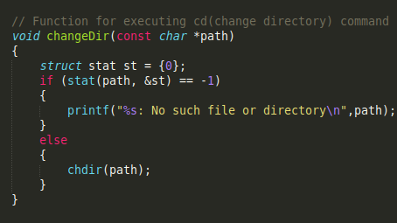
PWD:
It used the inbuilt “cwd” function to get the current directory and displays it on the output screen
ChangeDir
Used for executing cd: the change directory command
Input: path
If the path exists then it changes the directory otherwise prints the error

Slide 7
Client.cpp
fork()
Child_process
- Receives the message broadcasted by the server.
- If client is coupled, message is displayed.
- A parameter is maintained to show coupling.
Parent_process
- Takes input from user.
- Handle input: “couple” & “uncouple” and sends request to server for coupling and uncoupling respectively.
- For other system commands, it executes them on current terminal and sends their output to server via message queue.
- Process executes until “exit” command is entered.

Slide 8
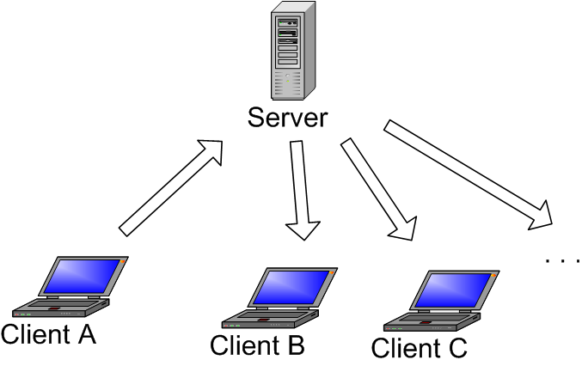
Server Side
The server receives messages sent by the clients.
Extract function is called to separate client name and message and creates a unique integer key from the client name.
If the message is “couple” then the server updates the vector “keys” by adding the key of the client obtained from “extract” function.
Else if the message is “uncouple” then the server finds and erases the client key from the vector “keys”.
Else the message is broadcasted to all the clients except the client sending the message thereby achieving Terminal Mirroring.

