Slide 1

Image Classification using Random Forests and Ferns

Slide 2
Introduction
The objective of this work is image classification – classifying an image by the object category that it contains.
Treating image classification as scene matching is not sufficient.
Instead,we automatically learn a Region Of Interest (ROI) in each of the training images rather than over the entire image.
Using Random Forest and Random Ferns as a multi way classifier.
The advantage of randomized trees,is that they are much faster in training and testing than traditional classifiers (such as an SVM).

Slide 3
Image Representation and Matching

Slide 4
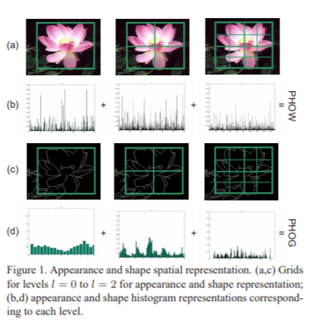
An image is represented using the spatial pyramid scheme which is based on spatial pyramid matching.
Here, spatial pyramid applied to both shape and appearance.we obtain two representations from this: (i) a Pyramid Histogram Of visual Words (PHOW) descriptor for appearance and (ii) a Pyramid HOG (PHOG) descriptor for shape.
Pyramid descriptor of the entire image (PHOW, PHOG) is a vector with dimensionality
Each bin in the histogram represents the number of edges that have orientations within a certain angular range.

Slide 5
Appearance and Shape
For the appearance both grey level and colour cues are used (termed AppGray and AppColour respectively).
SIFT descriptors are computed at points on a regular grid with spacing M pixel here we are taking M=10.
In AppColour the SIFT descriptors are computed for each HSV(Hue-Saturation-Value) component. This gives a 128 × 3 D-SIFT descriptor for each point.
In AppGray, SIFT descriptors are computed over the gray image (with intensity I = 0.3R + 0.59G + 0.11B) and the resulting SIFT descriptor is a 128 vector.
K-means clustering is performed over 5 training images per category selected at random.
Edge contours are extracted using the Canny edge detector.
In the experiments two shape descriptors are used: one with orientations in the range [0, 180] represented as Shape180 and the other with range [0, 360] represented as Shape360.

Slide 6

Image matching
Similarity between a pair of images I and J is computed using a kernel function between their PHOG (or PHOW) histogram descriptors Di and Dj , with appropriate weightings for each level of the pyramid.
Here, αl is the weight at level l and dl the distance between DI and DJ at pyramid level l

Slide 7
Automatically Selection of region of interest(roi)

Slide 8

Instead of using the entire image to learn the model, our focus is on the object instance in order to learn its visual description.
Between a subset of the training images for a particular class there will be regions with high visual similarity.
Let we know the ROI ri in image i and the subset of s other images j.Then we could determine the corresponding ROIs rj of images j by optimizing the following cost function:
Here,D(ri) and D(rj ) the descriptors for the ROIs ri and rj respectively.

Slide 9
Implementation of ROI Detection
The optimization process is done by testing the similarity between a number of images s ranging from 1 to 4.
The search is over the four parameters specifying the coordinates of the rectangle: x-min, x-max, y-min and y-max.
The search is carried out over a translation grid with 10 pixel per steps.
We scale the four parameters in steps by 0.1.
At each iteration we optimize the cost function for each training image.
The optimization terminates when there are no more changes in the ROIs or when the number of iterations reaches 10.

Slide 10
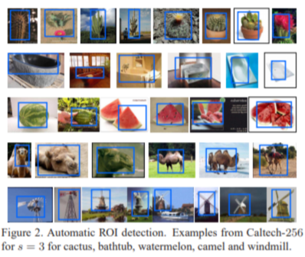

Slide 11
Random Forest and ferns

Slide 12

Random Forest Classifier
It is a multi-way classifier consists of number of trees, with each tree grown using some form of randomization.
It consists of binary tree and are constructed in a top-down manner.The binary test at each node can be chosen in one of two ways: (i) randomly (ii) by a greedy algorithm.
The leaf nodes of each tree estimate the posterior distribution over the image classes.
An image is classified by sending it down every tree and aggregating the reached leaf distributions.
At leaf node posterior probabilities are calculated and all the posterior probabilities are then averaged and the arg max is taken as the classification of the input image.
Node test for PHOG and PHOW:

Slide 13
Random ferns classifier
To increase the speed of the random forest Random fern classifier are used.
Ferns are nonhierarchical structures where each one consists of a set of binary tests (which in our case is 0 if n Tx + b > 0 or 1 if n Tx + b ≤ 0).
Each node in the fern provides a result for the binary test which is used to access the leaf which contains the posterior probability.
The posteriors are combined over the ferns in the same way as for random forests over trees.

Slide 14
Implementation of Randomized trees and ferns
At a given node, nf features are randomly selected.
The vector n is initialized with zeros and the nf variables chosen are coefficients that are uniform random numbers on [−1, 1].
b is randomly chosen between 0 and the distance of the further point x from the origin.
For the root node we chose r = 10,For all other nodes, we used r = 100D, where D is the depth of the node.
For the experiment we take 100 randomized trees with D=20, entropy optimization, and all the descriptors unless otherwise stated.

Slide 15
EXPERIMENT
Experiments are performed in dataset Caltech-101 and Caltech-256.
The Caltech101 data is split into 30 training images (chosen randomly) per category and 50 for testing – disjoint from the training images.
For Caltech-256, 30 images are used for training and 25 for testing.
The final performance score is computed as the mean recognition rate per class.
The classification process is repeated 10 times and the average performance score and its standard deviation are reported.

Slide 16
Image classification result

Slide 17
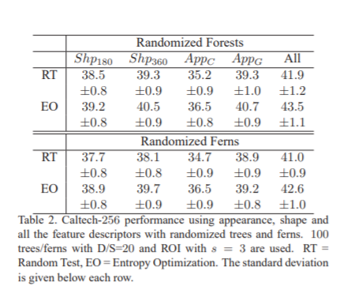
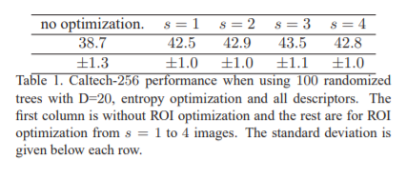

Slide 18
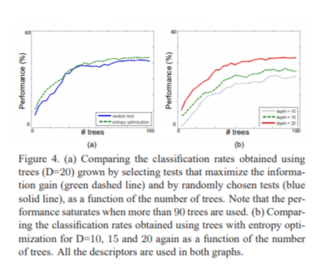
Increasing the depth increases performance however it also increases the memory required to store trees and ferns

Slide 19
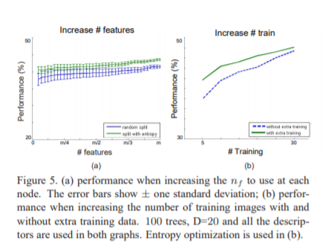

Slide 20
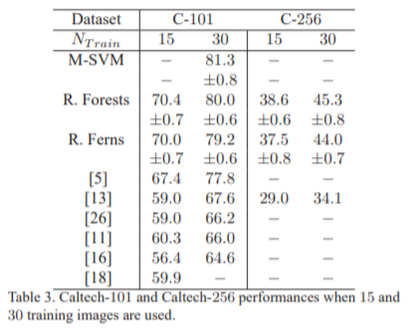

Slide 21
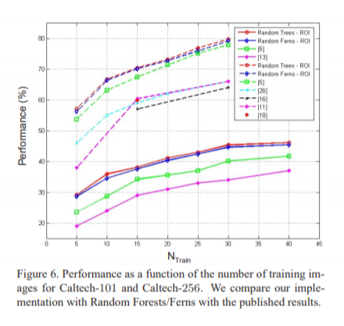

Slide 22

Thank you!
-RISHAV KUMAR(B19ME066)

