Slide 1
BitFusion Architecture with support for 6 bit quantization
Sreekrishna Ramaswamy
Rohit Gupta
Hadi Esmaeilzadeh

Slide 2
Weight Buffer
FROM COMPILER
CODE
SCHEDULER +
PE
FUSION UNIT
DRAM

Slide 3
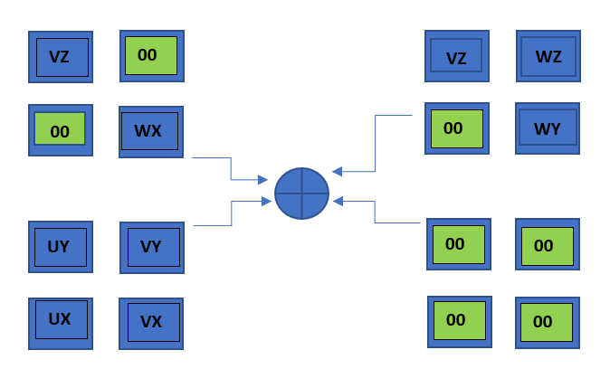
BIT FUSION ARCHITECTURE – 6b x 6b Quantization

Slide 4
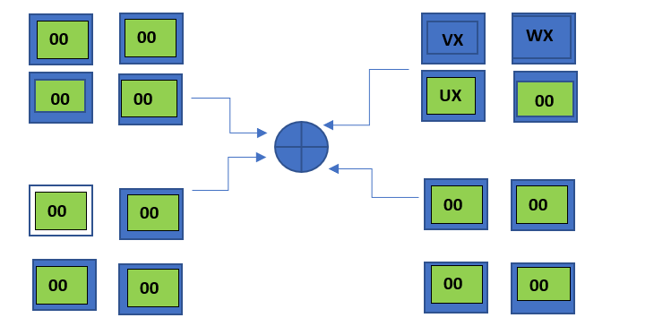
BIT FUSION ARCHITECTURE – 6b x 2b Quantization

Slide 5
Tasks & Status
ISA – Almost done
Micro-architecture – Almost done
Compiler – Currently being implemented
Cycle accurate simulator – Currently being implemented
Benchmarks – Work not commenced.

Slide 6
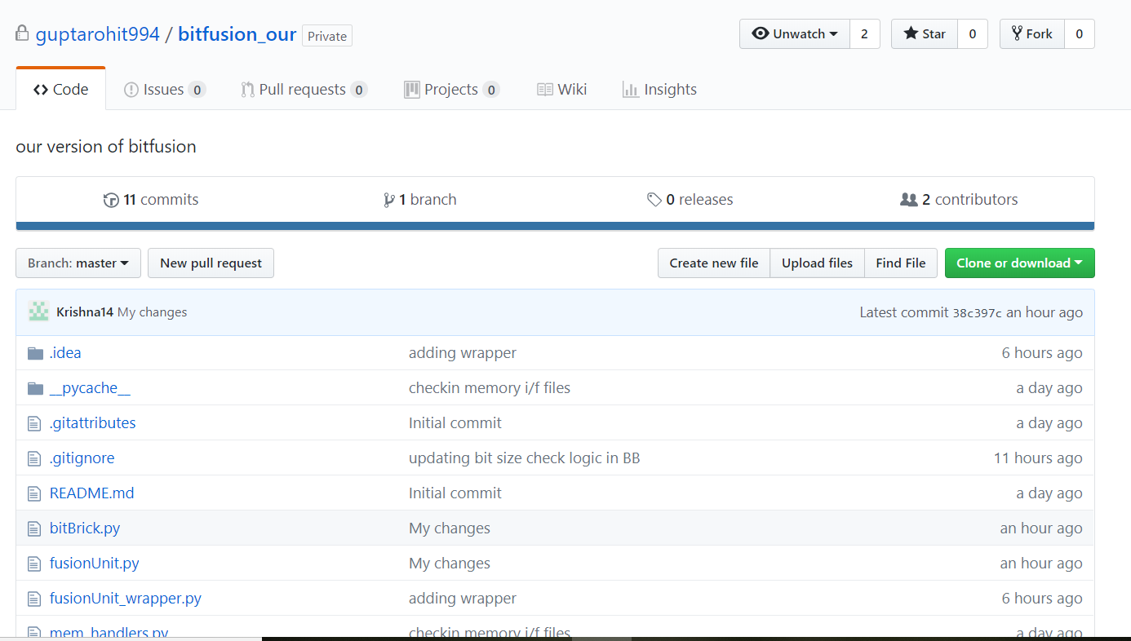
OUR WORK
https://github.com/guptarohit994/bitfusion_our

Slide 7
BIT FUSION ARCHITECTURE – 6b x 2b Quantization

