Slide 1


Team Name: Team Eco
Project Name: Zero Waste
Innovation Track
SDG 2 : Zero Hunger
Team Id:

Slide 2

Team Members
Garima Saigal
Aryan Gupta
Kumud Kesar
Achut Kumar

Slide 3
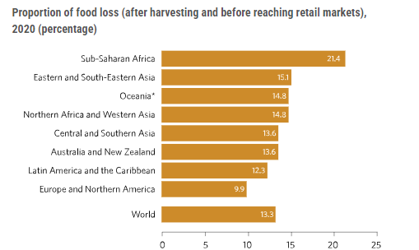
Problem Statement:
Massive quantities of edible food are discarded by restaurants and hotels each day, creating unnecessary waste and contributing to greenhouse gas emissions. Simultaneously, NGOs face challenges securing sufficient food for those in need.
This project seeks to address this by developing a mobile application that connects food donors with NGOs. By facilitating the donation of surplus prepared food, the application aims to reduce food waste, lessen carbon footprint, and support communities experiencing food insecurity.

Slide 4
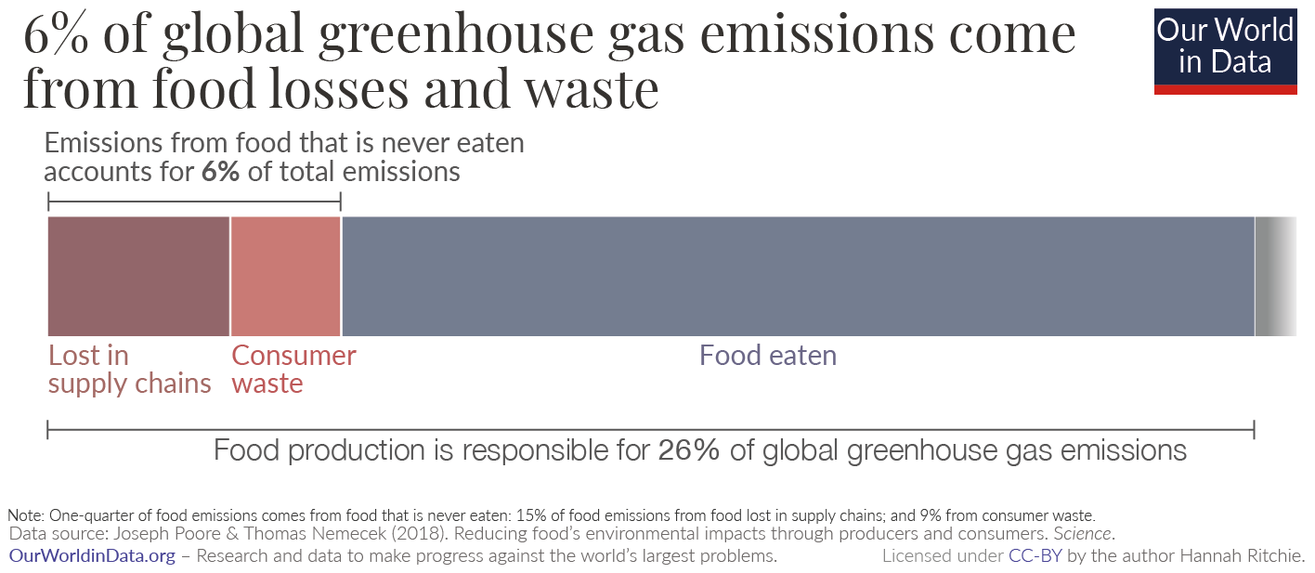
How?
Too much food is lost or wasted globally, with an estimated 13.3% of the world's food lost after harvesting and before reaching retail markets in 2020.
At consumer levels, approximately 17% of total food available is wasted, amounting to 931 million metric tons annually.
Food loss occurs primarily in developing countries, while food waste is more prevalent in developed nations.
Food waste contributes significantly to greenhouse gas emissions, generating 6 to 10% of global emissions.

Slide 5
Introduction
MISSION STATEMENT
Rescue surplus food, nourish communities, and reduce waste.
OBJECTIVES
Connect restaurants(donors) with NGOs in need with food insecurity.
Facilitate the donation of excess prepared food.
Reduce food waste and analyse its environmental impact through carbon footprint calculator.
Track the positive environmental impact (reduced carbon footprint) of food rescue.
Implement greener and more sustainable policies and solutions in waste reduction and management.

Slide 6
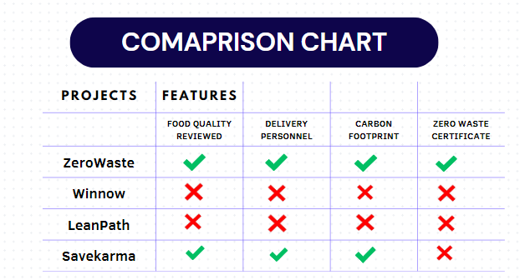
Research Survey:
Global annual volume of food wasted: 1.3 billion tons per year
Percentage of food produced that goes to waste: 17 %
Environmental Impact:Global food loss and waste generate annually 4.4 GtCO2 eq, or about 8% of total anthropogenic GHG emissions.
Contribution of food waste to greenhouse gas emissions: Almost equivalent (87%) to global road transport emissions.
Statistics on carbon footprint of food waste: 170 million metric tons of carbon dioxide equivalent (million MTCO2e) GHG emissions (excluding landfill emissions)
Economic Costs: $444 billion worth of food is wasted annually.
Financial losses incurred by businesses due to food waste: $218 billion from the $1.264 trillion agriculture industry, according to RTS

Slide 7
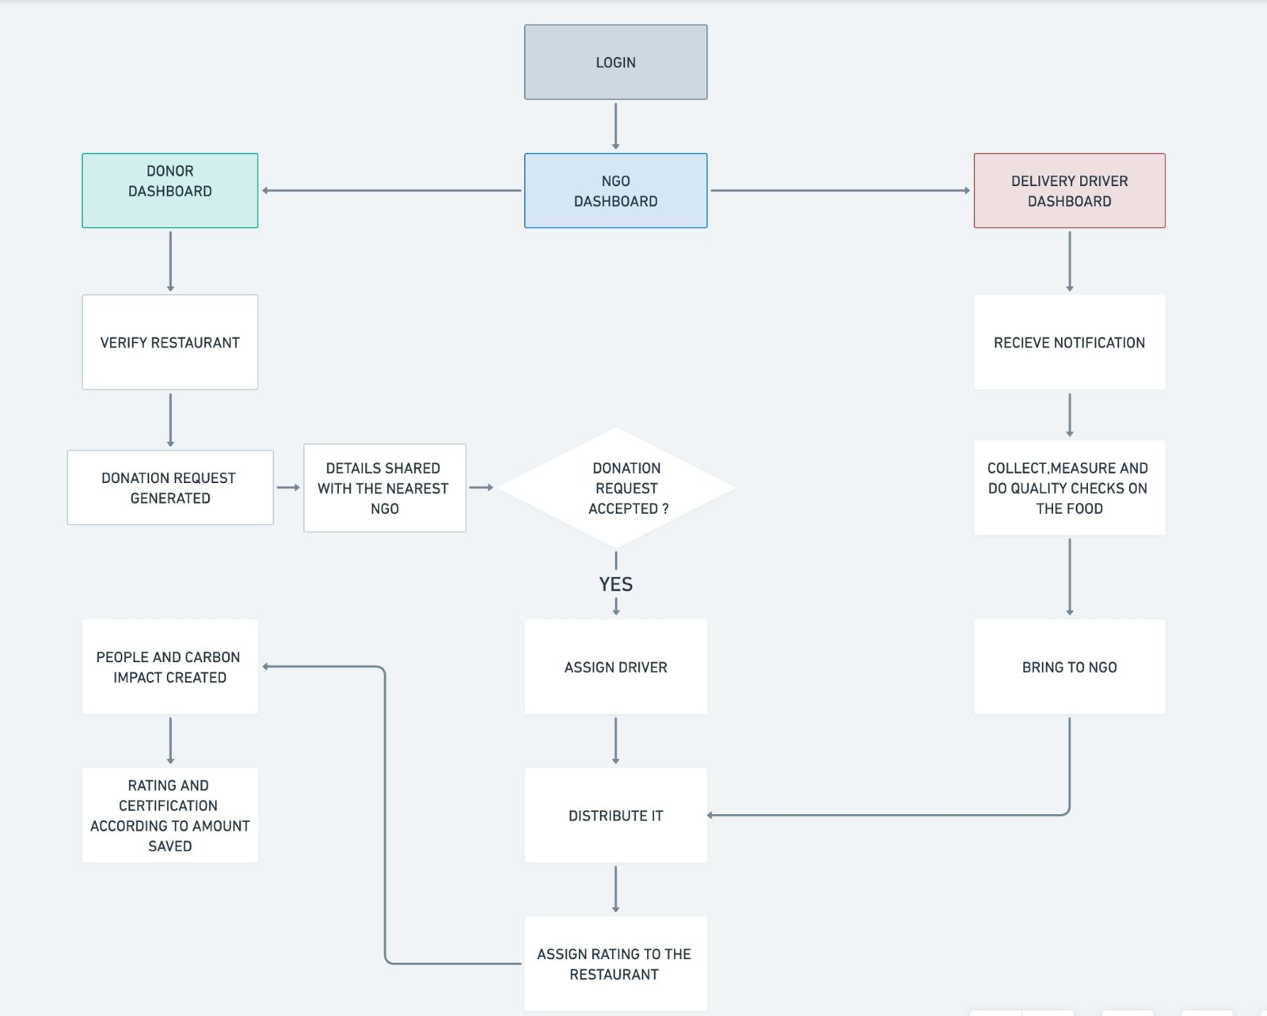
Proposed Solution
Donation Management: Surplus food to NGOs.
Zero Waste Certification: Sustainable practices.
Carbon Footprint: Environmental impact.
Sustainability Metrics: Progress tracking.

Slide 8
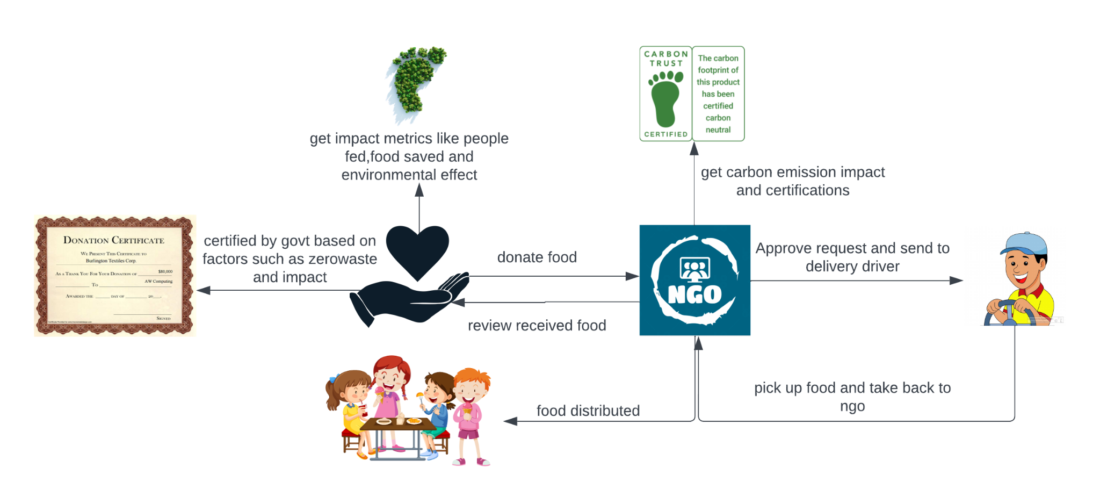
Project Architecture

Slide 9
Advantages & Disadvantages
ADVANTAGES | DISADVANTAGES
Reduced Food Waste | Initial Implementation Cost
Increased Food Security | Technical Complexity
Environmental Benefits Community Building | Scalability and Reach Volunteer Recruitment

Slide 10
Conclusion:
Food waste is a significant problem, but this mobile application offers a practical solution. By connecting donors with NGOs, it facilitates the redistribution of surplus food, reducing waste and supporting communities in need.
The application goes beyond simple donation management. It empowers businesses to pursue Zero Waste certification and track their environmental impact through carbon footprint calculations and sustainability metrics.

Slide 11
References:
UNEP. (2021). UNEP Food Waste Index Report 2021. United Nations Environment Programme. Retrieved from https://www.unep.org/resources/report/unep-food-waste-index-report-2021
USDA. (2022, January 24). Food Waste and Its Links to Greenhouse Gases and Climate Change. United States Department of Agriculture. Retrieved from https://www.usda.gov/media/blog/2022/01/24/food-waste-and-its-links-greenhouse-gases-and-climate-change#:~:text=Food%20loss%20and%20waste%20also,even%20more%20potent%20greenhouse%20gas.
New Food Magazine. (n.d.). The Impact of Food Waste on Climate Change. New Food Magazine. Retrieved from https://www.newfoodmagazine.com/article/153960/food-waste-climate/#:~:text=Putting%20it%20into%20perspective,more%20potent%20than%20CO2.
FAO. (n.d.). Food wastage footprint: Impacts on natural resources - Summary report. Food and Agriculture Organization of the United Nations. Retrieved from https://www.fao.org/3/bb144e/bb144e.pdf

Slide 12

Thank You

