Slide 1

Project : Socio-Pedia
Name : Aryan Gupta
Roll No : 2021a1r125
Domain: Web Development
Under the guidance of : Parmveer Nandal

Slide 2
Study Work
Existing systems explored
There are many existing systems for social media websites.
Some of the most popular ones include:
Linkedin: www.linkedin.com
Facebook: www.facebook.com
Reddit: www.reddit.com

Slide 3
Comparative analysis of those systems
The existing systems for news websites vary in a number of ways, including:
The section of people they appeal to : Some systems focus on a specific age group, such as teenagers or millennials , while others offer a more general social media platform.
The features they offer: Some systems offer features such as responsiveness, great UI while others are more basic.
The user interface: The user interface of different systems can vary in terms of its design and functionality.

Slide 4
Study Work
Problems In Existing Systems
Twitter: mostly text based and not much use of media
Facebook: UI very confusing for new users
Reddit: No friend request or social circle system

Slide 5
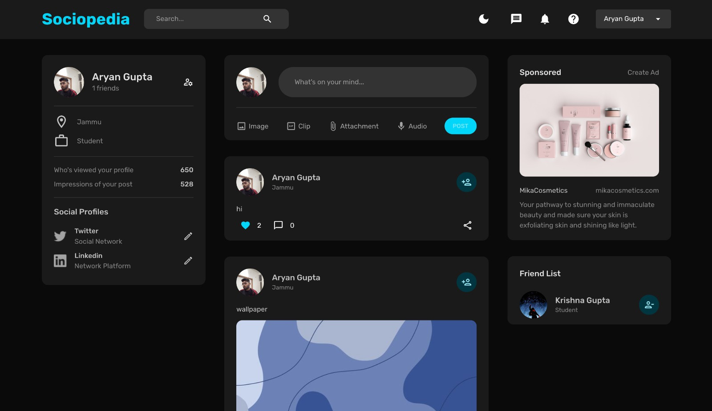
MAIN DASHBOARD

Slide 6
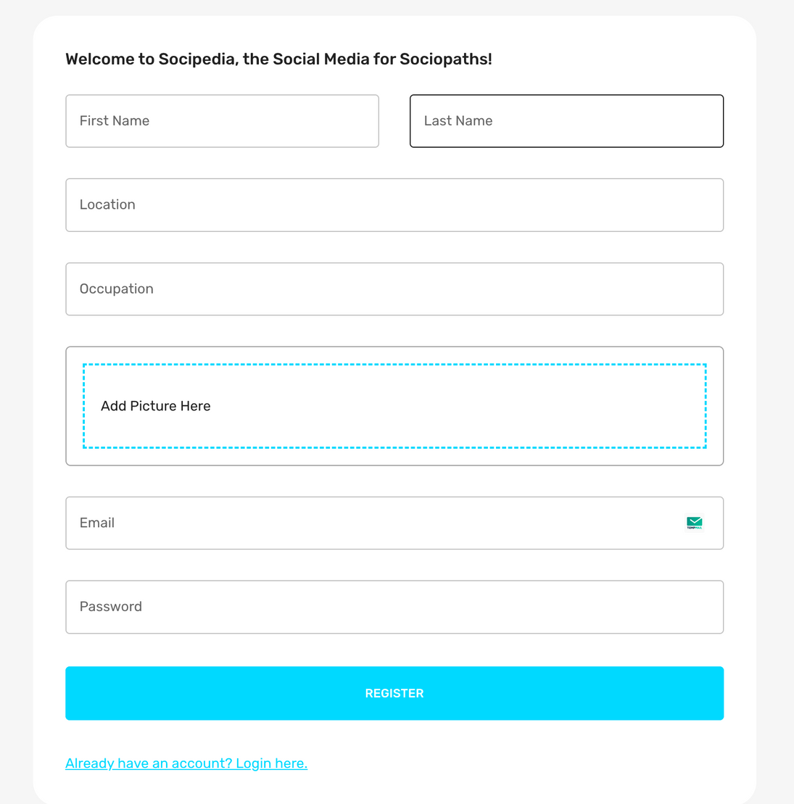
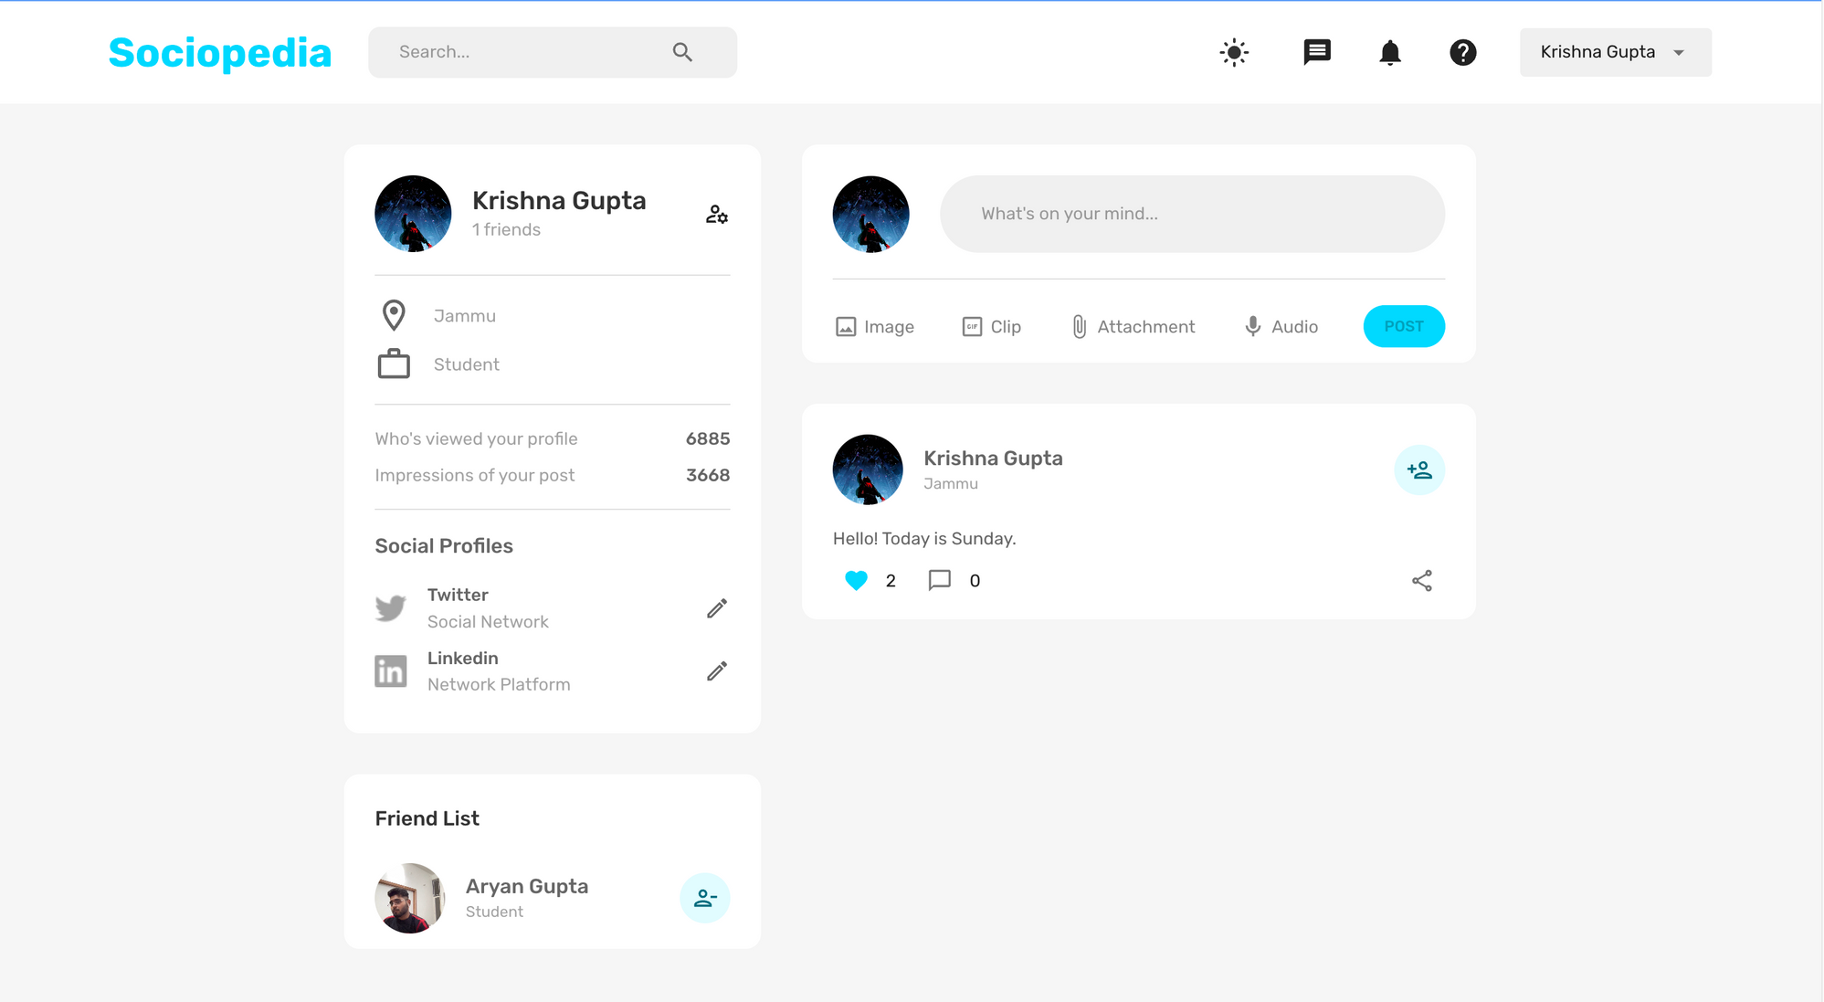
USER PROFILE
USER LOGIN & AUTHORISATION

Slide 7

How our system is better than those systems
MERN STACK
MERN stands for MongoDB, Express.js, React, and Node.js.
It's a full-stack JavaScript technology stack used for web development.
1. MongoDB
MongoDB is a NoSQL database.
Known for its flexibility and scalability.
Stores data in JSON-like documents.
2. Express JS
Express.js is a backend framework for Node.js.
Enables building robust server-side applications.
Features include routing and middleware support.
3. React
React is a JavaScript library for building user interfaces.
Utilizes a component-based architecture.
Creates dynamic and interactive front-end experiences.
4. Node JS
Node.js is a JavaScript runtime for server-side applications.
Offers non-blocking I/O and event-driven architecture.
Serves as the backend server in MERN applications.

Slide 8
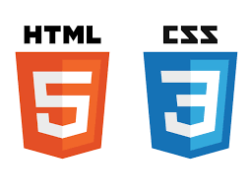
HTML
HTML is a fundamental markup language used to structure content on the web.
It defines the elements and their hierarchy in a web page.
1. SEMANTIC STRUCTURE
HTML provides semantic tags like headings, paragraphs, lists, and links,
which give meaning to the content and aid accessibility and SEO.
2. CROSS-BROWSER COMPATIBILITY
HTML is universally supported by web browsers, ensuring
consistent rendering of web content across different platforms..
3. VERSION EVOLUTION
HTML has evolved over time, with HTML5 being the latest standard, introducing new features like video, audio, and canvas for richer web experiences.

Slide 9

JavaScript
JavaScript is a text-based programming language used both on the client-side and server-side that allows you to make web pages interactivee..
1. CLIENT-SIDE WEB DEVELOPMENT:
JavaScript is primarily used for enhancing interactivity and
functionality on the client side of web applications.
2. BROWSER COMPATIBILITY:
It helps achieve cross-browser compatibility by detecting and
handling differences between web browsers.
3. EVENT HANDLING:
JavaScript enables developers to respond to user actions, such as
clicks, key presses, and mouse movements, by attaching
event listeners to HTML elements.
4. Form Validation:
It's used to validate user input in web forms, ensuring
data accuracy and preventing incorrect submissions.
5. AJAX Requests:
JavaScript can make asynchronous HTTP requests (AJAX) to fetch or send data to a server without requiring a full page reload, enabling dynamic content loading.

Slide 10




FEATURES
(Client-Side)
ACTIVATION OF DARK MODE
Interface can be turned into dark mode or bright mode as per user’s preference.
Can be toggled with the click of a button
CAN CONNECT WITH FRIENDS
User can connect with other users.
They can follow each other
POST AND LIKE
User can post images and text for fun or professional purposes.
Users can like the content that their friends have posted.
Users can upload media such as photos, videos etc

Slide 11


FEATURES
(Client-Side)
USER PROFILE
Users get their own user dashboard
Users can change any information about their account from here
RESPONSIVE
The interface is responsive
It adapts to the screen size so that all the users get a similar UI interface

Slide 12



FEATURES
(Server-Side)
CLOUD DATABASE
Used ‘MongoDB Atlas’ and AWS (Amazon Web Services) as a cloud database for developing a cloud server.
Collections for saving Posts and Users’ data in the cloud database.
USER AUTHENTICATION
Used ‘Bcrypt’ library for password hashing and adding ‘salt’
Used JSON Web Token (JWT) for token generation to visit different endpoints with verified credentials.
MULTI- USER EXPERIENCE
The web app provides multiple user experiences.
Collections for saving Posts and text snippets.

Slide 13


FEATURES
(Server-Side)
CONSISTENTENCY
The backend data is consistent
The data once shared remains consistent even after any environment/device change or reload
API
The app uses Express.JS as the API for calling and retrieving the data according to need
The API endpoints can be tested using ThunderClient Vs Code extension

Slide 14


