Slide 1
PROJECT 042
Document Intelligence
for Application Readiness
and Missing-Requirement Detection
Sakshi Gupta and Jigisha Baiswar
Notes:
Both presenters. Project title and scope from PROJECT_BRIEF.md.

Slide 2
The demonstration checklist
Which documents are present?
Which contain usable information?
Income Certificate
Caste Certificate
Marksheet
Identity Proof
The app accepts multiple images and makes missing types and incomplete fields visible in one report.
Students can select the required types for the session.
Demonstration profile in config/requirements.json
02
Notes:
Jigisha. Explain the four default types and why type detection and field checks are separate. Source: config/requirements.json and app.py.

Slide 3
System architecture
Image uploads
JPG, JPEG, PNG
Normalize image
Decode, orient, resize
Original OCR
Tesseract on original
Select OCR source
Display both outputs
Use one text for rules
DIP pipeline
Gray, denoise, contrast
Threshold, morphology
Processed OCR
Tesseract on final stage
Display and export
Image stages, OCR and checklist
JSON and Markdown reports
Assess readiness
Per-file and per-type
Classify and extract
Title phrases and labels
Checklist JSON
Production modules synchronized at M02
03
Notes:
Sakshi traces both OCR paths. Jigisha explains how the selected text feeds type detection and field extraction. The pipeline is independent of original OCR. Sources: app.py, modules/preprocessing.py, modules/ocr.py, modules/classification.py, modules/extraction.py and modules/readiness.py.

Slide 4
Application workflow
Set inputs
Uploads and checklist
DIP settings, OCR source
Analyze each file
Decode, run both OCR paths
and keep per-file errors
Check the selected text
Detect type, extract fields and
check OCR readability
Summarize required types
Count detected and usable types
Incomplete
At least one required type
is missing
Needs Attention
All types are detected, but
at least one is unusable
Ready
Every required type has
a usable file
Show findings and offer JSON or Markdown
Changes to analysis inputs clear the previous results and downloads.
04
Notes:
Jigisha. Explain status priority. A missing type takes precedence over a detected unusable type. Changes to uploads, checklist, settings or OCR source clear old results. Sources: app.py, modules/readiness.py and docs/merge/M02.md.

Slide 5
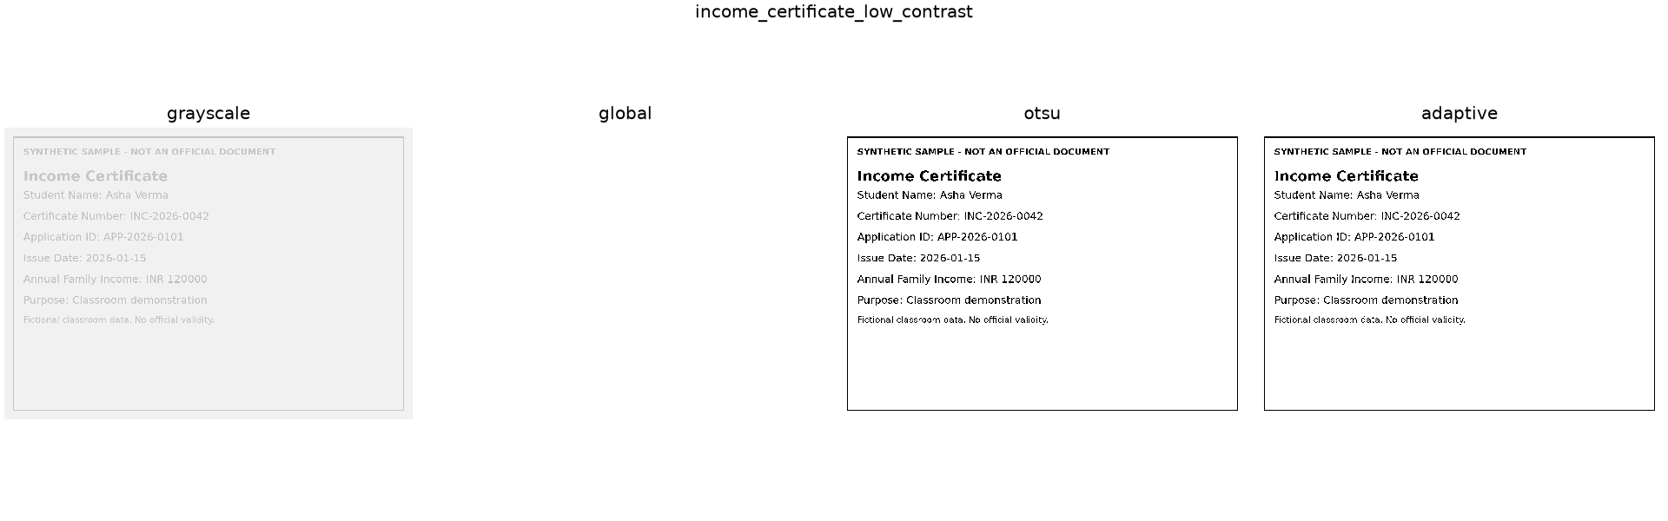
Image preprocessing
Default stages
Grayscale, median filter, CLAHE, then Otsu. Morphology is off by default.
The global threshold produced no OCR text on this sample.
SG05 threshold comparison on the fictional low-contrast income certificate
05
Notes:
Sakshi. The app converts to grayscale, then the default uses median 3, CLAHE clip 2.0 with 8×8 tiles, Otsu and no morphology. The frozen figure compares independent alternatives starting from grayscale. Global returned no text on the faint income sample. Source: outputs/experiments/SG05/income_certificate_low_contrast/thresholds.png and docs/merge/M02.md.

Slide 6
OCR, keywords and fields
Two OCR results
Tesseract 5.3.4 reads original and processed images using English and PSM 6.
Title phrases
The selected text matches “income certificate”. Competing title types produce Unknown.
Labeled fields
The regex reads and validates values after supported labels on the same line.
Asha Verma
INC-2026-0042
Frozen single-file browser report
06
Notes:
Sakshi explains both OCR inputs and PSM 6. Jigisha explains whole-phrase detection, ambiguous titles and line-anchored labels. Example values are from outputs/reports/JB05/single.json and outputs/screenshots/JB05/03_ocr_fields.jpg.

Slide 7
Coverage and readiness
Coverage
Readiness
100 × detected ÷ required
100 × usable ÷ required
100%
75%
All four required types detected
Three of four required types usable
Usable means one readable file contains every required field for its type. Repeated uploads earn no extra type credit.
Readable OCR has status ok and at least 20 letters or digits.
Four types in the frozen missing-name case
07
Notes:
Jigisha. Use the missing-name example. Readability is selected OCR status ok plus at least 20 alphanumeric characters. A single candidate must contain all required fields. Source: modules/readiness.py, config/requirements.json and outputs/reports/JB05/unusable.json.

Slide 8
Measured OCR results
Eight fictional images, 2,190 reference characters per method
Method | Pooled CER | Correct types | Exact present fields
Original | 0 | 8 / 8 | 28 / 28
Default processed | 0 | 8 / 8 | 28 / 28
Global threshold | 0.1324 | 7 / 8 | 24 / 28
Adaptive threshold | 0.1521 | 7 / 8 | 24 / 28
Global equalization | 1.1151 | 7 / 8 | 23 / 28
Original and default processed OCR tied at zero on this set.
Pooled character error rate (CER) = total edits ÷ total normalized reference characters.
SG05 summary.csv, selected methods from the M02 freeze
08
Notes:
Sakshi. Eight fictional images and 14 methods gave 112 measured OCR runs. Pooled CER is the total Levenshtein edits divided by 2,190 normalized reference characters per method. Casefold and collapse whitespace, retain punctuation. Insertions allow CER above 1. Source: outputs/experiments/SG05/summary.csv and docs/merge/M02.md.

Slide 9
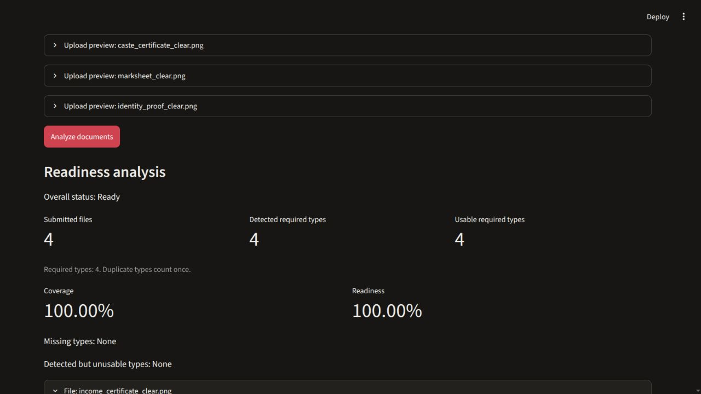
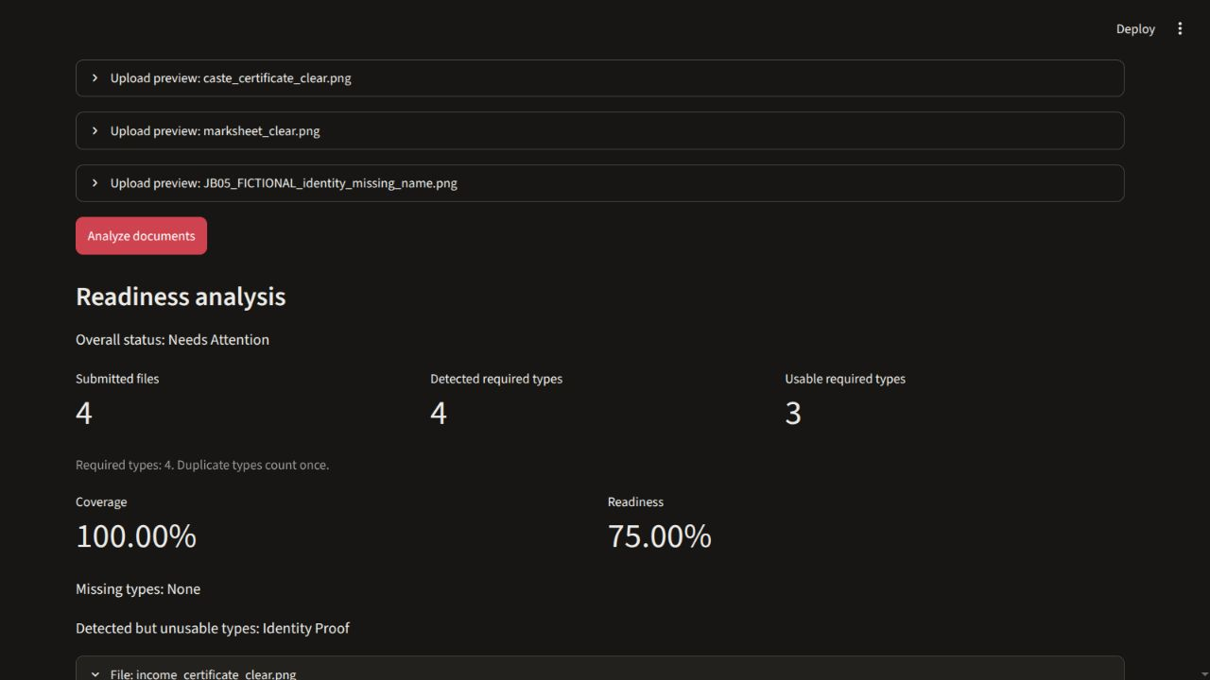
Browser results for two four-file batches
Four clear documents
Identity Proof lacks a name
100% coverage / 100% readiness
100% coverage / 75% readiness
Ready
Needs Attention
Actual browser captures with fictional inputs, JB05 evidence frozen at M02
09
Notes:
Jigisha. Both captures are original 1280×720 screenshots from the JB05 browser run. The missing-name Identity Proof remains readable by the heuristic. Sources: outputs/screenshots/JB05/05_complete_ready.jpg and 07_detected_unusable.jpg, plus complete.json and unusable.json in outputs/reports/JB05.

Slide 10
Browser edge cases
Scenario | Files | Detected | Usable | Coverage | Readiness
Missing Identity Proof | 3 | 3 / 4 | 3 / 4 | 75% | 75%
Nine-file batch | 9 | 4 / 4 | 3 / 4 | 100% | 75%
Three-type checklist | 9 | 3 / 3 | 3 / 3 | 100% | 100%
The nine-file report kept duplicates, blank text, an unrelated page and a corrupt file as separate records.
Only selected required types contribute to the two percentages.
Actual JB05 JSON downloads from the M02 freeze
10
Notes:
Jigisha. Show how a missing type differs from an unusable candidate. The nine-file batch retained duplicate uploads, blank/no_text, unrelated/unknown and corrupt/error. The three-type subset excluded Identity Proof. Sources: outputs/reports/JB05/missing.json, edge_batch.json, checklist_subset.json, original_source.json and changed_settings.json.

Slide 11
Evidence and scope limits
Eight images, four fictional layouts
The evaluation includes related derivatives. Accuracy on unfamiliar documents remains unmeasured.
Rules depend on recognizable labels
OCR errors and unfamiliar English layouts can leave titles or field values unresolved.
Readiness applies to the selected checklist
Authenticity, official eligibility and matching student identities are outside the app’s scope.
Local academic demonstration
11
Notes:
Both. The small set has four source layouts and four related derivatives. Explain why results cannot establish accuracy on unfamiliar layouts or official documents. Sources: docs/merge/M02.md, app.py and modules/readiness.py.

Slide 12
Demo sequence
01 Upload four clear samples
Jigisha previews the images and analyzes the default checklist.
02 Compare preprocessing and OCR
Sakshi shows the stages and reads the two Tesseract outputs for the Income Certificate.
03 Check missing and unusable cases
Jigisha removes Identity Proof, then adds the missing-name version and exports the report.
Fictional samples and frozen browser evidence
12
Notes:
Both. See docs/demo_script.md for inputs, launch, handovers and recovery. Expected values refer to outputs/reports/JB05/complete.json, missing.json and unusable.json.

