Slide 1
ScholarReady
Scholarship document readiness
Digital Image Processing and Data Science
Project 042
Sakshi Gupta and Jigisha Baiswar
6 November 2026
01
Notes:
20 seconds. Project 042. Full title: Scholarship Document Readiness and Missing-Requirement Detection using Digital Image Processing and Data Science. Team: Sakshi Gupta and Jigisha Baiswar. Codex assisted implementation and preparation. Student review/sign-off unreported. Roll numbers, institution, supervisor and deadline NOT PROVIDED. Source: HANDOFF.md, docs/CONTRIBUTIONS.md.

Slide 2
Local evidence and readiness
1 Image or PDF ingestion and original quality measures
2 Selected DIP branch and local Tesseract OCR
3 Document class and spatial field evidence
4 JSON requirements and unresolved issues
5 Shared CLI, evaluation and Streamlit result
Printed English, five supported types and other
Fictional checklist with explicit category applicability
02
Notes:
35 seconds. Explain input to result. Shared source: src/scholarready/pipeline.py, schemas.py, requirements.py and app/streamlit_app.py. No UI-only requirement rules. No manual OCR correction. This fictional checklist describes readiness and does not authenticate certificates, determine eligibility or predict awards.

Slide 3
Synthetic data and grouped partitions
Partition | Groups | Sources | Pages
Train | 10 | 60 | 130
Validation | 4 | 24 | 52
Test | 4 | 24 | 52
All test references checked before inference
24 correlated bundle scenarios across four applicants
One reserved layout family is a close template variant
03
Notes:
40 seconds. Source: data/manifests/expanded.metadata.json, expanded.splits.jsonl, data/annotations/expanded_review.json. Expanded-s09-1.0 has108 sources/234 pages/18 applicants. Original pilot30 sources/156 pages remains development-only. Every source/variant/applicant component keeps one split. 60 clean training pages fit TF-IDF and LR. Test52 pages/24 sources/four groups source-reviewed in a separate same-agent pass, no second annotator/student sign-off. Reserved layout13 pages/one close-template group.

Slide 4
Fixed image processing branches
Branch | Enabled operations
A | Ingested original
B | Grayscale and Otsu threshold
C | Grayscale, deskew, CLAHE, median, adaptive threshold, opening then closing
Same 52 pages and OCR settings
Tesseract 5.3.4, eng, OEM 3, PSM 3
300 DPI PDF rendering and 20 second OCR timeout
04
Notes:
45 seconds. Source: configs/evaluation.json and src/scholarready/preprocessing.py. Otsu global threshold versus adaptive local Gaussian mean minus constant: https://docs.opencv.org/4.x/d7/d4d/tutorial_py_thresholding.html. CLAHE clip2/grid8, median3, adaptive31/C15, identity1x1 opening then closing. Deskew±6 degrees with0.25 steps and heuristic abstention. https://docs.opencv.org/4.x/d5/daf/tutorial_py_histogram_equalization.html and https://docs.opencv.org/4.x/d9/d61/tutorial_py_morphological_ops.html. Black ink is inverted internally. Pixel matrix maps original to processed.

Slide 5
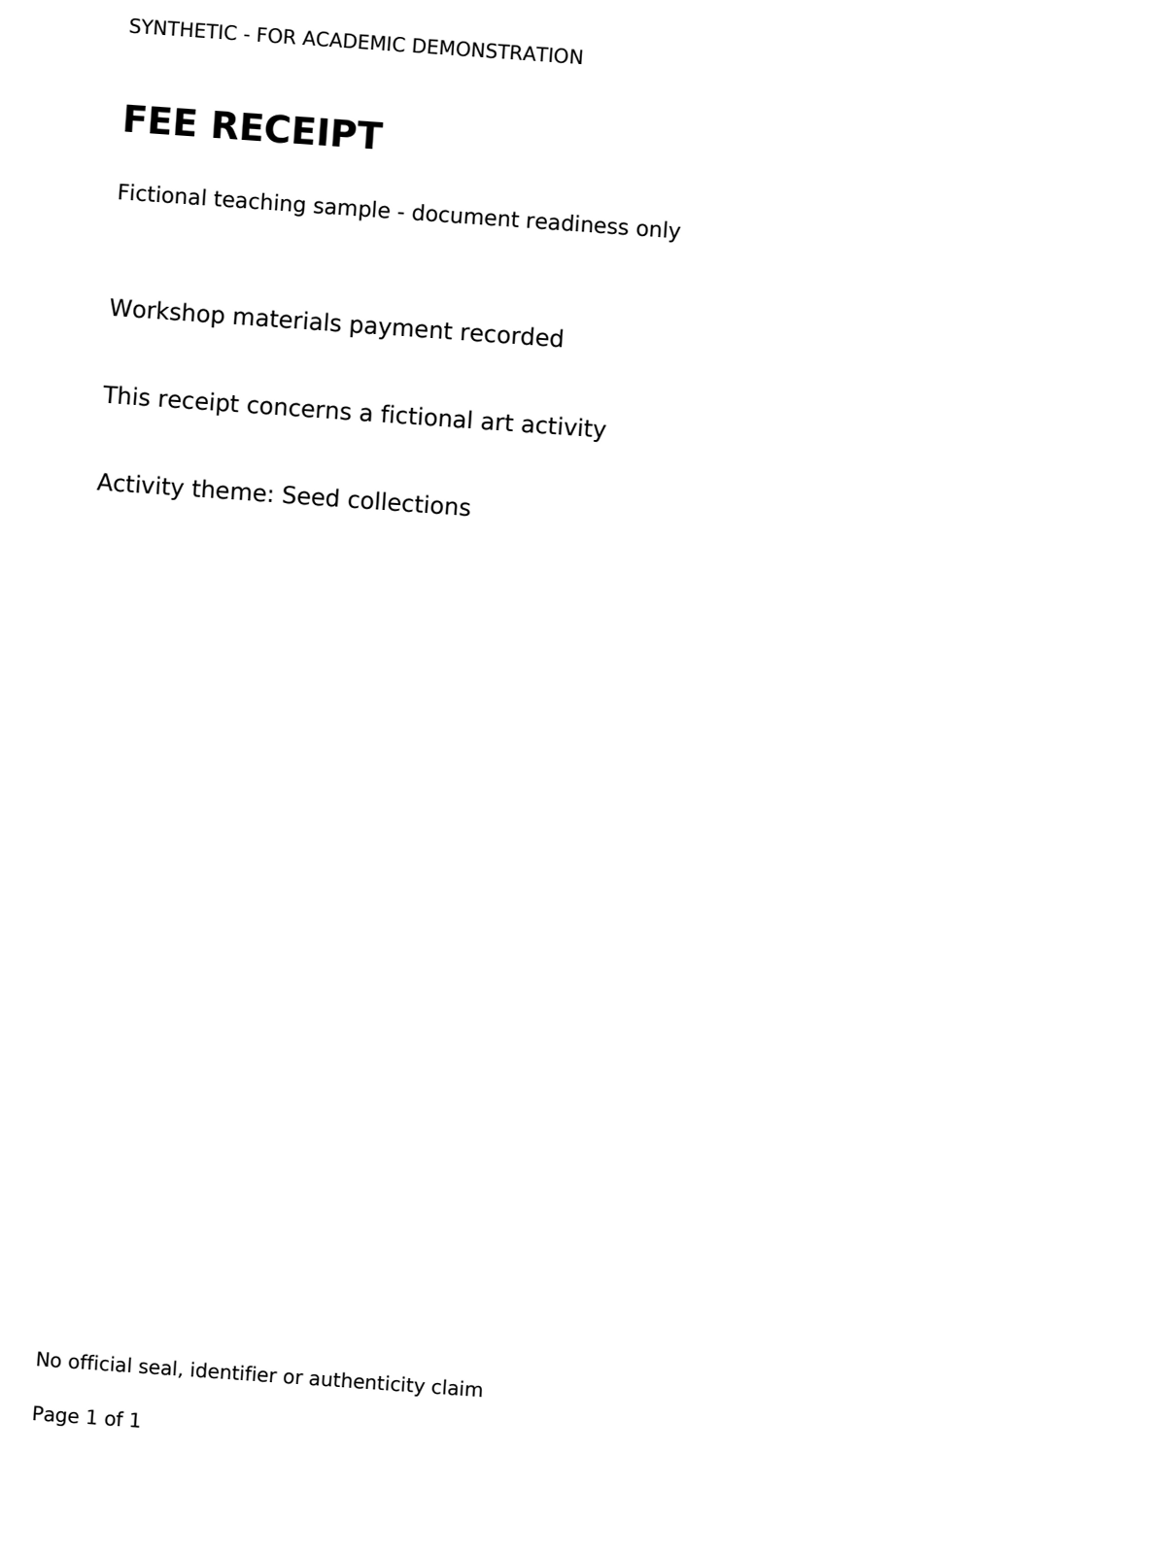
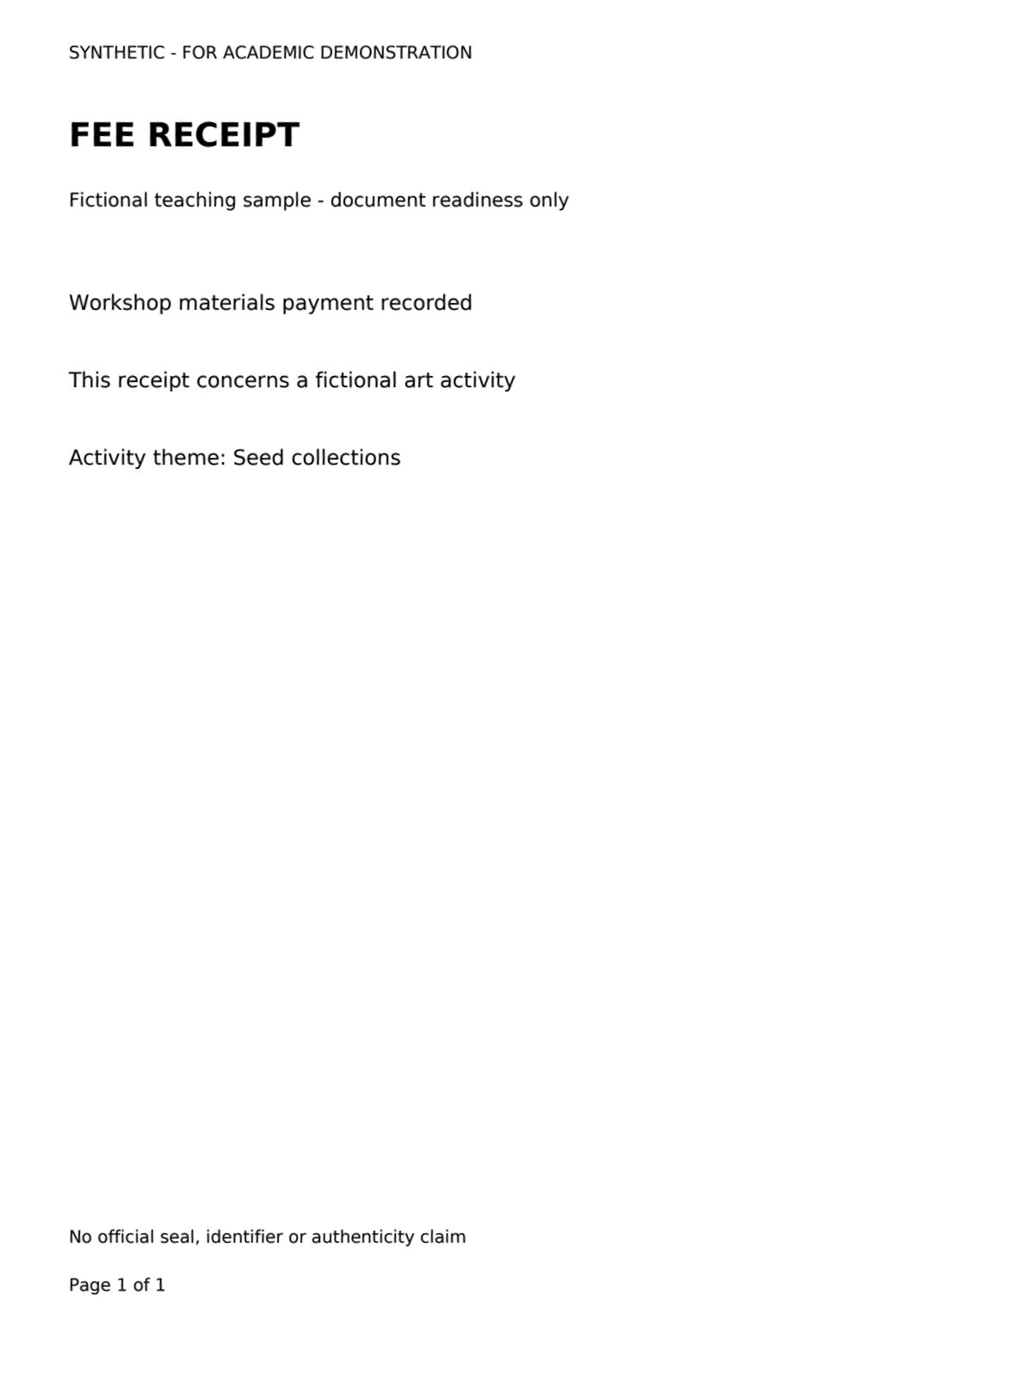

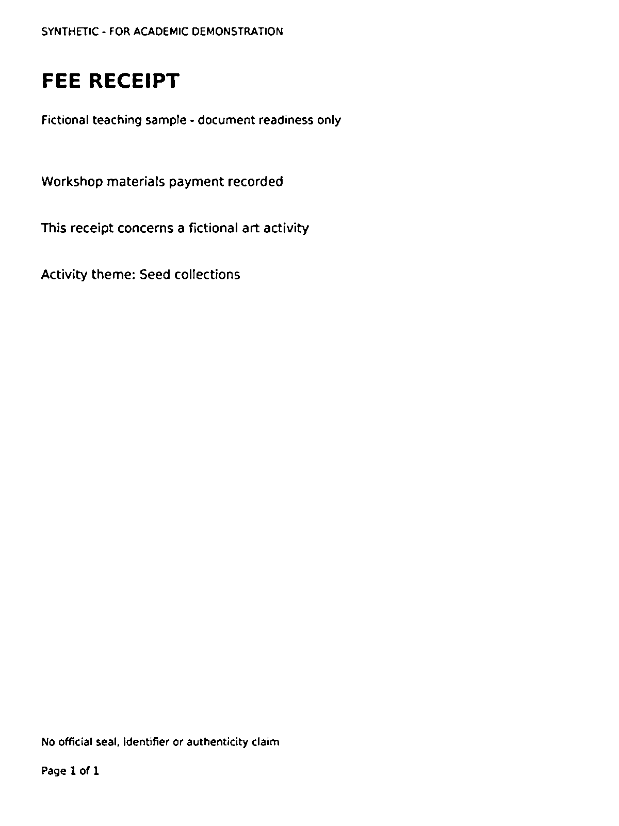
Saved processing stages
Original
Deskew
CLAHE
Adaptive
Four of seven saved stages, receipt exp-16-5-rotation
A has 0 character edits, C has 4
Darker text does not establish better OCR
05
Notes:
30 seconds. Source: docs/verification/s10/assets/figure_index.json C_stages. Four upper-page crops of seven original saved stages for exp-16-5-rotation. Full seven-stage sheet is in the report. Cropping is display-only, same region for all stages, no inference annotation. A0 edits/C4. Both keyword predictions unresolved. Resampling and binarization can change small print. The panel associates the full processing chain with errors and does not isolate each character cause.

Slide 6
C increased OCR errors on this test
Route | Char edits | Word edits | Fields /164
A/keyword | 3 | 4 | 161
A/learned | 3 | 4 | 161
B/keyword | 22 | 22 | 153
C/keyword | 50 | 46 | 158
14,900 reference characters and 2,092 words
A/B/C CER 0.0201% / 0.1477% / 0.3356%
52 synthetic pages from 24 sources and four groups
06
Notes:
45 seconds. Source: docs/verification/s10/assets/summary.csv, run/{A,B,C}/*_metrics.json. Identical14900 characters/2092 words, no processing failures or empty predictions. CER percent: A0.0201 B0.1477 C0.3356. WER percent:A0.1912 B1.0516 C2.1989. Exact field matches include value/unit/role. Four unreadable reference amounts excluded from164 present targets and retained separately. Learned A uses same OCR and fields.

Slide 7
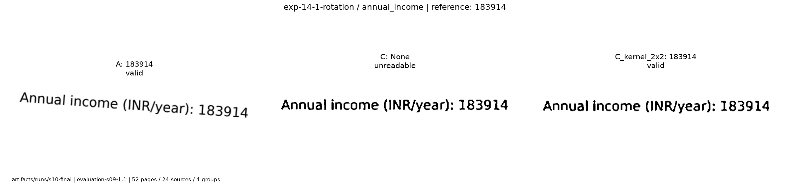
Classification and field evidence
Keyword macro-F1 0.944444
Learned A macro-F1 1.000000
Other recall rises from 4/8 to 8/8
A extracts 183914 INR/year
C leaves the value null after its token-score check
Model and OCR scores remain uncalibrated
07
Notes:
45 seconds. Six fixed labels include other. Source: docs/verification/s10/assets/classification_per_class.csv, fields_per_type.csv. Keyword macro-F1 .944444, learned1.0. All44 supported pages classified, keyword other4/8 correct and4 unresolved; learned8/8. True-type and predicted-type field totals agree because unsupported abstentions lack supported targets. Learned model train-only60 clean pages, C4,p0.6/margin0.2. No calibrated probability claim. Figure field_detail_C.png exp-14-1-rotation, reference crop for post-evaluation illustration only.

Slide 8
Every predeclared ablation remains visible
Variant | Edits | Fields
A | 3 | 161
B | 22 | 153
C | 50 | 158
No deskew | 37 | 159
No CLAHE | 165 | 160
No filter | 35 | 161
Variant | Edits | Fields
No threshold or morphology | 0 | 164
No morphology | 50 | 158
Grayscale only | 3 | 161
Kernel 1 by 2 | 83 | 158
Kernel 2 by 1 | 111 | 158
Kernel 2 by 2 | 158 | 142
Character edits / 14,900 and exact fields / 164
Zero-edit diagnostic needs a new untouched evaluation
08
Notes:
50 seconds. Source: summary.csv. Twelve preprocessing variants plus A learned give13 routes. Every row has same52 pages. No-threshold-or-morphology is coupled, not threshold alone. Diagnostic0 edits/164 fields is not promoted to frozen C after testing. Requires fresh development selection and confirmatory holdout. Identity1x1 and no morphology match. No per-page oracle.

Slide 9
False ready is zero in 16 nonready bundles
Route | Headlines /24 | Predicted ready | False ready
A/keyword | 24 | 8 | 0/16
A/learned | 24 | 8 | 0/16
B/keyword | 22 | 6 | 0/16
C/keyword | 24 | 8 | 0/16
Missing precision, recall and F1 are 1.0 on 120 items
Kernel 2 by 2 still agrees on only 18/24 headlines
Correlated synthetic cases do not establish real-world risk
09
Notes:
45 seconds. Source: summary.csv and each route readiness JSON. Reference8 ready/4 incomplete/4 clearer/8 review. All13 routes false-ready0/16. Missing TP4 FP0 FN0 TN116 across120 items; P/R/F1 all1 but these ignore false unreadable/review. B22/24, no-filter20/24, kernel2x218/24 headline agreement. Zero false ready does not establish population safety. Unknown category yields review/null denominator.

Slide 10
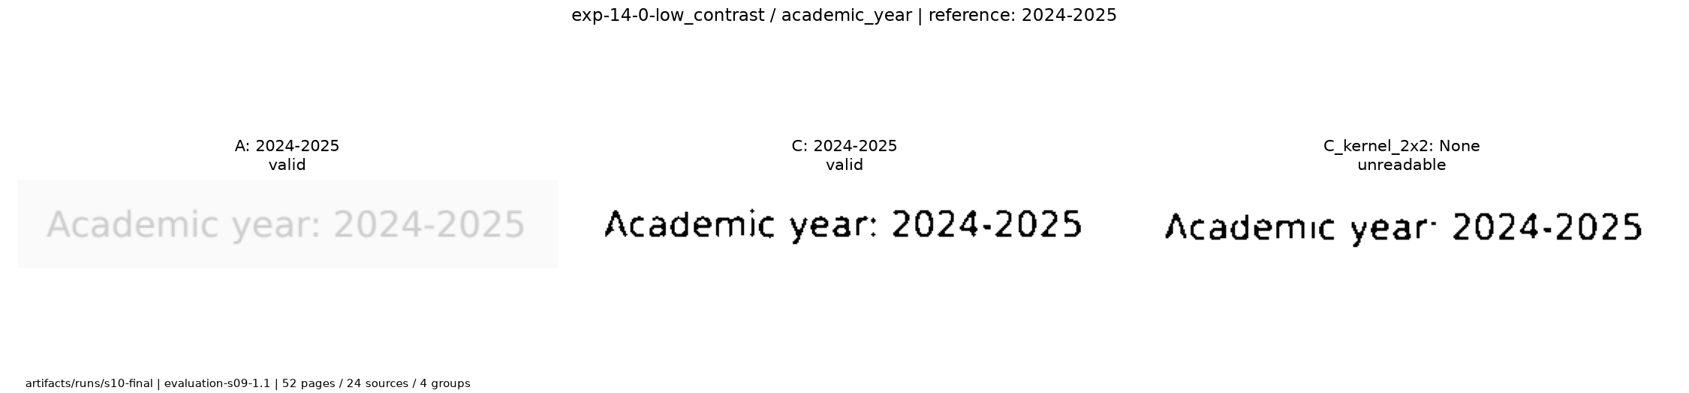
Morphology can discard readable fields
Kernel 2 by 2 rejects the readable academic year
Stroke changes can also corrupt numeric values
Raw text, boxes and uncertainty stay inspectable
10
Notes:
35 seconds. Source: field_detail_C_kernel_2x2.png and kernel_largest_change.png; exp-14-0-low_contrast. A0 character edits and kernel2x212. This crop shows the academic year token-score rejection. The separate full-page case also changes printed total804 into604. Selected after evaluation for explanation, not a representative frequency estimate. Other failure: frozen normalization counts BSC vs BSc Chemistry wrong, no post-test fix.

Slide 11
Four minute fictional demonstration
Case | Automatic headline | Completeness
Complete | ready | 100%
Missing income | incomplete | 80%
Unreadable amount | needs_clearer_upload | 80%
Applicant mismatch | needs_review | 0%
Run scripts/run_demo.py with a new output folder
Inspect result.json, field evidence and item states
No manual correction or hidden reference input
11
Notes:
20 second introduction, then four minute CLI walkthrough. See output/demo/DEMO_SCRIPT.md. Real rehearsal artifacts/runs/s12-demo-rehearsal,4/4 outcomes passed in9.327s computation. Allocation includes narration and evidence inspection. BranchA keyword, category true, expected name Fictional Aster. No OCR correction, no final-test input. Saved results are a labelled fallback, not live inference or a prerecorded video. Student timing not measured.

Slide 12
Reproduction and remaining limits
Smoke runs real development OCR
Final mode verifies preserved OCR and all 13 routes
Final test consumed remains YES
Synthetic English pages and closely related templates
Four final applicant groups and correlated bundles
Heuristic uncertainty and single-agent reference review
Student review and administrative details remain pending
12
Notes:
40 seconds. Source: docs/REPRODUCIBILITY.md, docs/CONTRIBUTIONS.md, docs/ERROR_ANALYSIS.md. S11 two fresh Python venvs on same Ubuntu host, not clean OS tests. Source and frozen assets archive plus separate Linux wheels. S12 companion academic deliverables. Smoke real development OCR, final saved-OCR verification all13 routes. Test permanently consumed since4Nov2026 22:11:17 IST. No real final benchmark, no calibrated scores, single-agent reference review,4 groups. Actual student contributions/sign-off/roll numbers/institution/template/deadline unknown. No submission/publication occurred.

