Slide 1
CSE350: Network Security
Assignment 2:
Data Encryption Standard (DES)

Slide 2
Question
You are required to develop a program to encrypt (and similarly decrypt) a 64-bit plaintext using DES. Then, with at least THREE pairs of <plaintext, ciphertext>:
Verify that the ciphertext when decrypted will yield the original plaintext.
Verify that output of the 1st encryption round is same as output of the 15th decryption round.
Verify that output of the 14th encryption round is same as the output of the 2nd decryption round.

Slide 3
About DES
Q. What is DES?
The Data Encryption Standard (DES) is a symmetric-key block cipher algorithm widely used for encryption of electronic data. Developed in the early 1970s by IBM and adopted by the U.S. government as a federal standard in 1977, DES became one of the most widely used encryption algorithms worldwide. DES operates on 64-bit blocks of plaintext using a 56-bit key, making it a 56-bit block cipher.
Q. Is it still in use?
DES is now considered insecure against modern cryptographic attacks due to its short key length. Consequently, it has been replaced by more secure algorithms like the Advanced Encryption Standard (AES).

Slide 4
Encryption Process
The encryption process is as follows:
Key Generation
Initial Permutation
16 Rounds of Encryption
Expansion
Substitution
Permutation
XOR with subkey
Final Permutation

Slide 5
Decryption
The decryption process is as follows:
Key Generation
Initial Permutation
16 Rounds of Decryption
Final Permutation

Slide 6
How to run the code
permutations.py: This file contains the permute function, which is a general permutation function used throughout the DES algorithm.
key_generation.py: This file contains functions related to key generation.
des_rounds.py: This file contains functions related to the DES rounds.
des.py: This file contains functions related to the overall DES encryption and decryption process.
main.py: This file serves as the entry point for running the DES encryption and decryption program.
Utils.py: helper functions of xor.
1. Open the terminal and navigate to the directory where the code is present.
2. Edit the fields of ciphertext and key file to change the plaintext message and the key within the code.
3. Run the following command:
python3 main.py
4. The output will be displayed on the terminal (integrity including original and obtained plaintexts and questions) and in the outputfile.txt (complete rounds).

Slide 7
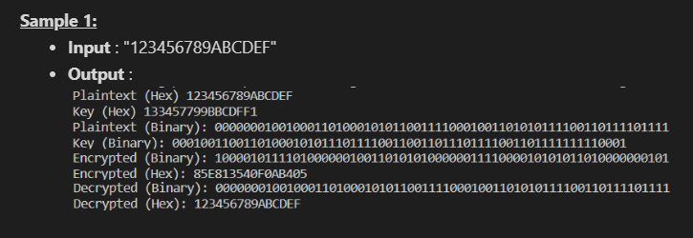
Input / Output examples

