Slide 1

Analysis of impact of socio-economic indicators on Micro Transit Occupancy
Team 17
Member: Samir Gupta
Subject: CS5266 - Topics in Big Data

Slide 2
Problem Statement
Analyze the impact of socio-economic factors such as median income on the ridership of micro-transit e-scooters in Nashville.
Use case:
This analysis can guide further research in the optimization and placement of e-scooters.
Helpful for e-scooter providers such as Bird, Lime, Spin, etc.
Further research in this subject can also guide research in the placement of charging station for these e-scooters according to the ridership.

Slide 3
Datasets Used and Specification
E-scooter Availability Data – 400 MB.
E-scooter Trips Data – 3.5 GB.
Socio-economic Data – 5 MB.

Slide 4
Technologies Used
Python 3.9.13
Spark 3.2 with Hadoop 2.7
Visualization tools used:
Geopandas
Plotly
Matplotlib
Hardware Used:
Intel i7 – 11th Gen
16 GB RAM
Intel Iris Xe Graphics
UDF Functions (PySpark)
SQL (PySpark)
Pandas

Slide 5
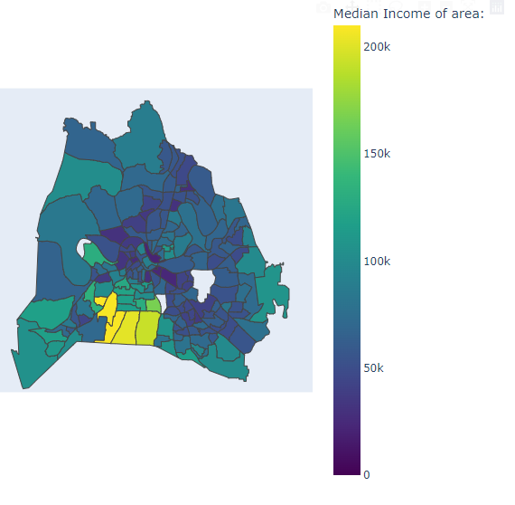
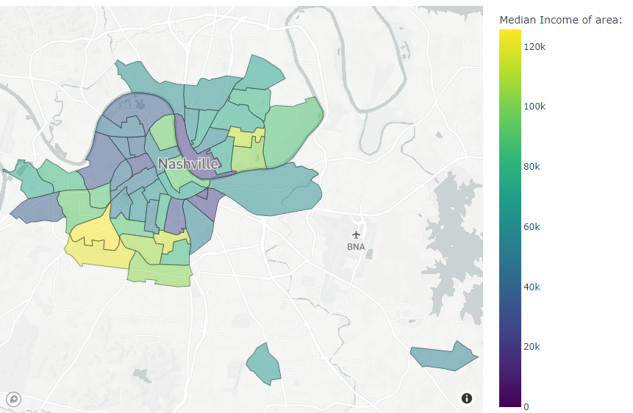
Visualize Socio Economic Factors in Nashvile

Slide 6
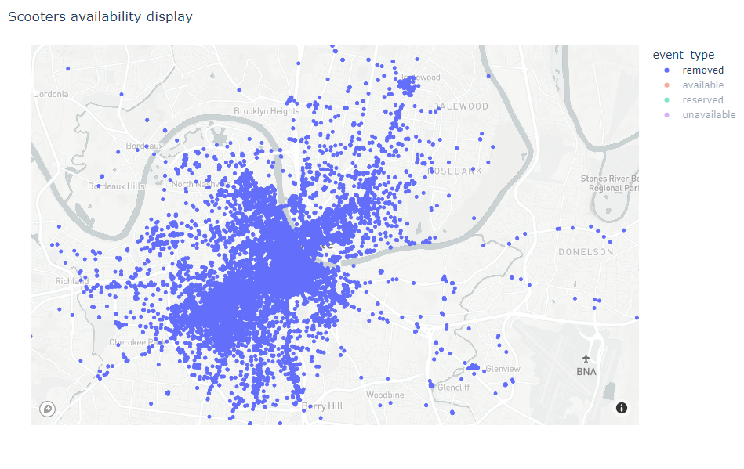
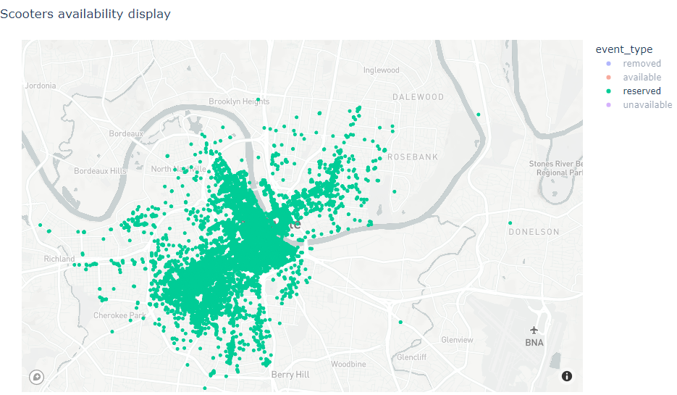
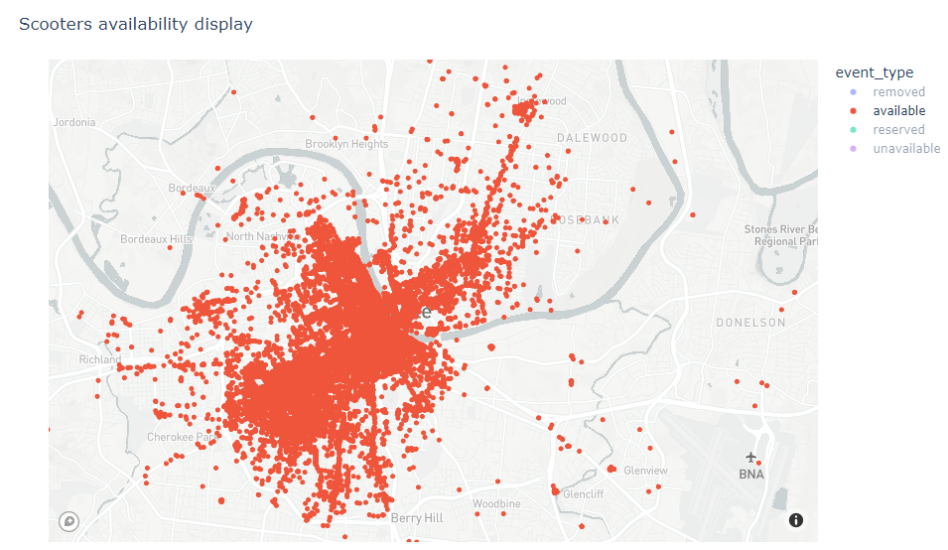
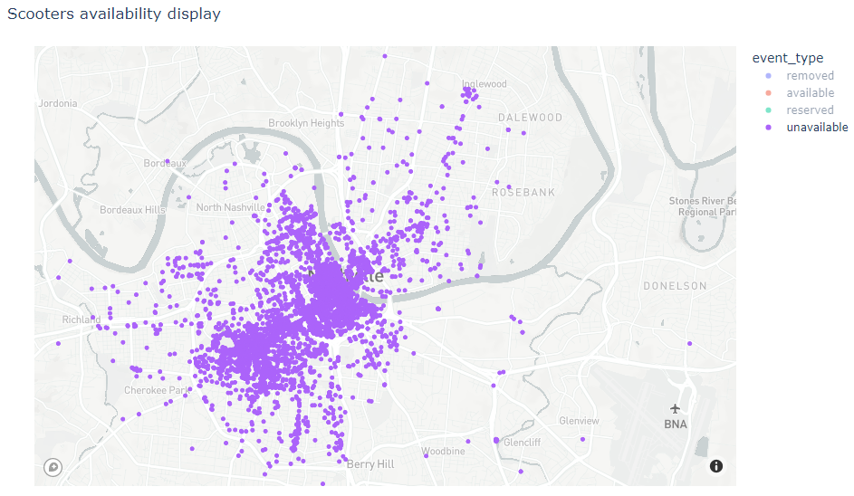
Visualize Availability of E-scooters in Nashville

Slide 7
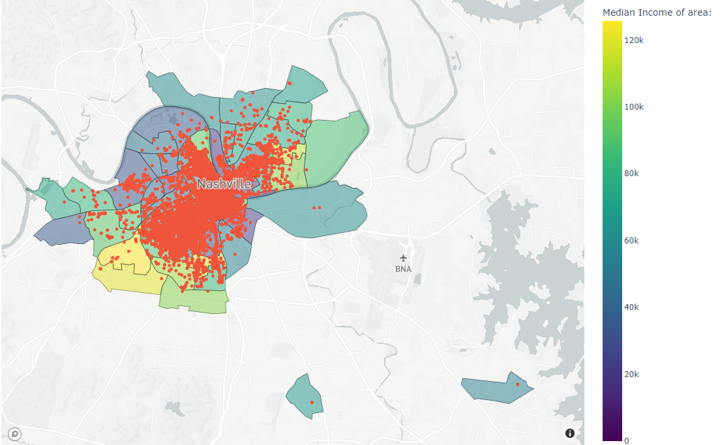
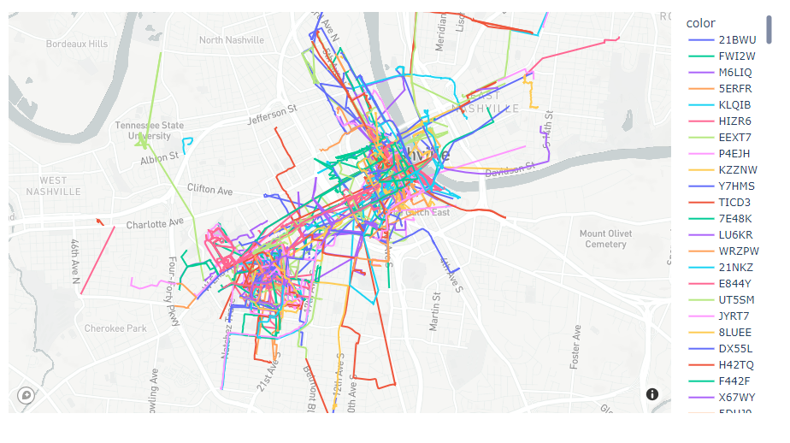
Visualizing trips of usage of the scooter

Slide 8
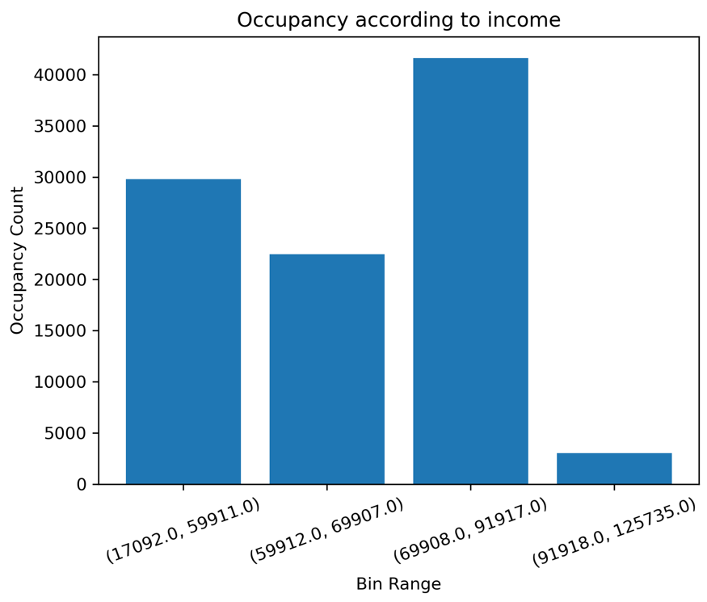
Results – Occupancy over socio economic ranges:

Slide 9
Lessons Learnt
Big Data is difficult to work with when you have major memory constraints.
Lot of times I ran into issues with memory.
Spark comes to the rescue.
Cloud is also useful but not always.
Made use of Athena.
EMR Cluster.

