Slide 1
Analysing the Challenges and Opportunities in Media Mix Modelling using Sales and Marketing Time Series Data
Saumya Gupta (Group 18)
DS

Slide 2
What is Marketing Mix Modelling (MMM)?
A statistical analysis technique widely used by many businesses for the past two decades for evaluating the effectiveness of different media spends on sales volume or sales revenue.
The inferences drive optimal budget allocations.
Helps answering questions:
how would their sales perform if the spending on a particular campaign is increased or decreased for the next budget cycle?
how much money their businesses earned from each unit of money spent in a specific campaign?
how should they allocate the budget for advertising to maximise their sales?

Slide 3
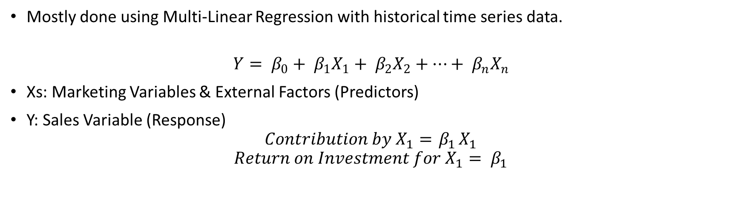
MMM contd.
Mostly done using Multi-Linear Regression with historical time series data.
$${Y= β}_{0}+ β_{1}X_{1}+ β_{2}X_{2}+…+ β_{n}X_{n}$$
Xs: Marketing Variables & External Factors (Predictors)
Y: Sales Variable (Response)
$$Contribution by X_{1}={ β}_{1}X_{1}$$
$$Return on Investment for X_{1}= β_{1}$$

Slide 4
The Problem; The Study Contributions
Model results are valid?
Results could be data-driven or modeller driven!
This study will help understand the various challenges faced by a modeller while walking through the whole modelling process, which can help obtain valid inferences, when understood correctly!

Slide 5
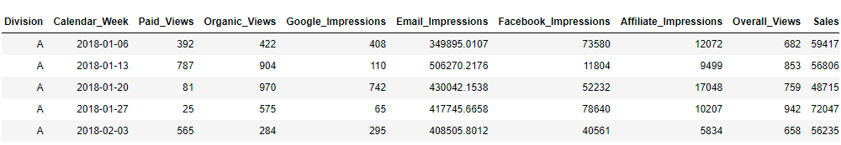
Dataset (from Kaggle)
Media Spending versus Sales Volume Data (3051 observations X 10 variables)
5 Media Channels (Online Media Variables):
113 weeks (Jan 2018 – Feb 2020) of Time Series Data (Weekly Frequency)
27 Divisions (Encrypted)
Google search impressions | YouTube (paid and organic) views
Facebook impressions | affiliate impressions
e-mail impressions

Slide 6
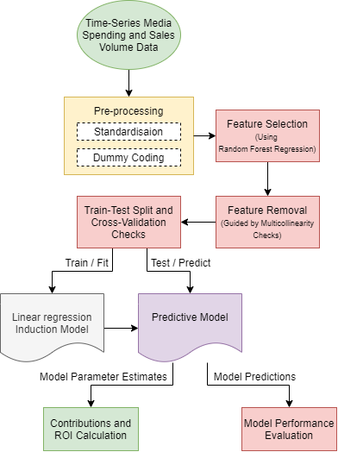
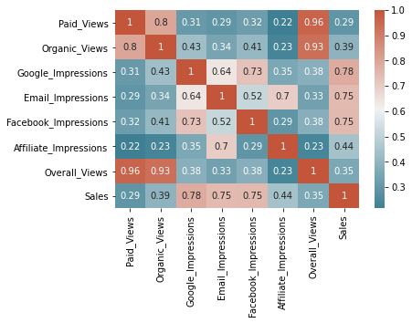
Data Pre-Processing & Exploratory Analysis
Pre-Processing:
Correct Encryption Inconsistency
Standardization
Dummy Coding
Sorting Based on Time
Exploratory Analysis: Correlation Checks

Slide 7
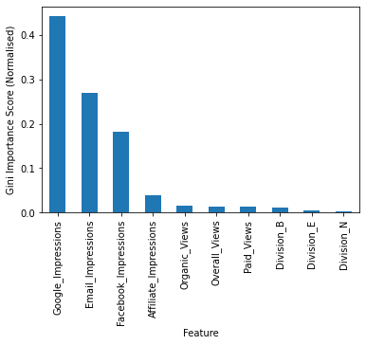
Model Building (with Cross-Validation)
Feature Selection:
Using Random Forest Regressor
Top 10 variables with highest Gini Importance Score
Further Feature Removal:
Using Variance Inflation Factor (VIF)

Slide 8
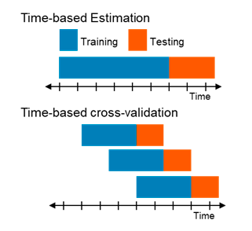
Model Building (with Cross-Validation) contd.
Model Fit and Validation:
Time Based Cross-Validation
Model Evaluation:
Mean Absolute Error (MAE) of 0.36 (0.22 for the train)
Mean Squared Error (MSE) of 0.44 (0.19 for the train)
R-squared of 0.6 (0.80 for the train).
The model performs well compared to the test MSE of 1.11 of the simplistic models (prediction by averaging).

Slide 9
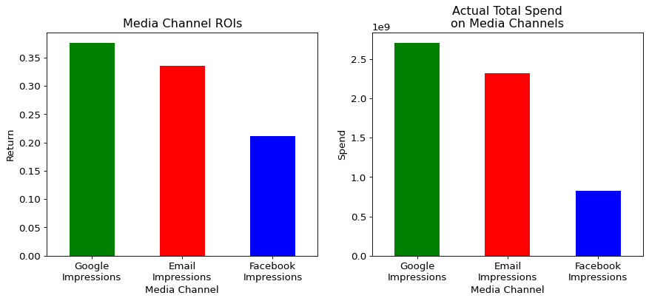
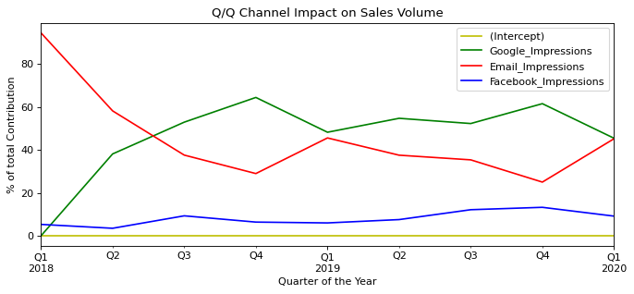
Opportunities from MMM (Model Results)

Slide 10
Conclusion
Challenges with MMM:
Highly Correlated Predictors:
Removal or use Shapley Value regression.
Negative Parameter Estimates
Removal of predictors with the problem?
Model Uncertainty [1]
Pitfall!
While choosing amongst all MMMs, organisations should keep in mind the proportion of the model results that are data-driven, to the model results driven by modellers’ decision to handle the challenge!
D. Chan and M. Perry, “Challenges and Opportunities in Media Mix Modeling,” Google, New York, 2017.

Slide 11
Q&A

Slide 12
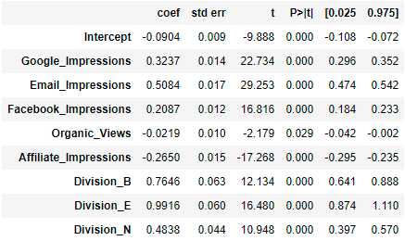
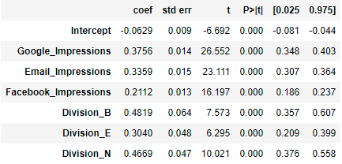
Appendix
Coefficient estimates of the model before and after removal of predictors with negative coefficient estimates:

Slide 13
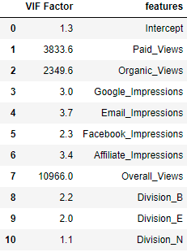
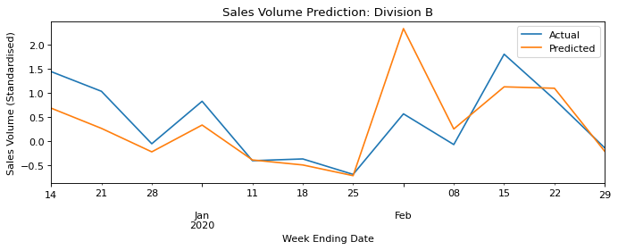
Appendix
Variance Inflation Factor Results before removing important collinear variables:
Final Model Results for Division B Test Set:

