Slide 1


Price Dispersion Analysis of Homogeneous Products in Online Markets
Xbox 360 Games
Saumya Gupta
M. M. Usman Zahid

Slide 2
Outline
Data
Result 1
Result 2
Conclusion
Q&A

Slide 3
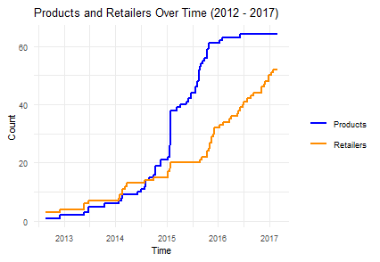
Data
Fig. 1 Product and online retailers over the years in the Xbox 360 market, showing an increase in the number of products and webpages, especially during early 2015.
64 products
52 stores
~54 months (Aug 2012 - Feb 2017)
CPI(Consumer Price Index)-adjusted prices
Prices ranging from 29 kr to 4179 kr.
Why did the number of Xbox 360 games kept increasing in the market even after the release of Xbox One?

Slide 4
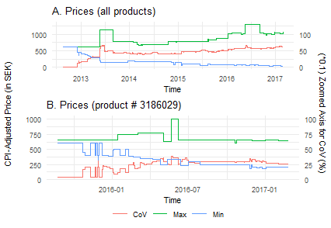
Is there a price dispersion among Xbox 360 products?
Fig. 2 Max, min and CoV of prices over time, across: (A) all products and (B) product ID 3186029. (Read CoV using the secondary axis.)
Yes!
Increasing range (Maximum - Minimum) of prices
Increasing Coefficient of Variation (CoV) of prices.

Slide 5
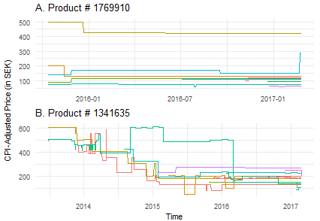
Is intertemporal price discrimination the cause for this?
Fig. 3 Pricing trends across all retailers for the product ID: (A) 1769910 and (B) 1341635. Different retailers in different colours.
Behaviour varies from product to product.
So we cluster the retailers for each product!

Slide 6
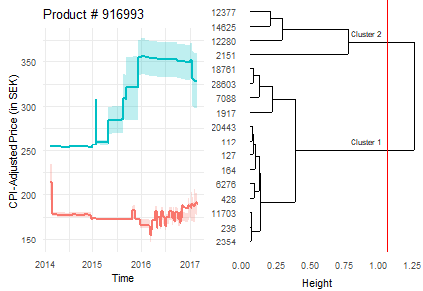
Clustering Result - Rejecting Clearinghouse
Fig. 4 Clustered retailers for product ID 916993 (left) Cluster dendrogram (right). The red line cuts the tree into two clusters. Notice the 25% - 75% interquartile range (IQR) ribbons.
Hierarchical clustering with dynamic time warping (dtw)
Optimal clusters using NbClust
For most of the products, retailers cluster into two non-overlapping levels of high and low pricing.

Slide 7
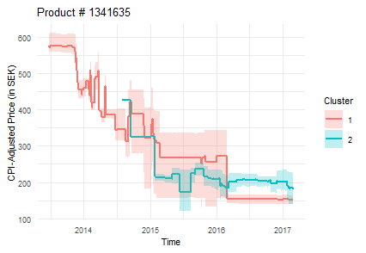
Clustering Result - Approving Clearinghouse
Fig. 5 Clustered retailers for product ID 1341635 with 25% - 75% interquartile range (IQR) ribbons.
For approx. ⅓ products, retailer clusters show price randomizations, accepting clearinghouse.
For the rest of the products, retailers are consistently setting prices in predictable patterns of high and low.

Slide 8
Conclusion
Intertemporal price discrimination is not the cause of price dispersion, as can be seen with many retailers who have predictable patterns of pricing.
Hence, we reject the clearinghouse model.

Slide 9
Questions?

