Slide 1
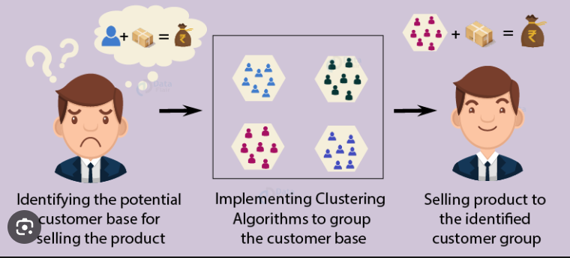
Customer Segmentation: Unveiling Patterns for Targeted Marketing Strategies
Data Science
Shivam Kailash Gupta
Harjinder

Slide 2
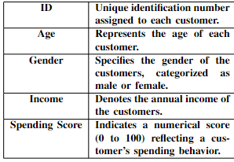
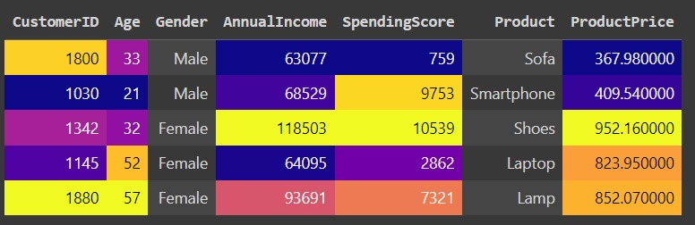
Dataset:
The dataset comprises a diverse range of customer information, including transaction data, age, gender, product service, spending score, purchase frequency, and customer id, annual income, Product.
This dataset provides valuable insights into customer behavior and preferences, forming the basis for segmentation analysis.
Source: Kaggle
Number of rows: 50K
Number of columns: 7

Slide 3
Problem Statement:
Businesses face challenges in catering to diverse customer preferences.
Traditional mass marketing is ineffective. Customer Segmentation, using machine learning, identifies distinct customer segments.
Tailored (personalized) marketing improves engagement, sales, and satisfaction.
It optimizes budgets by focusing resources on promising segments, maximizing ROI (Return On Investment).

Slide 4
Project Description:
The Customer Segmentation project focuses on analyzing a comprehensive dataset containing various customer attributes such as purchasing history, demographics, online behavior, and preferences.
By employing advanced machine learning techniques, specifically clustering algorithms, this project aims to identify distinct customer segments within the dataset.
These segments will enable businesses to tailor their marketing strategies, product offerings, and customer engagement initiatives to different customer groups effectively.
The K-means clustering technique will be employed to segment customers into six distinct clusters based on ’Age’, ’Annual Income’, and ’Spending Score’.

Slide 5
Methodology:
The project will utilize clustering algorithms, such as K-means, hierarchical clustering, to group customers with similar characteristics together.
By analyzing the patterns and similarities among customers, the project will identify clusters representing different market segments.
Feature selection and dimensionality reduction techniques may also be employed to enhance the accuracy of segmentation.
Utilizing the clustered data, an analysis was conducted to determine the most frequently purchased item within specific age groups across each cluster.
This analysis aimed to uncover potential buying preferences or trends based on age and clustered segments

Slide 6
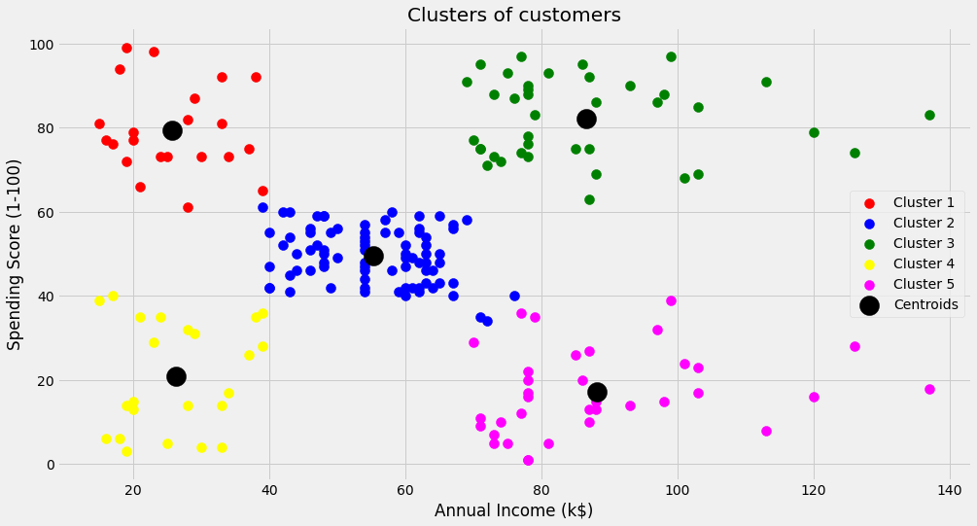
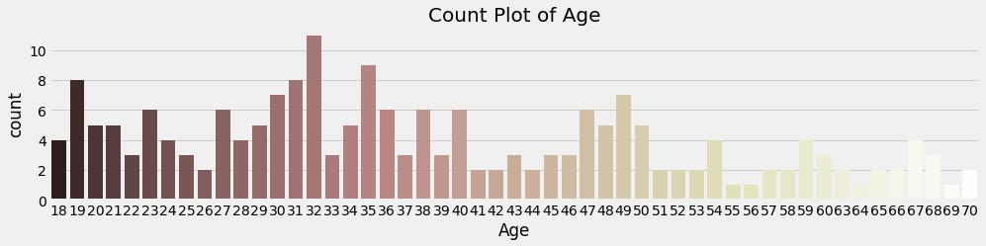
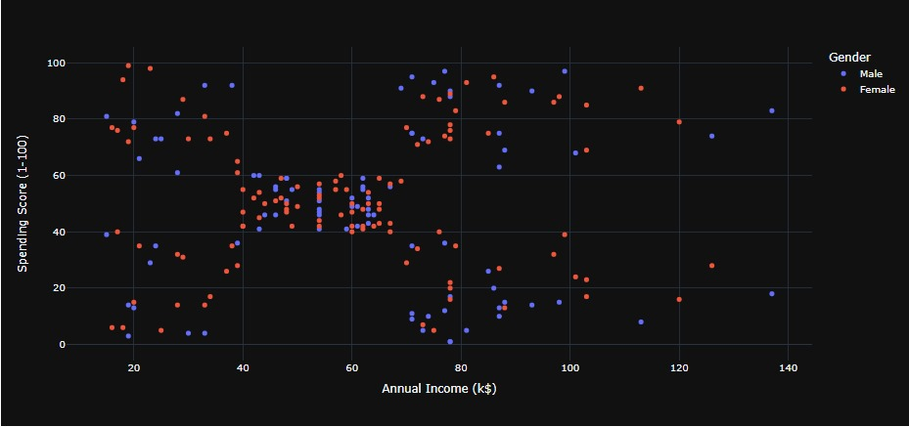
Visualized data:

Slide 7
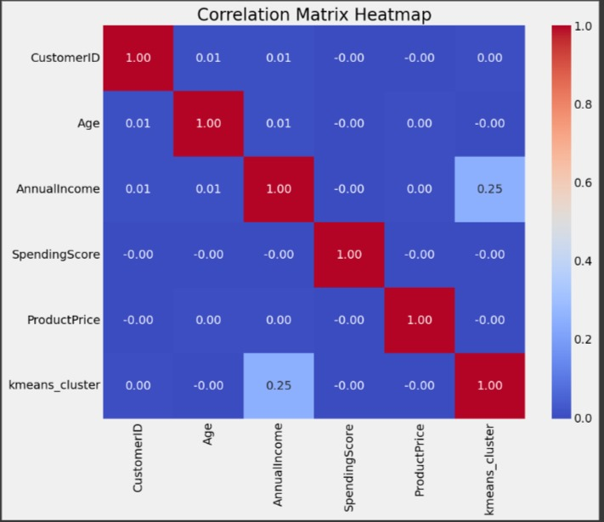
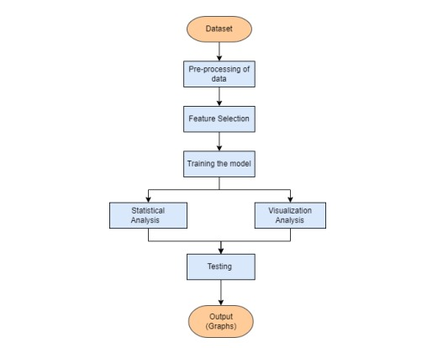
EDA:

Slide 8
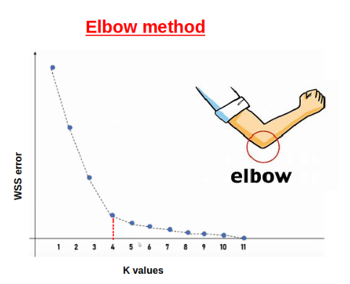
Implementation:
The elbow method is a simple heuristic used to determine the optimal number of clusters in a dataset when using K-Means clustering.
For each k value, the sum of squared errors (SSE) or inertia is calculated. SSE measures how close each member of a cluster is to its centroid.
The silhouette score is a metric used to evaluate the goodness of a clustering technique.
For each sample, silhouette score calculates the mean intra-cluster distance a and the mean nearest-cluster distance b.
The silhouette coefficient s for a sample is then given by: s = (b - a) / max(a, b)
This score ranges from -1 to +1.

Slide 9
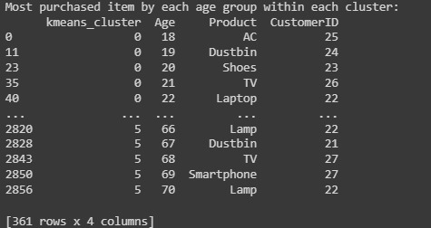
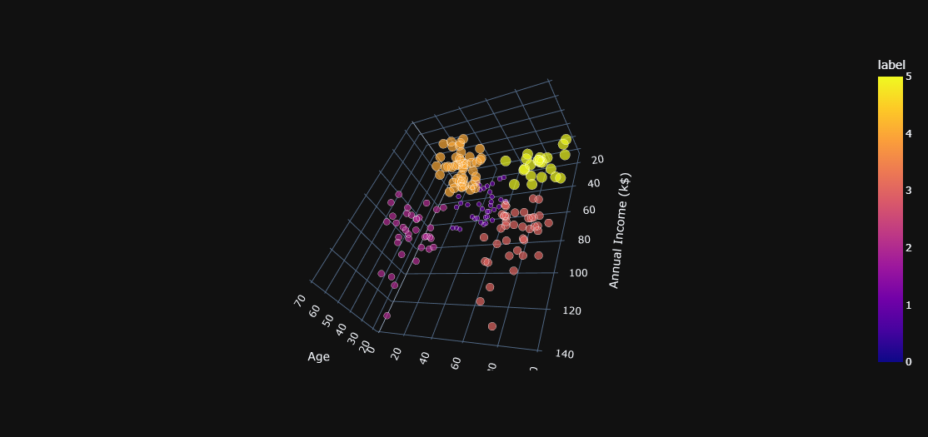
Result :
The exploration of customer segmentation through K-means clustering presents rich insights into distinct customer behaviors and preferences.
Analysis based on attributes such as Annual Income and Spending Score revealed clear clusters, illuminating diverse spending patterns among customers

Slide 10

Summary and Future goals:
Integrating external datasets or incorporating qualitative research methodologies like surveys or interviews might enrich the analysis.
Additionally, advanced machine learning techniques, such as predictive analytics or recommendation systems, could aid in foreseeing future purchasing patterns and tailoring offerings accordingly.
These multifaceted analyses promise to deepen insights into consumer behavior, thereby refining marketing strategies for more impactful and enduring customer relationships

Slide 11
References:
1) Comparison of cluster-ing algorithms for customer segmentation. International Journal of Engineering and Advanced Technology.
2) An intelligent market segmentation system using k-means, SOM, and PSO.
3) Gomes, A., Meisen, T. (2023). RFM analysis for cus-tomer segmentation in retail: A literature review. Journal of Business Research, 157, 111110.
4) Kumar, A. (2023). Customer Segmentation: Concepts, Methods, and Applications. Igi Global.
5) Pu, L. (2022). Improving k-means clustering with density-based initialization for customer segmentation. Expert Systems with Applications, 191, 116319
6) Salminen, J., Kuusisto, J., Kuikka, S., Penttinen, E. (2023). Customer segmentation using k-means cluster-
ing: A systematic literature review. Journal of Business Research, 157, 111117.
7) Tabianan, S., Darmawahyuni, R., Permana, I. G. (2022). Customer segmentation using k-means clustering and principal component analysis for bank marketing. Inter- national Journal of Electrical and Computer Engineer-ing, 12(1), 73-82.
8) Tavor, A., Gonen, R., Spiegel, U. (2023). Using barcode scanners to enhance customer segmentation and pricing strategies. Journal of Retailing, 100(1), 100093.
9) Turkmen, S. (2022). Evaluation of different cluster- ing algorithms for customer segmentation. International Journal of Data Science and Machine Learning, 13(1), 1-13.
10) Yıldız, C., C ̧ oban, Y., Karakas ̧, H. (2023). Customer segmentation in big data environment: A comprehensive review. Expert Systems with Applications, 190, 116299.

