Slide 1
Next Hikes IT Solutions Project 1: Building Basic Calculator
Name:- Shubham Gupta

Slide 2
Introduction
A simple calculator program using tkinter.
Built using Python programming language.
Provides basic arithmetic operations.

Slide 3
User Interface
The calculator has a clean and user-friendly interface.
Consists of buttons for numbers and operators.
3. Includes an entry field for input and display.

Slide 4
Functionality
The calculator supports addition, subtraction,
multiplication, and division.
It can perform calculations on both integers and
floating-point numbers.
Implements basic error handling for division by
zero.

Slide 5
Input and Output
Users can enter numbers by clicking the
corresponding buttons or typing on the keyboard.
The calculator displays the input and the result
in the entry field.
3. Clear button resets the input and output.

Slide 6
Code Structure
The program follows a modular approach with
separate functions for different operations.
Uses the tkinter library for creating the graphical
user interface.
Utilizes event-driven programming for handling
button clicks.

Slide 7
Conclusion
A simple calculator program built with tkinter.
Provides basic arithmetic operations with a
user-friendly interface.
Customizable and can be extended with additional
features if desired.

Slide 8
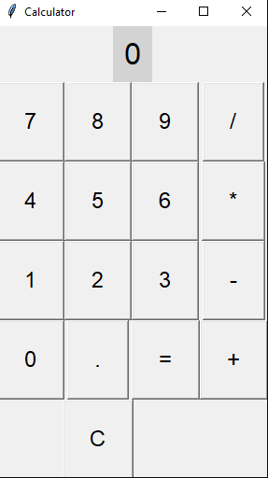
Basic Calculator

Slide 9
Thank You

