Slide 1
Pending Event Set Management
in
Parallel Discrete Event Simulation
Sounak Gupta
Ph.D. Candidate
Computer Science and Engineering
Committee Chair : Philip A. Wilsey, Ph.D.

Slide 2
Related Publications (in prep)
S. Gupta, and P. A. Wilsey, “Time Warp Parallel Simulation and the Pending Event Set,” ACM Transactions on Modeling and Computer Simulation (TOMACS), (in prep).
S. Gupta, J. B. Yang, and P. A. Wilsey, “A Synthetic Simulation Model for Studies of Scalability in Parallel Simulation,” Simulation Modelling Practice and Theory (SIMPAT), (in prep).
D. Weber, S. Gupta, P. A. Wilsey, N. Abu-Ghazaleh, and D. Ponomarev, “Time Warp Simulation on Multi-core Processors and Clusters,” SCS Transactions on Simulation, (in prep).

Slide 3
Related Publications
S. Gupta, and P. A. Wilsey, “Quantitative Driven Optimization of a Time Warp Kernel,” In Proceedings of the 2017 ACM SIGSIM Conference on Principles of Advanced Discrete Simulation (SIGSIM-PADS ’17), 27-38.
S. Gupta, and P. A. Wilsey, “Lock-Free Pending Event Set Management in Time Warp,” In Proceedings of the 2014 ACM SIGSIM/PADS conference on Principles of Advanced Discrete Simulation (SIGSIM-PADS’14), 15-26.
T. Dickman, S. Gupta, and P. A. Wilsey, “Event pool structures for PDES on many-core Beowulf clusters,” In Proceedings of the 2013 ACM SIGSIM conference on Principles of Advanced Discrete Simulation (SIGSIM-PADS ’13), 103-114.

Slide 4
Publications (other)
J Xu, BJ Hartley, P Kurup, A Phillips, A Topol, M Xu, C Ononenyi, E Foscue, S Ho, TD Baguley, N Carty, CS Barros, U Mller, S Gupta, D Ruderfer, P Sklar, J Rapoport, JA Ellman, C Pittenger, B Aronow, AC Nairn, MW Nestor, PJ Lombroso and KJ Brennand, “Inhibition of STEP 61 ameliorates deficits in mouse and hiPSC-based schizophrenia models,” Molecular Psychiatry (2016); doi:10.1038/mp.2016.163
A Topol, JA English, E Flaherty, P Rajarajan, BJ Hartley, S Gupta, F Desland, S Zhu, T Goff, L Friedman, J Rapoport, D Felsenfeld, G Cagney, A Mackay-Sim, JN Savas, B Aronow, G Fang, B Zhang, D Cotter and KJ Brennand, “Increased abundance of translation machinery in stem cell-derived neural progenitor cells from four schizophrenia patients,” Translational Psychiatry (2015) 5, e633; doi:10.1038/tp.2015.118
S. Gupta and G. Paul. “Revisiting Fermat's Factorization for the RSA Modulus,” Computing Research Repository (CoRR) abs/0910.4179 (2009)

Slide 5
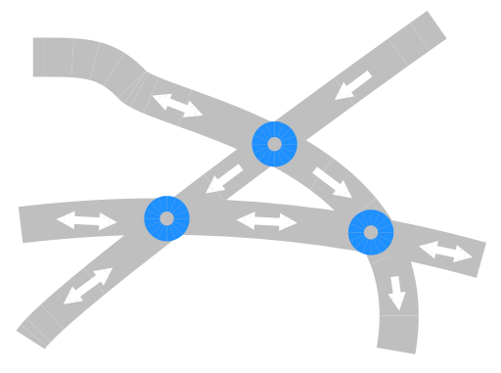
Building Blocks: Logical Process (LP), LP State, and Event

Slide 6
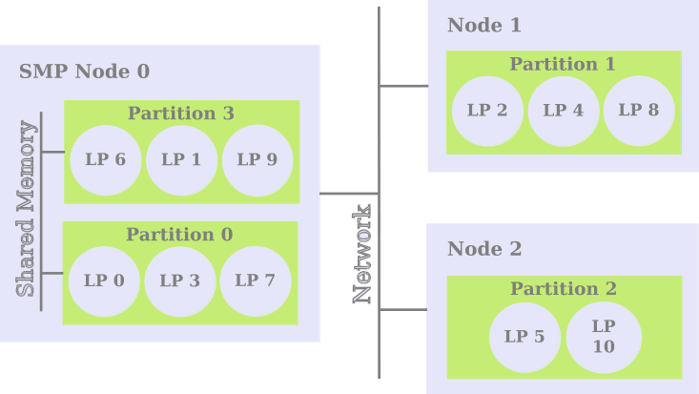
Parallel Discrete Event Simulation (PDES)

Slide 7
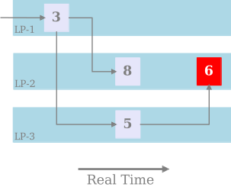
Event Causality

Slide 8
The Time Warp Mechanism
Each LP processes events w/o regard for progress of other LPs
Causal Violation triggered by a Straggler event
Rollback used to recover from a causal violation
      Reset state and time
      Send anti-messages to cancel prematurely sent events
      Continue event processing at reset time

Slide 9
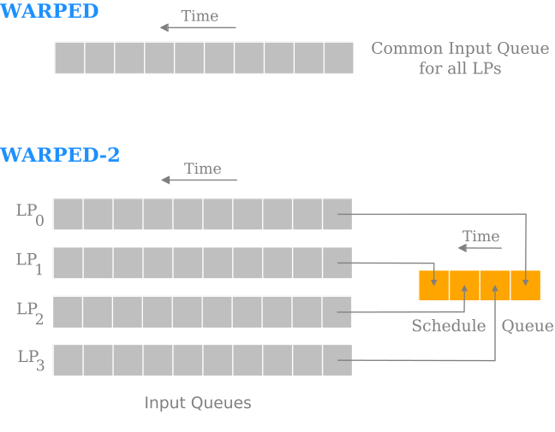
The Evolution of WARPED to Multi-Core

Slide 10
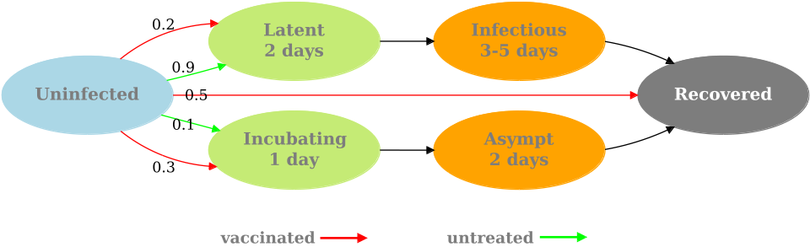
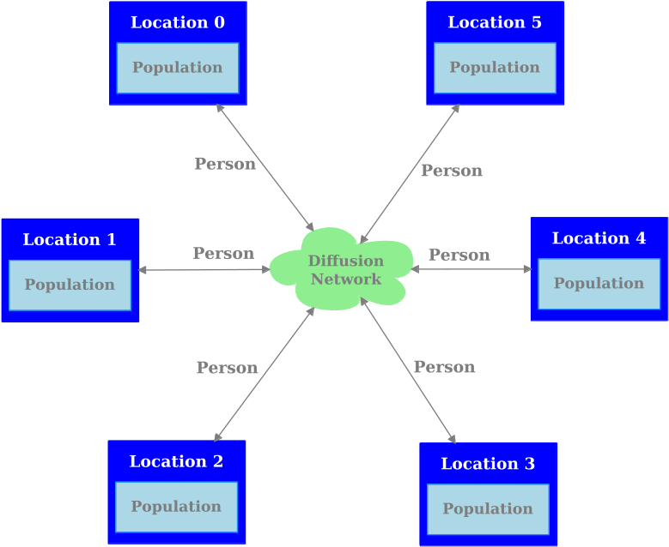
Simulation Model: Epidemic
State Transition of Disease
Diffusion Network: 2 types
  Watts-Strogatz
  Barabasi-Albert

Slide 11
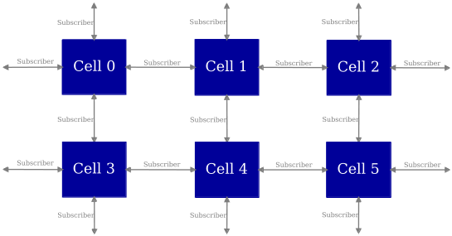
PCS Model : Network Structure

Slide 12

Traffic Model : Events

Slide 13

Sandpile Model : Generated patterns

Slide 14
WARPED-2: Pending Event Set
Schedule Queue: Data Structure Options
STL MultiSet: Red-Black Tree, sorted
Splay Tree: Self-adjusting Binary Search Tree, sorted
Calendar Queue: Partitions events into “months” based on timestamp
    Difficult to size a month
    Largely unused due to size/resize complications & costs
Ladder Queue: Variant of calendar queue that solves month sizing issue
    Lightweight, self-sizing
    Previously unknown to the PDES community

Slide 15
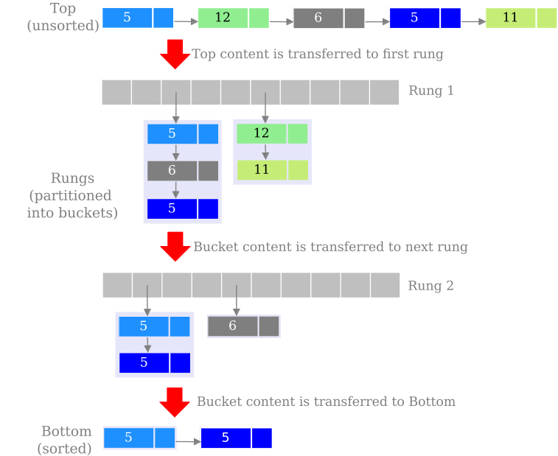
Ladder Queue

Slide 16
Ladder Queue Options
Unsorted Bottom
    Causal Independence of events in Bottom
    Lock-free implementation of Unsorted Bottom
        Compare-and-Swap (CAS) operations
        No need for computationally-intensive operations (sorting, searching and random deletion)

Slide 17
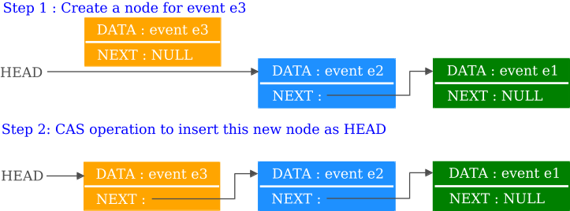
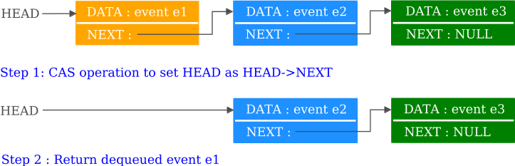
Lock-free Unsorted Bottom in a Ladder Queue
Event Insert
Event Remove

Slide 18
Modification to the Ladder Queue Algorithm
Overflow of events in Bottom
    Reorganization triggered in original Ladder Queue
    Events are split between Bottom and lowest rung
    New algorithm ignores this trigger
Value of Bottom Threshold
    Value mentioned in paper not relevant for Pending Event Set
      event time window matters more than event count

Slide 19
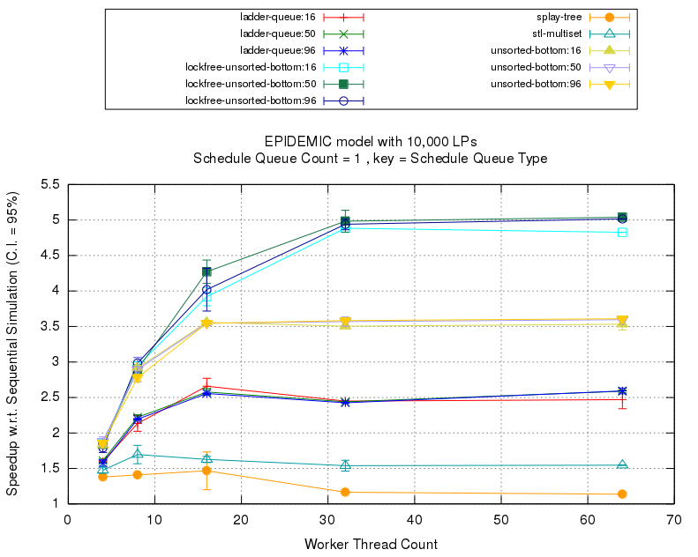
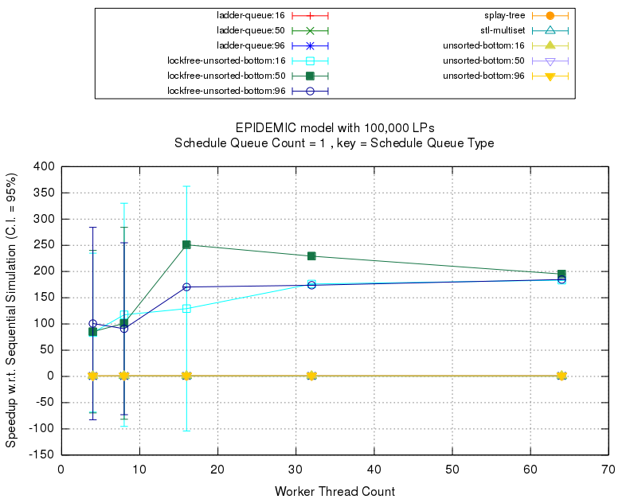
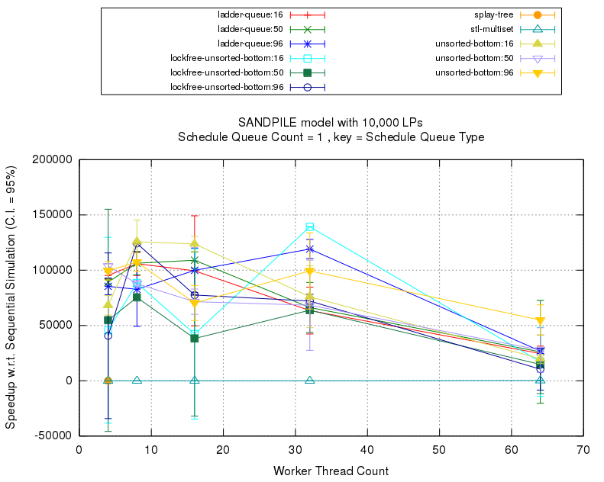
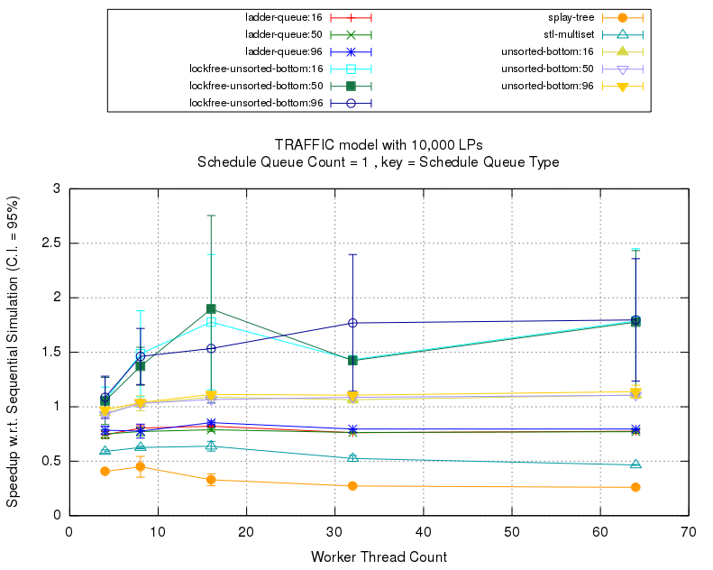
Performance of Schedule Queue Types
Epidemic 10K-WS
Epidemic 100K-WS
Sandpile-10K
Traffic-10K

Slide 20
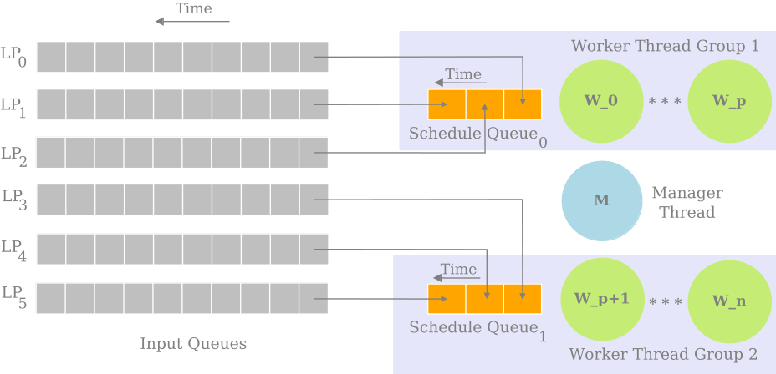
Multiple Schedule Queues

Slide 21
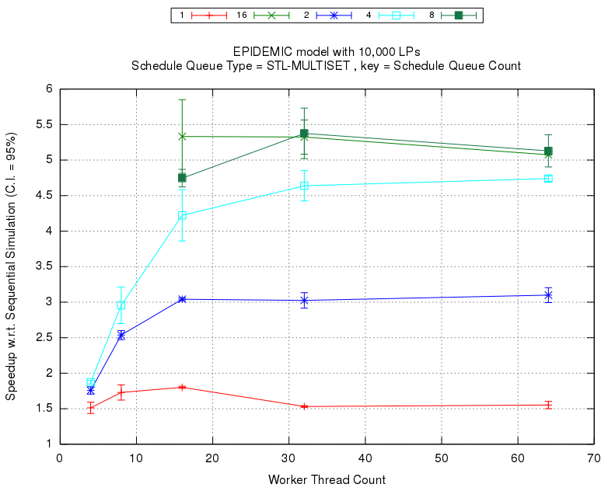
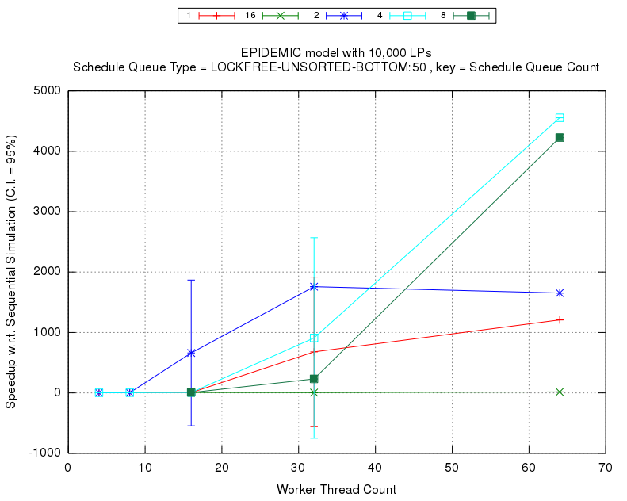
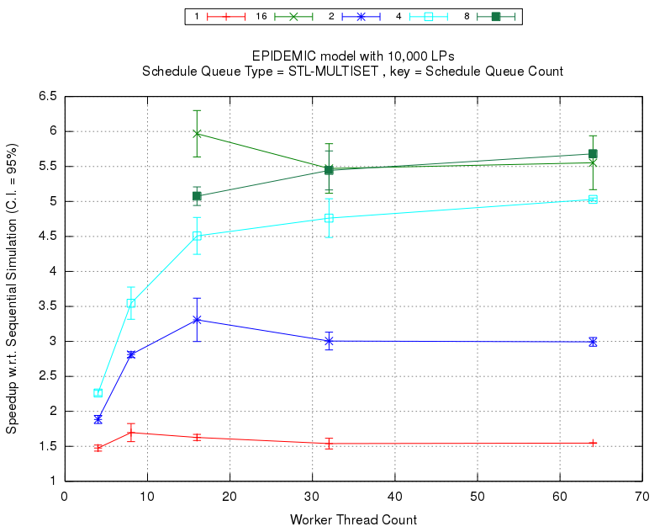
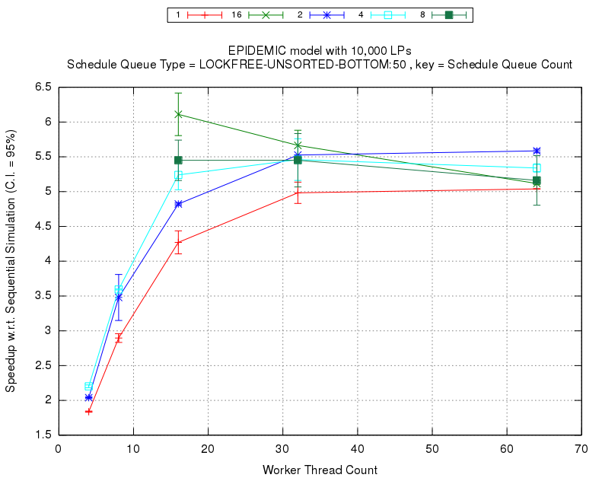
Performance of Multiple Schedule Queues: Epidemic, 10K LPs
BA Network
WS Network

Slide 22
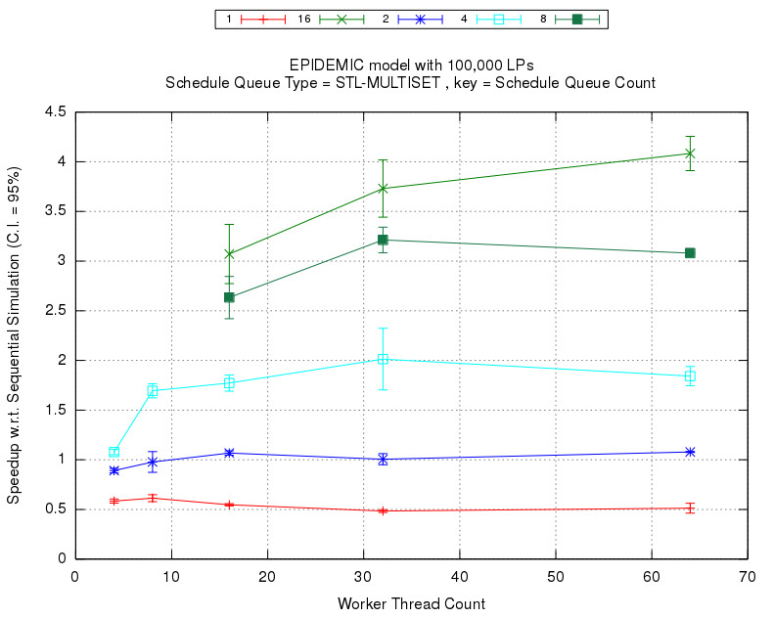
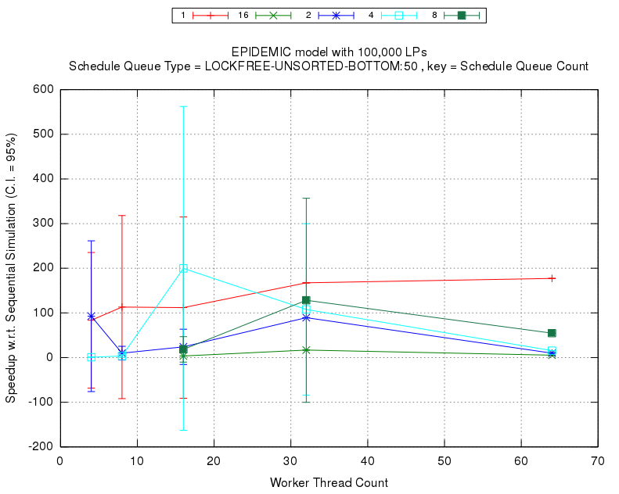
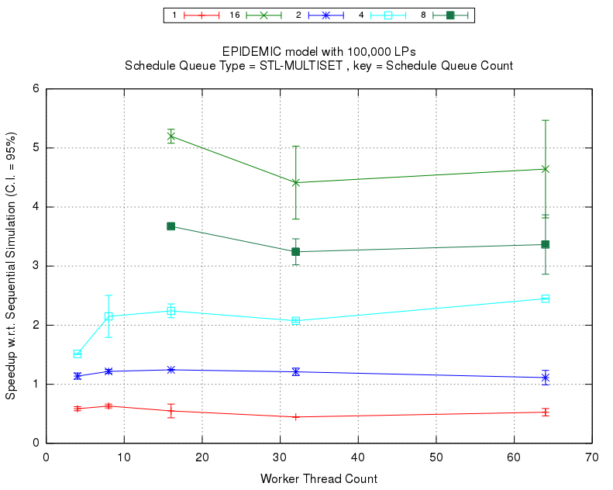
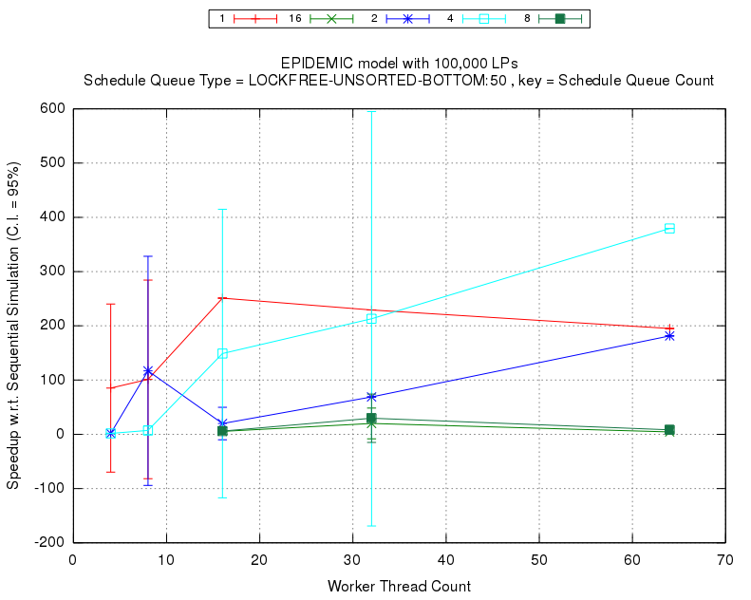
Performance of Multiple Schedule Queues :Epidemic, 100K LPs
BA Network
WS Network

Slide 23
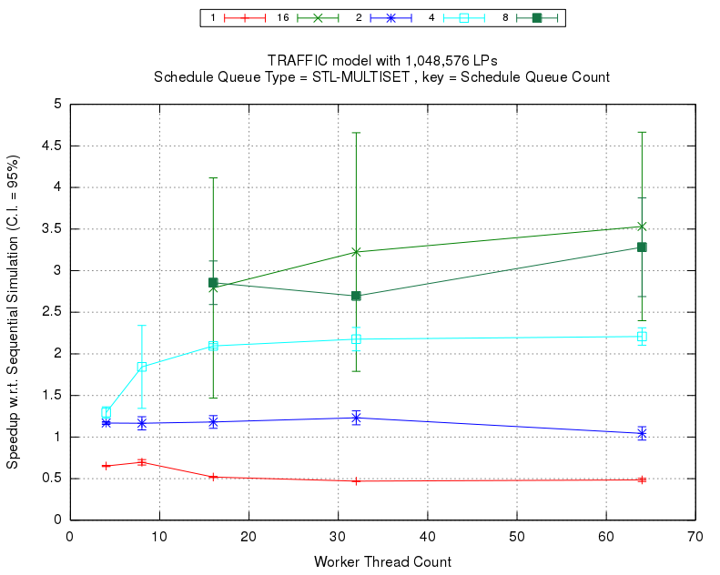
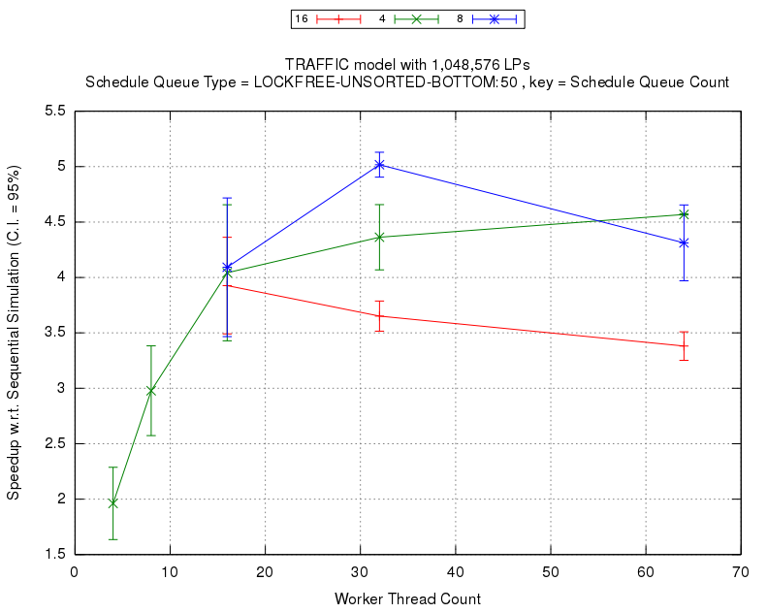
Performance of Multiple Schedule Queues :
Traffic, 1,048,576 LPs

Slide 24
Schedule Events in Groups
Schedule multiple events to a worker thread at the same time.
Three types:
    Event Chains: schedule multiple events from one LP
    Event Blocks: schedule multiple events from the schedule queue
    Event Bags: LPs grouped into communities based on event traffic statistics
        Schedule multiple events from each bag
        Static memory allocation and circular organization of bags

Slide 25
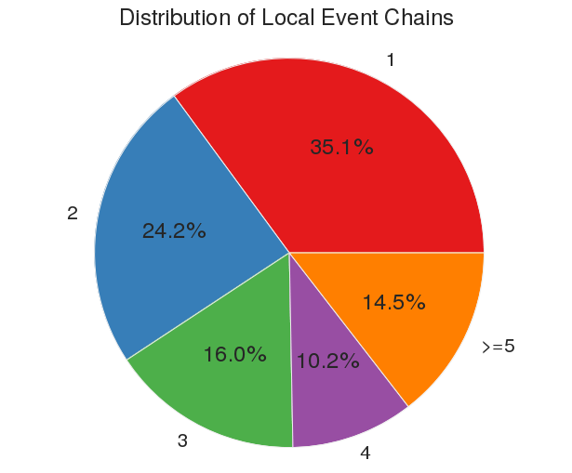
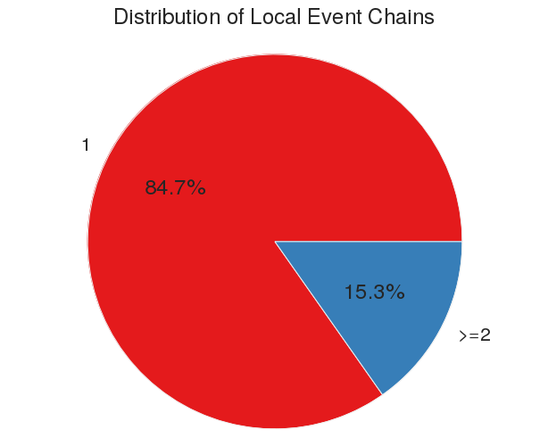
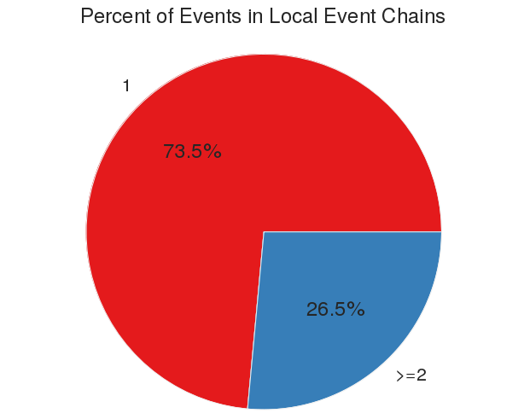
DESMetrics Analysis: Event Chains
Traffic Model
Epidemic (WS) Model

Slide 26
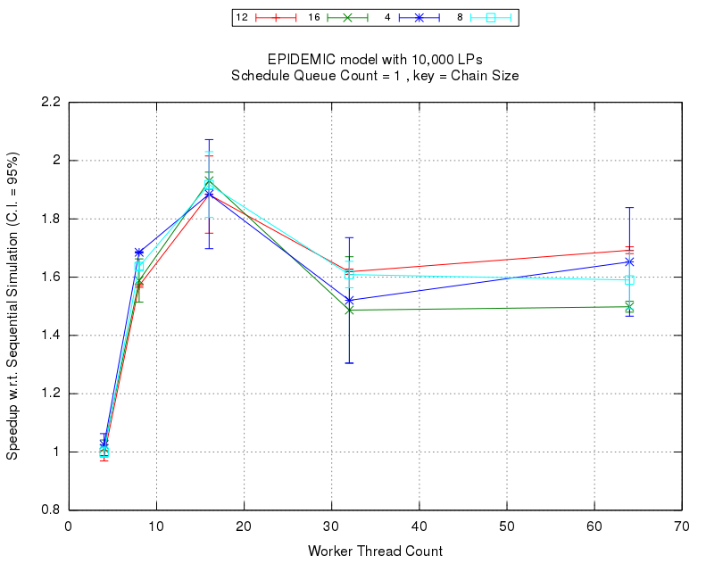
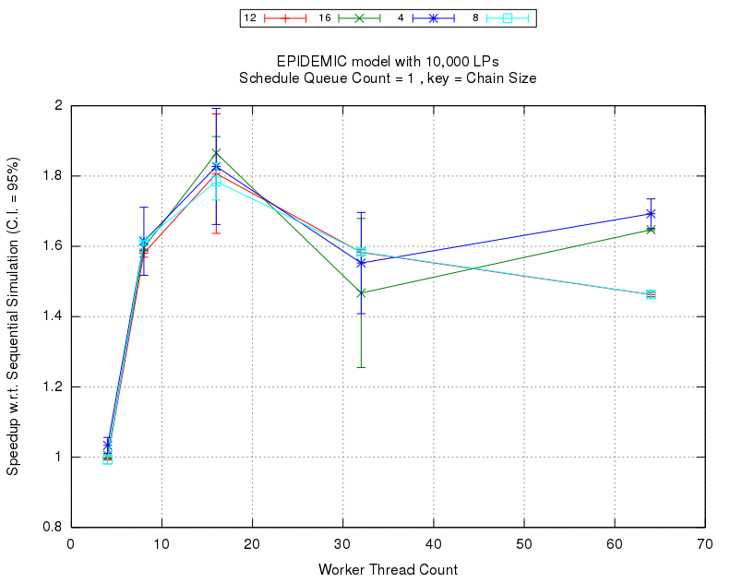
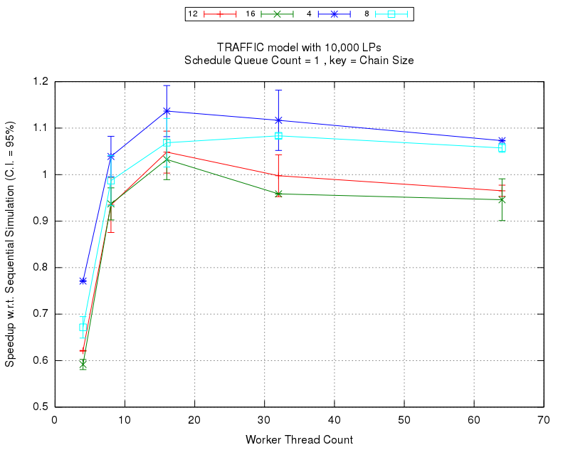
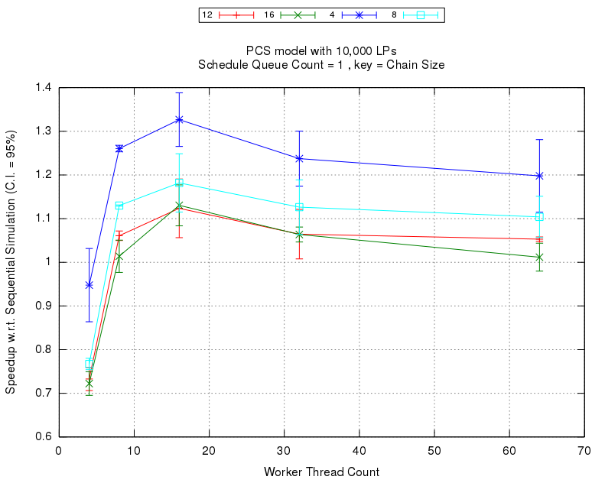
Performance Impact of Chain Scheduling
Epidemic-10K-BA
Epidemic-10K-WS
Traffic-10K
PCS-10K

Slide 27
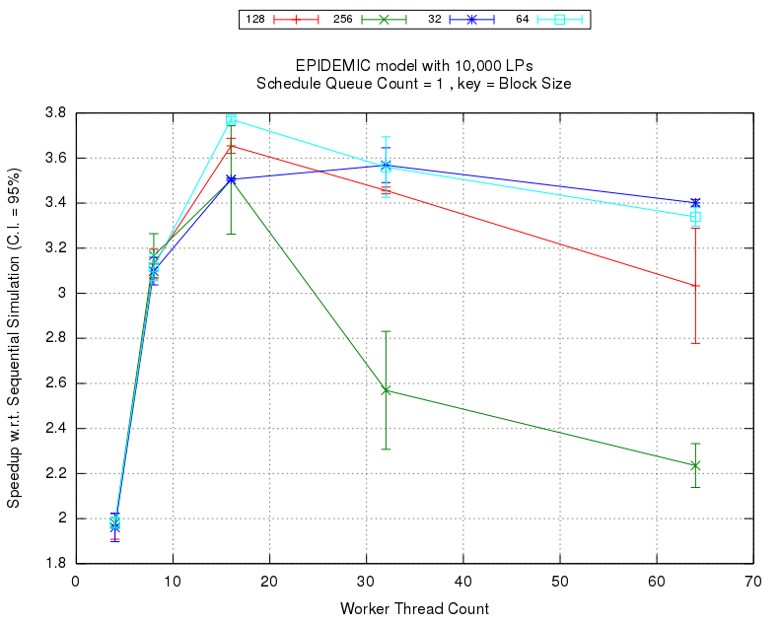
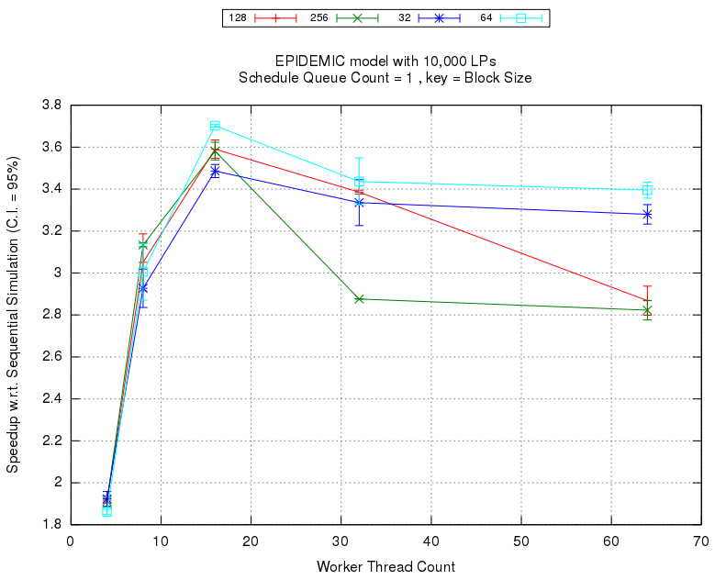
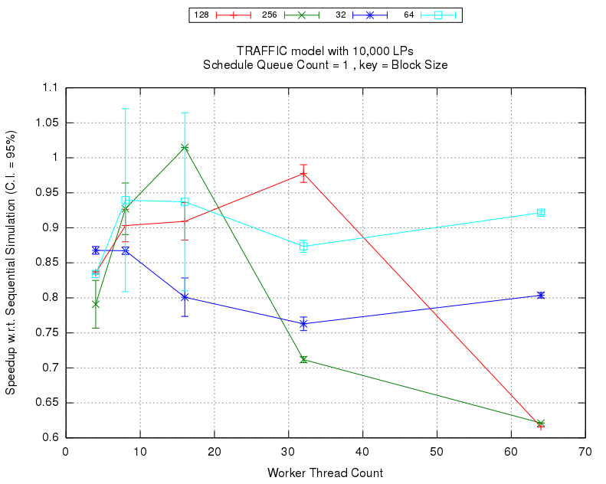
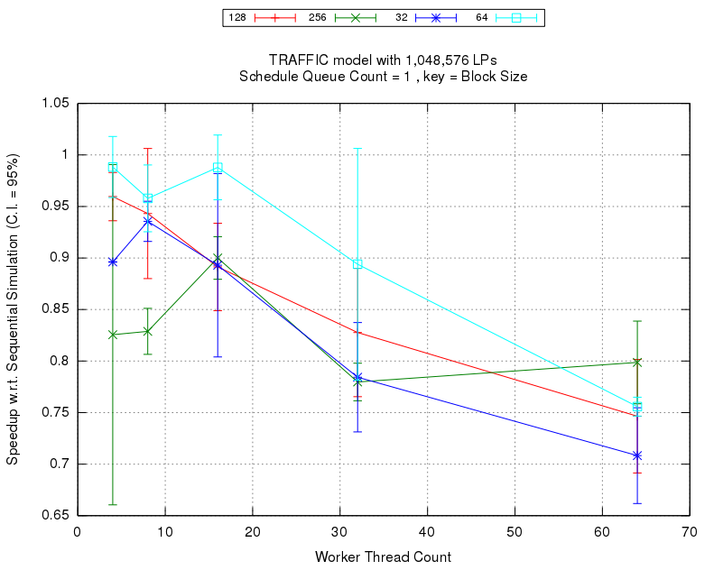
Performance Impact of Block Scheduling
Epidemic-10K-BA
Epidemic-10K-WS
Traffic-10K
Traffic-1M

Slide 28
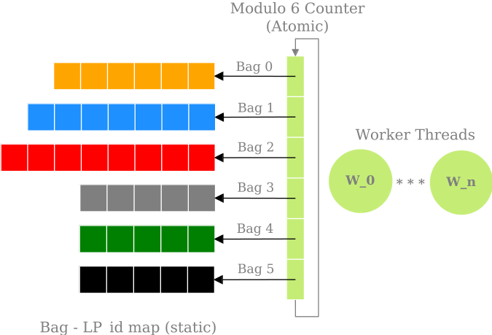
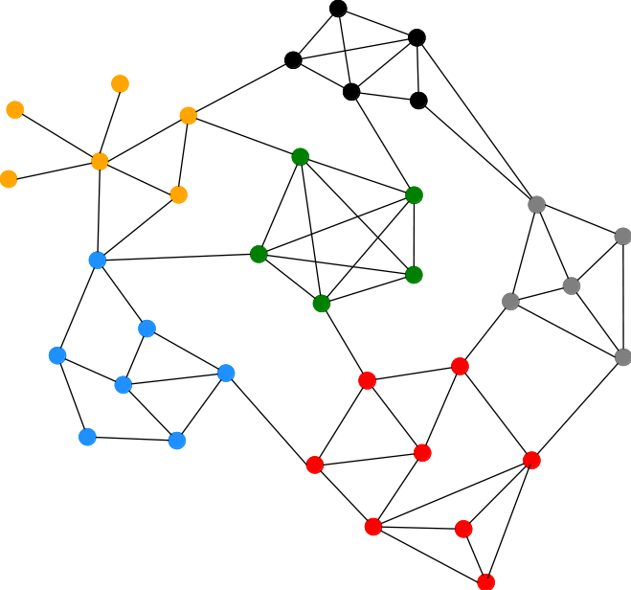
Louvain Partitioner and Bag Scheduling

Slide 29
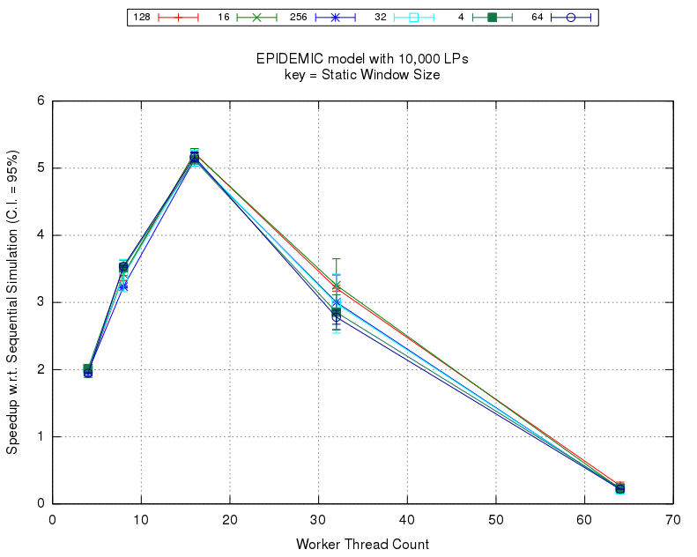
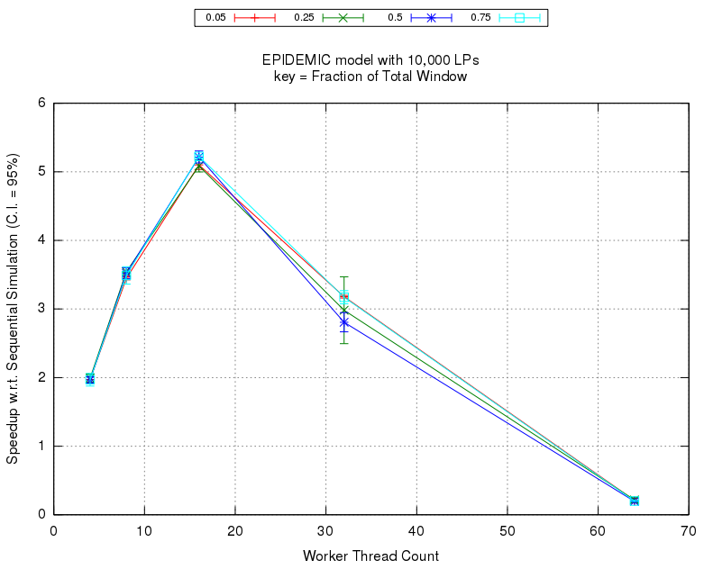
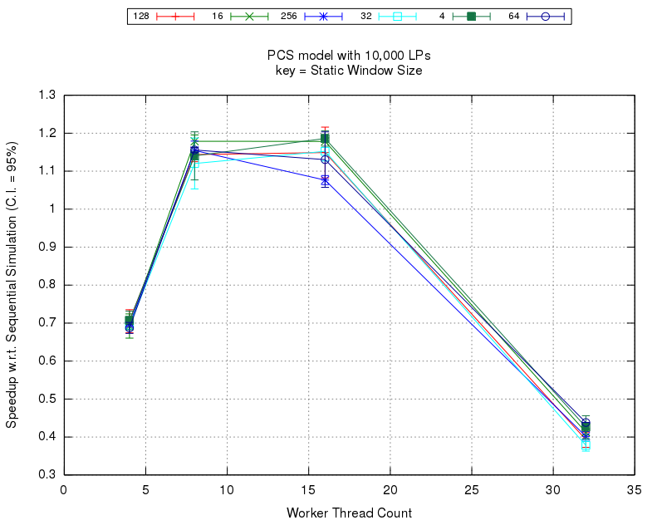
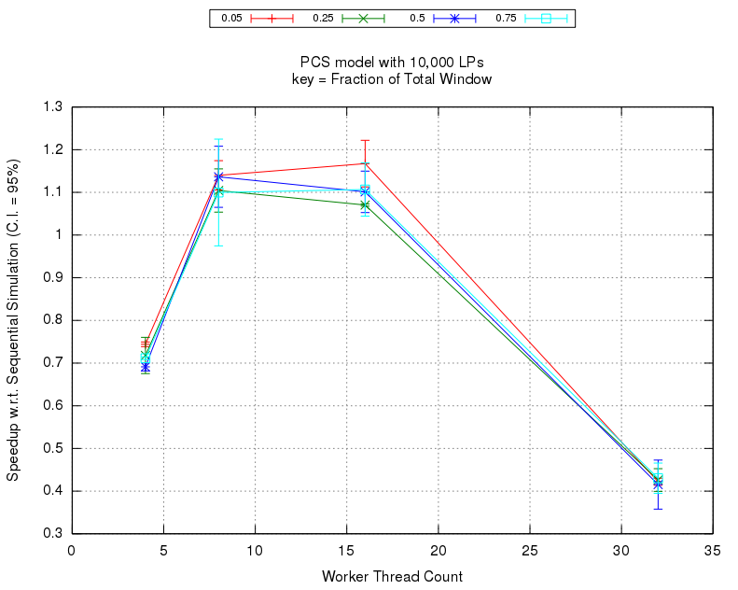
Performance Impact of Bag Scheduling: 10K LPs
Epidemic-WS
PCS

Slide 30
Thank You !

