Slide 1
British Airways
Data Scraping/Data Cleaning/Data Analysis

Slide 2
Agenda:
Word Cloud of review data
Topic modelling
Data Exploration and Analysis

Slide 3
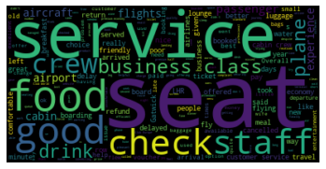
Word Cloud
Some of the topics most talked about the airline are:
1.Service
2.Business Class
3.Seating and comfort
4.Food and Drinks
5.Airport crew and staff

Slide 4
Topic Modelling
The following is the most talked about topic and words that are used for describing the particular topic.
['business seat call button person front class lounge choose seat london british british airway food offering month advance flew british row seat economy cabin food ok could see delay due’,
'everything went immediately behind long time good wine would recommend british airway call button favourite airline seat close service british row seat travel companion looking forward well managed think unacceptable’,
'good service charm food lounge access check business qatar airway boarding people could speak seat without london gatwick good overall back london movie selection economy class friendly service outbound journey’,
'bread roll madrid london seat tiny hour wait business seat food offering london british call button coffee tea took almost singapore london queue bag long time exit row film choice’,
'british airway crew attentive business seat travel companion london british number given number called experience ever flew british choice ife care customer boarding well ask refund crew pretty crew good']

Slide 5
Topic modelling
Words mostly usesd | Probable topic
'business seat call button person front class lounge choose seat London British airway food offering month advance flew row seat economy cabin food ok could see delay due' | - Business Class
everything went immediately behind long time good wine would recommend british airway call button favourite airline seat close service british row seat travel companion looking forward well managed think unacceptable' | - Food and Comfort
'good service charm food lounge access check business qatar airway boarding people could speak seat without london gatwick good overall back london movie selection economy class friendly service outbound journey' | - Hospitality
'bread roll madrid london seat tiny hour wait business seat food offering london british call button coffee tea took almost singapore london queue bag long time exit row film choice' | - Boarding
'british airway crew attentive business seat travel companion london british number given number called experience ever flew british choice ife care customer boarding well ask refund crew pretty crew good' | - Customer care

Slide 6
Data Exploration & Analysis:
The next slides some of the findings that has been gathered by Exploratory data analysis and “Sentiment Analysis using Random Forest Classifier”.

Slide 7
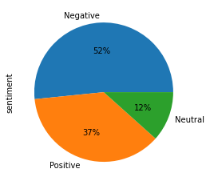
Overall Sentiment:
The pie chart here describes the overall sentiment of the customers about the airline.
Findings:
1. A majority of reviews have a negative sentiment for the airline services.

Slide 8
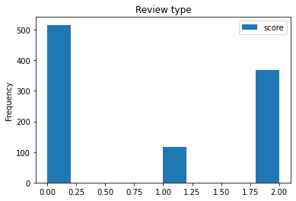
Overall Sentiment:
The bar chart here describes the count of positive,neutral and negative reviews in the overall data corpus.

Slide 9
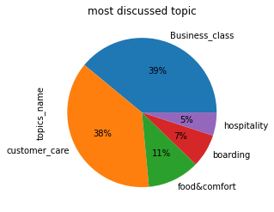
Most Discussed Topic:
The pie chart here describes the most frequently reviewed topic from the customers about the airline.
Findings:
A majority of reviews deal with business class features and customer care that the airline offers.

Slide 10
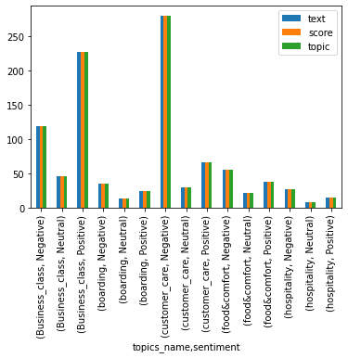
Sentiment about a particular topic:
The bar chart here describes the sentiment of the reviews about a particular topic.
Key Findings:
There’s a positive response from the customers about the business class facilities from the airline.
The customers are not very satisfied with the customer care and after sales service.
There’s a mixed review about the food and drinks the airline offers

Slide 11
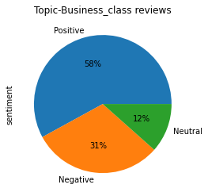
Sentiment related to Business Class:
The pie chart here describes the sentiment of the reviews about a the business class facilities and features that the airline offers.
Key Findings:
“Good news”, the customer’s are a happy with the business class facilities of British Airways.
There’s a slight neutral and negative feeling due to the airline seats.

Slide 12
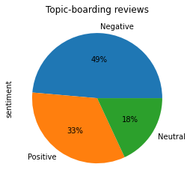
Sentiment related to Boarding services:
The pie chart here describes the sentiment of the reviews about the “Boarding Facilities and features” that the airline offers.
Key Findings:
the customers find the boarding process and the facilities to be more improved.

Slide 13
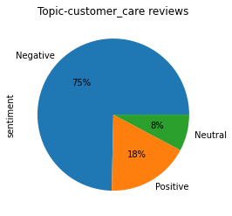
Sentiment related to Customer Care:
The pie chart here describes the sentiment of the reviews about the “Customer care and griviences-settlement department” that the airline has.
Key Findings:
the customers find that the customer care and customer dispute settlement has a lot to be improved .

Slide 14
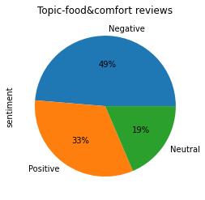
Sentiment related to Food & Hospitality:
The pie chart here describes the sentiment of the reviews about the “food and the service staffs” that the airline has.
Key Findings:
there is a scope for improvement in the fooding and menus that the airline offers to the customers.

Slide 15
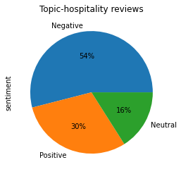
Sentiment related to Staffs and their Behaviour:
The pie chart here describes the sentiment of the reviews about the “airport staffs and their behaviour ” towards the customers.
Key Findings:
there is much to improve in the staff and behaviour of the staff towards the customers.

Slide 16
Thank you

