Slide 1
Customer-Behaviour-Analysis
Using SQL

Slide 2
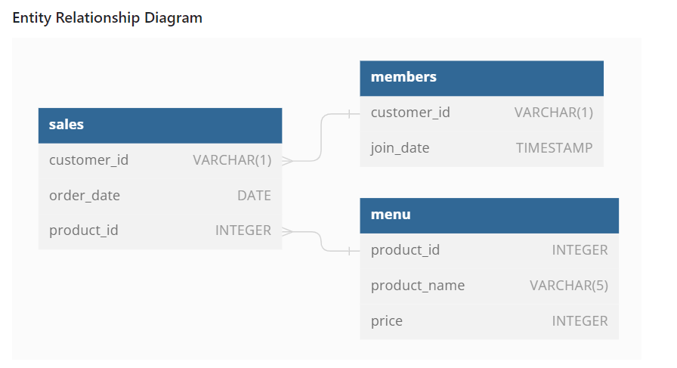

Slide 3
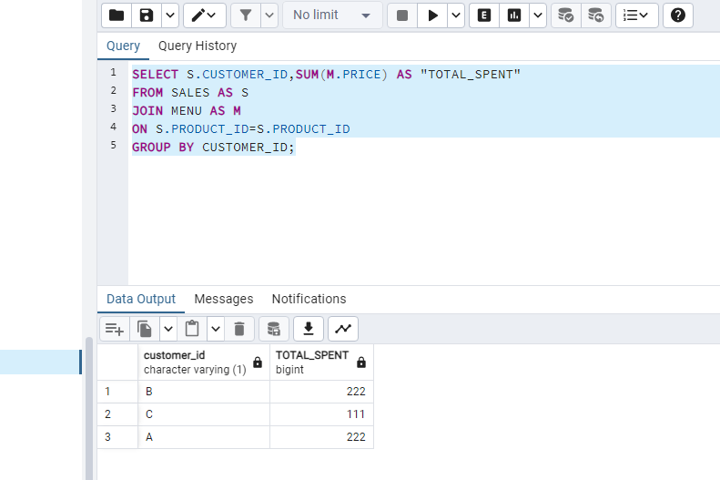
TOTAL AMOUNT EACH CUSTOMER SPENT AT THE RESTURANT?

Slide 4
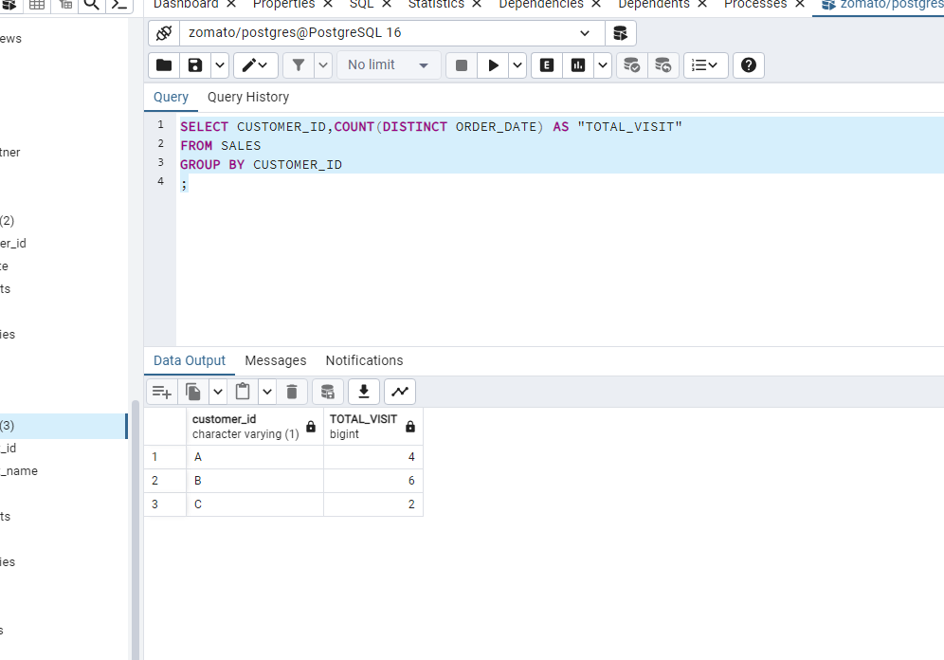
HOW MANY DAYS EACH CUSTOMER VISITED THE RESTAURANT?

Slide 5
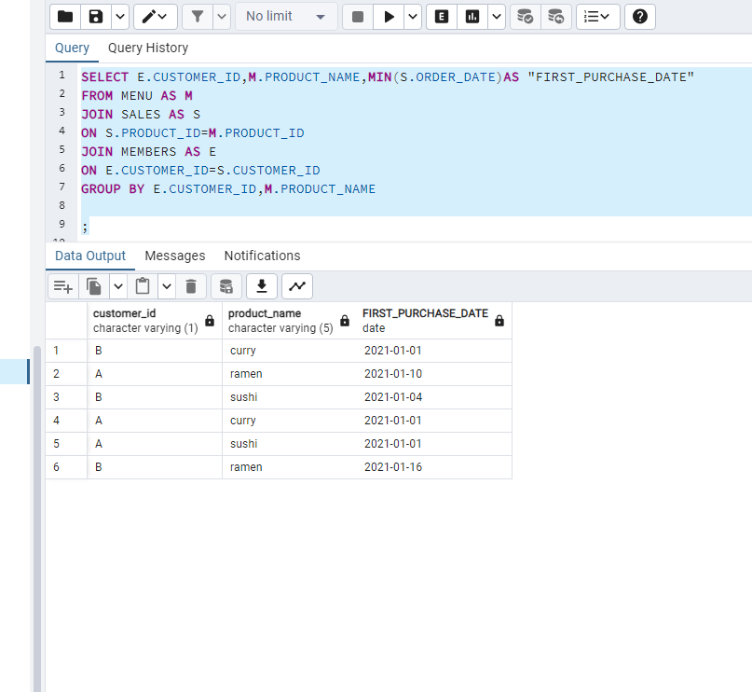
WHAT WAS THE FIRST ITEM FROM THE MENU PURCHASED BY EACH CUSTOMER?

Slide 6
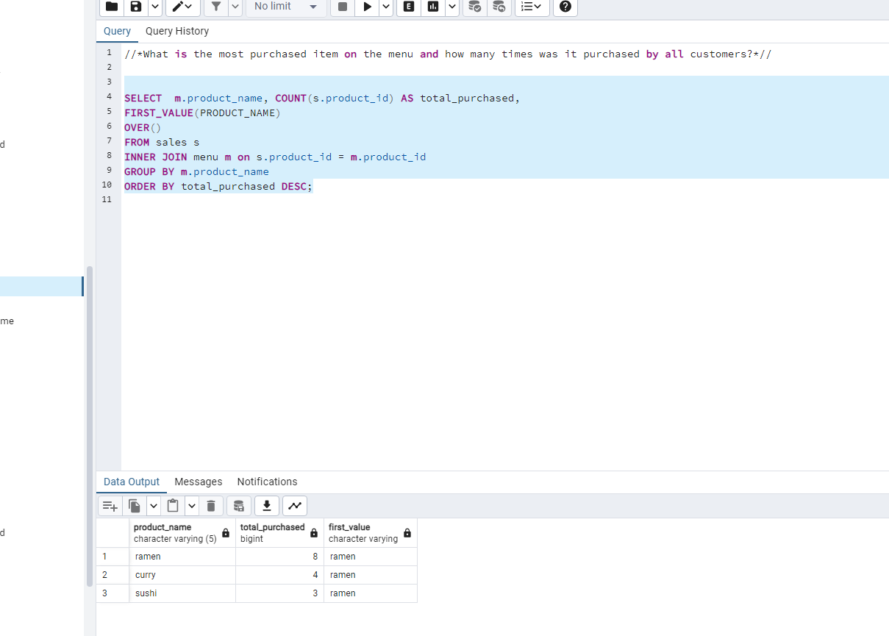

Slide 7
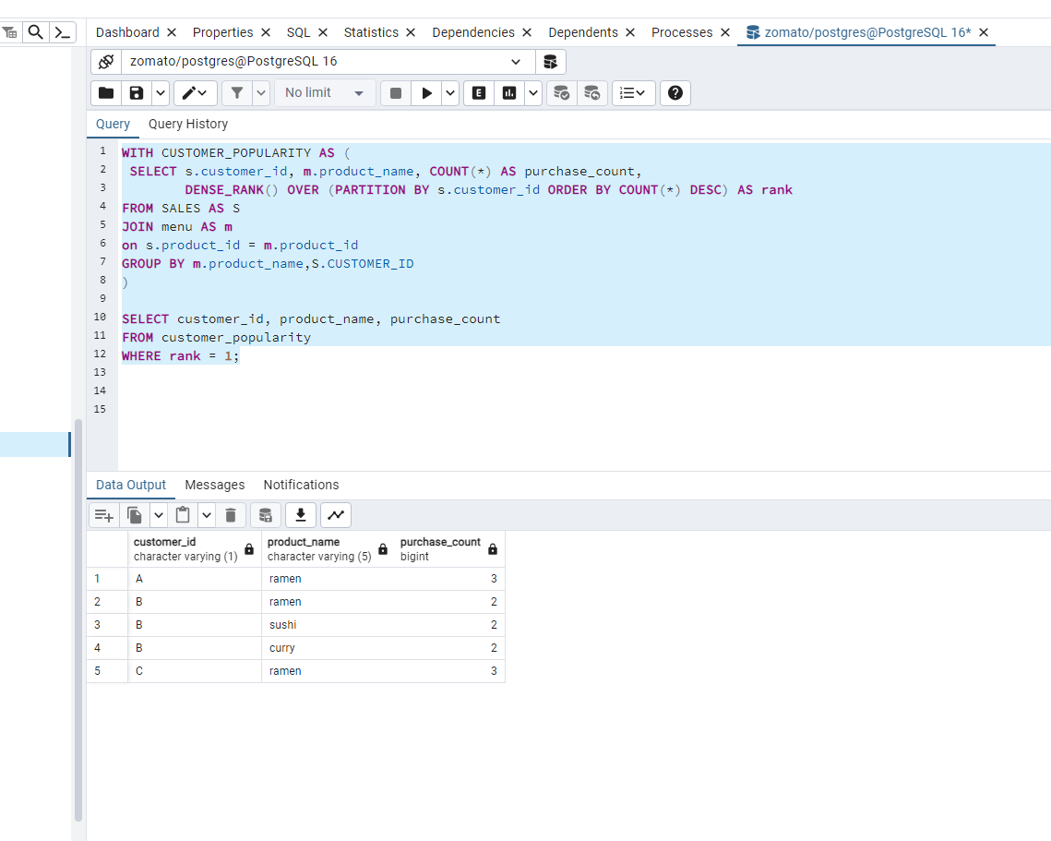
MOST POPULAR ITEM FOR EACH CUSTOMER?

Slide 8
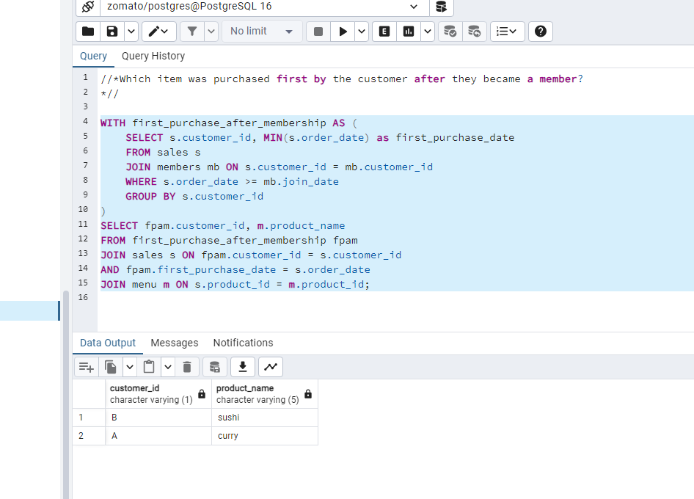

Slide 9
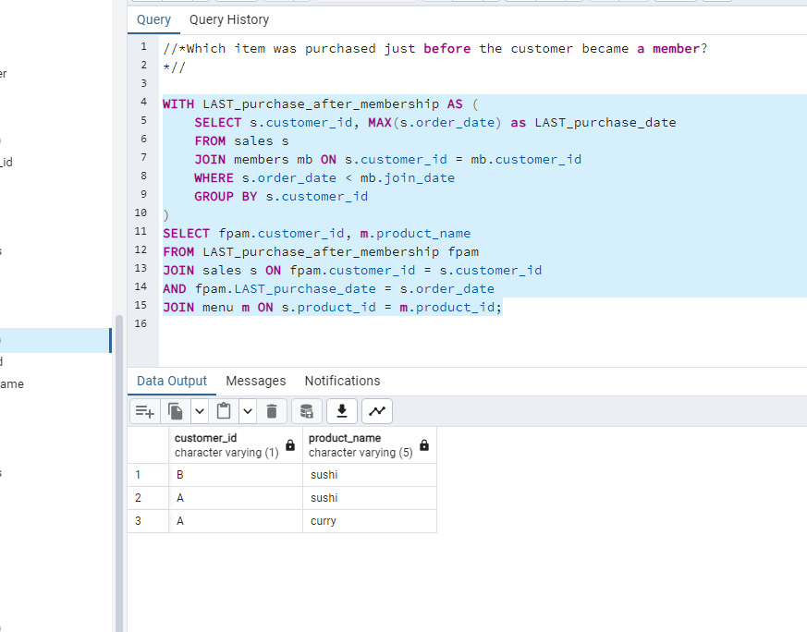

Slide 10
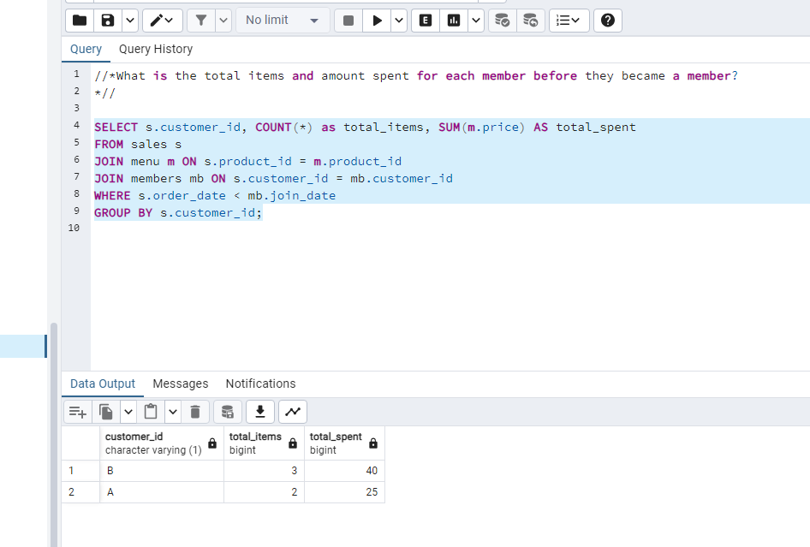

Slide 11
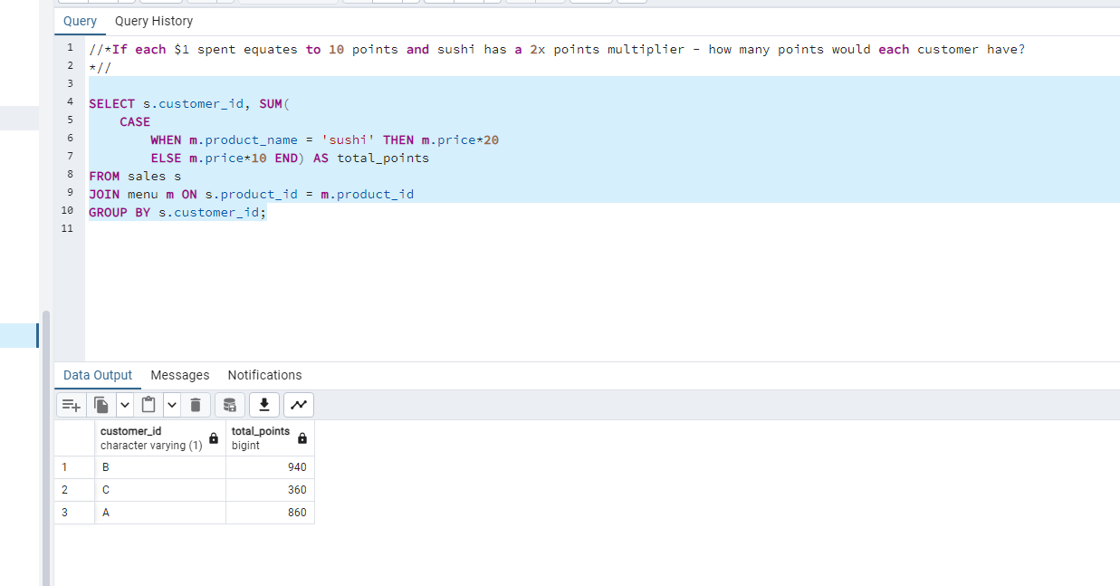

Slide 12
