Slide 1
Weather Prediction
Swati Gupta (sgupta612)

Slide 2
Aim
Analyze weather data to predict temperatures
Approach
Account for seasonality by differencing
Fit univariate ARIMA model to make predictions
Fit VAR model to make predictions

Slide 3
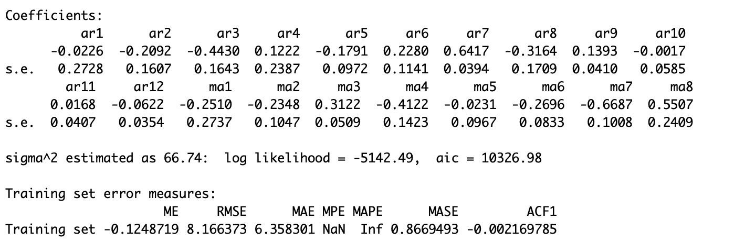
ARIMA (12,1,8) Model Summary

Slide 4
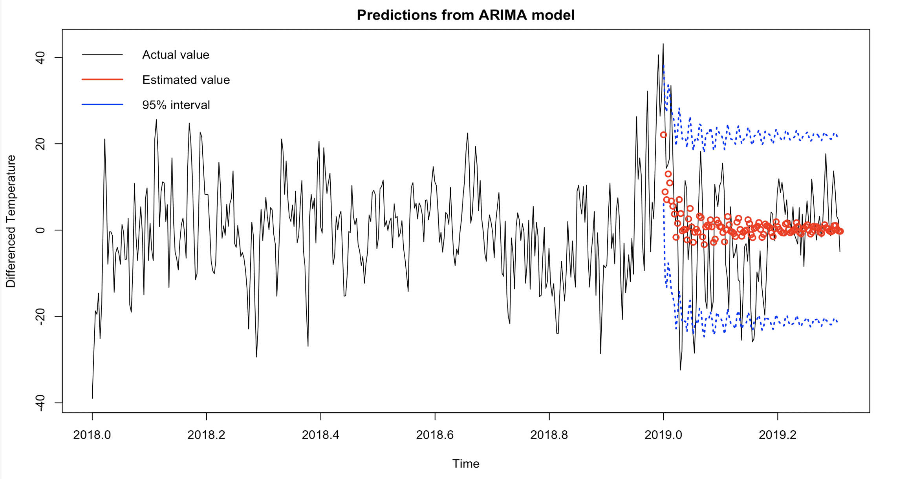
ARIMA (12,1,8) Model Predictions

Slide 5
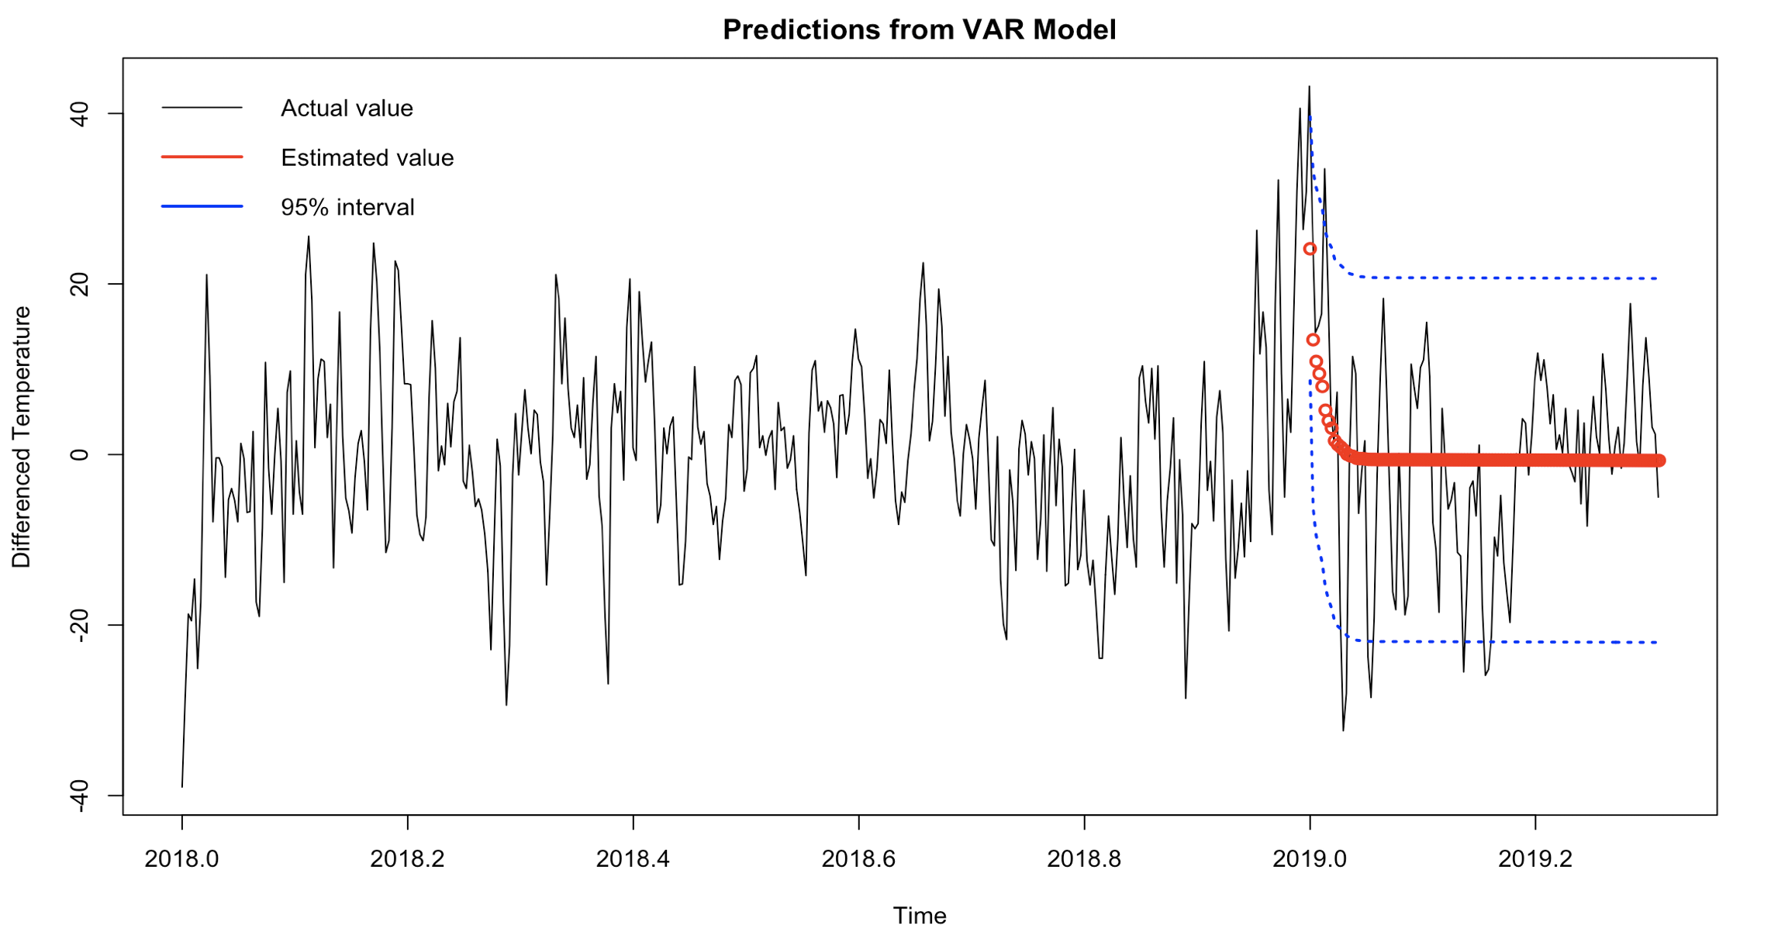
VAR (p=8) Model Predictions

Slide 6
Conclusions
While the first few predictions were close, the later predictions were not very accurate. The models fail to predict values much further into the future
There is no improvement in predictions after including wind speed in the model. This may be because temperature predictions require more parameters than just wind speed.

