Slide 1

School of Computer Science and Engineering
Department of Computer Science and Engineering
Detection Of Deepfakes Using CNN and OpenCV
Submitted By:
Vidur Gupta
23FE10CSE00481
Supervised By: Dr. Rishi Kumar Srivastava

Slide 2

Outline
Introduction
Literature Review
Problem Statement
Objectives
Proposed Methodology
Model Architecture
Training Procedure
Results

Slide 3
Introduction
Deepfake technology has rapidly evolved, making it possible to generate highly realistic synthetic human faces.
While this technology has creative uses, it poses major risks in misinformation, identity fraud, and digital manipulation. This project focuses on detecting whether an image is real or fake using computer vision and a Convolutional Neural Network trained on real and AI-generated facial images.

Slide 4
Introduction
Deepfake technology uses AI (GANs, Autoencoders) to generate realistic fake images/videos.
It poses serious threats such as:
Misinformation
Identity theft
Fraud and manipulation
Detecting deepfakes is critical for digital security and trust.

Slide 5
Introduction
This project builds a deepfake detection system using CNN + OpenCV
Key pipeline:
Image preprocessing (OpenCV)
Deep learning classification (CNN + MobileNetV2)
Real-time prediction using Gradio
Goal: High accuracy + real-time usability

Slide 6

Literature Review
Chen et al. (2023)
Used CNN with frequency-domain features for deepfake detection
Improved accuracy using texture inconsistencies
Liu et al. (2023)
Applied spatiotemporal CNNs for deepfake detection
Effective for video-based detection
Khalid & Woo (2024)
Proposed one-class deepfake detection (OC-FakeDect)
Detects unseen fake patterns

Slide 7
Literature Review
Nguyen et al. (2023)
Used vision-language pretraining for deepfake detection
Improved feature understanding using multimodal learning
Abdelali et al. (2024)
Proposed lightweight CNN for real-time deepfake detection
Faster inference with good accuracy

Slide 8
Literature Review (Research Gap)
Existing methods:
Struggle with generalization
High computational cost (especially video models)
Limited real-time deployment
Trade-off between accuracy vs speed still exists
Summary: Existing models struggle with generalization and explainability. A lightweight, effective, and interpretable solution is still needed.

Slide 9
Problem Statement
Deepfakes are becoming increasingly realistic, making them hard to detect. Current models lack accuracy, speed, and generalization. There is a need for a lightweight CNN model that can quickly and reliably classify real vs fake faces and work well on diverse images.

Slide 10
Objectives
To design a CNN model that classifies facial images as real or fake.
To preprocess images using OpenCV for consistent model inputs.
To evaluate performance using accuracy, confusion matrix, F1 score, and ROC AUC.
To build a complete prediction pipeline for real-time detection.
Deploy system using Gradio for real-time prediction

Slide 11
Dataset Description
Dataset Used
Kaggle – “140K Real and Fake Faces”
Balanced dataset:
Real images
GAN-generated fake images
Real images: High-quality actual human faces. Fake images: GAN-generated synthetic faces.
Balanced sampling of real and fake images used for training.

Slide 12
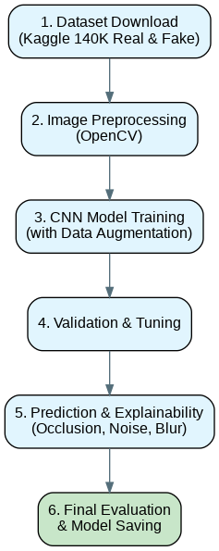
Proposed Methodology
Dataset download from Kaggle (140K Real & Fake Faces)
Image preprocessing using OpenCV
CNN + MobileNetV2 Training
Validation & tuning
Prediction and explainability (occlusion, noise, blur)
Final evaluation and saving the model

Slide 13
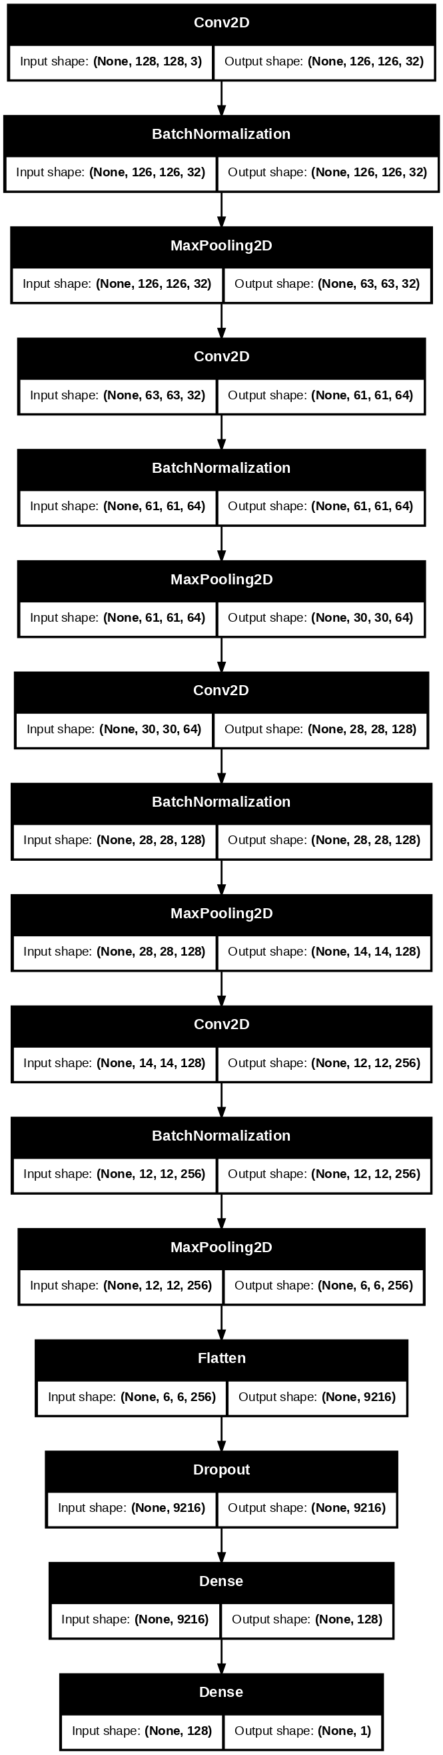
Model Architecture
BLOCK 1 : Basic Feature Detection (edges, lines)
BLOCK 2 : Facial Structure Detection (eyes, nose)
BLOCK 3 : Texture Analysis (skin texture mismatch & noise patterns)
BLOCK 4 : High Level Forgery Detection (unnatural symmetry & biological inconsistency)
Conv2D (features extraction edges, corners) + MaxPooling (Keeps strongest-features, size reduction)
Batch Normalization (stable and fast training)
MaxPooling2D (reduces size by half) (imp ft. only)
Flatten(2D to 1D vector) + Dense Layers (final decision)
Dropout for regularization and prevent overfitting & data memorization
DENSE LAYER - Sigmoid activation for binary classification
Transfer Learning:
MobileNetV2 (ImageNet pretrained)
Ensemble of CNN + MobileNetV2

Slide 14
Training Procedure
Training performed on Google Colab (T4 GPU)
Data augmentation applied (rotation, flipping, zoom)
Early stopping + ReduceLROnPlateau used to avoid overfitting.
Model saved in .keras format for deployment

Slide 15
Testing Procedure
Test set loaded using ImageDataGenerator
Predictions evaluated using threshold 0.5
Model performance measured using: Confusion Matrix Precision, Recall, F1 Score ROC Curve & AUC
Explainability applied using occlusion and noise sensitivity

Slide 16
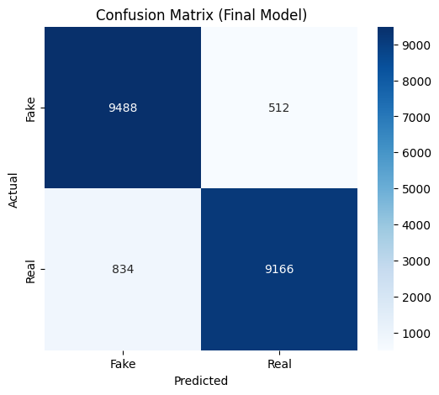
Results (Confusion Matrix) of the Ensemble Model
The confusion matrix shows that the model correctly classifies the majority of real and fake images with high accuracy.
A small number of deepfakes are missed and some real images are incorrectly flagged, but overall performance has significantly improved, achieving an accuracy of 93.575%.

Slide 17
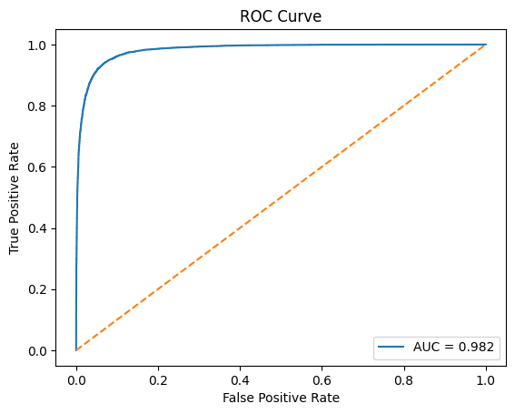
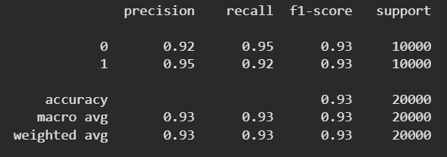
Results (ROC Curve), Precision & F1-Score
Precision, Recall & F1- Score
Achieved 93% overall accuracy on 20,000 samples
Balanced performance for both real and fake classes (F1-score: 0.934)
High precision and recall indicate reliable and consistent predictions
Receiver Operating Characteristic
AUC = 0.982 indicates the model has strong discriminatory power and detects deepfakes with high accuracy.

Slide 18
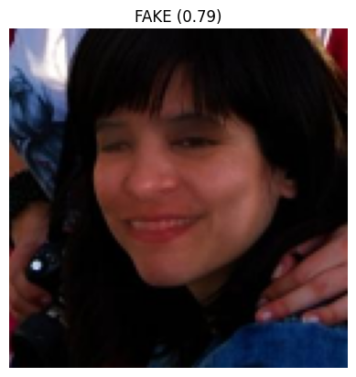
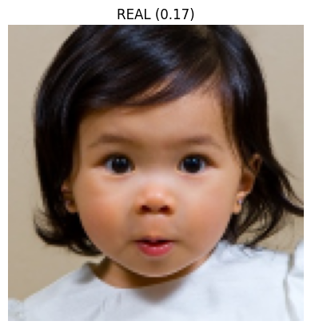
Sample Predictions (Original Model)
Fake Image (0.79): Model detects synthetic facial patterns; high confidence in fake classification.
Real Image (0.17): Model identifies natural facial features; predicted as real.

Slide 19
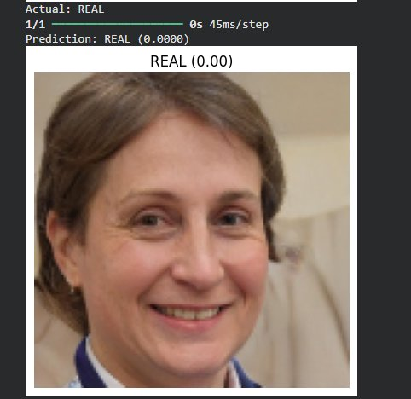
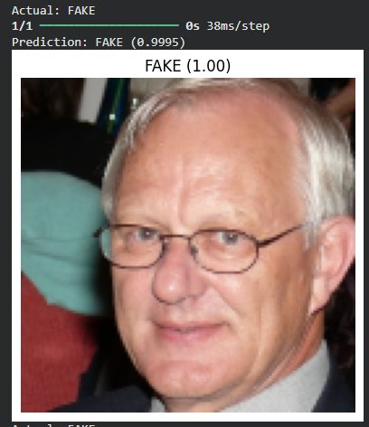
Sample Predictions (Ensemble Model)
REAL image → Confidence ≈ 0.00
FAKE image → Confidence ≈ 0.9995
Model gives high confidence predictions

Slide 20
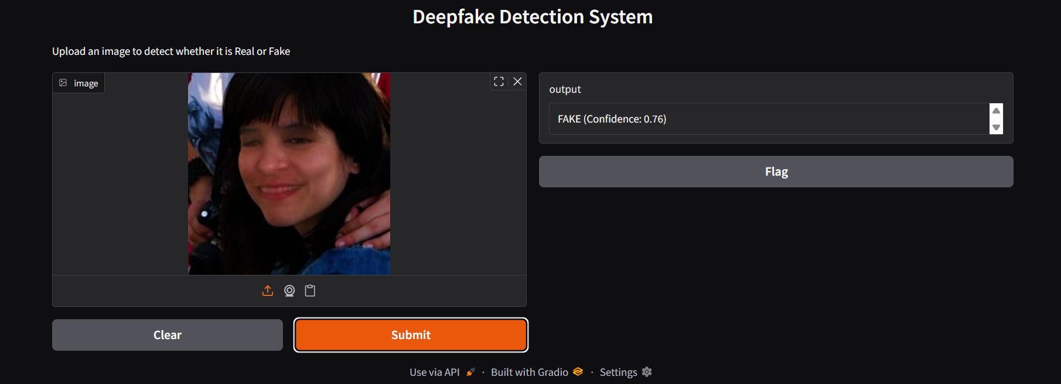

Deployment
Integrated with OpenCV preprocessing pipeline
Deployed using Gradio web interface
Features:
Upload image
Instant prediction
Confidence score
Real-time inference (~40 ms)

Slide 21
Outcome
Current Outcome
Future Outcome
Video-based deepfake detection
Add Grad-CAM explainability
Webcam real-time detection
Developed a complete deepfake detection system
Achieved 93.575% accuracy
Achieved AUC = 0.982
Built real-time prediction pipeline
Successfully deployed using Gradio

Slide 22
Conclusion
CNN + Transfer Learning improves performance significantly.
Ensemble approach increases accuracy.
System is accurate, efficient, and deployable.
Practical solution for real-world deepfake detection.

Slide 23
References
Tolosana et al., Deepfakes and Beyond, 2020
Liu et al., Spatiotemporal CNN for Deepfake Detection, 2023
Chen et al., Frequency Domain Deepfake Detection, 2023
Khalid & Woo, OC-FakeDect, 2024
Abdelali et al., DeepFakeHunter, 2024
Kaggle: 140K Real & Fake Faces Dataset
TensorFlow & OpenCV
Kaggle. (2020). 140K Real and Fake Faces Dataset. Retrieved from https://www.kaggle.com/datasets/xhlulu/140k-real-and-fake-faces

Slide 24
Thank You

