Slide 1
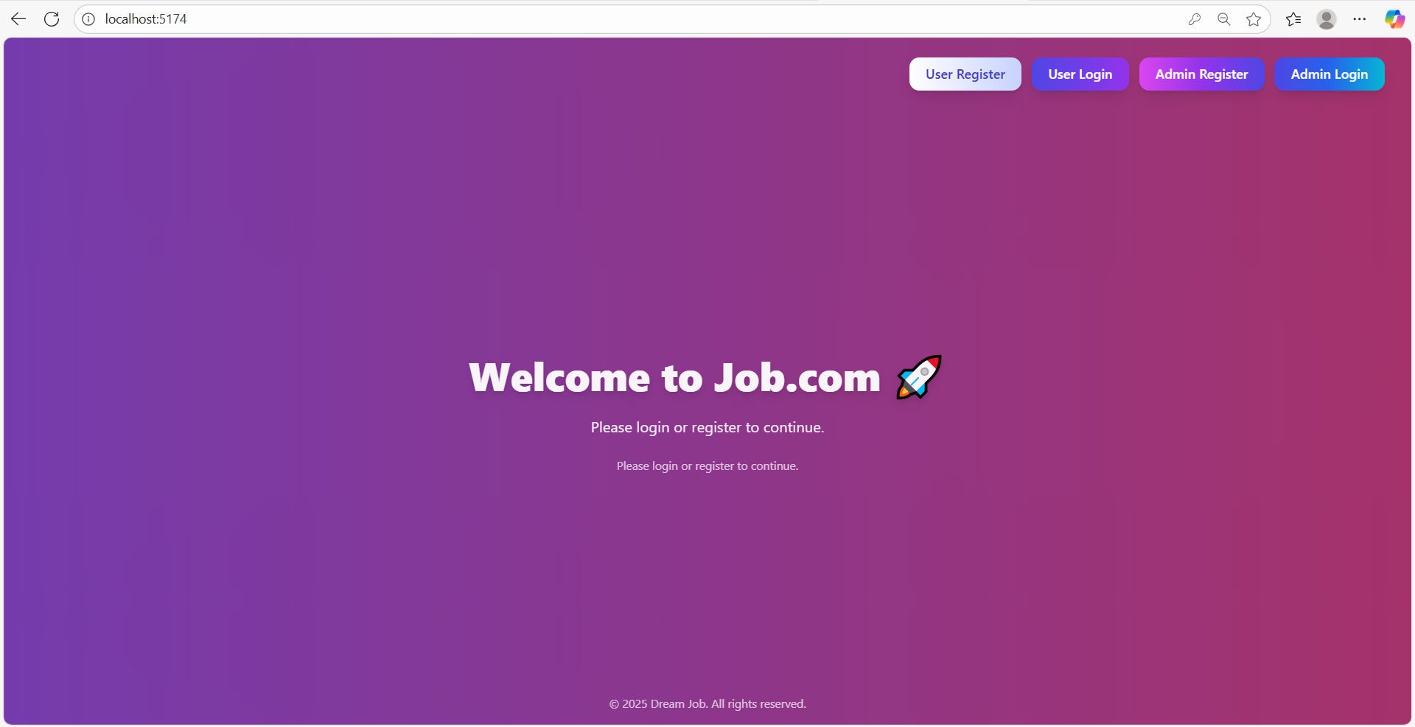
“Home Page, User and Admin Registration and Login”

Slide 2
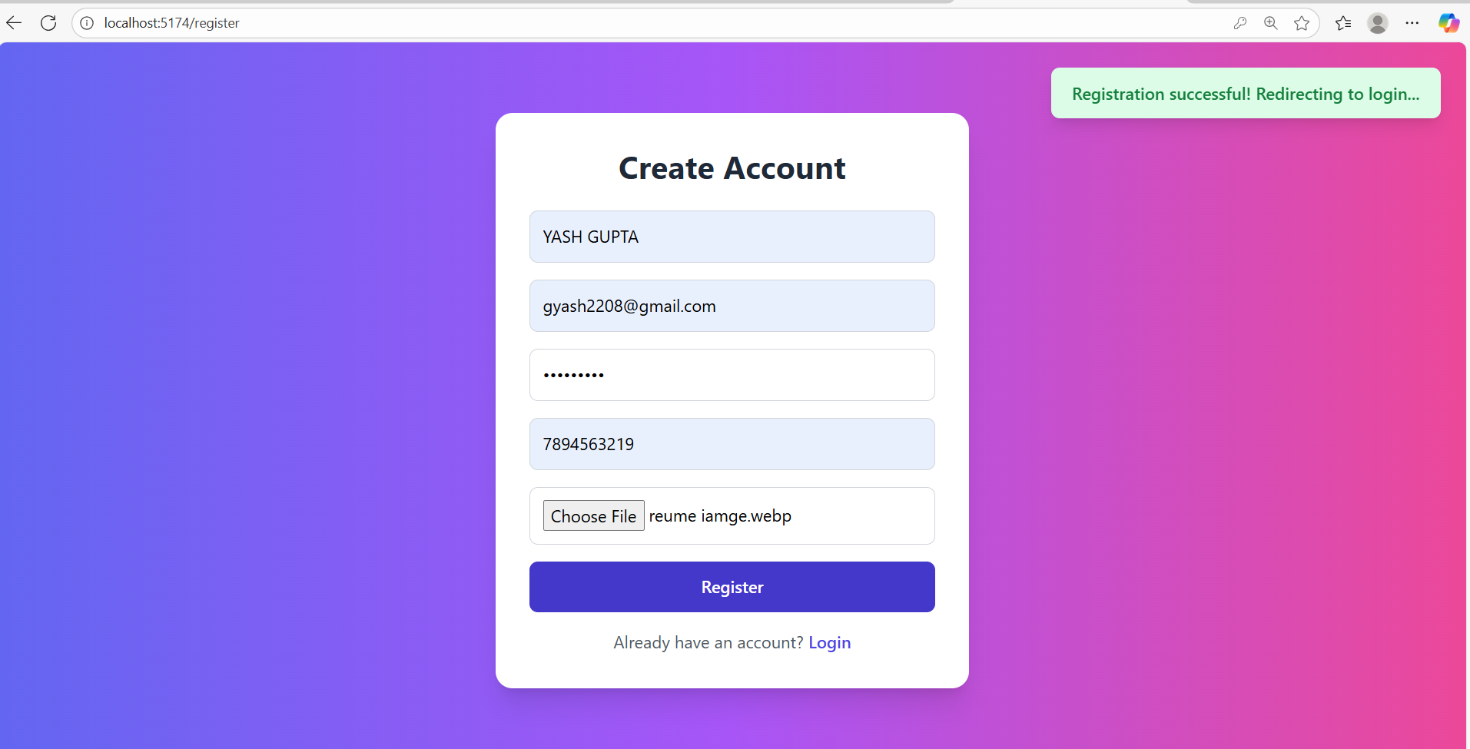
User Register And Login
User Register
User login

Slide 3
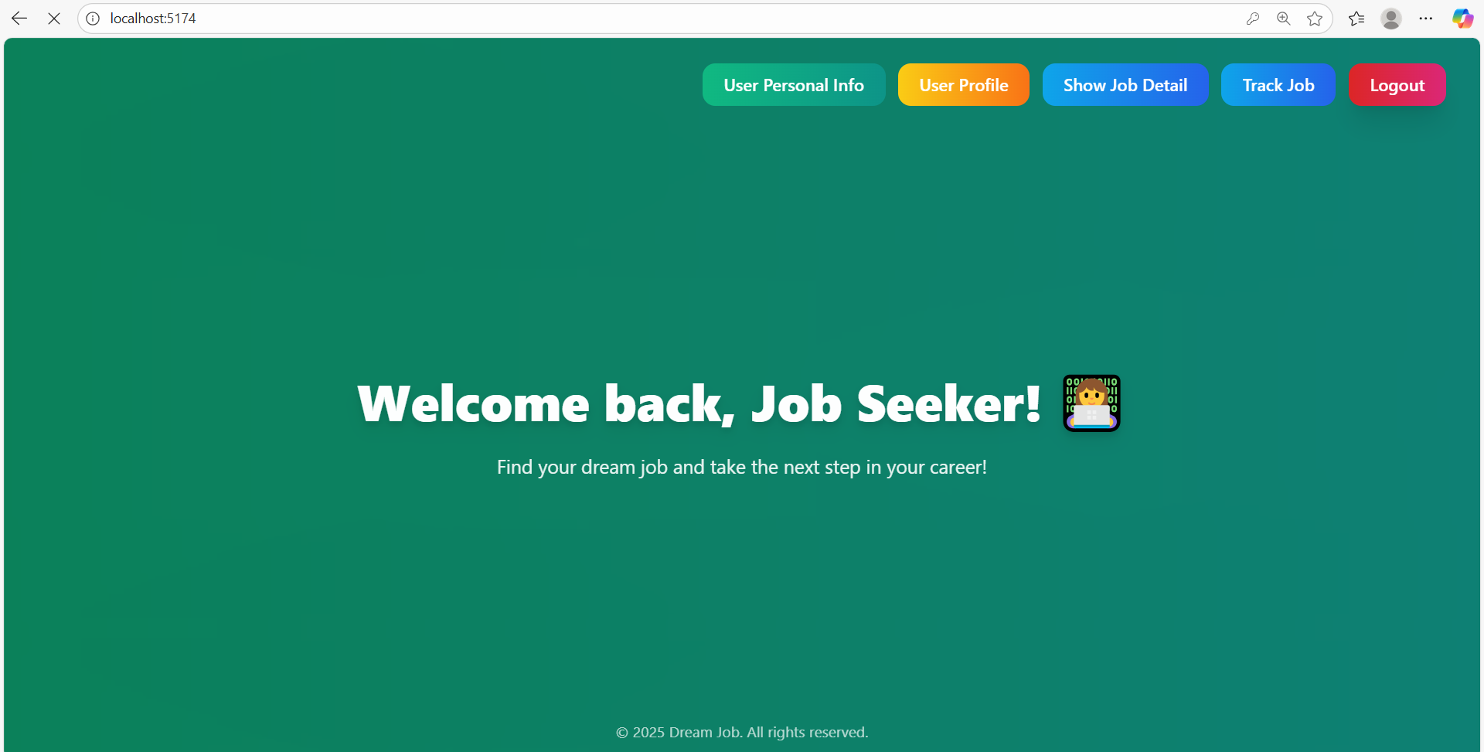
After User Login
We can see Heading
User Personal Info
User Profile
Show Job Detail
Track Job
Logout

Slide 4
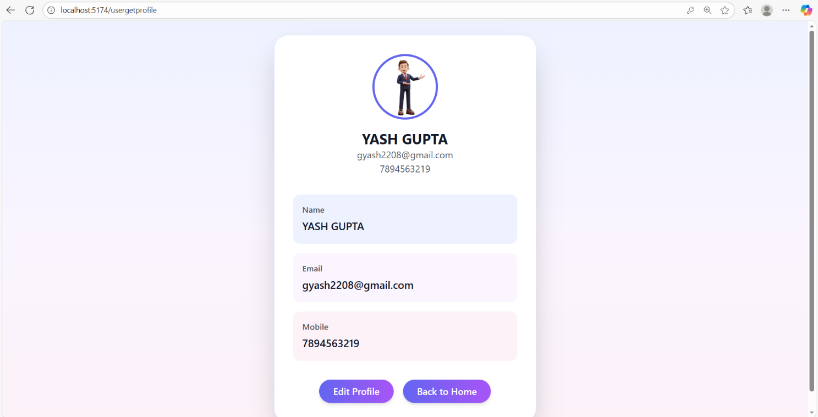
In User Profile
The user profile section allows users to view their details and profile picture, and provides an option to update them.

Slide 5
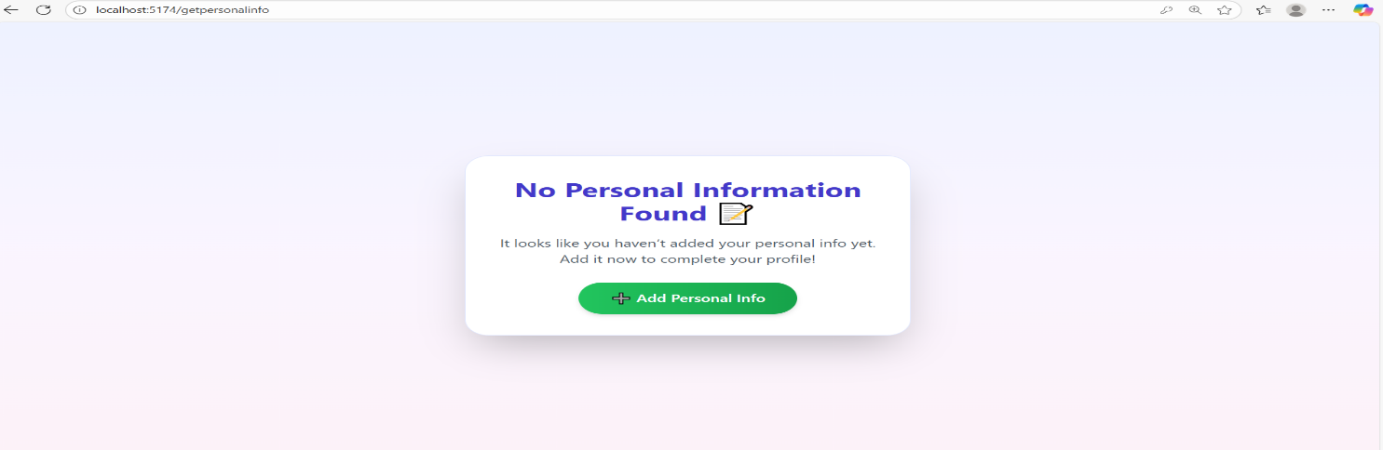
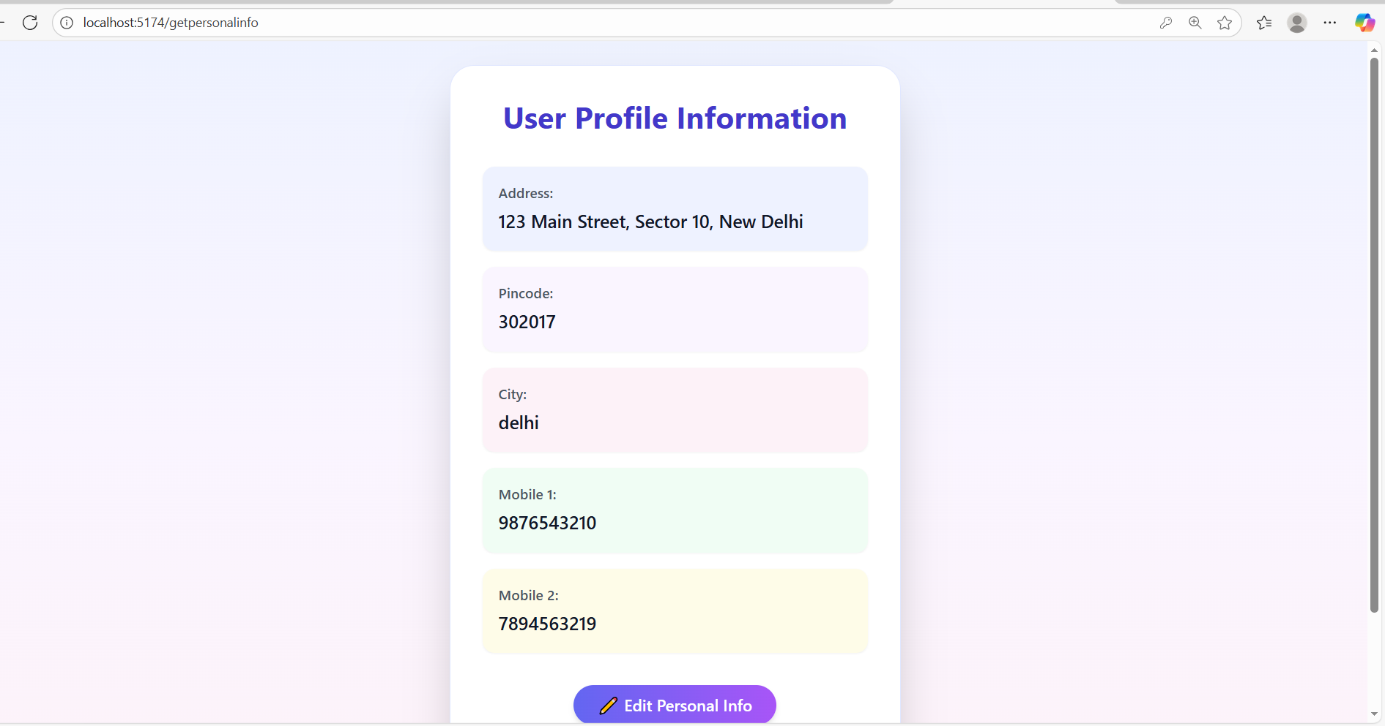
User Personal Info
The user can add and update their personal information through add and edit option.

Slide 6
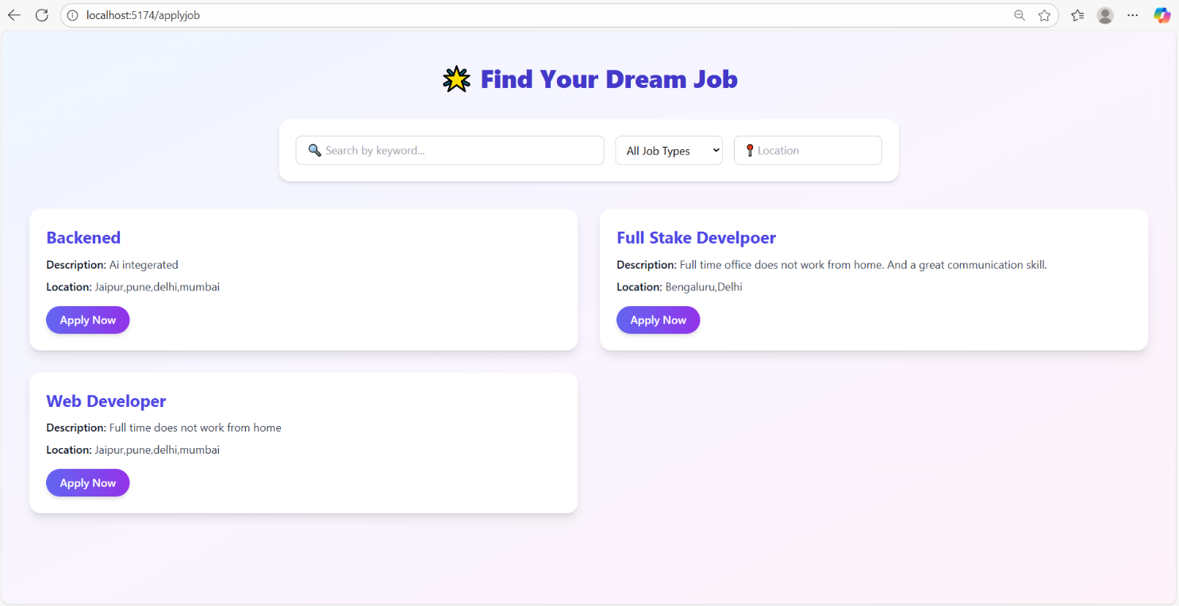
Show Job Detail
Users can browse and search for available job listings and apply for suitable positions directly through the system.

Slide 7
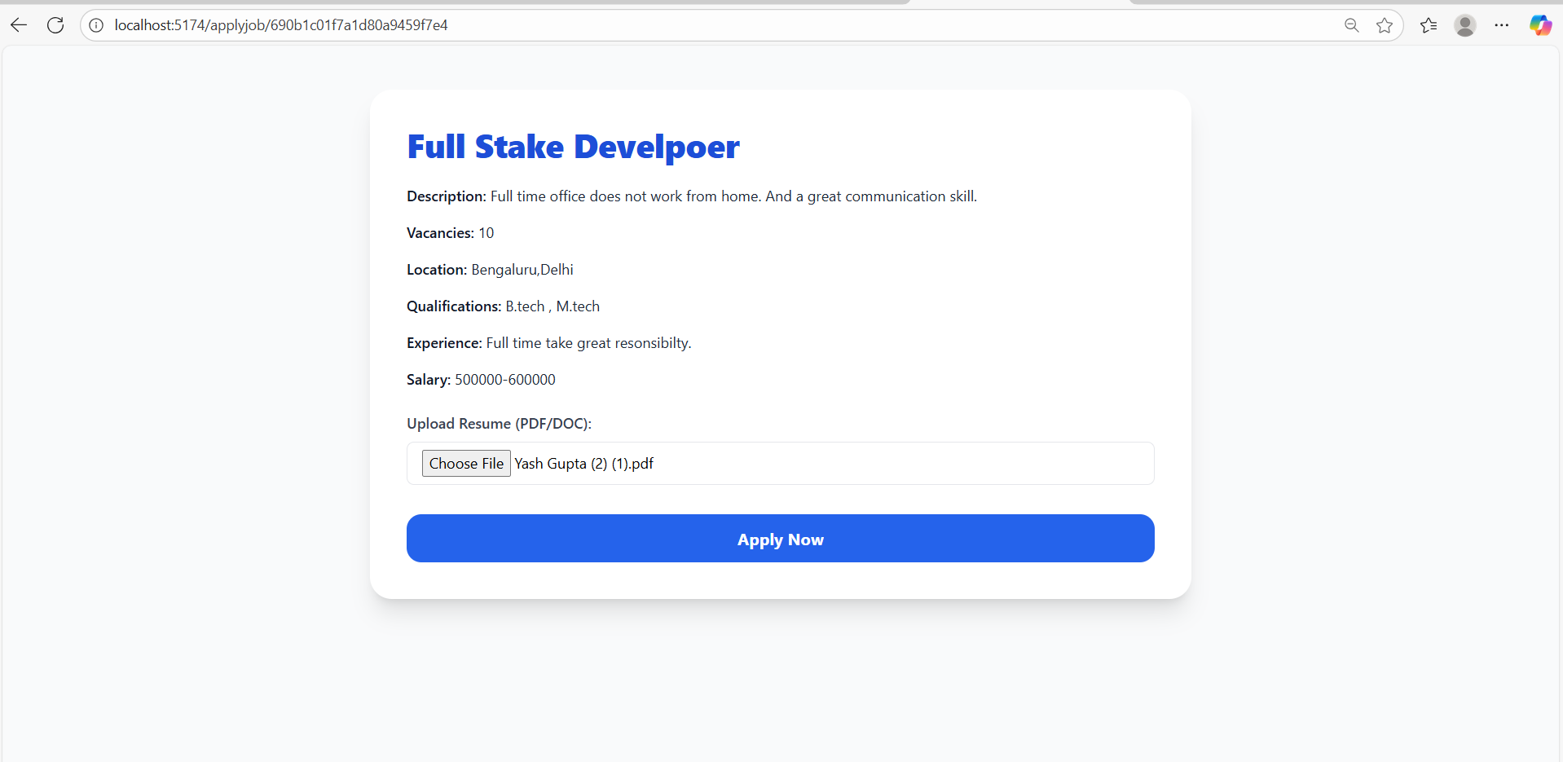
User apply Job
Allows users to upload their resume and
apply for desired job postings.

Slide 8
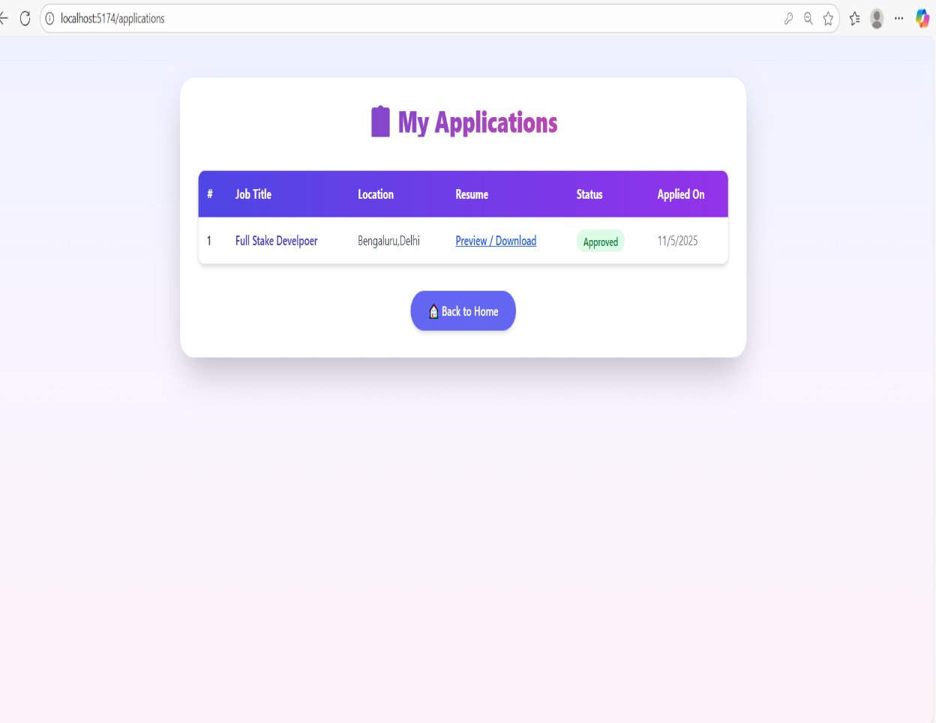
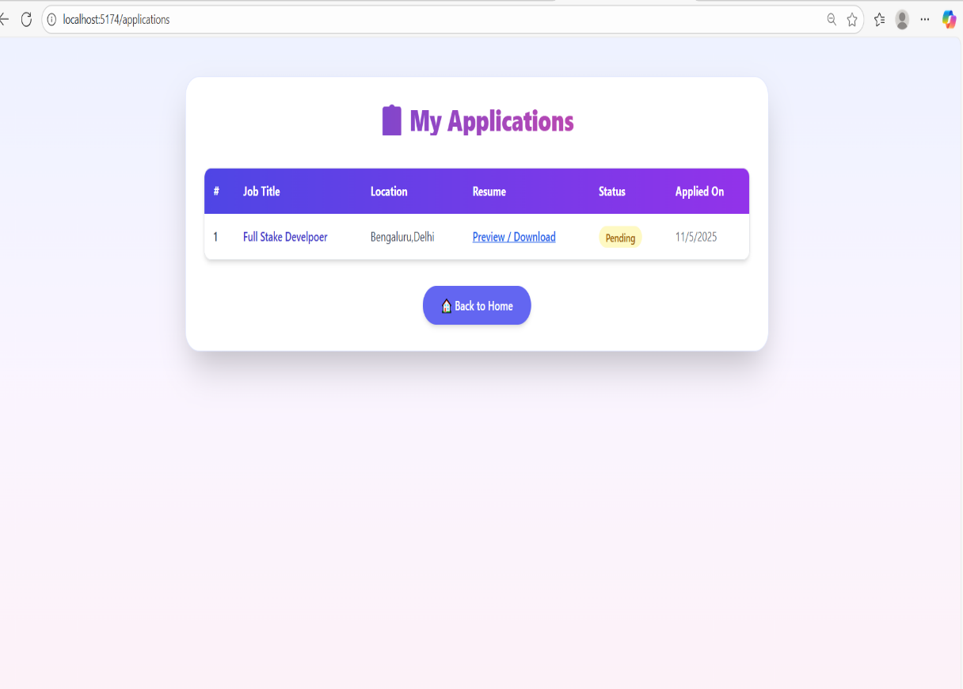
User Can Track Job

Slide 9
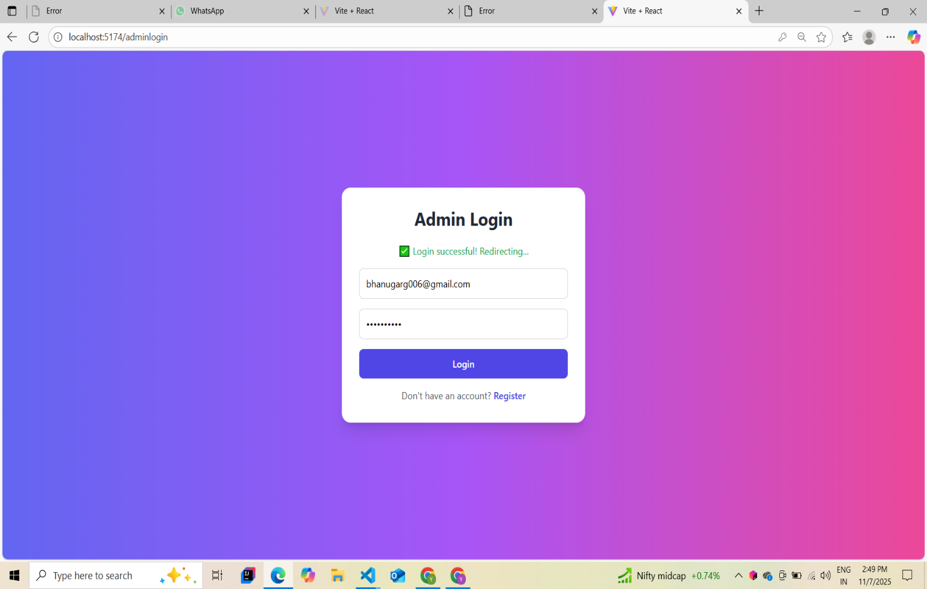
Admin Register & Login

Slide 10
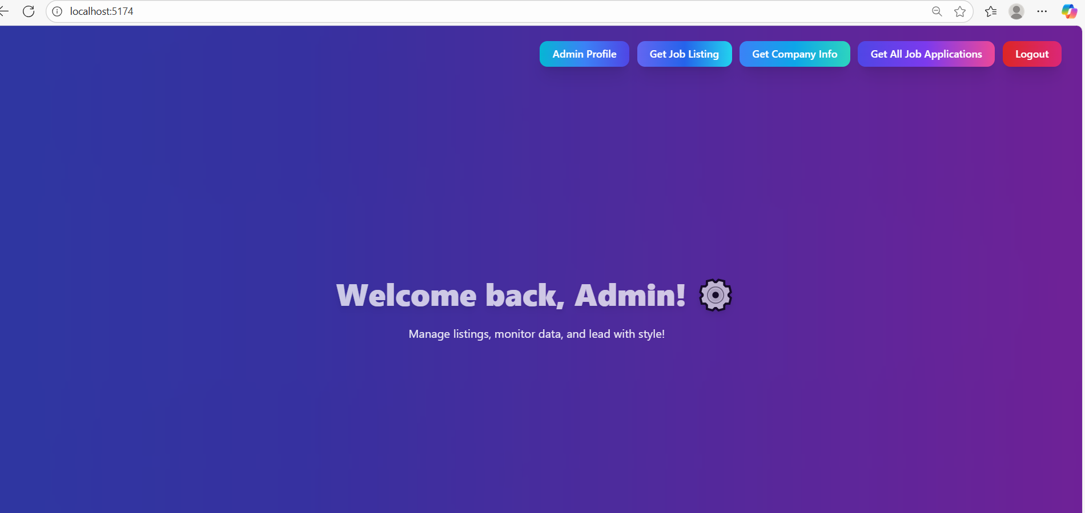
After User Login
Admin Profile
Get Job Listing
Get Company Info
Get All Job Applications
Logout

Slide 11
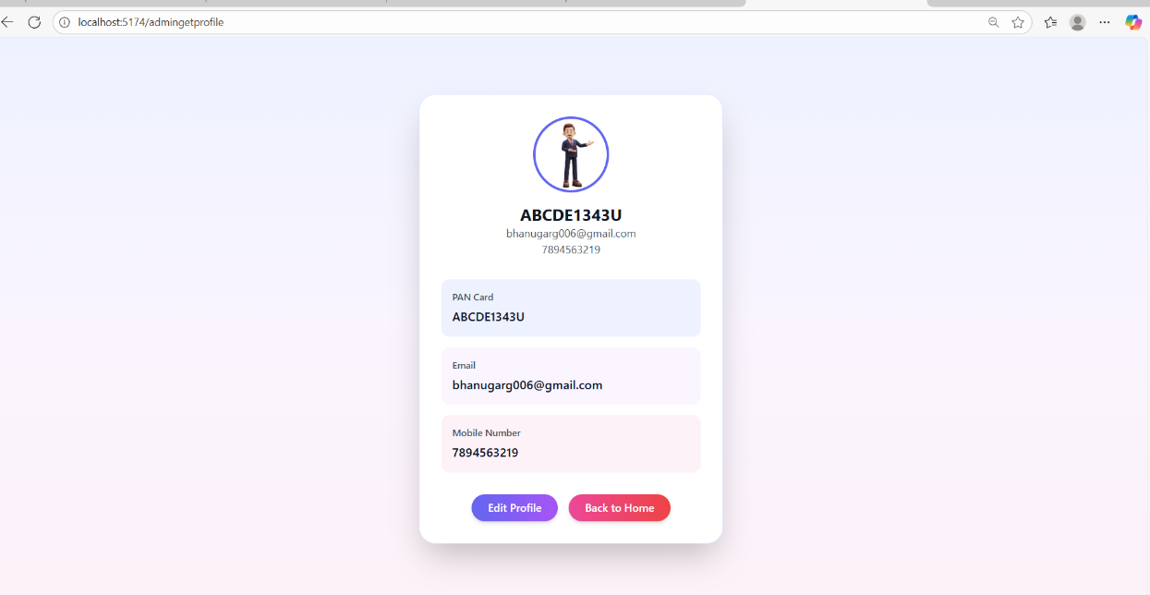
Admin Profile
The admin profile section allows admin to view their details and profile picture, and provides an option to update them.

Slide 12
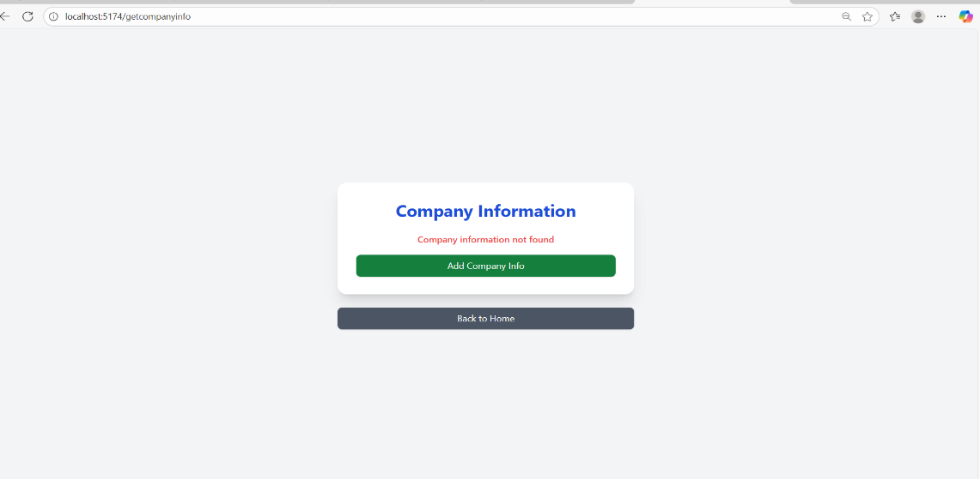
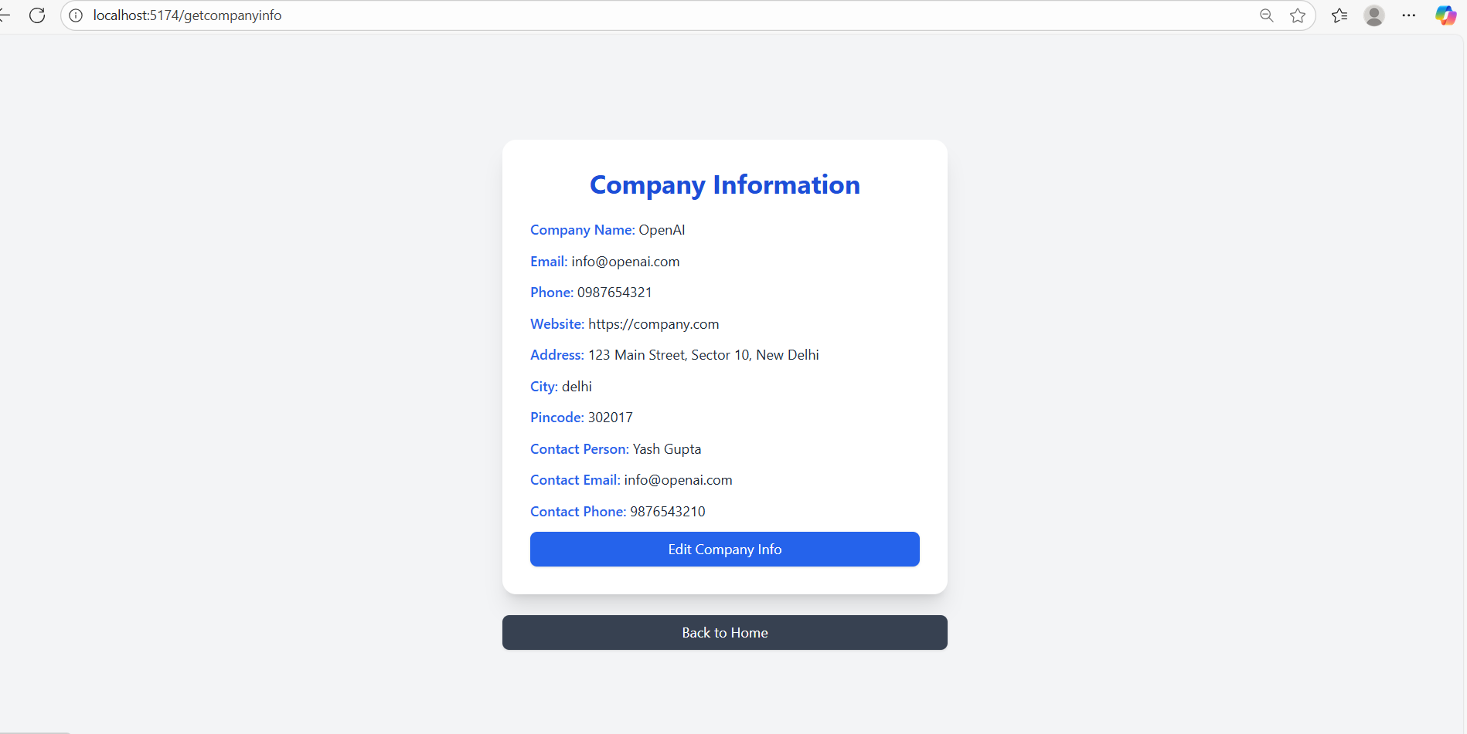
Get Company Info
Admin allows to add his own company information

Slide 13
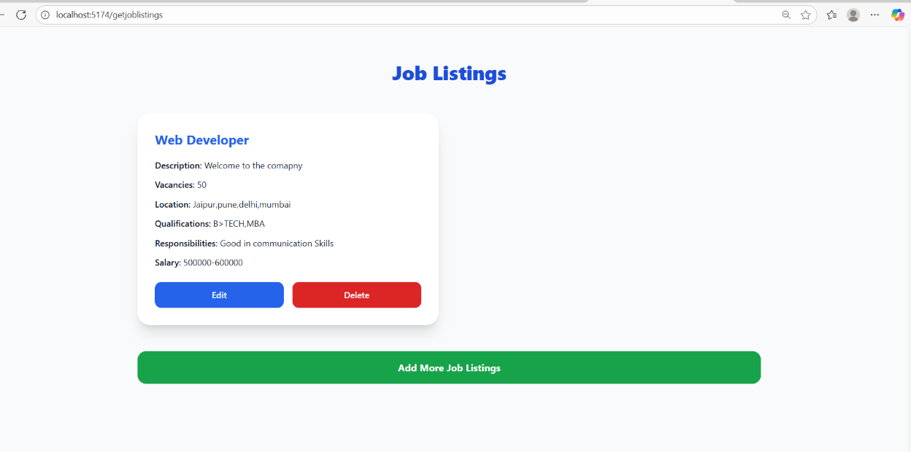
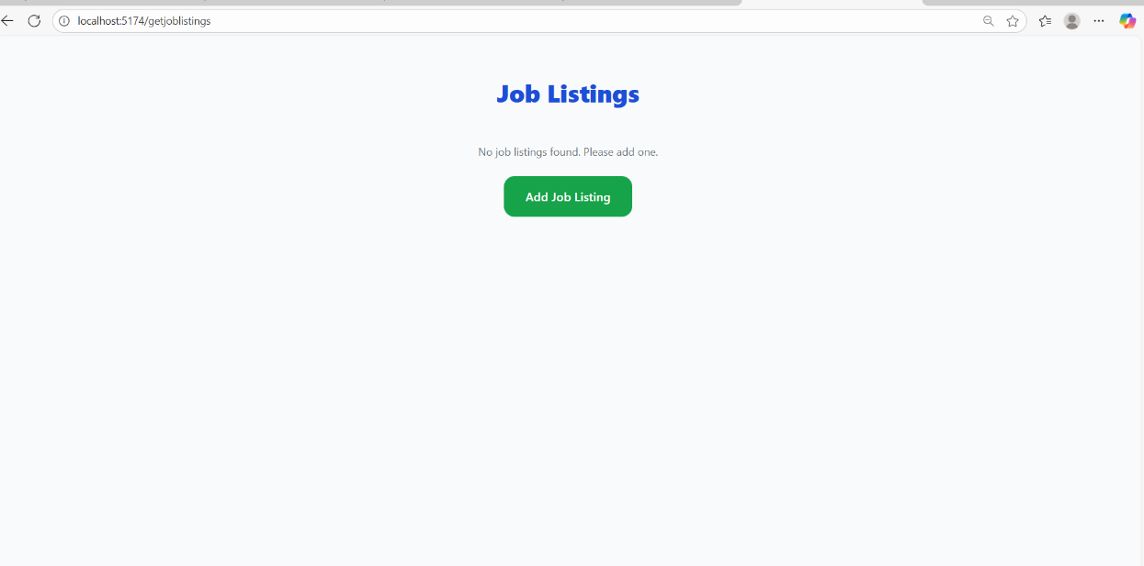
Admin Allow to add job

