Slide 1
SIGMOD Programming Contest

Slide 2
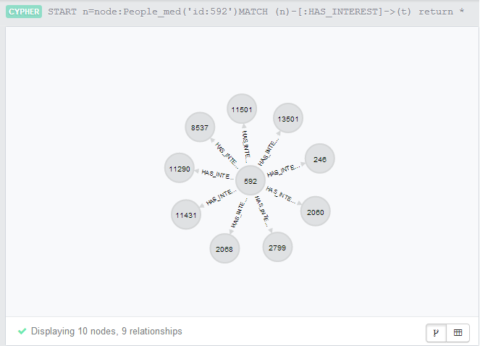
Neo4j
Graph Database
Very scalable
Excellent, well-evolved APIs
Notes:
1. RDBMS don’t perform very well on graph data due to expensive joins
2. Other graph DBs don’t store data natively – they serialize into RD, causes performance hit

Slide 3
Py2neo
Python library for Neo4j
Uses RESTful web service interface
Convenient for batch processing

Slide 4
Design Principles
Split computation into loading and query exec phases
Push most computation into the one-time loading phase
Batch load operations
Do not depend on Neo4j optimizer (it sucks)
Notes:
Complex queries don’t work very well in Neo4j – not a very good optimizer
Load operation includes building indexes and copying data to Neo4j
Instead of using a socket call for each node, we bunch them together and send them to Neo4j as a batch of nodes and edges

Slide 5
Optimizations
Push some of the loading into the query part
Optimal batch size – speed vs. memory limits
Handling special cases if they are worth it
Notes:
Smaller batch sizes lead to many socket requests, but if the batch size is too large, the VM system swaps out to disk, and this makes everything slower
Query 1 was about finding a path with certain constraints. We found that if the constraints were loose enough, the problem devolved to a shortest path finding algorithm. Using a different approach in this case worked out well for us
Query 3 involved finding common interests amongst people who lived in a particular place. The place could be a city, a country, or a continent. We found that tailoring our approach for each of these cases worked out well. So, we’d have one approach if the place were a continent and another approach if the place were a city

Slide 6
Performance – Load Times – One Time (1k)
Time for one-time copy operation into the Neo4j database
Notes:
Query 2 and 3, previously, we had to create nodes, get all the nodes, and then create edges. We were able to exploit py2neo and cut out the middle phase – we didn’t have to get the nodes again in order to create the edges
Lazy loading - for query 1 and 4, we decided not to load much of the data until it is actually needed. In fact, for query 4, we decided to cut out the loading phase altogether – we have the option where if we need to use the same db for a lot of queries, we can actually do the complete loading

Slide 7
Performance – Querying portion (1k)
Query 1
Query 2
Query 3
Query 4
Case | Time (MT) | Time (Fin)
1 | 38.6770 | 0.1980
2 | 34.5740 | 617.0000
3 | 33.6690 | 0.0390
4 | 34.3120 | 0.0970
5 | 54.8840 | 816.9230
6 | 34.9470 | 0.0270
7 | 28.3530 | 0.0240
8 | 82.4440 | 1371.9690
9 | 31.8030 | 0.0280
10 | 46.3350 | 323.8860
Case | Time (MT) | Time (Fin)
1 | 80.8550 | 64.0640
2 | 61.5350 | 57.0600
3 | 56.0460 | 50.8630
4 | 60.3880 | 44.5300
5 | 41.0670 | 38.1210
6 | 34.0410 | 31.4430
7 | 38.2730 | 27.0580
8 | 23.4510 | 20.4530
9 | 14.3300 | 13.7380
10 | 8.1090 | 7.9870
Case | Time (MT) | Time (Fin)
1 | 473.3810 | 12.1390
2 | 1.9490 | 1.8880
3 | 0.4450 | 0.4450
4 | 0.3110 | 0.3300
5 | 0.1370 | 0.1430
6 | 0.1580 | 0.1330
7 | 0.1090 | 0.1250
8 | 0.0980 | 0.1080
9 | 0.0900 | 0.0840
10 | 0.1310 | 0.1370
Case | Time (MT) | Time (Fin)
1 | 9849.7040 | 42.7480
2 | 6724.1700 | 39.9200
3 |  | 36.7740
4 |  | 35.4460
5 |  | 33.9790
6 |  | 35.0080
7 |  | 33.8510
8 |  | 32.2780
9 |  | 32.6950
10 |  | 34.7650

Slide 8
Performance – Load Time (1k vs. 10k)

Slide 9
Performance – Querying Portion (10k)
Query 1
Query 2
Query 3
Query 4
Case | Time
1 | 1.101
2 | 164.763
3 | 0.029
4 | 0.044
5 | 0.364
6 | 0.062
Case | Time
1 | 642.562
2 | 479.379
3 | 372.153
4 | 258.904
5 | 141.903
6 | 28.067
Case | Time
1 | 335.686
2 | 0.184
3 | 0.092
Case | Time
1 | 2293.663
2 | 2374.124
All performance measures were carried out on an ultra-book – Intel Core i5-3317U @ 1.7GHz, 6GB RAM

Slide 10
Questions

