Slide 1


Crop and Fertilizer Recommendation system using machine learning
Name = Tushar Khandelwal
AICTE ID = STU67cd61f2490791741513202

Slide 2

Learning Objectives
Understand the application of Machine Learning in the agriculture domain using Python.
Learn how to use Decision Tree Classifier, Random Forest, and SVM for predictive modeling.
Develop a system to recommend the most suitable crop based on environmental and soil parameters.
Create a logic-based module to suggest appropriate fertilizers based on NPK levels.
Enhance analytical skills in data preprocessing, model evaluation, and implementation of ML pipelines.
GOAL
Source :
www.freepik.com/

Slide 3
Tools and Technology used
Languages: Python
Libraries: pandas, numpy, matplotlib, seaborn, scikit-learn
ML Models: Random Forest, SVM, Decision Tree
Platform: Jupyter Notebook

Slide 4
Methodology
Data Collection: Acquired soil, weather, and fertilizer data.
Data Preprocessing: Cleaned and normalized the data.
Model Building: Trained models using labeled datasets.
Crop Prediction: Random Forest classifier with high accuracy.
Fertilizer Recommendation: Rule-based logic based on soil nutrients.
Evaluation: Accuracy and classification reports used for model validation.
Deployment: Models tested with various user inputs.

Slide 5
Problem Statement:
Farmers often struggle to choose the right crop and fertilizer due to a lack of scientific tools and data. This leads to low yields and poor soil health. There's a need for an AI-based system that can provide accurate crop and fertilizer recommendations based on soil and weather conditions.

Slide 6
Solution:
🌱 Green Skill with AI is harnessed to develop an intelligent agriculture support system. ⚙️ A Machine Learning model using Decision Tree Classifier (DTC) predicts the most suitable crop based on soil and climate inputs. 📊 The Crop Recommendation model achieves an accuracy of 100% on the training dataset, ensuring highly reliable predictions. 🧪 The Fertilizer Recommendation system achieving 100% accuracy in recommending suitable fertilizers. 🚜 This system enables farmers to make data-driven decisions for both crop selection and fertilizer usage, improving yield and promoting sustainable agriculture. 🔗 GitHub Repository:Repo link

Slide 7
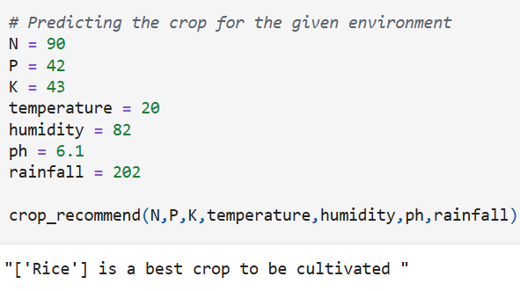
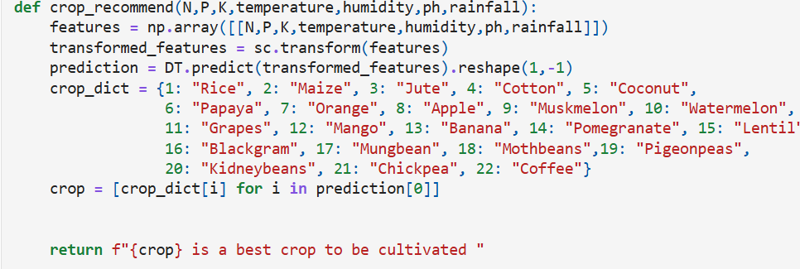
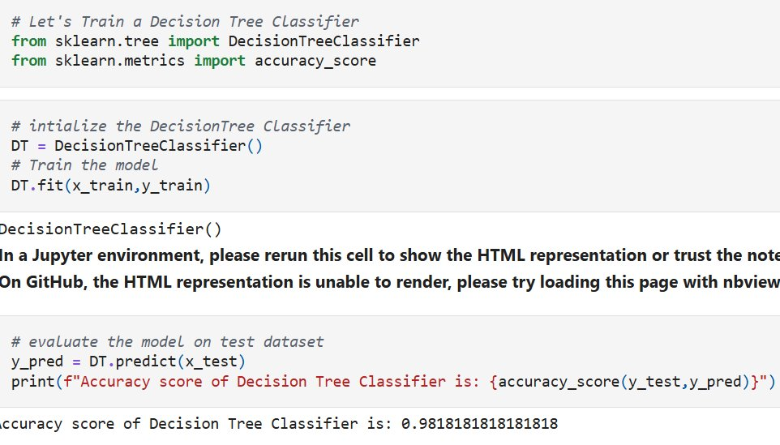
Screenshot of Output:

Slide 8
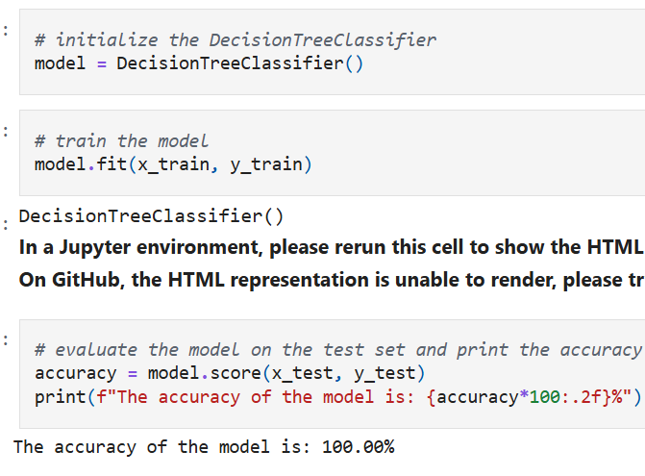
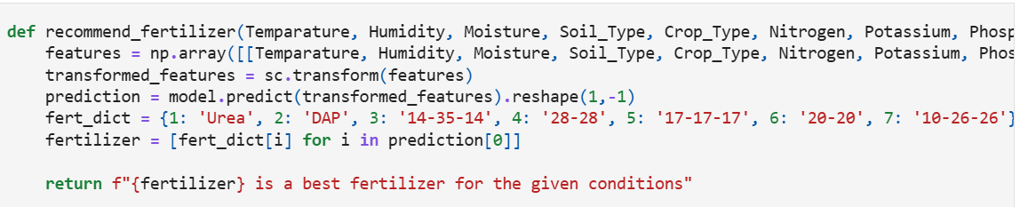
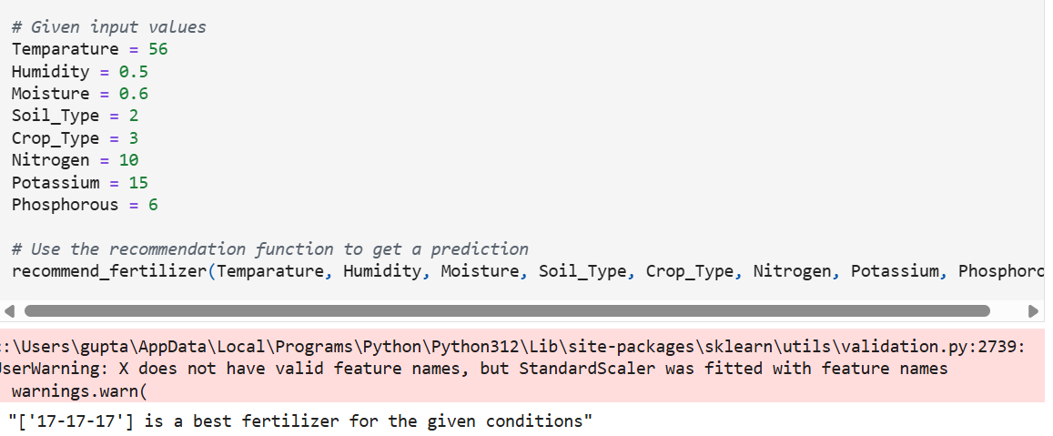
Screenshot of Output:

Slide 9
Conclusion:
Built using Green Skill with AI and Decision Tree Classifier
Achieved 100% accuracy in crop and fertilizer prediction
Uses NPK logic for accurate fertilizer suggestions
Helps farmers make smart, data-driven decisions
Supports sustainable and efficient farming
Future Scope
Deploy as a mobile/web app
Add IoT integration for real-time data
Use deep learning for better accuracy
Support regional languages and crops
Improve with user feedback

